Slide 1
Quiz
1

Slide 2
Execution Time
Compute the execution time for the following code snippet:
.include "m328Pdef.inc”
Init:
ser r16
out DDRB,r16
ldi r16,0b11111110
out DDRD,r16
clr r16
out PortB, r16
ldi r16,0b00000001
out PortD, r16
Main:
in r16, PinD
out PortB, r16
rjmp Main

Slide 3
Arduino Port Registers
1

Slide 4
Port Registers
PORTD maps to Arduino digital pins 0 to 7
DDRD - The Port D Data Direction Register - read/write
PORTD - The Port D Data Register - read/write
PIND - The Port D Input Pins Register - read only
PORTB maps to Arduino digital pins 8 to 13 The two high bits (6 & 7) map to the crystal pins and are not usable
DDRB - The Port B Data Direction Register - read/write
PORTB - The Port B Data Register - read/write
PINB - The Port B Input Pins Register - read only
PORTC maps to Arduino analog pins 0 to 5. Pins 6 & 7 are only accessible on the Arduino Mini
DDRC - The Port C Data Direction Register - read/write
PORTC - The Port C Data Register - read/write
PINC - The Port C Input Pins Register - read only
Each bit of these registers corresponds to a single pin; e.g. the low bit of DDRB, PORTB, and PINB refers to pin PB0(digital pin 8)

Slide 5
CLR – Clear Register
Clears a register. This instruction performs an Exclusive OR between a register and itself. This will clear all bits in the register.
Operation:
Rd ← Rd ⊕ Rd
Program Counter:
PC ← PC + 1
Example:
clr r16

Slide 6
SER – Set all Bits in Register
Loads $FF directly to register Rd.
Operation:
(i) Rd ← $FF
Program Counter:
PC ← PC + 1
Example:
ser r17

Slide 7
NOP – No Operation
This instruction performs a single cycle No Operation.
Operation:
Program Counter:
PC ← PC + 1
Example:
nop

Slide 8
OUT
Stores data from register Rr in the Register File to I/O Space (Ports, Timers, Configuration Registers etc.).
Operation:
I/O(A) ← Rr
Program Counter:
PC ← PC + 1
Example:
clr r16 ser r17 out $18,r16
nop out $18,r17

Slide 9
IN - Load an I/O Location to Register
Loads data from the I/O Space (Ports, Timers, Configuration Registers etc.) into register Rd in the Register File.
Operation:
Rd ← I/O(A)
Program Counter:
PC ← PC + 1
Example:
in r16, PinD

Slide 10
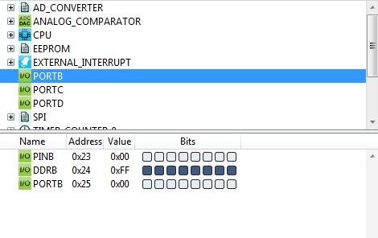
Input and Output
.include "m328Pdef.inc"
Init:
ser r16
out DDRB, r16
ldi r16, 0b11111110
out DDRD, r16
clr r16
out PortB, r16
ldi r16, 0b00000001
out PortD, r16
Main:
in r16, PinD
out PortB, r16
rjmp Main
We use the last bit of D as input
We use the whole bits of B as output
For the first run of the code, nothing happened.
PortB and PortD should look like this:
Prefix 0b followed by a series of 0 and 1digits, e.g. 0b11 == 3.
Constants B0 through B11111111

Slide 11
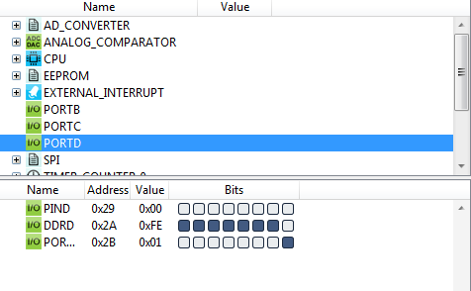
Input and Output
.include "m328Pdef.inc"
Init:
ser r16
out DDRB, r16
ldi r16, 0b11111110
out DDRD, r16
clr r16
out PortB, r16
ldi r16, 0b00000001
out PortD, r16
Main:
in r16, PinD
out PortB, r16
rjmp Main
We use the last bit of D as input
We use the whole bits of B as output
For the first run of the code, nothing happened.
PortB and PortD should look like this:

Slide 12
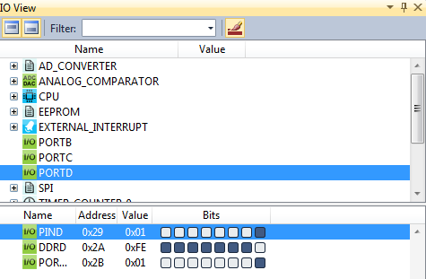
Input and Output
.include "m328Pdef.inc"
Init:
ser r16
out DDRB, r16
ldi r16, 0b11111110
out DDRD, r16
clr r16
out PortB, r16
ldi r16, 0b00000001
out PortD, r16
Main:
in r16, PinD
out PortB, r16
rjmp Main
When the code runs to the point “rjmp Main”, click the last bit of the PIND to light up the bit as an input:

Slide 13
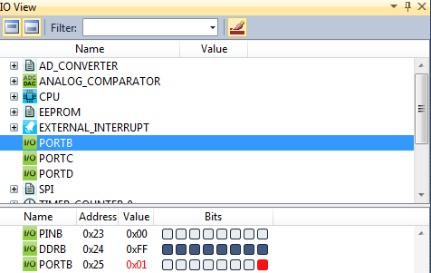
Input and Output
.include "m328Pdef.inc"
Init:
ser r16
out DDRB, r16
ldi r16, 0b11111110
out DDRD, r16
clr r16
out PortB, r16
ldi r16, 0b00000001
out PortD, r16
Main:
in r16, PinD
out PortB, r16
rjmp Main
then continue to execute the program, you can see that the r16 register becomes 1, which means it reads the bit we modified, then you can see the last bit of PortB lights up.

Slide 14
Conditional Branching
1

Slide 15
Control Structure
IF-THEN-ELSE control structure
if (a < 0)
b = 1;
else
b = 3;
Numbers x, z are 8-bit integers and stored in registers. You need to decide which registers to use.
Instructions interested
Compare
Conditional branch
Unconditional jump

Slide 16
Compare
Syntax:
Operands:
Operation:
cp Rd, Rr
Rd ∈{r0, r1, …, r31}
Rd–Rr
Flags affected: H, S, V, N, Z, C
Words:
Cycles:
Example:
cp r4, r5 brne noteq
...
noteq: nop
1
1
; Compare r4 with r5
; Branch if r4 ≠ r5
; Branch destination (do nothing)

Slide 17
Compare with Immediate
Syntax:
Operands:
k ≤ 255
Operation:
cpi Rd, k
Rd ∈{r16, r17, …, r31} and 0≤
Rd – k
Flags affected: H, S, V, N, Z, C
Words:
Cycles:
1
1
This instruction performs a compare between register Rd and a constant.
cpi r19,3 ; Compare r19 with 3
brne error ; Branch if r19⇔3 ...
error: nop ; Branch destination (do nothing)

Slide 18
BREQ - Branch if Equal
BRNE - Branch if Not Equal
BRGE - Branch if Greater or Equal Signed)
BRLO - Branch if Lower (Unsigned)

Slide 19
Conditional Branch
Syntax:
Operands:
Operation:
brge k
-64 ≤ k < 64
If Rd≥Rr (N⊕V=0) then PC←PC+k+1, else PC ← PC+1 if condition is false
Branch if Greater or Equal Signed)
Flag affected: None
Words:
Cycles:
1
1 if condition is false; 2 if condition is true
cp r11,r12 ; Compare registers r11 and r12
brge greateq ; Branch if r11 ≥ r12 (signed)
...
greateq: nop ; Branch destination (do nothing)

Slide 20
Jump
Syntax:
Operands:
Operation:
jump k
PC ← k
JMP k 0 ≤ k < 4M PC ← k Unchanged
Flag affected: None
Words:
Cycles:
2
3
mov r1,r0 ; Copy r0 to r1
jmp farplc ; Unconditional jump
...
farplc: nop ; Jump destination (do nothing)

Slide 21
Relative Jump
Syntax:
Operands:
Operation:
rjmp k
-2K ≤ k < 2K PC ← PC+k+1
Flag affected: None
Words:
Cycles:
1
2
cpi r16,$42 ; Compare r16 to $42
brne error ; Branch if r16 ⇔ $42
rjmp ok ; Unconditional branch
error: addr16,r17 ; Add r17 to r16
incr16 ; Increment r16
ok: nop ; Destination for rjmp (do nothing)

Slide 22
Control
IF-THEN-ELSE control structure
if (a < 0)
b = 1;
else
b = 3;
Numbers x, z are 8-bit signed integers and stored in registers. You need to decide which registers to use.
.def .def | a = b = cpi | r16 r17 a, 0 | ; | a - 0
 | brge | ELSE | ; | if a ≥ | 0
 | ldi | b, 1 | ; | b = 1
 | rjmp | END | ; | end of | IF statement
ELSE: | ldi | b, 3 | ; | b = 3
END: | … |  |  |  | 61

Slide 23
AVR Registers (cont.)
General purpose registers
The following register pairs can work as address
indexes
● X, r26:r27
● Y, r28:r29
● Z, r30:r31
The following registers can be applied for specific
use
r1:r0 store the result of multiplication instruction
r0 stores the data loaded from the program memory

