Slide 1
Assembly Loops
1

Slide 2
DEC- Decrement
Operation: Rd ← Rd – 1
Subtracts one -1- from the contents of register Rd and places the result in the destination register Rd.
The C flag in SREG is not affected by the operation,
dec r17 ; Decrement r17

Slide 3
INC- Increment
Operation: Rd ← Rd + 1
Adds one -1- to the contents of register Rd and places the result in the destination register Rd.
inc r22 ; increment r22

Slide 4
CP – Compare
This instruction performs a compare between two registers Rd and Rr. None of the registers are changed. All conditional branches can be used after this instruction.
Operation: Rd - Rr
cp r4,r19 ; Compare r4 with r19
brne noteq ; Branch if r4 <> r19
...
noteq: nop

Slide 5
BRLO - Branch if Lower (Unsigned)
Conditional relative branch
Tests the Carry Flag (C) and branches relatively to PC if C is set.
If the instruction is executed immediately after any of the instructions CP, CPI, SUB or SUBI, the branch will occur if and only if the unsigned binary number represented in Rd was smaller than the unsigned binary number represented in Rr.
Operation:
If Rd < Rr (C = 1) then
PC ← PC + k + 1
else
PC ← PC + 1
cpi r19,0x10 ; Compare r19 with $10
brlo loop ; Branch if r19 < 10 (unsigned)

Slide 6
WHILE loop
i = 1
n=2
while (i <= n) {
sum += i * i;
i++;
}
62

Slide 7
Loops
.include "m325Pdef.inc"
init:
.def i=r16
.def n=r17
.def sum=r18
main:
ldi i,1
ldi n,0x02
clr sum
loop:
cp n,i
brlo end
mul i,i
add sum,r0
inc i
rjmp loop
end: rjmp init
i = 1
n = 2
while (i <= n) {
sum += i * i;
i++;
}
63

Slide 8
Address Space - SDRAM

Slide 9





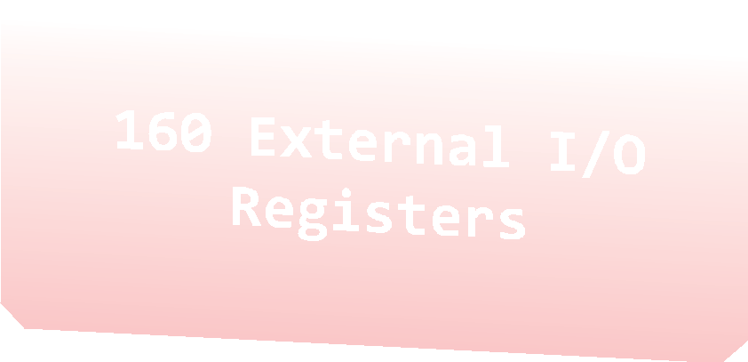

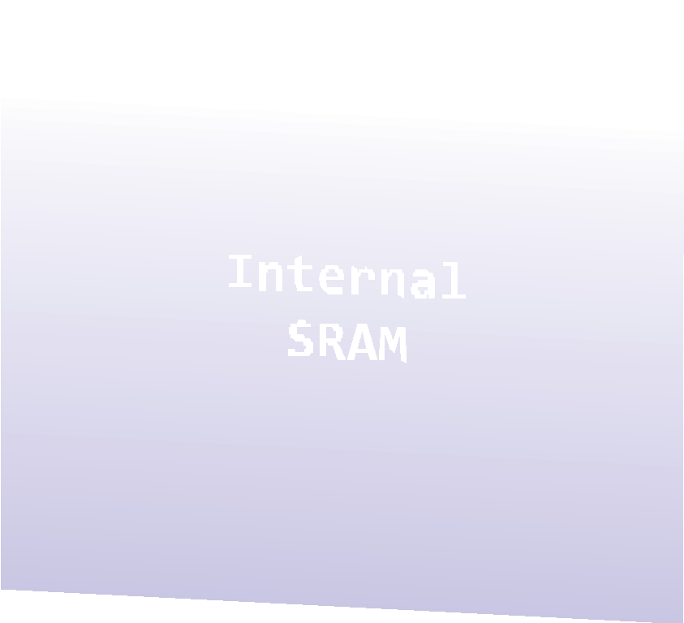
Address Space
0x0000 0x0020 | -­‐ -­‐ | 0x001F 0x005F
0x0060 | -­‐ | 0x00FF
0x0100 -­‐ 0x08FF

Slide 10
LDS – Load Direct from Data Space
Loads one byte from the data space to a register. For parts with SRAM, the data space consists of the Register File, I/O memory and internal SRAM (and external SRAM if applicable).
Loads one byte from the data space to a register
A 16-bit address must be supplied
lds r2,$0100 ;Load r2 with the contents of data space location $0100
add r2,r1 ; add r1 to r2

Slide 11
STS - Store Direct to data space
Loads one byte from the data space to a register
A 16-bit address must be supplied
lds r2,$0100 ;Load r2 with the contents of data space location $0100
add r2,r1 ; add r1 to r2
sts $0100,r2 ; Write back

Slide 12
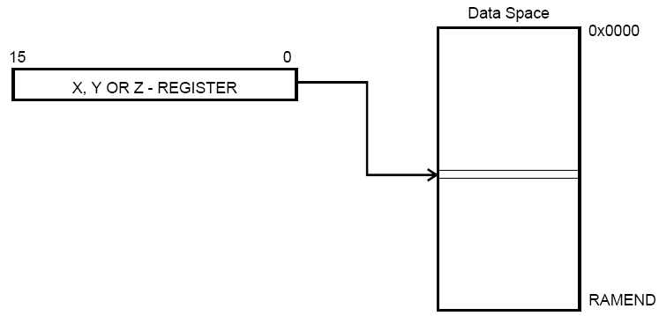
X, Y, Z
0x00 | R0
0x01 | R1
0x02 | R2
0x0D | R13
0x0E | R14
0x0F | R15
0x10 | R16
0x11 | R17
0x1A | R26 | X-register | Low byte
0x1B | R27 | X-register | High byte
0x1C | R28 | Y-register | Low byte
0x1D | R29 | Y-register | High byte
0x1E | R30 | Z-register | Low byte
0x1F | R31 | Z-register | High byte

Slide 13
Using register Z
Write an assembly language program that gets the numbers from the Data Space with memory address 0x0100. Use register z to get number.
.include "m325Pdef.inc”
init:
ldi r22, 0x20
sts 0x0100, r22
main:
ldi zh, 0x01
ldi zl, 0x00
clr r22
ld r22, z

Slide 14
Attendance Quiz
Write an assembly language program that outputs the numbers from 15 to 1 to Port B using loops and branches.

Slide 15
Attendance Quiz
Write an assembly language program that outputs the numbers from 15 to 1 to Port B using loops and branches.
.include "m325Pdef.inc"
init:
clr r20
ldi r20, $0E
ser r16
out DDRB, r16
main:
loop:
cpi r20, 0
breq end
out PORTB, r20
dec r20
rjmp loop
end:
ret

Slide 16
Attendance Quiz
Write an assembly language program that load the numbers 1-123 to the memory

