Slide 1
Address Space
1

Slide 2





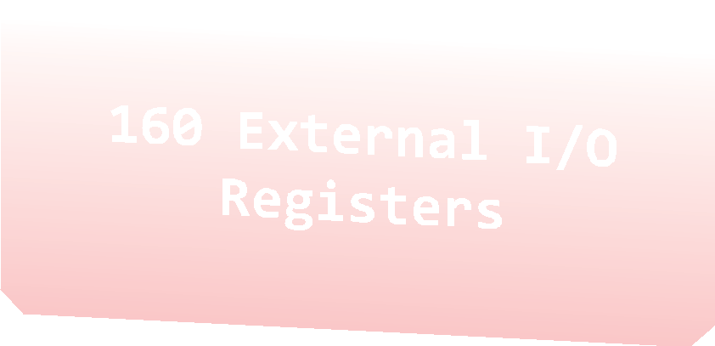

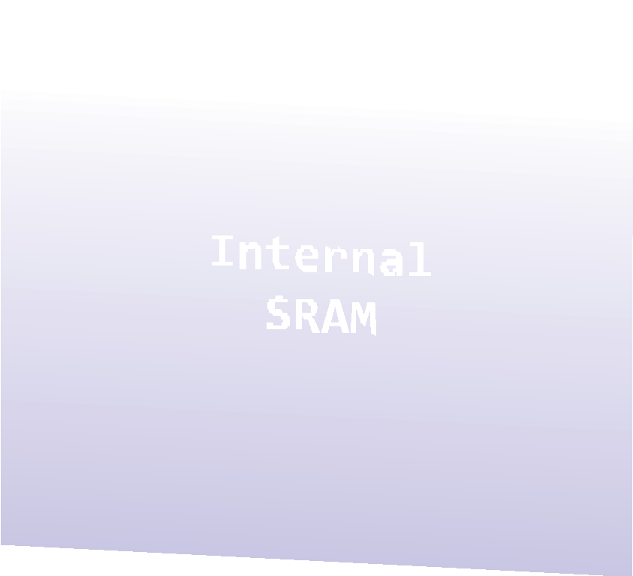
Address Space
0x0000 0x0020 | -­‐ -­‐ | 0x001F 0x005F
0x0060 | -­‐ | 0x00FF
0x0100 -­‐ 0x08FF

Slide 3
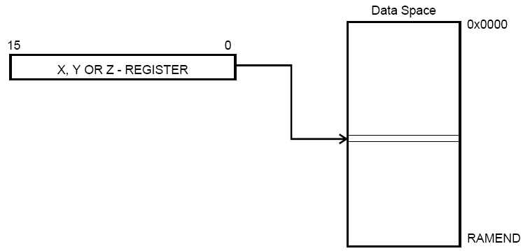
X, Y, Z
0x00 | R0
0x01 | R1
0x02 | R2
0x0D | R13
0x0E | R14
0x0F | R15
0x10 | R16
0x11 | R17
0x1A | R26 | X-register | Low byte
0x1B | R27 | X-register | High byte
0x1C | R28 | Y-register | Low byte
0x1D | R29 | Y-register | High byte
0x1E | R30 | Z-register | Low byte
0x1F | R31 | Z-register | High byte

Slide 4
LDI - Load Immediate
Syntax:
Operands:
255
Operation:
ldi Rd, k
Rd∈{r16, …, r31}, 0 ≤ k ≤
Rd←k
Flag affected: None
Words:
Cycles:
Encoding:
Example:
1
1
1110 kkkk dddd kkkk
ldi r16, 0x42
; Load 0x42 to r16
10

Slide 5
LDS – Load Direct from Data Space
Loads one byte from the data space to a register. For parts with SRAM, the data space consists of the Register File, I/O memory and internal SRAM (and external SRAM if applicable).
Loads one byte from the data space to a register
A 16-bit address must be supplied
lds r2,$FF00 ;Load r2 with the contents of data space location $FF00
add r2,r1 ; add r1 to r2

Slide 6
STS - Store Direct to data space
Loads one byte from the data space to a register
A 16-bit address must be supplied
lds r2,$FF00 ;Load r2 with the contents of data space location $FF00
add r2,r1 ; add r1 to r2
sts $FF00,r2 ; Write back

Slide 7
Example 1
Write an assembly language program that gets the numbers from the Data Space with memory address 0x0100.
Output the lower byte of the result to Port B and the high byte of the result to Port C.
Use register z to get number.
.include "m325Pdef.inc”
init:
ldi r22, 0x20
sts 0x0100, r22
main:
ldi zh, 0x01
ldi zl, 0x00
clr r22
ld r22, z
output:
ser r16
out DDRB, r16
out DDRC, r16
out PortB, r30
out PortC, r31
ret

