Slide 1
Networking
1

Slide 2
Networking

Slide 3
java.net.ServerSocket
accept() - Listens for a connection to be made to this socket and accepts it.

Slide 4
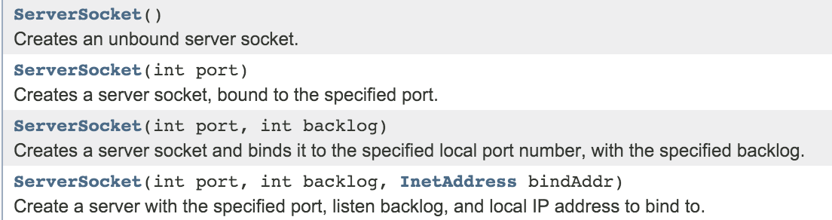
java.net.ServerSocket

Slide 5
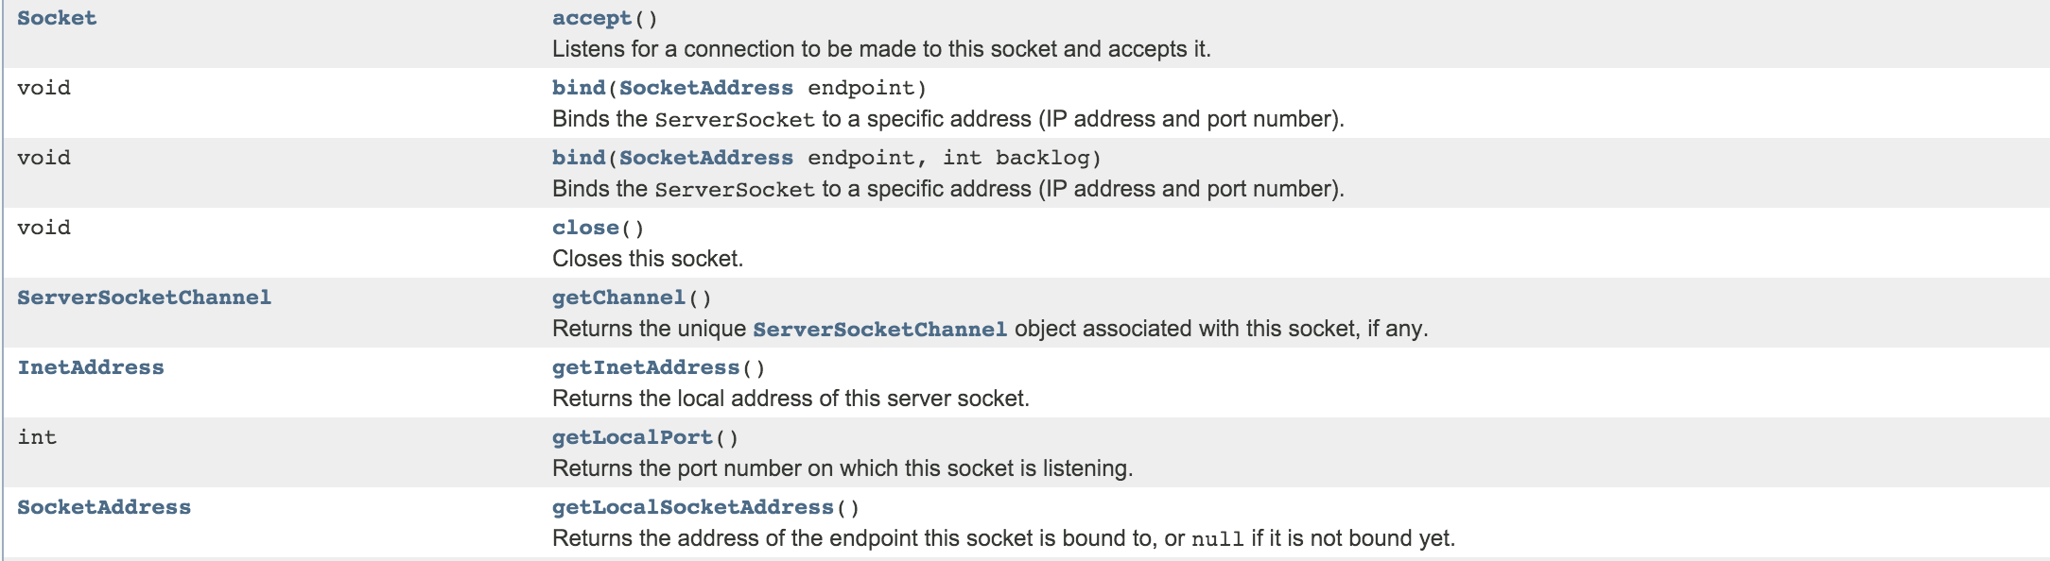
java.net.ServerSocket

Slide 6
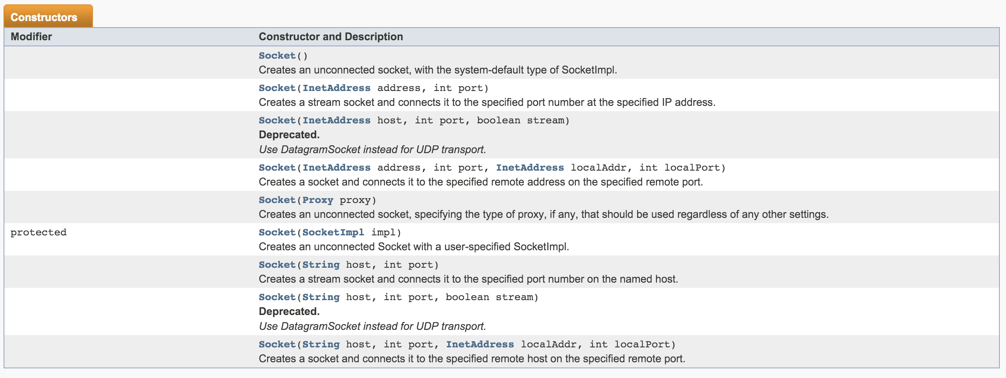
Socket

Slide 7
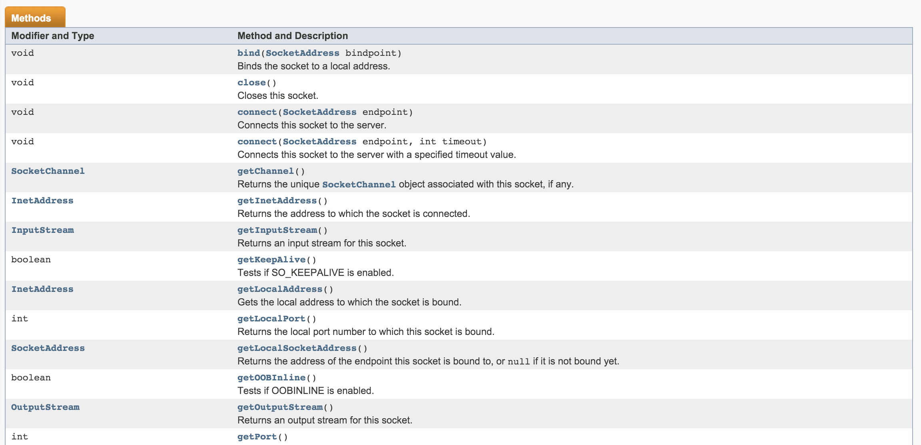
Socket

Slide 8
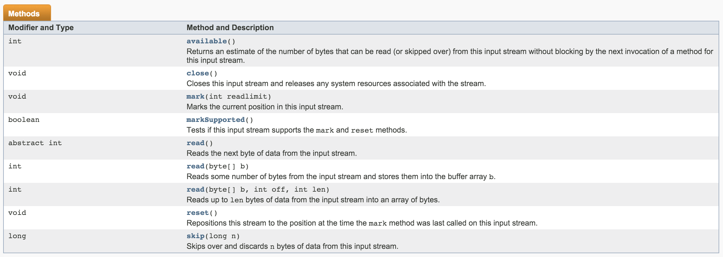
InputStream

Slide 9
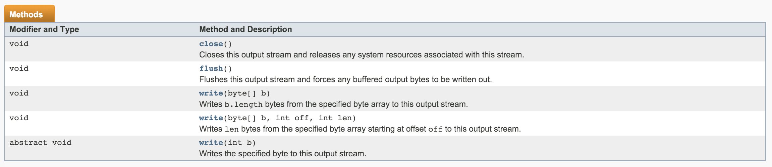
OutputStream

Slide 10
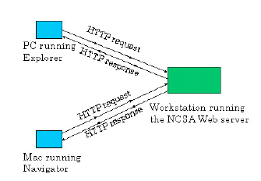
Web

Slide 11

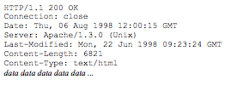
HTTP
HTTP requests
HTTP respond
GET / HTTP/1.0\n\n

Slide 12
Echo Server
Input ==”Hello”/ Output=”Welcome”
Input ! =”Hello”/ Output=”Not Welcomed”
Input !=”bye”/ Output ←Input
AWAIT
ECHO
Input ==”bye”/ Output=”bye”

Slide 13
BufferedReader instream = new BufferedReader (new InputStreamReader (csocket.getInputStream()));
BufferedWriter outstream = new BufferedWriter(new OutputStreamWriter(csocket.getOutputStream()));
//String strin = instream.readLine();
String strin ;
while ((strin = instream.readLine()) != null) {
if (strin.equals("Hi")){
outstream.write("Hi");
}else{
System.out.println(strin);
}
if (strin.equals("Bye."))
break;
}

Slide 14
Multi Thread
public static void main(String args[])
throws Exception {
ServerSocket ssock = new ServerSocket(8080);
System.out.println("Listening");
while (true) {
Socket sock = ssock.accept();
System.out.println("Connected");
new Thread(new MultiThreadServer(sock)).start();
}
}

Slide 15
Runnable
public class MultiThreadServer implements Runnable {
Socket csocket;
MultiThreadServer(Socket csocket) {
this.csocket = csocket;
}

Slide 16
Run()
public void run() {
try {
BufferedReader instream = new BufferedReader (new InputStreamReader (csocket.getInputStream()));
BufferedWriter outstream = new BufferedWriter(new OutputStreamWriter(csocket.getOutputStream()));
//String strin = instream.readLine();
String strin ;
while ((strin = instream.readLine()) != null) {
// csocket.close();
}
catch (IOException e) {
System.out.println(e);
}
}

