Slide 1
Homework 1.1.1
True or False?

Slide 2
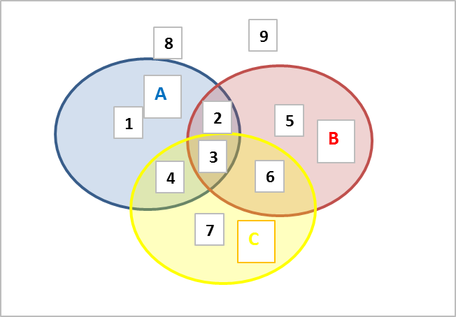
Homework 1.1.1

Slide 3
Homework 1.1.2
Juan is playing the following game: he rolls two dice. If they sum up to 7 he loses a dollar. If they sum up to 2, he wins 2 dollars. Otherwise, he doesn’t win nor lose.
After playing this game for a long time, what shall happen? why?

Slide 4
Homework 1.1.2

Slide 5
Homework 1.1.3
Jerry and Susan have a joint bank account.
Jerry goes to the bank 20% of the days.
Susan goes there 30% of the days.
Together they are at the bank 8% of the days.
Susan was at the bank last Monday. What’s the probability that Jerry was there too?
Last Friday, Susan wasn’t at the bank. What’s the probability that Jerry was there?
Last Wednesday at least one of them was at the bank. What is the probability that both of them were there?

Slide 6
Homework 1.1.3

Slide 7
Homework 1.1.4
Harold and Mary are studying for a test.
Harold’s chances of getting a “B” are 80%. Mary’s chances of getting a “B” are 90%.
The probability of at least one of them getting a “B” is 91%.
What is the probability that only Harold gets a “B”?
What is the probability that only Sharon gets a “B”?
What is the probability that both won’t get a “B”?

Slide 8
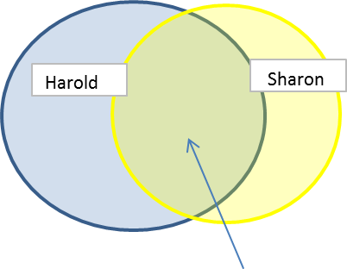
Homework 1.1.4
.80
.90
.79
P(Harold) |  |  | 0.8
P(Sharon) |  |  | 0.9
P(Harold or Sharon) |  |  | 0.91
P(Harold or Sharon)
P(Harlod) + P(Sharon) - P(Harold and Sharon)
 |  | .80 + .90 - P(Harold and Sharon) |  |  | = .91
 |  |  |  | .80+.90-.91 | 0.79
P( only Harold) |  | .8 - .79 | = | 1.00%
P(Only Sharon) |  | .9 - .79 | = | 11.00%
P(none) |  | 1 - .91 |  | 9.00%

Slide 9
Homework 1.1.5
Jerry and Susan have a joint bank account.
Jerry goes to the bank 20% of the days.
Susan goes there 30% of the days.
Together they are at the bank 8% of the days.
Are the events “Jerry is at the bank” and “Susan is at the bank” independent?
NO
20% | * | 30% | = | 6.00%

Slide 10
Homework 1.1.6
You roll 2 dice.
Are the events “the sum is 6” and “the second die shows 5” independent?
Are the events “the sum is 7” and “the first die shows 5” independent?

Slide 11
Homework 1.1.6
 | 1 | 2 | 3 | 4 | 5 | 6
1 | 2 | 3 | 4 | 5 | 6 | 7
2 | 3 | 4 | 5 | 6 | 7 | 8
3 | 4 | 5 | 6 | 7 | 8 | 9
4 | 5 | 6 | 7 | 8 | 9 | 10
5 | 6 | 7 | 8 | 9 | 10 | 11
6 | 7 | 8 | 9 | 10 | 11 | 12
p(second=5) |  | 6/36
P(total=6) |  | 5/36
P(total=6 and second=5)= |  |  | '1/36 | NE | 6/36 * 5/36
 | 1 | 2 | 3 | 4 | 5 | 6
1 | 2 | 3 | 4 | 5 | 6 | 7
2 | 3 | 4 | 5 | 6 | 7 | 8
3 | 4 | 5 | 6 | 7 | 8 | 9
4 | 5 | 6 | 7 | 8 | 9 | 10
5 | 6 | 7 | 8 | 9 | 10 | 11
6 | 7 | 8 | 9 | 10 | 11 | 12
p(total=7) |  | 6/36
P(first=5) |  | 6/36
P(first=5 & total 7) |  | 1/36 | EQ | 6/36 * 6/36

Slide 12
Homework 1.1.7
An oil company is considering drilling in either TX, AK and NJ. The company may operate in only one state. There is 60% chance the company will choose TX and 10% chance – NJ.
There is 30% chance of finding oil in TX, 20% - in AK, and 10% - in NJ.
What’s the probability of finding oil?
The company decided to drill and found oil. What is the probability that they drilled in TX?

Slide 13
Homework 1.1.7
 | TX | AK | NJ | Total
Oil | 18.00% | 6.00% | 1.00% | 25.00%
No Oil | 42.00% | 24.00% | 9.00% | 75.00%
 | 60.00% | 30.00% | 10.00% | 100.00%
 | P(Oil/Tx) | 0.3 | =P(oil & TX)/P(Tx)
 | P((oil & TX)= | .3*.60 =.18 | 0.18
 | P((oil & AK)= | =0.2*0.3 | 0.06
 | P((oil & NJ)= | .10*.10 | 0.01
 | P(oil) | 25.00%
 | P(TX/oil) | .18/.25 | 0.72

Slide 14
Homework 1.1.8
An company is considering an investment.
The outcomes can be as follows:
Success: 20%
Average: 50%
Failure: 30%
The company decides to hire a specialist. His advice is either YES or NO.
From past experience, the company knows that:
p(YES|success) = 0.9
p(YES|Average) = 0.2
p(YES|Failure) = 0.1
The specialist said YES. What is the probability for success?

Slide 15
Homework 1.1.8

