Slide 1
Queues
Chapter 6

Slide 2
Chapter Objectives
Learn how to represent a “waiting line”, i.e., a queue
Learn how to use the methods in the Queue interface
  Insertion (offer and add)
  Removal (remove and poll)
  Accessing front element (peek and element)
Understand how to implement the Queue interface
  Double-linked list, single-linked list, circular array
Understand how to simulate the operation of a physical system that has one or more waiting lines using queues
  Also using random number generators
Chapter 6: Queues

Slide 3
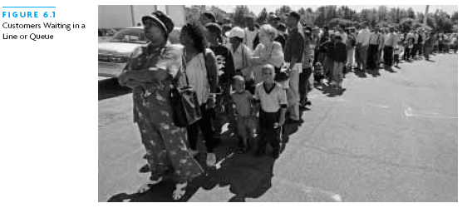
Queue Abstract Data Type
A line of customers waiting for service is a queue
Q: Who is served next?
A: The person who has waited the longest
Q: Where do new arrivals go?
A: The end of the queue (line)
Chapter 6: Queues

Slide 4
Uses for Queues
Operating systems use queues to manage tasks involving scarce resource
Q: Why a queue?
A: To ensure that the tasks are carried out in the order that they were generated
For example, a print queue
Printing is much slower than selecting pages to print
Chapter 6: Queues

Slide 5
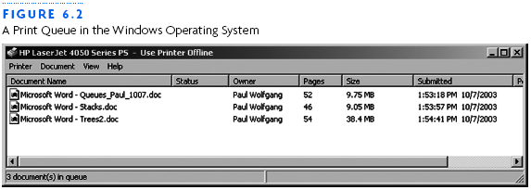
Print Queue
Chapter 6: Queues

Slide 6
Unsuitability of a Print Stack
Stacks are last-in, first-out (LIFO)
Most recently selected document would be next to print
Unless the printer queue is empty, your print job may never get executed if others are issuing print jobs
Queue is better choice for printing
Queue since first in, first out (FIFO)
“Oldest” selected document gets printed next
Much fairer than “print stack”
Chapter 6: Queues

Slide 7
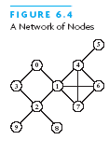
Queues Used to Traverse Graphs
A graph models a network of nodes, with many links connecting each node to other nodes in the network
A node in a graph may have several successors
Can use a queue to ensure that nodes closer to the starting point are visited before nodes farther away
  We will see this later…
Chapter 6: Queues

Slide 8
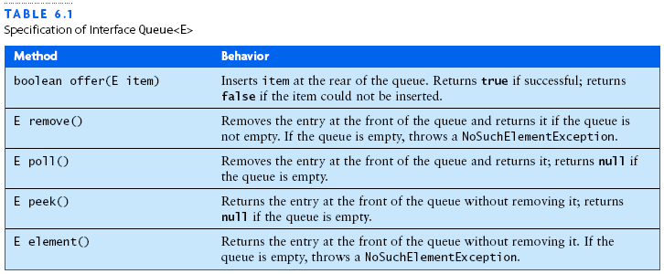
Specification for a Queue Interface
Chapter 6: Queues

Slide 9
LinkedList Implements Queue Interface
LinkedList provides methods for inserting and removing elements at either end of a double-linked list
Java 5.0 LinkedList class implements Queue interface
Queue<String> names = new LinkedList<String>();
creates Queue reference, names (in this example, stores references to String objects)
The actual object referenced by names is type LinkedList<String>
Because names is a type Queue<String> reference, you can apply only the Queue methods to it
Chapter 6: Queues

Slide 10
Queue Examples
Consider
Queue<String> names = new LinkedList<String>();
Suppose names currently contains
Where “Dorothy” was 1st into the queue
Dorothy
Toto
Scarecrow
Tinman
Lion
Chapter 6: Queues

Slide 11
Queue Examples
Suppose names currently contains
What do each of the following do?
String first = names.peek();
String first = names.element();
Dorothy
Toto
Scarecrow
Tinman
Lion
Chapter 6: Queues

Slide 12
Queue Examples
Suppose names currently contains
What do each of the following do?
String temp = names.remove();
String temp = names.poll();
Dorothy
Toto
Scarecrow
Tinman
Lion
Chapter 6: Queues

Slide 13
Queue Examples
Suppose names currently contains
What do both of the following do?
names.offer(“Wizard”);
names.add(“Wizard”);
Toto
Scarecrow
Tinman
Lion
Chapter 6: Queues

Slide 14
Queue Examples
Then names contains
Assuming that only offer or add executed (not both)
Toto
Scarecrow
Tinman
Lion
Wizard
Chapter 6: Queues

Slide 15
Case Study: A Queue of Customers
Problem: Write menu-driven program that maintains a queue of customers waiting for service. Program must be able to
  Insert new customer in line
  Remove customer who is next in line
  Display length of the line
  Determine a specific customers place in line
Chapter 6: Queues

Slide 16
Case Study: A Queue of Customers
Analysis: Queue is the obvious choice…
  Use JOptionPane for dialog menus
Inputs:
  Operation to be performed
  Name of a customer
Outputs:
  Effect of each operation
Chapter 6: Queues

Slide 17
Case Study: A Queue of Customers
Design:
  Class MaintainQueue with Queue<String> component, customers
  Method processCustomers displays menu choices and processes input
Chapter 6: Queues

Slide 18
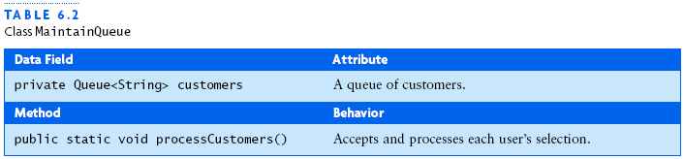
Case Study: A Queue of Customers
Chapter 6: Queues

Slide 19
Case Study: A Queue of Customers
Algorithm for processCustomers
While the user is not finished
  Display menu and get selected operation
  Perform selected operation
Each operation requires call to a Queue method
  Except for finding customer’s place in line
  How to do this?
Chapter 6: Queues

Slide 20
Case Study: A Queue of Customers
Algorithm for position in queue
Get customer’s name
Set count of customers ahead to 0
For each customer in the queue
  If customer is not specified customer
    Increment count
  Else
    Display count and exit loop
If all customers examined without success
  Display message that customer is not in line
Chapter 6: Queues

Slide 21
Case Study: A Queue of Customers
Class file MaintainQueue.java is in the book and at
http://www.cs.sjsu.edu/~stamp/CS46B/other/queue/
Chapter 6: Queues

Slide 22
Queue Implementations
We consider 3 different implementations:
Double-linked list
  This is what Java designers used
Single-linked list
  Similar to using double-linked list
Circular array
  Most efficient approach (in terms of space)
  But somewhat more complex
Chapter 6: Queues

Slide 23
Double-Linked List Queue Implemention
Insertion and removal from either end of a double-linked list is O(1)
  So either end can be the front (or rear) of the queue
  Which would you choose?
Java makes head of the linked list front of queue
  So tail is the rear of the queue
Issue: LinkedList object is used as a queue
Why is this an “issue”?
May be possible to apply other LinkedList methods
  In addition to the ones required by the Queue interface
Chapter 6: Queues

Slide 24
Single-Linked List Queue Implementation
Can implement a queue using a single-linked list
Book gives Class ListQueue
  Contains a collection of Node<E> objects
Which end should be front of queue?
Front makes sense, that is…
  insertions are at the rear of a queue and…
  removals are from the front
Want to have a reference to the last list node (why?)
Number of elements changed by insert and remove
Empty queue is a special case
Chapter 6: Queues

Slide 25
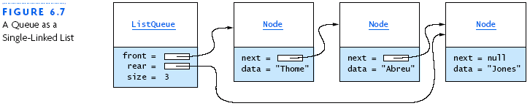
Single-Linked List Queue Implementation
Chapter 6: Queues

Slide 26
Circular Array Queue Implementation
Time efficiency of using a single- or double-linked list to implement a queue is O(1)
  However there are some space inefficiencies
Storage space is increased when using a linked list due to references stored at each list node
Array Implementation: Front and rear?
  Insertion at rear of array is constant time
  But them removal from the front is linear time (why?)
  Removal from rear of array is constant time
  But then insertion at the front is linear time (why?)
Chapter 6: Queues

Slide 27
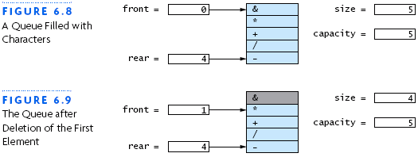
Circular Array Queue Implementation
Chapter 6: Queues

Slide 28
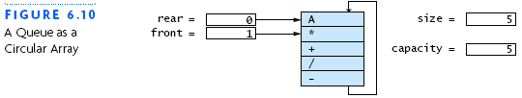
Circular Array Queue Implementation
Chapter 6: Queues

Slide 29
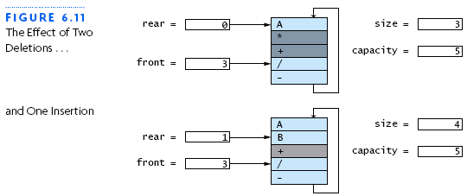
Circular Array Queue Implementation
Chapter 6: Queues

Slide 30
Circular Array Queue Implementation
How to access elements in circular array?
Use “mod” operator: %
For example, to insert (at rear):
  rear = (rear + 1) % capacity;
Chapter 6: Queues

Slide 31
Clock Arithmetic
For integers x and n, “x mod n” is the remainder of x ÷ n
  In Java, “x mod n” is: x % n
Examples
  7 mod 6 = 1
  33 mod 5 = 3
  33 mod 6 = 3
  51 mod 17 = 0
  17 mod 6 = 5
5
1
arithmetic
mod 6
2
4
3
Chapter 6: Queues

Slide 32
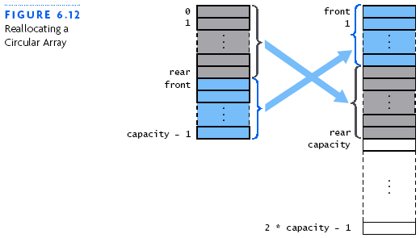
Circular Array Queue Implementation
Chapter 6: Queues

Slide 33
Circular Array Queue Implementation
Why not use System.arraycopy to copy elements when reallocating circular array?
System.arraycopy(theData, 0, newData, 0, capacity)
This will not work!
Consider
Toto
0
Scarecrow
1
rear
Tinman
2
front
Lion
3
Wizard
4
Chapter 6: Queues

Slide 34
Circular Array Queue Implementation
Suppose to reallocate, we try
System.arraycopy(theData, 0, newData, 0, capacity)
In this case…
Toto
0
Scarecrow
1
rear
Tinman
2
Toto
0
front
Lion
3
Scarecrow
1
Wizard
4
rear
Tinman
2
5
Lion
3
6
front
Wizard
4
7
8
Chapter 6: Queues
9

Slide 35
Implementing Class ArrayQueue<E>.Iter
To fully implement the Queue interface…
We must implement the missing Queue methods
  And an inner class Iter
Field index has subscript of the next element to access
The constructor initializes index to front when a new Iter object is created
Data field count keeps track of the number of items accessed so far
Method Iter.remove throws
Unsupported-OperationException
Would violate “contract” by removing item other than 1st
Chapter 6: Queues

Slide 36
Comparing 3 Queue Implementations
All three are O(1), i.e., constant time
  What about reallocate in circular array?
But linked lists require more storage: Why?
Extra space for links!
  Node for single-linked list stores two references
  Node for double-linked list stores three references
How much better is circular array?
  If filled to capacity, requires half the storage of a single-linked list to store same number of elements
Chapter 6: Queues

Slide 37
Simulating Waiting Lines Using Queues
Simulations used to study the performance of systems
  Can Use math and/or computer model of system
Simulations allow designers of system to estimate performance and/or characteristics before building it
Simulation can lead to changes in the design that will improve a proposed system
Simulation is useful, for example, when real system is
  too expensive to build
  too dangerous to experiment with
Chapter 6: Queues

Slide 38
Airline Check-In Counter Simulation
Two lines/queues: regular passenger and frequent flyers
Only one ticket agent
How to serve the 2 lines?
  Democratic strategy: alternate between lines
  Another democratic strategy: serve longest waiting
  Elitist approach: serve frequent flyers first
  Combination strategies
Queuing theory can be used to analyze this problem
  Mathematical theory ⎯ also used to study networks
Here, we use a computer simulation
Chapter 6: Queues

Slide 39

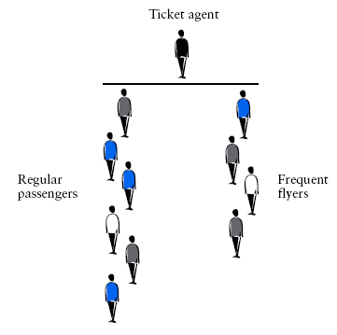
Airline Check-In Counter Simulation
Chapter 6: Queues

Slide 40
Airline Check-In Counter Simulation
Problem: Wizard of Oz Airlines is considering redesigning its ticket counter operations
Assumptions include
  One ticket agent
  Two lines of customers (regular, frequent flyers)
Want to experiment with various strategies
  Democratic, elitist, combinations thereof
Want to know effect on waiting time for both lines, under various assumptions on arrival rates
Chapter 6: Queues

Slide 41
Airline Check-In Counter Simulation
Analysis: Computer simulation is a good idea, since difficult to study many alternatives in real world situation
Must keep track of “time”
Types of “events” that can occur:
  New frequent flyer arrives in line
  New regular passenger arrives in line
  Ticket agent finishes serving someone and begins serving frequent flyer
  Ticket agent finishes serving someone and begins serving regular passenger
  Ticket agent is idle (no passengers to serve)
Chapter 6: Queues

Slide 42
Airline Check-In Counter Simulation
Analysis (continued): Purpose is to generate statistics on waiting time for passengers
Also, we can display minute-by-minute trace
  Useful for debugging
Results will depend on
  Priority given to frequent flyers
  Arrival rate of each type of passenger
  Time required to serve each passenger
Chapter 6: Queues

Slide 43
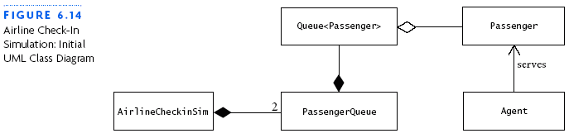
Airline Check-In Counter Simulation
Design: Want to identify the objects
Look at the nouns:
  Agent, passengers, passenger lines, simulation
Gives us the following UML diagram
We will use a queue to represent the “lines” (surprised?)
Chapter 6: Queues

Slide 44
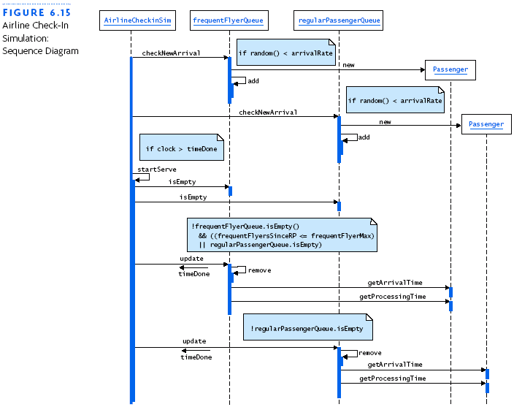
Airline Check-In Counter Simulation
Sequence diagram
Shows the flow between objects
Also, data that is passed
Chapter 6: Queues

Slide 45
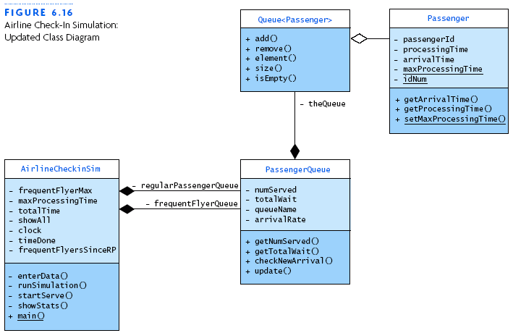
Airline Check-In Counter Simulation
Sequence diagram tells us agent is either busy or idle
Also tells us the methods needed in each class
Revise UML diagram
Chapter 6: Queues

Slide 46
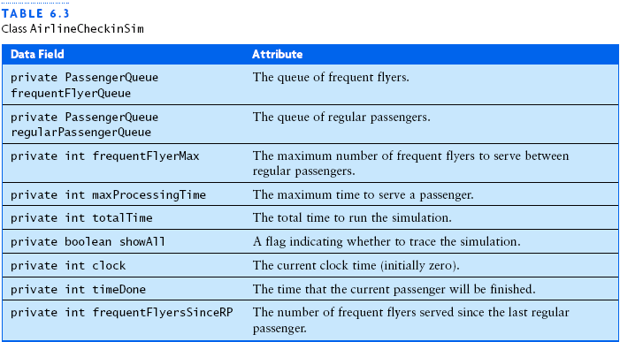
Class AirlineCheckinSim
Chapter 6: Queues

Slide 47
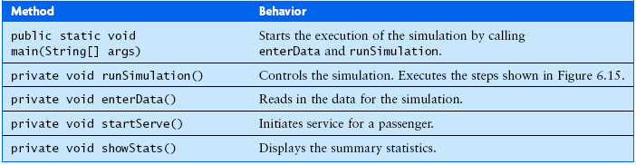
Class AirlineCheckinSim
Chapter 6: Queues

Slide 48
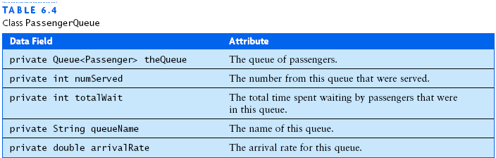
Class PassengerQueue
Chapter 6: Queues

Slide 49
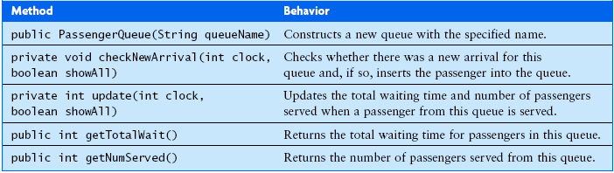
Class PassengerQueue
Chapter 6: Queues

Slide 50
Class Passenger
This class stores following info about a passenger
  Unique ID number
  Time at which passenger arrived
  Processing time
  Maximum processing time
Note that “ID number” is just the position in queue
Chapter 6: Queues

Slide 51
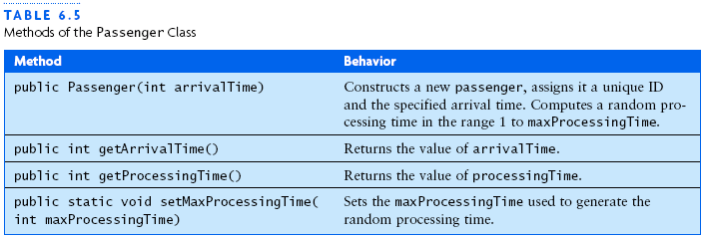
Class Passenger
Chapter 6: Queues

Slide 52
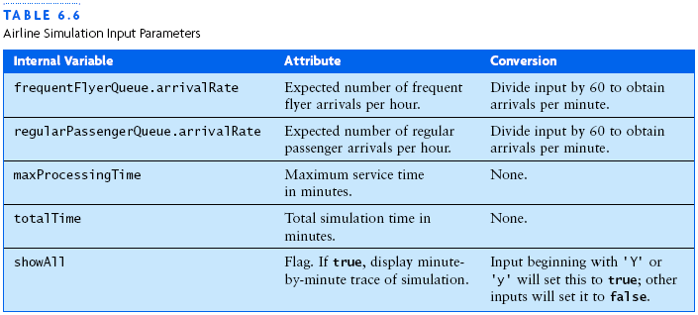
Input Parameters
Chapter 6: Queues

Slide 53
Pseudorandom Numbers
How to generate “random” numbers?
In the real world, flip a coin, roll a die, etc.
In computer simulation, use “pseudorandom” numbers
  Generated in sequence
  Based on an initial “seed” value
  Note that same seed yields same sequence
    Why is this useful (necessary) for computer simulation?
  Not really “random”, so pseudorandom
  But these numbers have nice statistical properties
Chapter 6: Queues

Slide 54
Pseudorandom Numbers
Our airline simulation uses pseudorandom numbers to…
  Determine whether a passenger has arrived within a given minute of simulation
  Determine how long it takes to serve a passenger
Suppose passengers arrival rate is 1 every 5 minutes
Do passengers arrive precisely at 0,5,10,15,… ?
No! On average, one arrives every 5 minutes
How to simulate this?
Chapter 6: Queues

Slide 55
Pseudorandom Numbers
Suppose passengers arrival rate is 1 every 5 minutes
For a given 1 minute time interval of simulation
  Generate pseudorandom number between 0 and 1
  If generated number less than 0.2, then passenger arrived in that interval
  Else no passenger arrived
Suppose arrivalRate is rate at which passengers arrive (per minute)
Then, in Java, passenger arrives if
  Math.random() < arrivalRate
Otherwise, no passenger arrives
Chapter 6: Queues

Slide 56
Airline Check-In Counter Simulation Code
http://www.cs.sjsu.edu/~stamp/CS46B/other/queue/airline/
Chapter 6: Queues

Slide 57
Chapter Review
Queue is an abstract data type with a first-in, first-out structure (FIFO)
The Queue interface declares methods offer, remove, poll, peek, and element.
Three ways to implement the Queue interface: double-linked list, single-linked list, and circular array
To avoid the cost of building a physical system or running an actual experiment, computer simulation can be used to evaluate the expected performance of a system or operation strategy
Chapter 6: Queues

