Slide 1
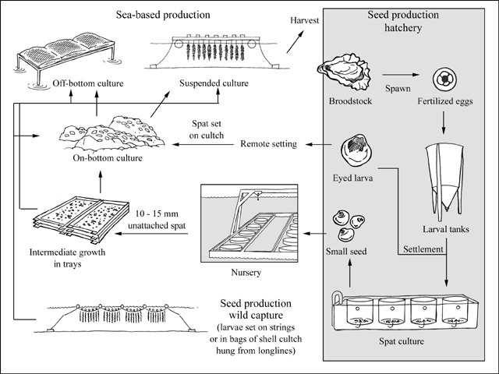
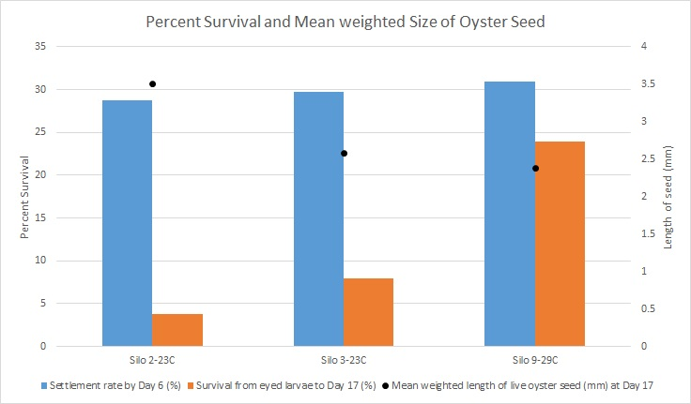
Larvae Mortality in Hatcheries
23°C vs 29°C
FAO (2018)
Rhonda Elliot, UW

Slide 2
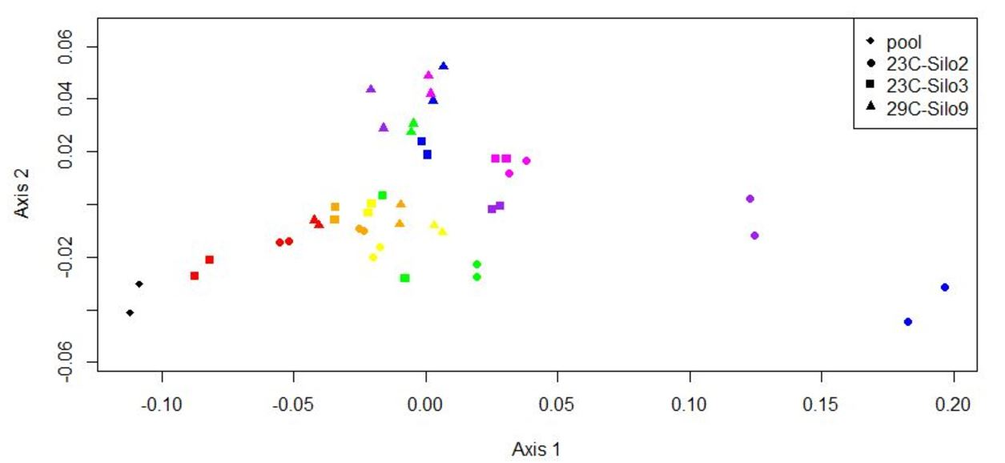
“-omics” tools can identify changes through time and between each temperature.
Rhonda Elliot, UW

Slide 3
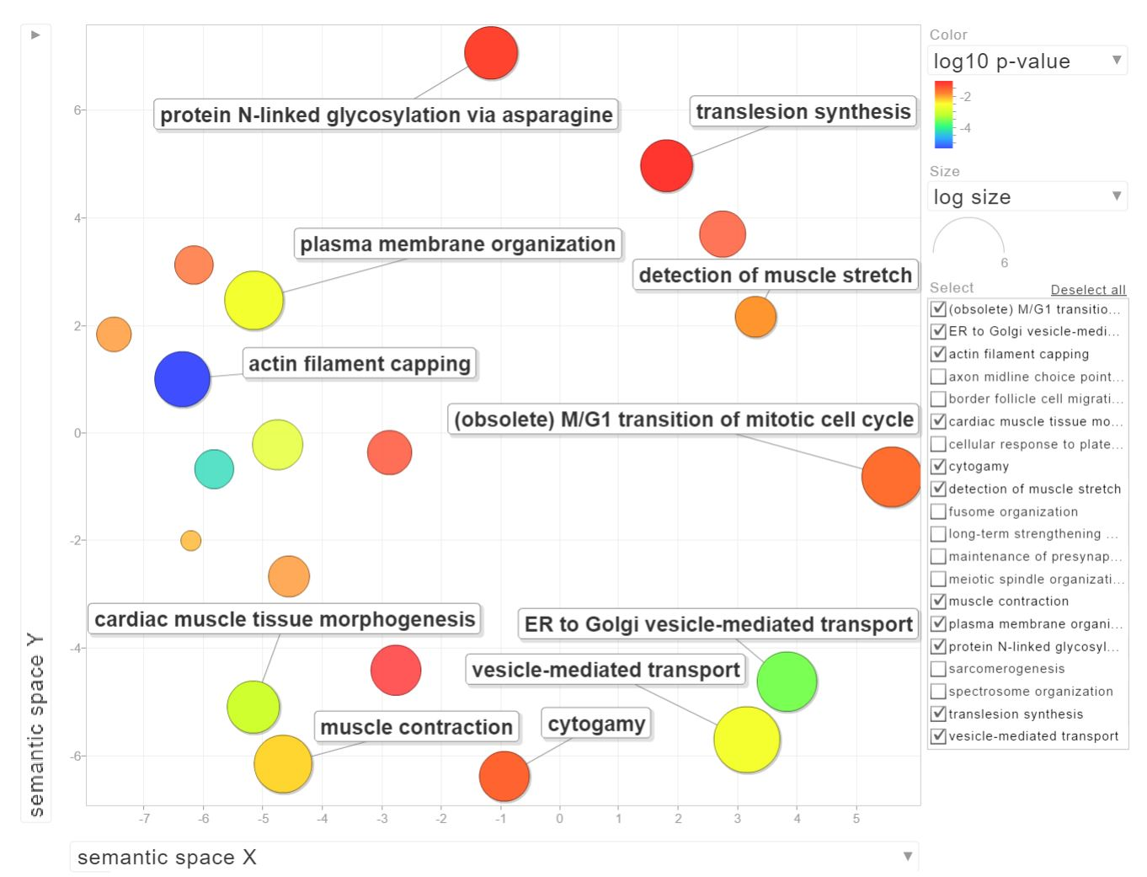
ID Proteins changing through time
Proteins → Genes
Relation of enriched genes
What biological processes are changing in larval oysters?

