Slide 1
.
Biteman:
An Online Food Order Website
B
iteman
Team 10:
Meng Wang, Yalei Peng,
Jianjun Luo, Jiaoyan Chen

Slide 2
Features
Login/Logout (as different roles)
Search Restaurant
Show Menu
Restaurant:
Update Menu
Manage Orders (accept/deliver)
Customer:
Sign Up
Create Orders (add/delete/place)
Cancel & Confirm Orders
.
B
iteman

Slide 3
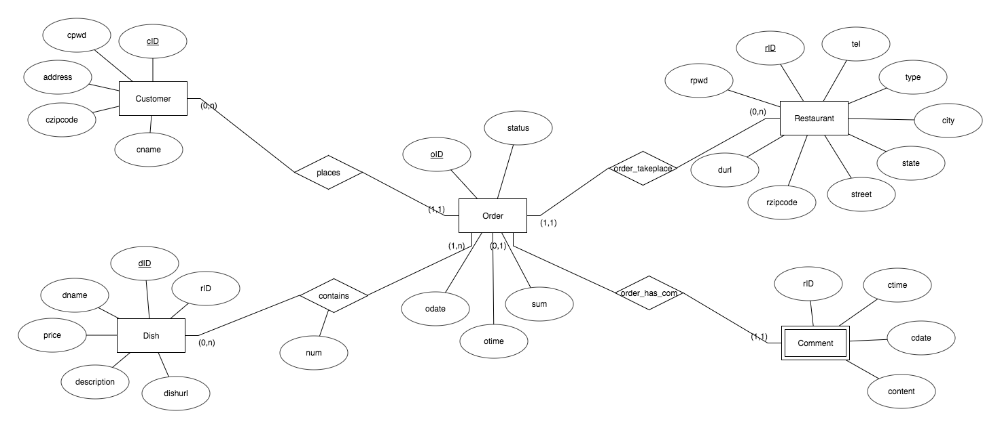
Database
.
B
iteman

Slide 4
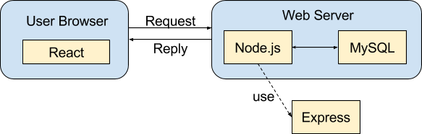
Approach
.
B
iteman

Slide 5
Thank you!
Q&A
.
B
iteman

