Slide 1
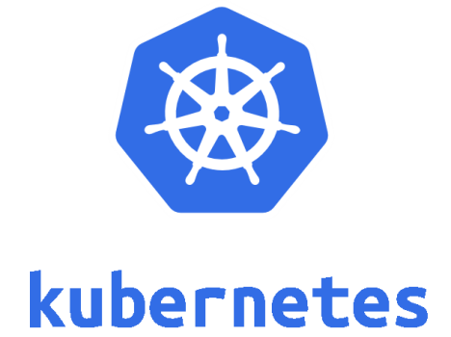
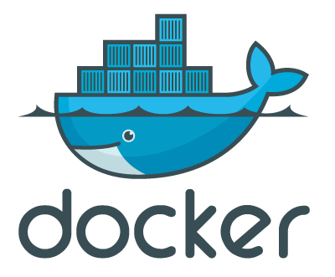
Pod
sandbox
container
container

Slide 2

stage 0
Pod
stage 1
fly
stage 2
stage 2
sandbox
container
container

Slide 3
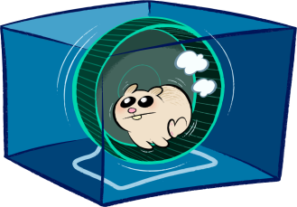
OCI Runtime
OCI Runtime
Pod
runC
runC
sandbox
container
container

Slide 4

containerd-shim
containerd-shim
OCI Runtime
OCI Runtime
Pod
runC
runC
sandbox
container
container

Slide 5
CRI impl
dockershim
containerd-shim
containerd-shim
OCI Runtime
OCI Runtime
Pod
runC
runC
sandbox
container
container

Slide 6
CRI impl
cri-containerd
containerd-shim
containerd-shim
OCI Runtime
OCI Runtime
Pod
runC
runC
sandbox
container
container

Slide 7
CRI impl
containerd-shim
containerd-shim
OCI Runtime
OCI Runtime
Pod
runC
runC
sandbox
container
container

Slide 8

CRI impl
containerd-shim
containerd-shim
OCI Runtime
OCI Runtime
runnc
runnc
ユーザアプリ
ユーザアプリ
ライブラリOS
(Rumprun)
ライブラリOS
(Rumprun)
Solo5
Solo5
container
container

Slide 9

CRI impl
gvisor-containerd-shim
gvisor-containerd-shim
OCI Runtime
OCI Runtime
Pod
runsc
runsc
sandbox
container
container
kernel (Sentry)
kernel (Sentry)
FS proxy (Gofer)
FS proxy (Gofer)

Slide 10

CRI impl
conmon
conmon
OCI Runtime
OCI Runtime
Pod
runC
runC
sandbox
container
container

Slide 11
HCS
container
container

Slide 12
CRI impl
hcsshim
hcsshim
OCI Runtime
OCI Runtime
runhcs
runhcs
HCS
Pod
sandbox
container
container

Slide 13

CRI impl
containerd-shim
containerd-shim
OCI Runtime
OCI Runtime
kata-runtime
kata-runtime
kata-shim
kata-proxy
kata-shim
VM (Clear Linux, etc.)
kata-agent
Pod
sandbox
container
container
Hypervisor (QEMU, etc.)

Slide 14

OCI Runtime
OCI Runtime
cc-runtime
cc-runtime
cc-shim
cc-shim
Clear Linux VM
cc-proxy
Clear Linux VM
cc-proxy
container-vm-agent
container-vm-agent
container
container
Hypervisor (qemu-light, etc.)

Slide 15
CRI impl
VM (Clear Linux, etc.)
containerd-shim-kata-v2
Pod
kata-agent
sandbox
container
container
Hypervisor (QEMU, etc.)

Slide 16
CRI impl
CRI Proxy
CRI impl
CRI impl
dockershim
virtlet manager
vmwrapper
vmwrapper
CRI impl
QEMU VM
QEMU VM

Slide 17
コンテナランタイム選定開始
何も考えず
とりあえず試したい
Yes
Docker
(containerdとrunC付き)
No
Yes
Windowsアプリを
動かしたい
Windows Containers
(i.e. Windows版Docker)
No
Yes
コンテナ対応していない
アプリを動かしたい
virtlet
No
Yes
信用しきれない
アプリを動かしたい
No
QEMUが使える
Yes
containerd とgVisor
No
containerd と
Kata Containers
RedHatが好き
Yes
CRI-OとrunC
No
containerdとrunC

Slide 18










2013
2014
2015
Windows Containers
Clear Containers
runC
2016
Singularity
2017
CRI
Fracti
railcar
virtlet
2018
Kata Containers
2019

Slide 19
AWS Fargate, etc.
with FC control plugin
Firecracker VM
FC runtime
OCI Runtime
FC agent
OCI Runtime
Pod
runC
runC
sandbox
container
container
KVM

Slide 20

CRI impl
containerd-shim
containerd-shim
OCI Runtime
OCI Runtime
runu
runu
ユーザアプリ
ユーザアプリ
ライブラリOS
(LKL)
ライブラリOS
(LKL)
container
container

