Slide 1
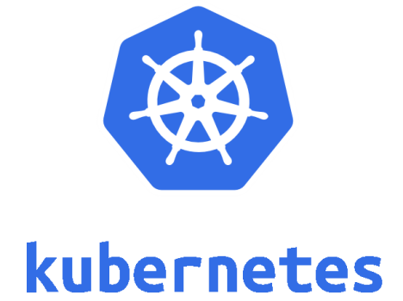
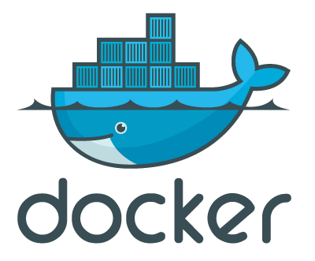
Pod
sandbox
container
container

Slide 2
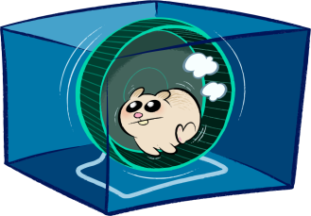
OCI Runtime
OCI Runtime
Pod
runC
runC
sandbox
container
container

Slide 3

containerd-shim
containerd-shim
OCI Runtime
OCI Runtime
Pod
runC
runC
sandbox
container
container

Slide 4
CRI impl
dockershim
containerd-shim
containerd-shim
OCI Runtime
OCI Runtime
Pod
runC
runC
sandbox
container
container

Slide 5
CRI impl
cri-containerd
containerd-shim
containerd-shim
OCI Runtime
OCI Runtime
Pod
runC
runC
sandbox
container
container

Slide 6
CRI impl
containerd-shim
containerd-shim
OCI Runtime
OCI Runtime
Pod
runC
runC
sandbox
container
container

Slide 7
HCS
container
container

Slide 8
CRI impl
hcsshim
hcsshim
OCI Runtime
OCI Runtime
runhcs
runhcs
HCS
Pod
sandbox
container
container

Slide 9

CRI impl
containerd-shim
containerd-shim
OCI Runtime
OCI Runtime
kata-runtime
kata-runtime
kata-shim
kata-proxy
kata-shim
VM (Clear Linux, etc.)
kata-agent
Pod
sandbox
container
container
Hypervisor (QEMU, etc.)

Slide 10
CRI impl
VM (Clear Linux, etc.)
containerd-shim-kata-v2
Pod
kata-agent
sandbox
container
container
Hypervisor (QEMU, etc.)

Slide 11
CRI impl
CRI Proxy
CRI impl
CRI impl
dockershim
virtlet manager
vmwrapper
vmwrapper
CRI impl
QEMU VM
QEMU VM

