Slide 1



$$z$$
$$y$$
$$x$$

Slide 2






$$z$$
$$\hat{Z}$$
$$\hat{Y}$$
$$y$$
$$\hat{X}$$
$$x$$

Slide 3
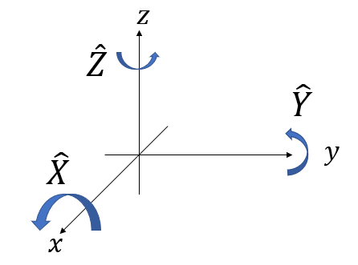


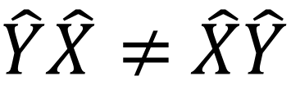


$$\hat{X}$$
$$\hat{Y}$$
$\hat{Y}\hat{X}≠$ $\hat{X}\hat{Y}$
$$\hat{Y}$$
$$\hat{X}$$

Slide 4

$$\hat{X}$$
$$\hat{Y}$$
$$−\hat{X}$$

Slide 5
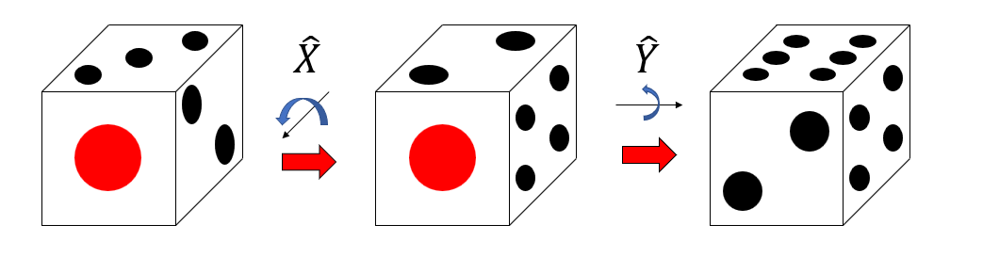
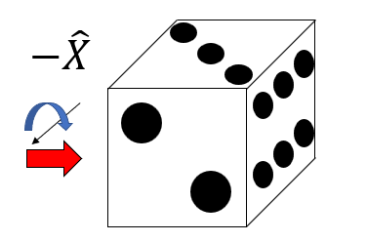



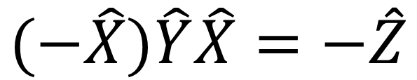




$$(−\hat{X})\hat{Y}\hat{X}=−\hat{Z}$$
$$z$$
$$−\hat{Z}$$
$$\hat{Z}$$
$$\hat{Y}$$
$$\hat{X}$$
$$y$$
$$x$$

Slide 6
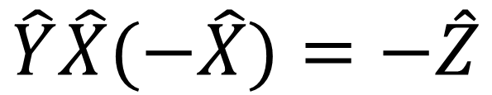

$$\hat{Y}\hat{X}(−\hat{X})=−\hat{Z}$$
$$z$$
$$−\hat{Z}$$
$$\hat{Z}$$
$$\hat{Y}$$
$$\hat{X}$$
$$y$$
$$x$$

