Slide 1












$$W_{1}(q,Q)$$
$$W_{2}=W_{1}+PQ$$
$$W_{2}(q,P)$$
$$dW_{1}=pdq−PdQ$$
$$dW_{2}=pdq+QdP$$
$$W_{3}=W_{1}−pq$$
$$W_{4}=W_{2}−pq$$
$${dW}_{3}=−qdp−PdQ$$
$${dW}_{4}=−qdp+PdQ$$
$$W_{4}=W_{3}+PQ$$
$$W_{4}(p,P)$$
$$W_{3}(p,Q)$$

Slide 2

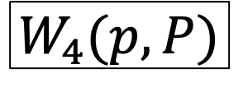
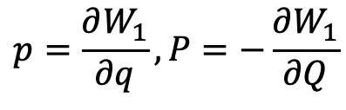
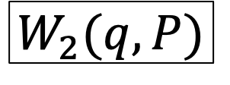
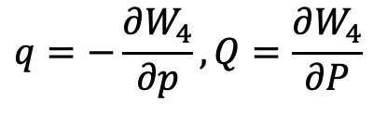



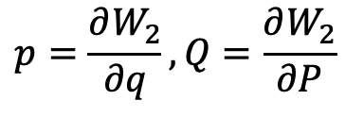



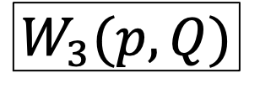
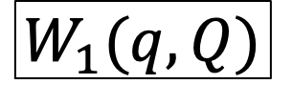
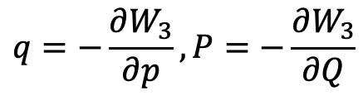

$$W_{2}=W_{1}+PQ$$
$$W_{1}(q,Q)$$
$$W_{2}(q,P)$$
$$dW_{1}=pdq−PdQ$$
$$dW_{2}=pdq+QdP$$
$$p=\frac{∂W_{1}}{∂q},P=−\frac{∂W_{1}}{∂Q}$$
$$p=\frac{∂W_{2}}{∂q},Q=\frac{∂W_{2}}{∂P}$$
$$W_{3}=W_{1}−pq$$
$$W_{4}=W_{2}−pq$$
$$W_{3}(p,Q)$$
$$W_{4}(p,P)$$
$$dW_{3}=−qdp−PdQ$$
$$dW_{4}=−qdp+QdP$$
$$q=−\frac{∂W_{3}}{∂p},P=−\frac{∂W_{3}}{∂Q}$$
$$q=−\frac{∂W_{4}}{∂p},Q=\frac{∂W_{4}}{∂P}$$
$$W_{4}=W_{3}+PQ$$

