Slide 1












$$W_{1}(q,Q)$$
$$W_{2}=W_{1}+PQ$$
$$W_{2}(q,P)$$
$$dW_{1}=pdq−PdQ$$
$$dW_{2}=pdq+QdP$$
$$W_{3}=W_{1}−pq$$
$$W_{4}=W_{2}−pq$$
$${dW}_{3}=−qdp−PdQ$$
$${dW}_{4}=−qdp+PdQ$$
$$W_{4}=W_{3}+PQ$$
$$W_{4}(p,P)$$
$$W_{3}(p,Q)$$

Slide 2
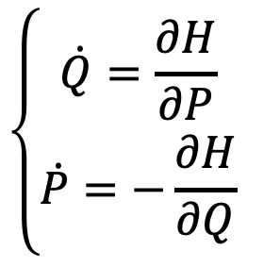
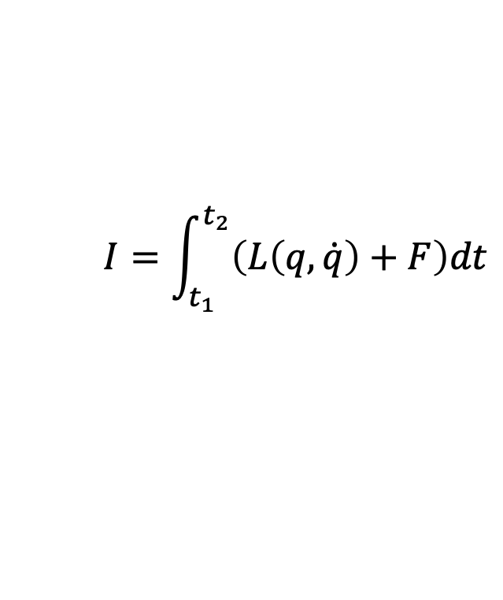
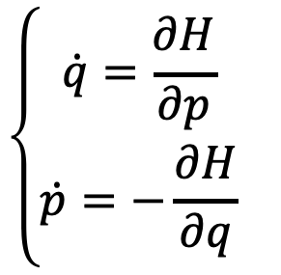




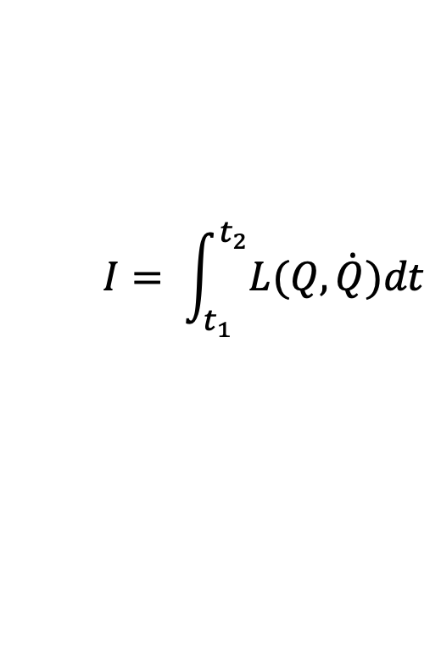
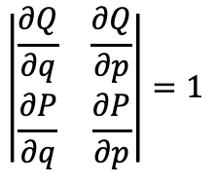
$$I=\int_{t_{1}}^{t_{2}}{\left(L\left(q,\dot{q}\right)+F\right)dt}$$
$$I= \int_{t_{1}}^{t_{2}}{L(Q,\dot{Q})dt}$$
$$I= \int_{t_{1}}^{t_{2}}{\left(p\dot{q}−H\left(q,p\right)+F\right)dt }$$
$$I= \int_{t_{1}}^{t_{2}}{\left(P\dot{Q}−H\left(Q,P\right)\right)dt }$$
$$δI=0$$
$$\left|\begin{matrix}\frac{∂Q}{∂q} & \frac{∂Q}{∂p} \\ \frac{∂P}{∂q} & \frac{∂P}{∂p}\end{matrix}\right|=1$$
$$δI=0$$
$$\left\{\begin{matrix}\dot{q}=\frac{∂H}{∂p} \\ \dot{p}=−\frac{∂H}{∂q} \end{matrix}\right.$$
$$\left\{\begin{matrix}\dot{Q}=\frac{∂H}{∂P} \\ \dot{P}=−\frac{∂H}{∂Q} \end{matrix}\right.$$

Slide 3

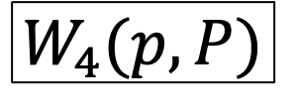
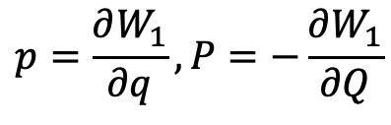
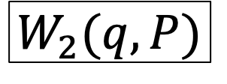
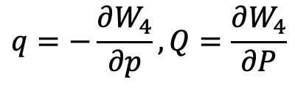



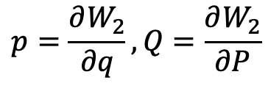



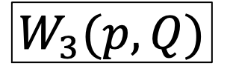
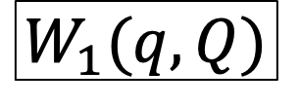
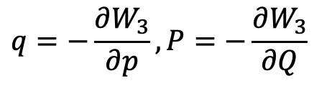

$$W_{2}=W_{1}+PQ$$
$$W_{1}(q,Q)$$
$$W_{2}(q,P)$$
$$dW_{1}=pdq−PdQ$$
$$dW_{2}=pdq+QdP$$
$$p=\frac{∂W_{1}}{∂q},P=−\frac{∂W_{1}}{∂Q}$$
$$p=\frac{∂W_{2}}{∂q},Q=\frac{∂W_{2}}{∂P}$$
$$W_{3}=W_{1}−pq$$
$$W_{4}=W_{2}−pq$$
$$W_{3}(p,Q)$$
$$W_{4}(p,P)$$
$$dW_{3}=−qdp−PdQ$$
$$dW_{4}=−qdp+QdP$$
$$q=−\frac{∂W_{3}}{∂p},P=−\frac{∂W_{3}}{∂Q}$$
$$q=−\frac{∂W_{4}}{∂p},Q=\frac{∂W_{4}}{∂P}$$
$$W_{4}=W_{3}+PQ$$

