Slide 1
ハミルトンの運動方程式由来の流れ
熱浴由来の流れ
q
ζ
p
p
O
O

Slide 2
C
O
r

Slide 3
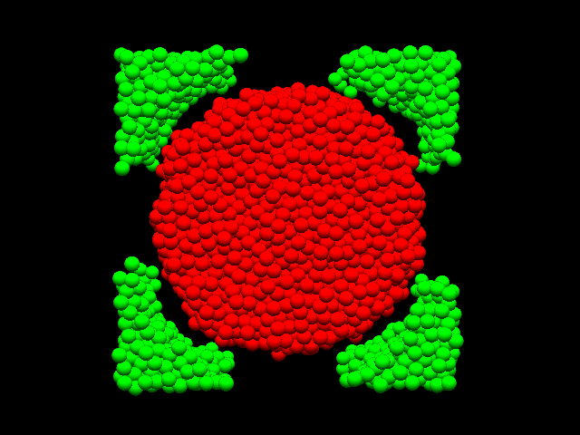
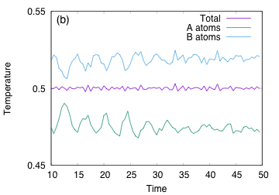
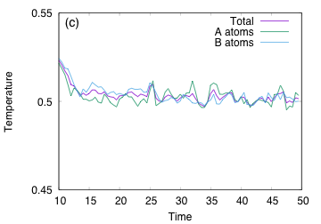
High Temperature
Region
Low Temperature
Region
A atoms
B atoms
Nose-Hoover
Langevin

Slide 4
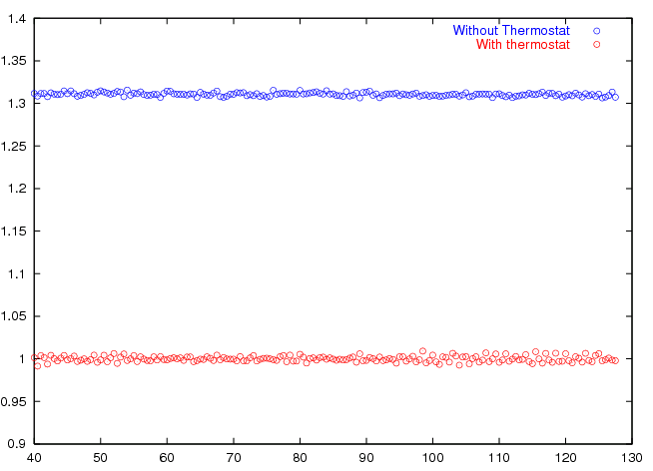
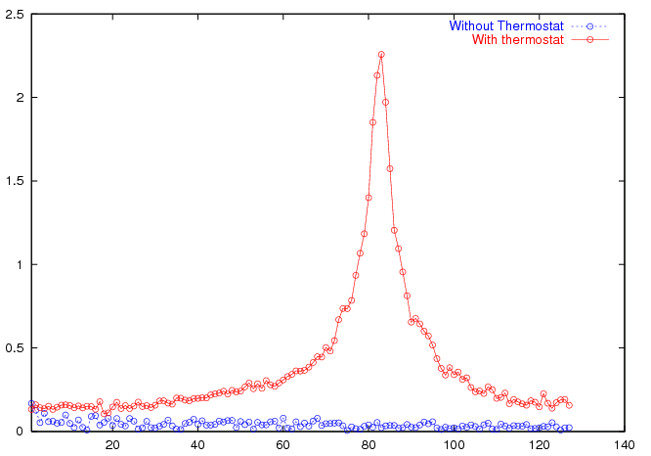
Temperature
Spectra
Non-trivial peak
Without Thermostat
With Thermostat
With Thermostat
Time
Without Thermostat

Slide 5
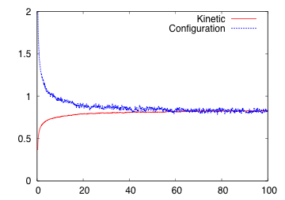
Configuration Temperature
Temperature
Kinetic Temperature
Time

