Slide 1
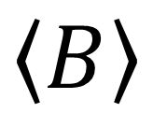
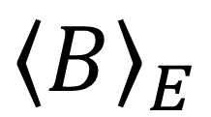
Microcanonical ensemble
Canonical ensemble
$${\left\langle B\right\rangle }_{E}$$
$$\left\langle B\right\rangle$$
E
E

