Slide 1





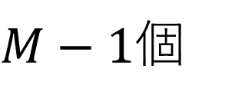
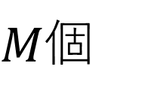
$$N$$
$M$個
$$B$$
$M−1$個
$$θ_{1}(M−1)$$
$$θ_{2}(M−1)$$
・・・
$$θ_{M}(M−1)$$

