Slide 1
Memory
CPU
CORE
CPU
CORE
CPU
CORE
CPU
CORE
Memory
Memory
CPU CORE
CPU
CORE
CPU CORE
CPU
CORE
Memory
Memory
CPU
CORE
CPU
CORE
CPU
CORE
CPU
CORE
Memory
Memory
CPU CORE
CPU
CORE
CPU CORE
CPU
CORE
Memory

Slide 2
Memory
CPU
CORE
CPU
CORE
CPU
CORE
CPU
CORE
Memory
Memory
CPU CORE
CPU
CORE
CPU CORE
CPU
CORE
Memory
Memory
CPU
CORE
CPU
CORE
CPU
CORE
CPU
CORE
Memory
Memory
CPU CORE
CPU
CORE
CPU CORE
CPU
CORE
Memory

Slide 3
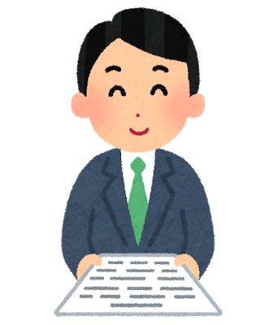
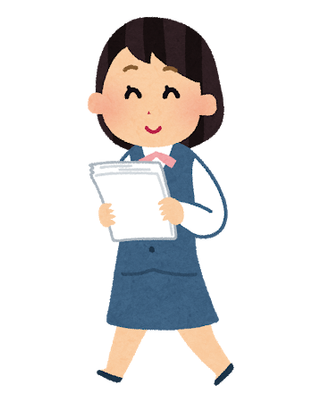
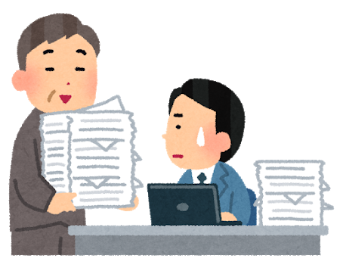
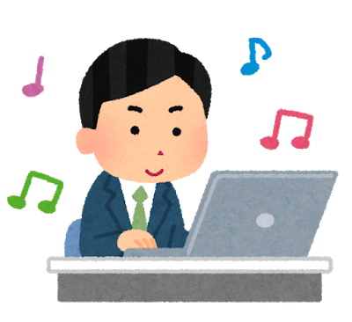
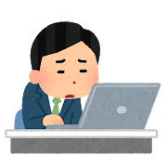
ファーストタッチの原則
これ頼むよ
これもお願いね
この件、君が
担当って聞いたんで
いいっすよ～
最初に「楽そうだから」と思って
仕事を引き受けすぎると・・・
いつの間にか「担当者」になって
大変なことに・・・

Slide 4
First-touch policy
Can you take care of this?
Please handle this too.
I heard you're in charge
of this.
Sure!
If you accept too much work at first because it looks easy...
Before you know it, you become "the person in charge" and things get painful...

Slide 5
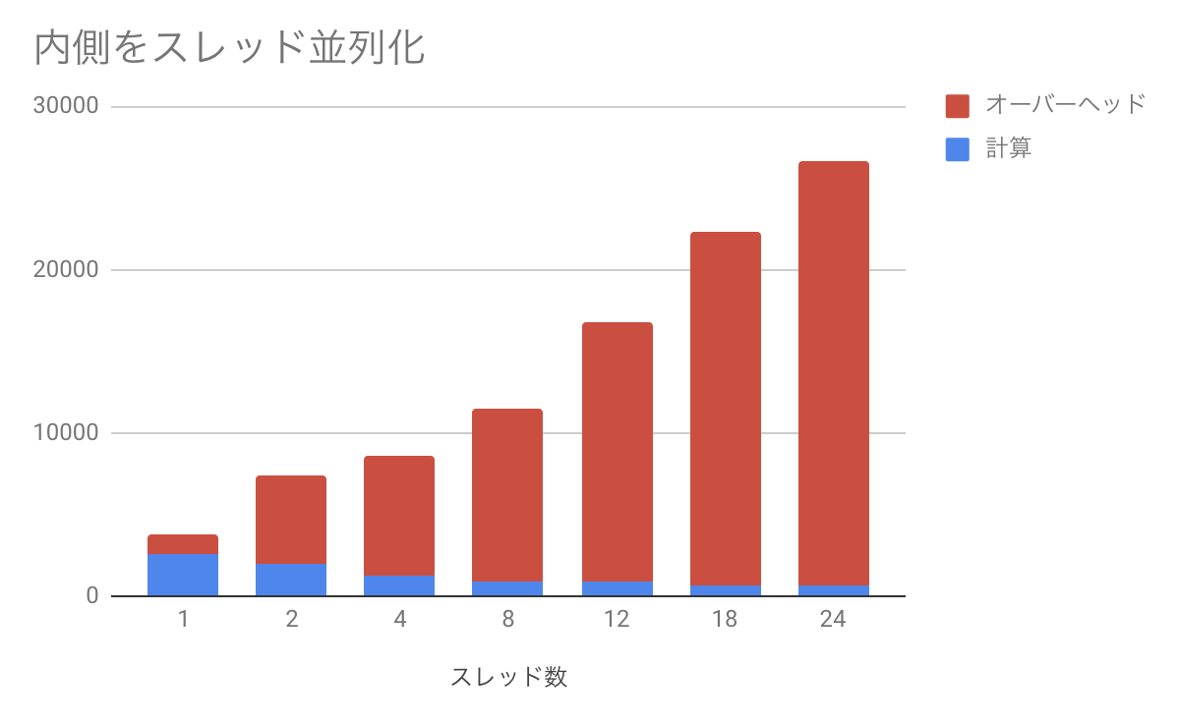

Slide 6
When parallelizing the inner loop
Overhead
Computation
Number of Threads

Slide 7
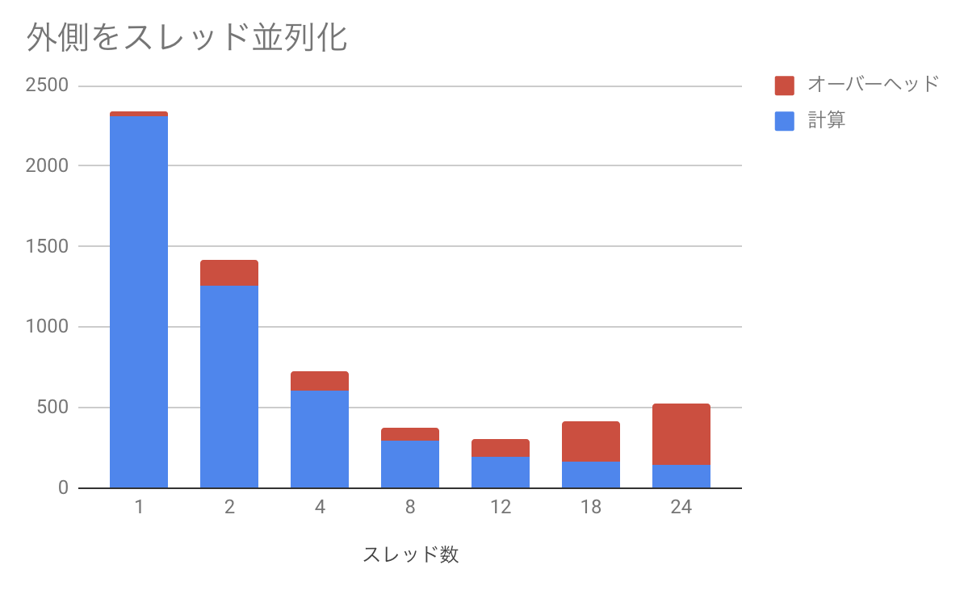

Slide 8
When parallelizing the outer loop
Overhead
Computation
Number of Threads

Slide 9
シングルノード(12コア x 2ソケット)でのスケーリング
実行時間
並列化効率

Slide 10
Scaling on a single node (12 cores x 2 sockets)
Execution time
Parallel efficiency

