Slide 1

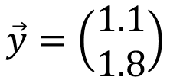



$$y_{2}$$
$$\vec{y}=\left(\begin{matrix}1.1 \\ 1.8\end{matrix}\right)$$
$$\vec{\tilde{y}}=\left(\begin{aligned}a \\ 2a\end{aligned}\right)$$
$$y_{1}$$
$$O$$

Slide 2






$$y_{3}$$
$$\vec{y}$$
$$\vec{\tilde{y}}$$
$$y_{2}$$
$$O$$
$$y_{1}$$

