Slide 1
Logistic Regression: Credit Card Fraud
Utilizing the Logistic Regression algorithm to predict fraudulent credit card transactions

Slide 2
In this notebook you will see the following steps taken:
1. Prepare the data
2. Split the data into training and testing sets
3. Model and fit the data into a logistic regression
4. Predict the testing labels
5. Calculate the performance metrics

Slide 3
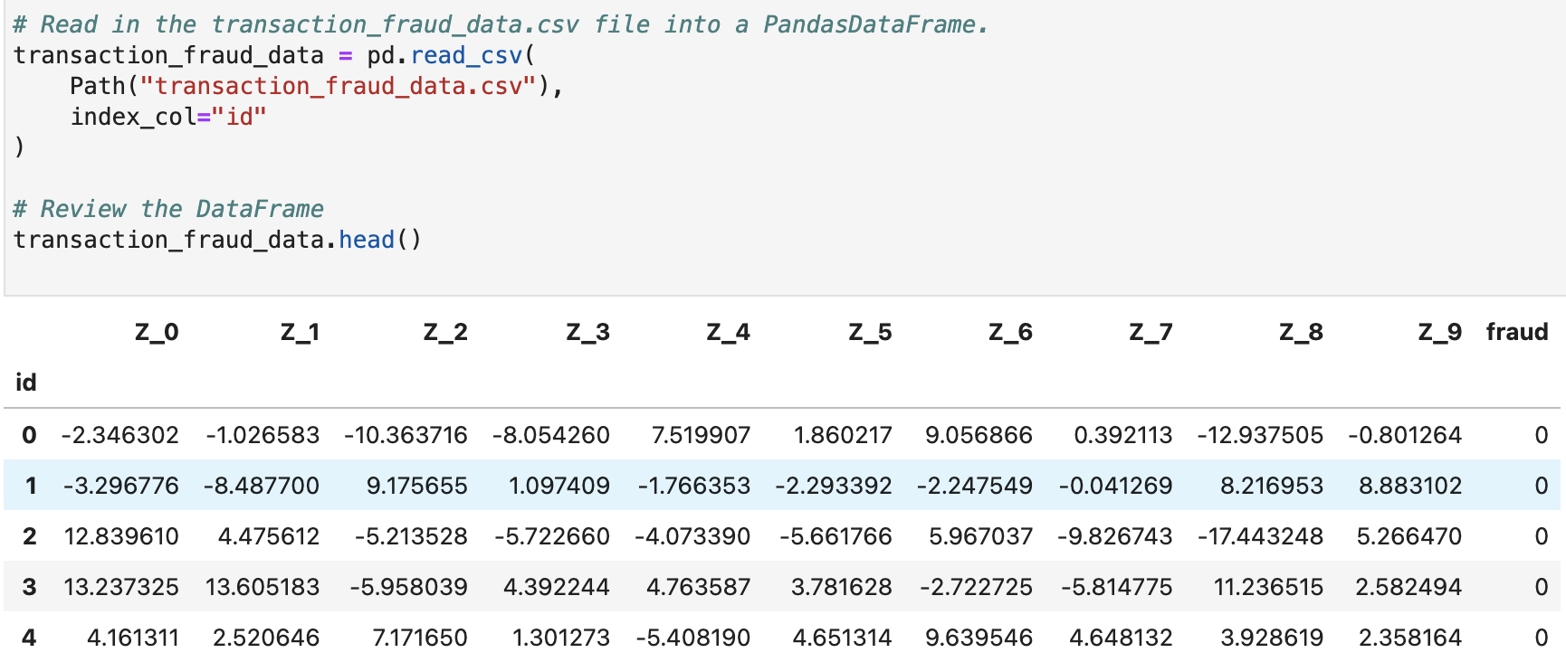
Prepare the Data
1. I will load the `transaction_fraud_data.csv` file into a Pandas DataFrame. I will then set the “id” column as the index.

Slide 4
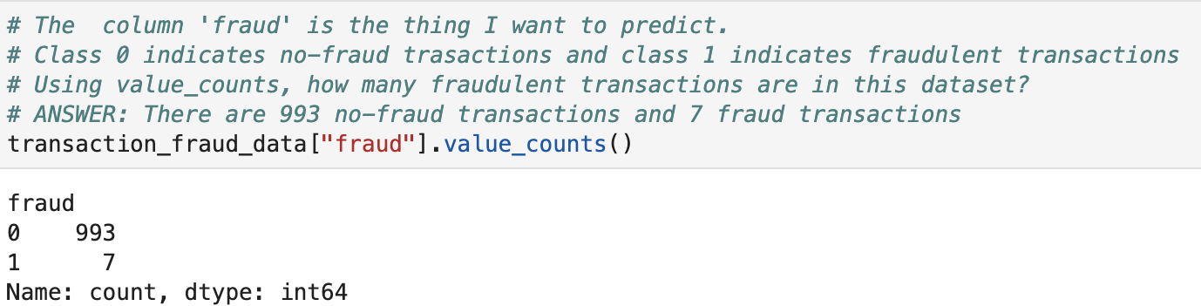
Prepare the Data
2. Note that I will be predicting the `fraud` variable. I will then be able to use 'value_counts' to determine how many fraudulent transactions exist in this dataset.
There are 993 no-fraud transactions, and 7 fraud transactions.

Slide 5
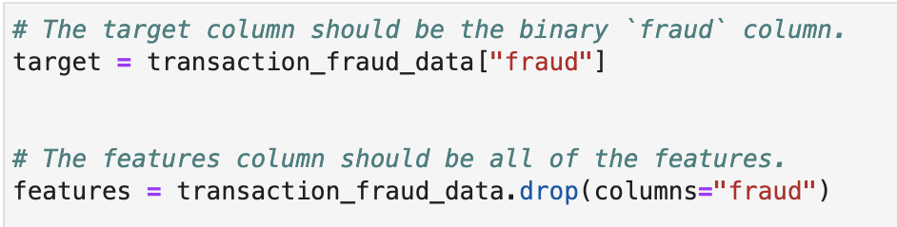
Splitting the Data into Training & Testing Sets
1. Using the `transaction_fraud_data` DataFrame, I will separate the data into training and testing data. I will start by defining the `target` (the “fraud” column) and the `features` of the data (all the columns except “fraud”).
2. I will then split the features and target data into `training_features`, `testing_features`, `training_targets`, and `testing_targets` datasets by using the `train_test_split` function.

Slide 6
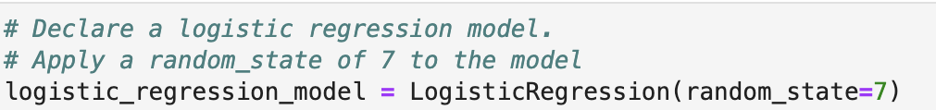
Model & Fit the Data into a Logistic Regression Model
1. I will then declare a `LogisticRegression` model.
2. Next I will fit the training data to the model, and save the model.

Slide 7
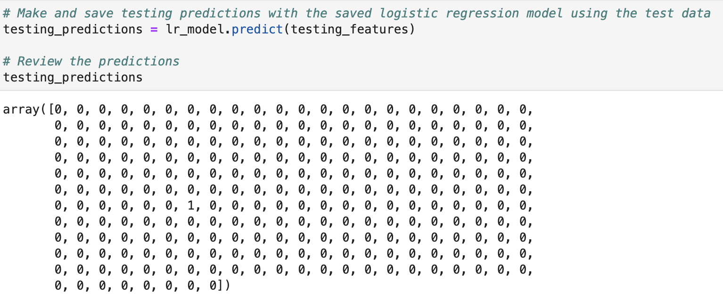
Predict the Testing Labels
I will make predictions about fraud by using the testing dataset, and save those predictions.

Slide 8
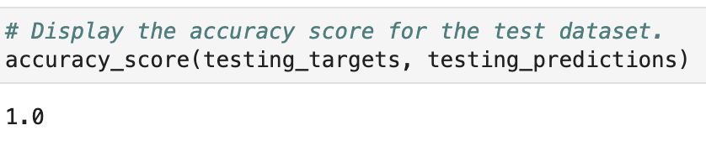
Calculate the Performance Metrics
I will calculate the accuracy score by evaluating `testing_targets` vs. `testing_predictions`.

Slide 9
Conclusion
Q: For this dataset, how well did the model predict the actual fraudulent transactions?
A: For this test data: Accuracy looks extremely good: 100% of the transactions in the test data were accurately categorized by the model. However, based on `value_counts`, there were very few transactions in the data that were actually fraudulent, and so our model could have had high accuracy by simply predicting all transactions to be valid.

