Slide 1
ATM Banking System Course Title: Software Development Project-II Course code: CSE3114
Students | Supervisor
Kaium Miah CE – 15047 3rd Year 1st Semester Session: 2014-15 Dept. of CSE, MBSTU | Lubna Yasmin Assistant Professor Dept. of CSE MBSTU

Slide 2
Table of Content
Introduction
Individual Contribution
Analysis
Methodology
Plan of Work
Example
Conclusion
Reference

Slide 3
Introduction
An automated teller machine (ATM) is an electronic banking outlet that allows customers to complete basic transactions without the aid of a branch representative or teller. Anyone with a credit card or debit card can access cash at most ATMs
In this project, user has the overall capability of using features. User can access all kind of features of the ATM.

Slide 4
Individual Contributions:
Student Information | Requirements Specification | Software Design | Coding | Debugging & Testing | Report Preparation
Kaium Miah CE - 15047 | ✔ | ✔ | ✔ | ✔ | ✔

Slide 5
Analysis
Entry: Every user has to enter the information first.
Balance: Initial value will be provided by user.
Withdraw: User can withdraw cash by using this option. Here the amount has to be multiple of 500.
Deposit: User can deposit any amount. There are no limitations for deposit.
Exit: Leave from the ATM system.

Slide 6
Methodology

Slide 7
PIN ENTRY
No
PIN MATCHED?D?
Yes
System
Balance Check
Withdraw
Deposit
No
Multiple of 500?
Yes
Again Transaction?
Yes
No
Exit

Slide 8
Description
First Information: Every time user has to give the information to use the system. It is a must and it is provided by the user.
Withdraw: Withdraw means; users can take their money form the account. But there is a condition that it should be multiple of 500. If not, withdraw money will be demolished.
Deposit: Here user can input the amount of money he/she want to store. The amount will be added with the previous amount
Exit: It’s a specification where the system will be terminated.

Slide 9
Plan of Work
Project Period – 2021
Activities | Jan | Feb | Mar | Apr | May | Jun | Jul | Aug | Sep
Topic Specification | ***
Software Design | *** | *** | ***
Methodology Development |  |  | *** | ***
Debugging and Testing |  |  | *** | *** | *** | *** | *** | ***
Writing and Editing Report |  |  |  |  |  |  | *** | *** | ***
Project Submission |  |  |  |  |  |  |  |  | ***

Slide 10
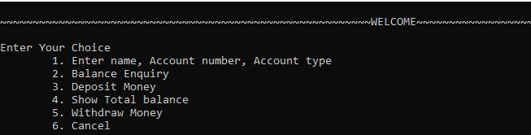
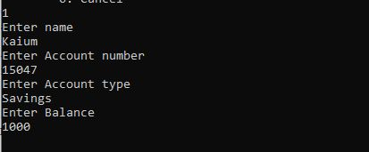
Example

Slide 11
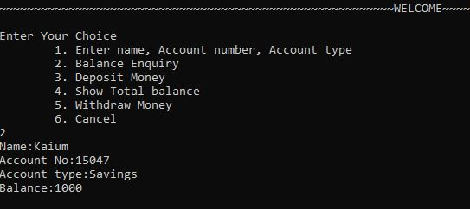
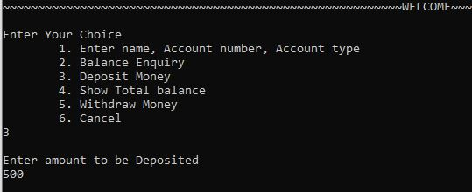
Example Contd.

Slide 12
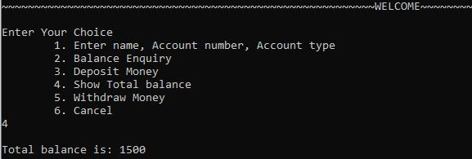
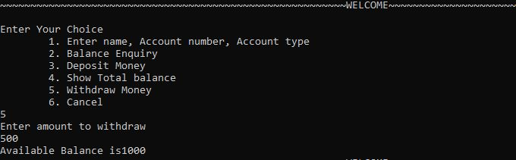
Example Contd.

Slide 13
Conclusion
Here, I try my best to create an easy user interface (UI) for the users in this project.
Starting from the pin and at last exit from the system is totally user friendly. I have created a console UI. User can easily go from one line to another just inputting the choices.

Slide 14
Reference
https://www.tutorialspoint.com/java/java_environment_setup.htm
https://www.guru99.com/c-loop-statement.html
https://www.investopedia.com/terms/a/atm.asp
https://www.tutorialspoint.com/cprogramming/switch_statement_in_c.htm
https://en.wikipedia.org/wiki/Switch_statement
https://www.tutorialspoint.com/use-of-fflush-stdin-in-c

