Slide 1

Data Analysis Project
(Using PowerBI and MySQL)
Created By-Kaival Shah

Slide 2
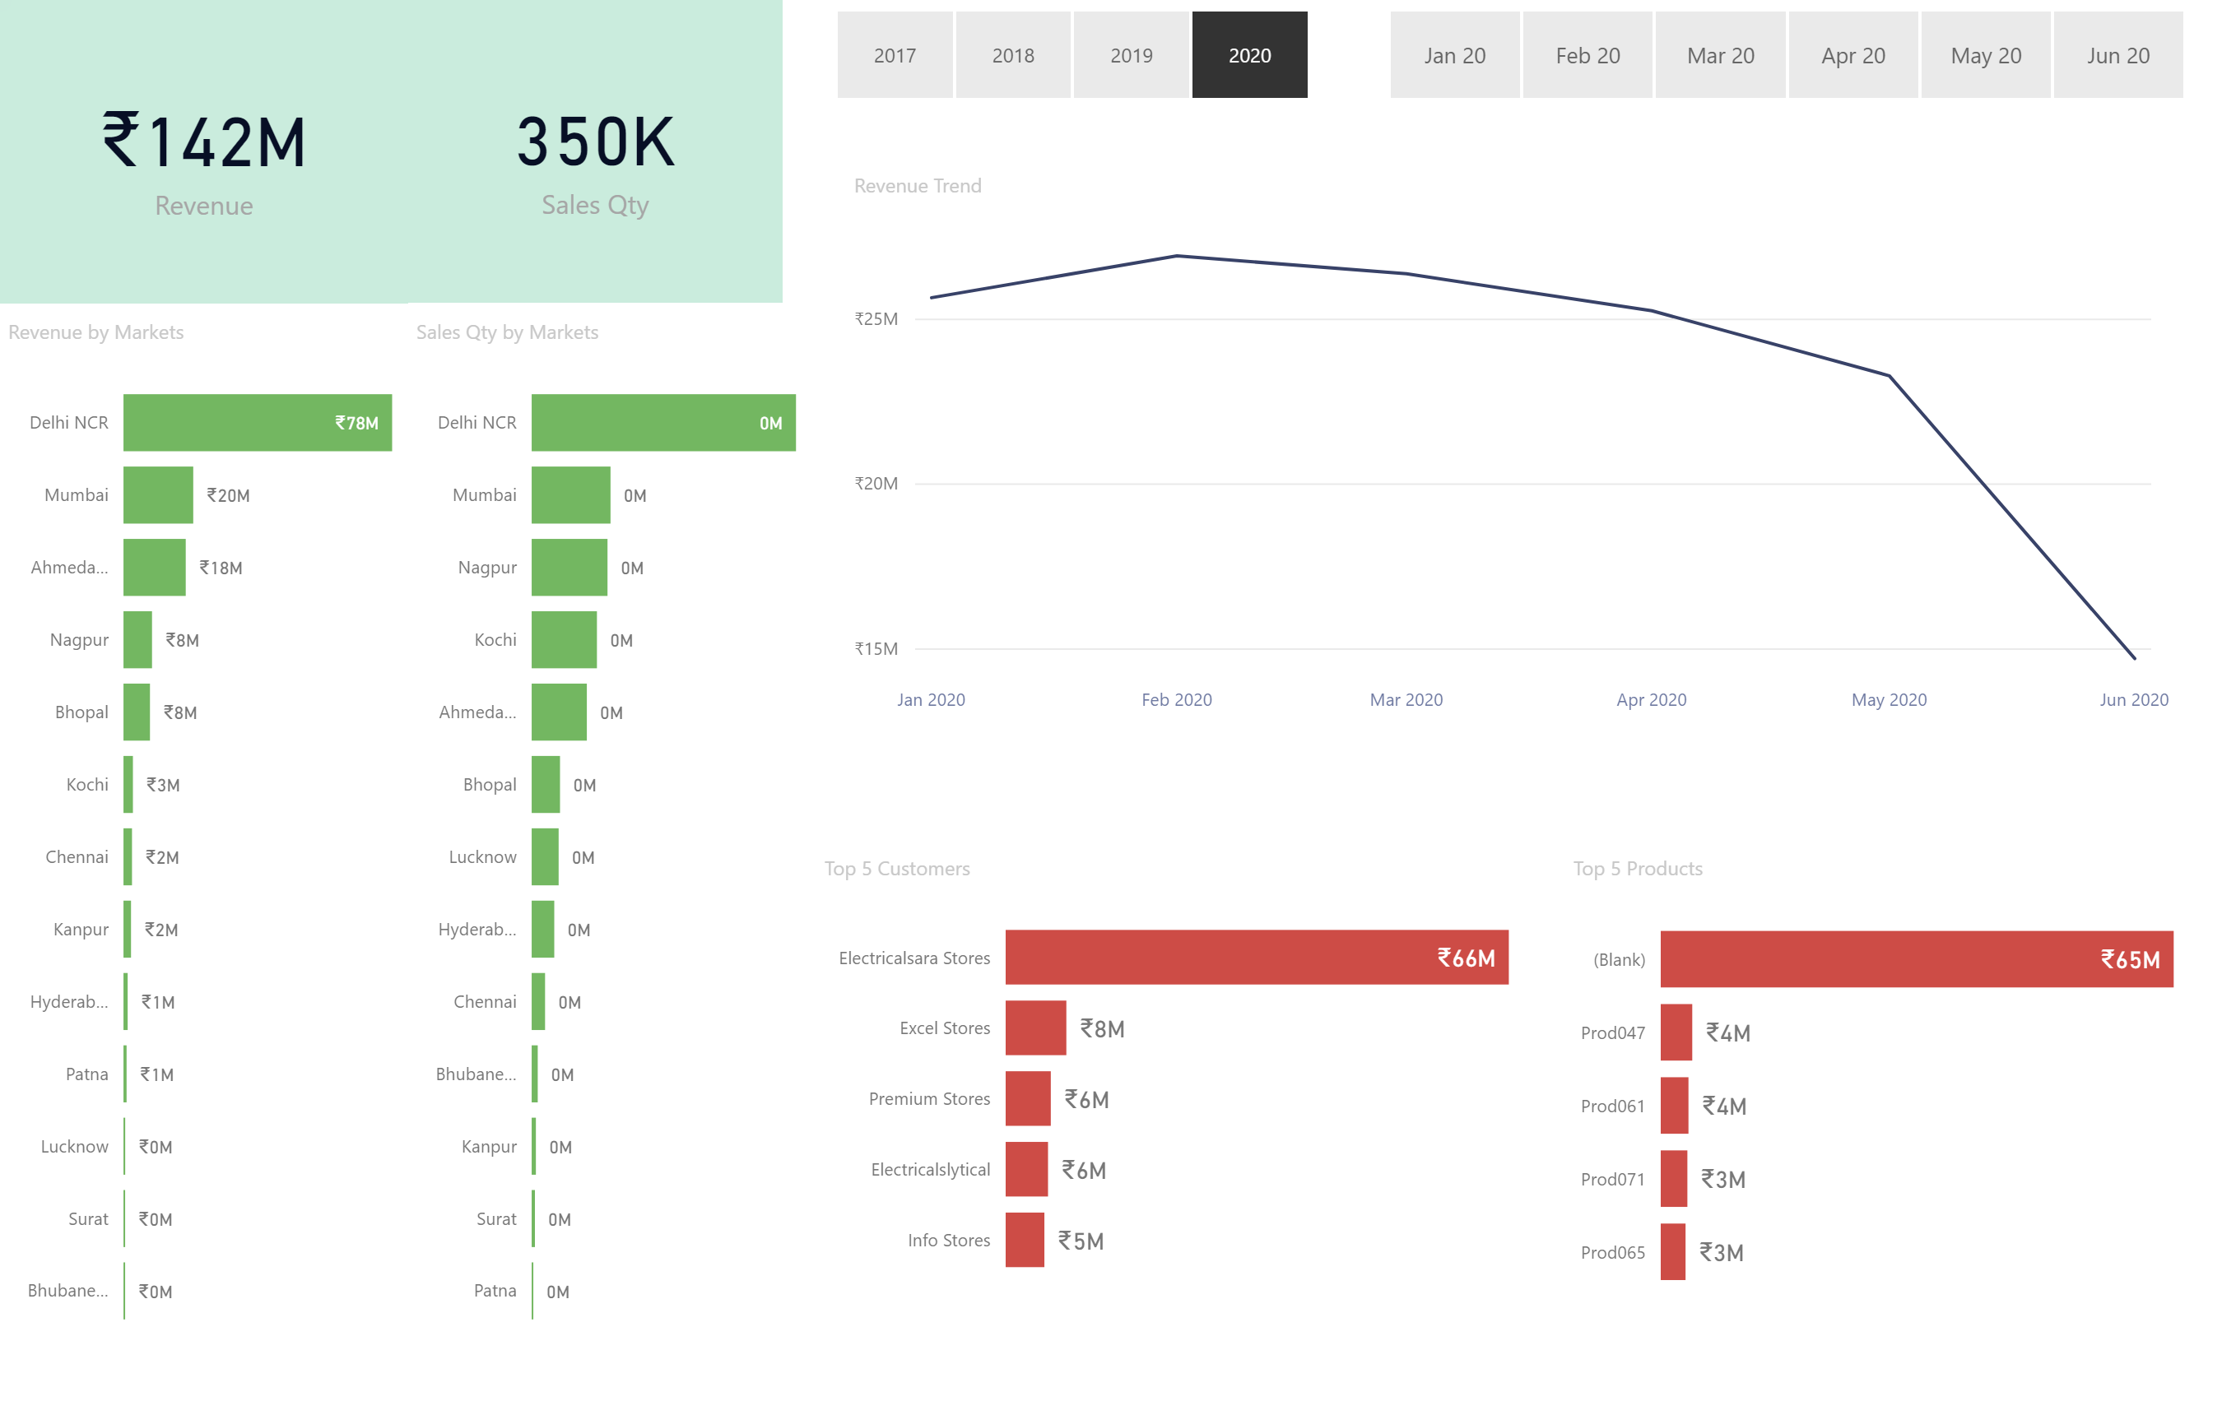

Slide 3
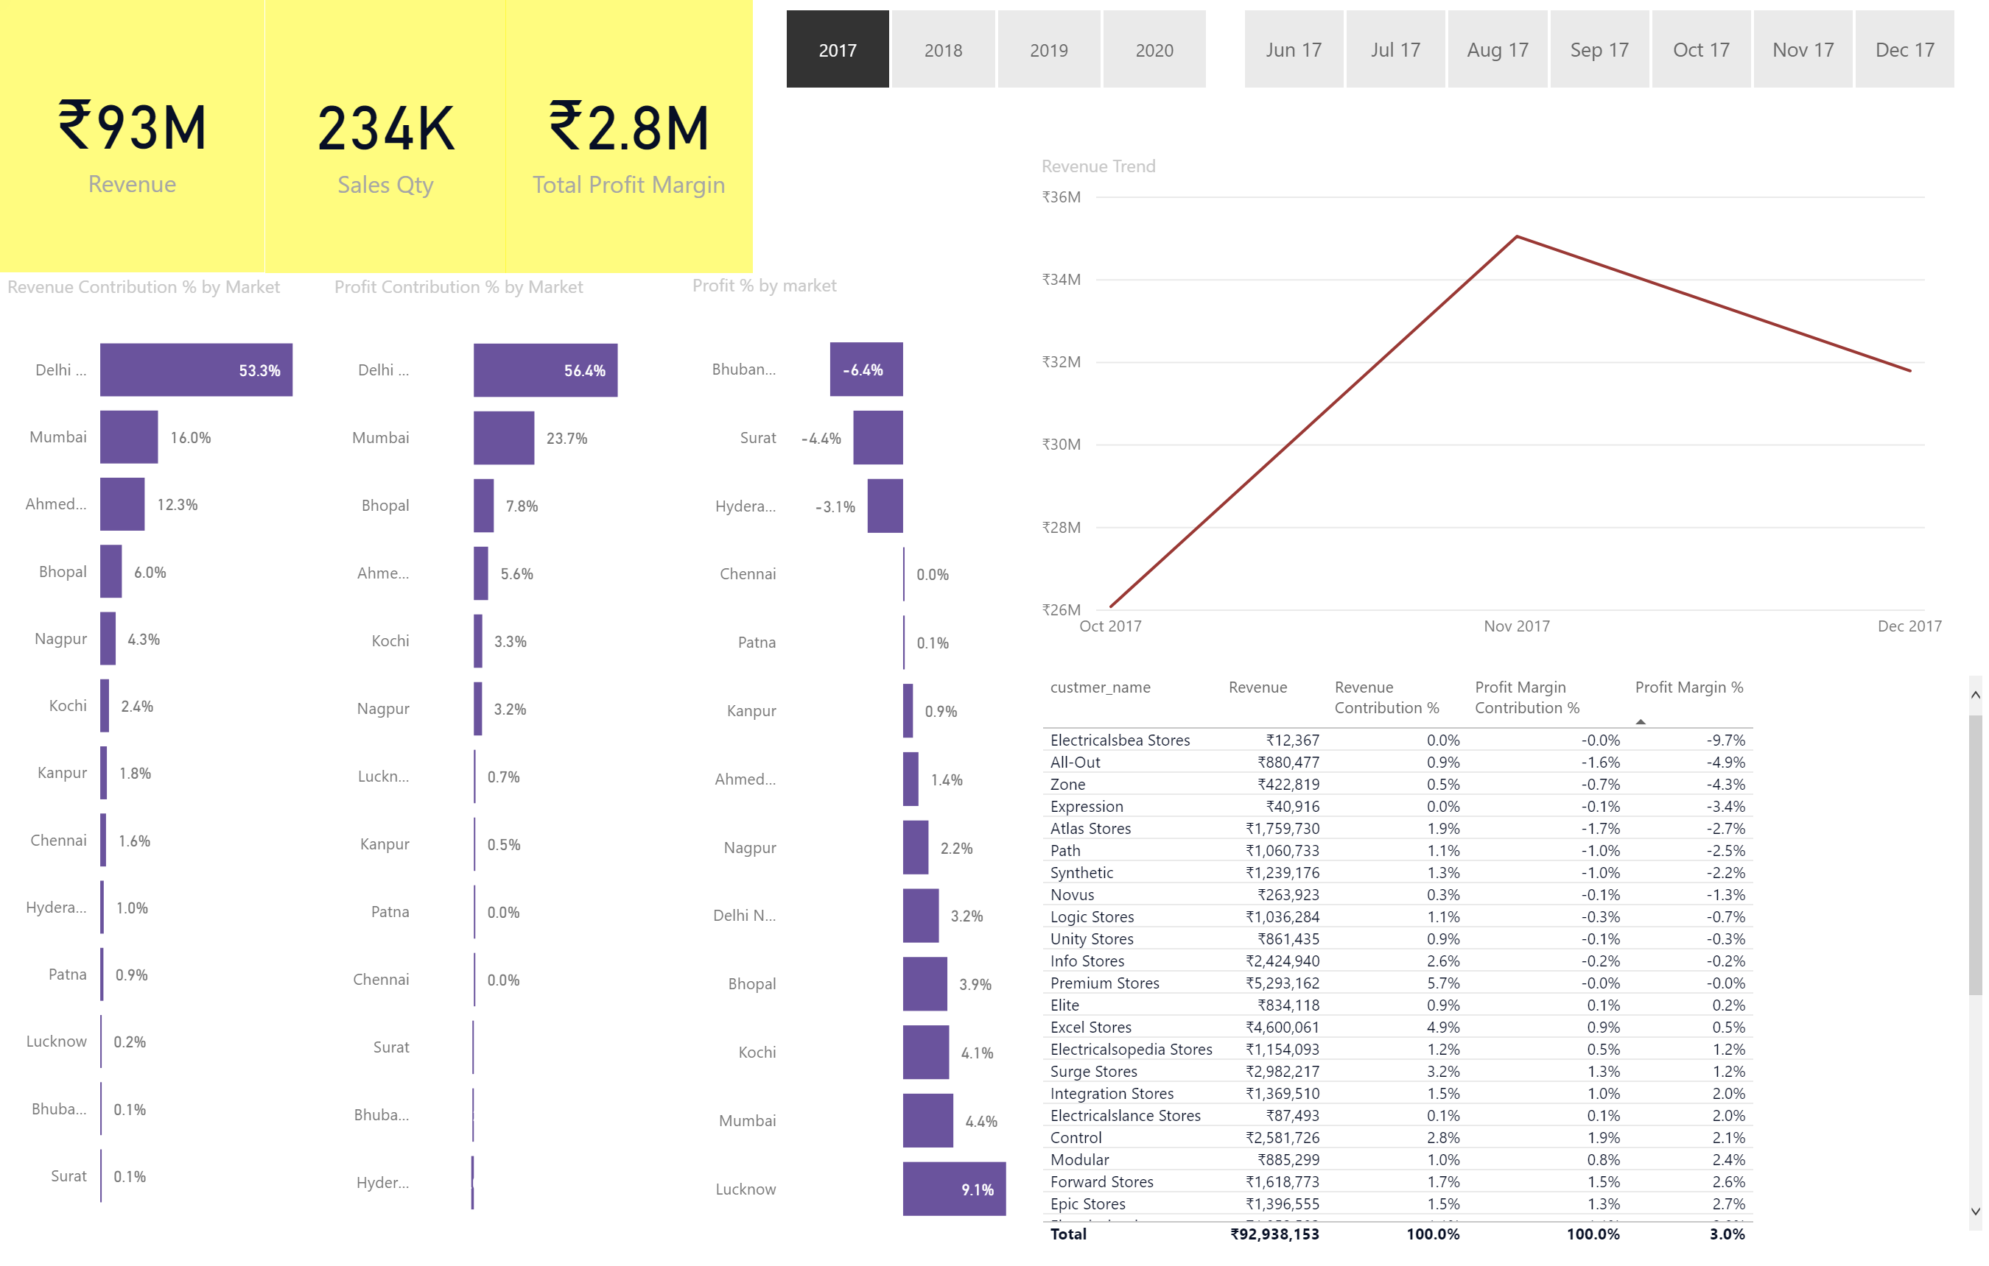

Slide 4
