Slide 1

AI-Based Drone Search & Rescue in Disaster Zones
MISSION ACTIVE
MISSION CLASSIFICATION: PROPOSED SYSTEM · ACADEMIC CASE STUDY
POSSIBLE SURVIVOR?
Intelligent Search Planning for Faster Emergency Response
MISSION TEAM
Shujaat Khan
Kaivalya Khandeshe
Ritesh Talpade
202501110017
202501110016
202501110005
Artificial Intelligence · MSE Group Presentation
SCAN SECTOR · DISASTER ZONE
Notes:
PRESENTER: Shujaat Khan
Imagine the first hours after an earthquake. Buildings have collapsed, roads are blocked, and nobody knows exactly where survivors are. Our project proposes how an AI-powered drone could decide where to search and how to get there efficiently.
Introduce the three of you and say who covers what: Shujaat = problem, system and AI concepts (slides 2-4); Kaivalya = search space and the A* walkthrough (slides 5-8); Ritesh = why A*, limits, impact and conclusion (slides 9-12).
Stress: this is a PROPOSED system and an academic case study, not a deployed product.

Slide 2
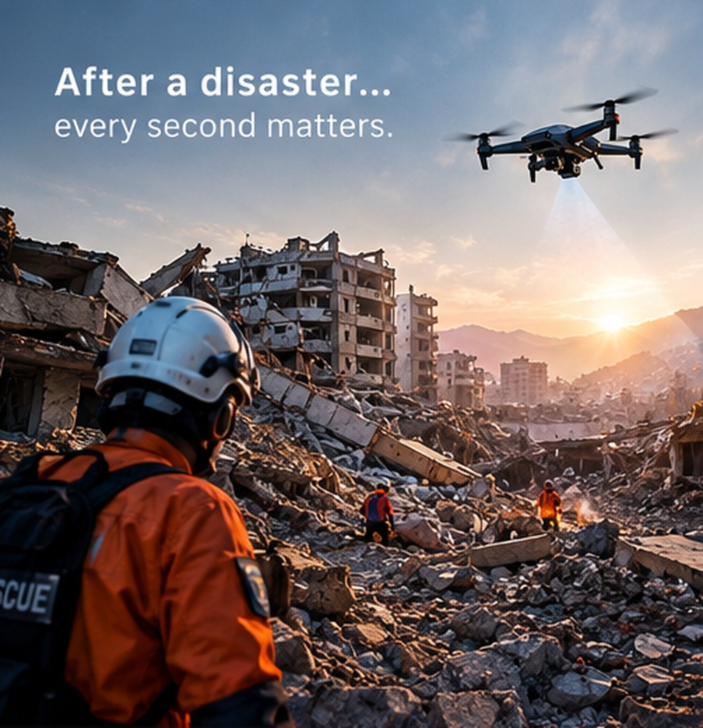

Why conventional search is hard
PHASE 01 · PROBLEM & DOMAIN
GROUND TEAM
AI-ASSISTED DRONE
ACCESS
Roads blocked by debris, unstable ground
Flies over rubble and water
VIEW
Survivors hidden, limited line of sight
Wide aerial view of the whole zone
RISK
Aftershocks; rescuers enter unknown areas
Scouts first, so no one is exposed
SEARCH
Slow, manual, hard to prioritise
Systematic, planned with A*
DOMAIN: DISASTER MANAGEMENT & EMERGENCY RESPONSE
Intended benefits of the proposed design. The drone supports rescuers; it does not replace them.
RUBRIC · PROBLEM & DOMAIN · 2 MARKS
Notes:
PRESENTER: Shujaat Khan
Use the photo: a collapsed neighbourhood, a rescuer on the rubble, a drone overhead. Name the application domain clearly: disaster management and emergency response.
Walk down the four rows, one short sentence each. ACCESS: roads are blocked and the ground is unstable. VIEW: survivors are hidden and a person on the ground sees very little. RISK: aftershocks, and rescuers walk into unknown areas. SEARCH: manual searching is slow and hard to prioritise. The right-hand column is what the drone changes.
Say clearly that these are INTENDED benefits of our proposal, not proven results, and that the drone supports rescuers, it does not replace them.
KEY POINT: we understand the real problem and its domain, and there is a clear need that motivates an AI solution.

Slide 3

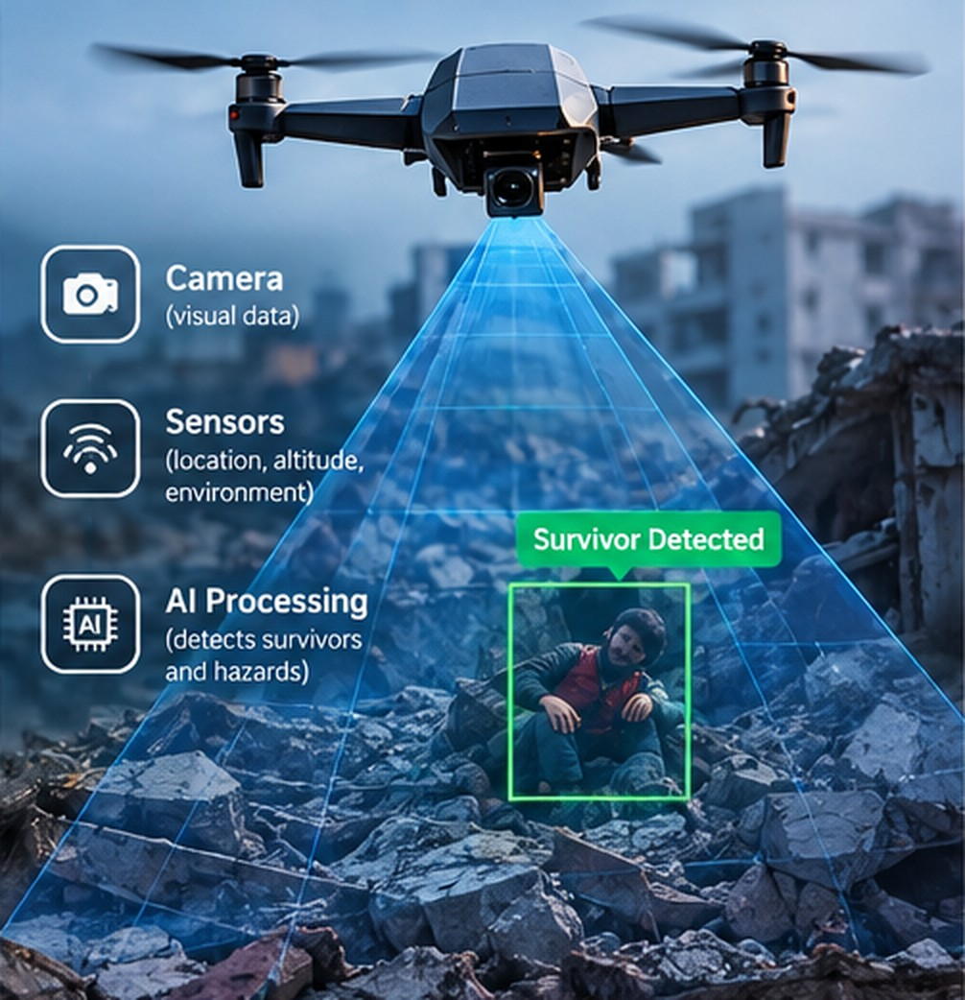






Our proposed system: from camera to rescue
PHASE 02 · PROPOSED SYSTEM
Disaster zone
Environment
Camera & sensors
Hardware
SEE
AI perception
Computer vision
Survivor detection
Candidate target
State space
Grid of positions
THINK
A* search
f = g + h
Navigation
Fly planned path
ACT
Rescue
Human team
SEE · AI PERCEPTION FEED
AI component
Hardware / action
PROPOSED SYSTEM · NOT A DEPLOYED PRODUCT
RUBRIC · AI SOLUTION & IMPACT · 3 MARKS
Notes:
PRESENTER: Shujaat Khan
Walk the pipeline top to bottom, then point at the photo. The camera and sensors are hardware. AI starts at perception, where computer vision analyses the frames (the picture on the right: camera, sensors, AI processing, and a green box on a possible survivor).
SEE = disaster zone to survivor detection. Detection gives a CANDIDATE survivor location, which becomes the GOAL.
THINK = the environment becomes a state space, and A* plans the route to that goal.
ACT = the drone flies the planned path and human rescuers take over.
Emphasise: cyan = where AI is used. Grey = hardware or action. This is a design proposal, not a product that exists.
KEY POINT: a complete, clearly structured AI solution with the AI components explicitly identified.

Slide 4
How the drone “thinks”: five AI concepts
PHASE 03 · AI CONCEPTS
1
Intelligent Agent
LOOP
PERCEIVE
Senses the zone → chooses a move → flies it
4
A* Search
DECIDE
Uses path cost and estimated distance to find the optimal route.
2
Computer Vision
PERCEIVE
Camera frames → “possible person” detected
DRONE AGENT
5
Goal-based planning
PLAN
Goal: reach the survivor at minimum cost
3
State Space
REPRESENT
ACT
DECIDE
Each drone position (grid cell) = one state
repeats until the survivor is reached
RUBRIC · FUNDAMENTAL AI CONCEPTS · 5 MARKS
Notes:
PRESENTER: Shujaat Khan
Give each concept ONE drone-specific sentence, and point at the loop in the middle (perceive, decide, act, repeat).
1. Intelligent agent: the drone senses its environment, chooses an action (move one cell) and acts, again and again.
2. Computer vision: camera frames go into a trained object detector that outputs a CANDIDATE survivor with a confidence level; that location becomes the goal.
3. State space: a state is the drone's grid cell; an action is a one-cell move; the goal test is "is this the survivor cell?".
4. Heuristic search: A* uses an estimated remaining distance to decide which state to expand next.
5. Goal-based planning: the agent has an explicit goal (reach the survivor) and plans a minimum-cost path to it.
Hand over to Kaivalya: "Now let's see what the state space looks like."
KEY POINT: we APPLY the five concepts to our specific drone, we do not just define them.

Slide 5
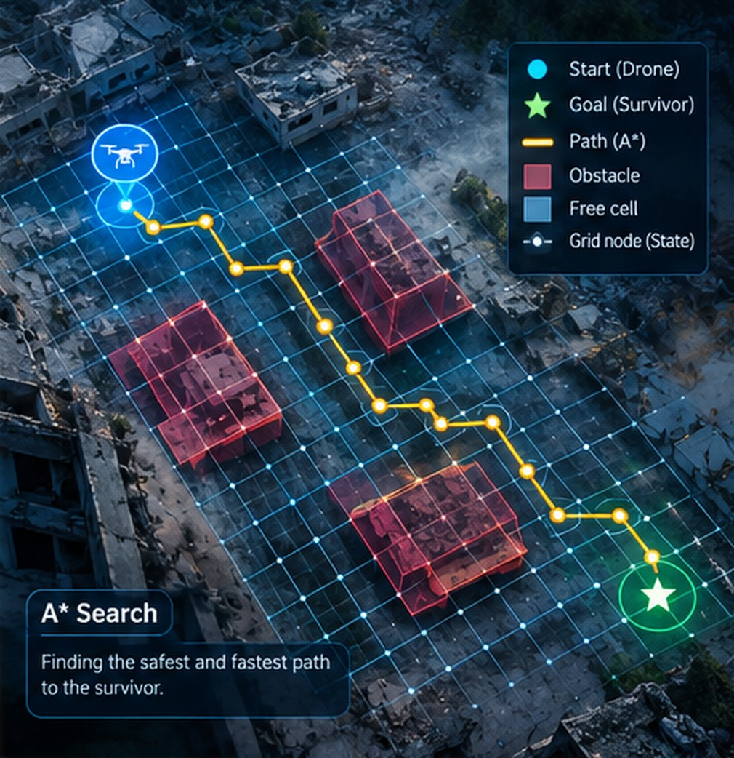

The disaster zone becomes a search space
PHASE 04 · SEARCH SPACE
WHAT THE DRONE SEES · AERIAL VIEW + GRID
SIMPLIFIED MODEL · 6×5 GRID
PROBLEM FORMULATION
A
B
C
D
E
F
1
STATE
One free cell = one possible drone position
2
ACTIONS
3
S
G
Up · Down · Left · Right
4
COST
1 per move
5
GOAL TEST
Drone start (S)
Survivor (G)
Is the drone at F3, the survivor cell?
Illustrative view: every free grid node is a state, red blocks are obstacles. Our worked example uses a simplified model.
Blocked
Free = state
Simplified model: 6×5 grid, 4 blocked cells
RUBRIC · STATE SPACE · A* SETUP
Notes:
PRESENTER: Kaivalya Khandeshe
Start with the picture on the left: this is what the drone's map could look like after we lay a grid over the aerial view. Free cells are possible positions, red blocks are collapsed areas. (It is an illustrative image; the path drawn in it is not our worked example.)
The arrow takes us to the simplified model we will actually calculate on: 6 columns A to F, 5 rows, drone at A3, survivor at F3, collapsed cells C2, C3, C4 and D1.
Explain the formulation on the right: every free cell is a state; moving to a neighbouring cell is an action costing 1; the goal test is "are we at F3?".
Point out that the wall C2-C4 sits directly between the drone and the survivor, and D1 closes the gap at the top. That is what makes the problem interesting. Say clearly this is a simplified model; real maps are noisier.
KEY POINT: the state space is correctly formulated: states, actions, step cost and goal test.

Slide 6

Why A* search?
PHASE 05 · A* DECISION
f(n) = g(n) + h(n)
WHY IT FITS OUR DRONE
The goal location is known
Computer vision supplies it
g(n)
h(n)
Every move has a cost
cost already travelled
estimated cost remaining
Time and battery
S
n
G
We want the cheapest path
Drone
Current state
Survivor
Not just any path
OUR h(n): MANHATTAN DISTANCE
f(n)
total estimated cost of a path through n
|Δcol| + |Δrow|
e.g. h(A3) = 5 + 0 = 5
Informed search · Complete · Optimal when h never overestimates (Manhattan distance never does on our grid)
RUBRIC · SEARCH STRATEGY IDENTIFIED · 3 MARKS
Notes:
PRESENTER: Kaivalya Khandeshe
"g is what we have already spent to reach this state. h is our estimate of what is left. f is the sum, and A* always expands the state with the lowest f."
Our h is Manhattan distance: columns to go plus rows to go. It ignores the walls, so it can never be larger than the true remaining cost. That is why A* stays optimal here.
Link the three "why it fits" reasons to the drone: the goal is known (computer vision supplies it), every move costs time and battery, and we want the cheapest path, not just any path.
KEY POINT: we correctly identify and define A* and its heuristic, and tie it to the problem.

Slide 7
A* in action: the first decision
PHASE 05 · A* IN ACTION · 1 / 2
A
B
C
D
E
F
A* STEPS 1–2 OF 6
1
h=7
h=6
h=5
h=3
h=2
Start at S and evaluate the neighbours
The drone starts at A3 and every free cell shows its estimate h(n) to F3. From A3 it can move to B3, A2 or A4; each move costs 1, so g = 1 for all three.
2
7
1+6
h=5
h=3
h=2
h=1
↑
OPEN LIST · A* EXPANDS THE LOWEST f NEXT
3
5
0+5
5
1+4
h=2
h=1
h=0
S
G
NODE | g | h | f = g + h | RESULT
B3 | 1 | 4 | 1+4 = 5 | ◀ next
A2 | 1 | 6 | 1+6 = 7 | waits
A4 | 1 | 6 | 1+6 = 7 | waits
→
4
7
1+6
h=5
h=3
h=2
h=1
↓
5
h=7
h=6
h=5
h=4
h=3
h=2
h(B3) = |col B→F| + |row 3→3| = 4 + 0 = 4
g(B3) = 1 → f(B3) = 1 + 4 = 5
Current
Open list
Expanded
Blocked
Lowest f wins: 5 < 7, so B3 is expanded first. Notice h ignores the wall at C2–C4.
Cell: f = g + h · arrow = move that reached it · grey = h only
RUBRIC · A* APPLICATION · 5 MARKS
Notes:
PRESENTER: Kaivalya Khandeshe
Say: "The drone starts at A3. The small grey numbers are h, the Manhattan estimate to F3. Notice A3 is 5 away, and the wall is in the way. h does not know about the wall."
"From A3 the drone can move to B3, A2 or A4. Each costs 1, so g = 1. h for B3 is 4, for A2 and A4 it is 6. So f is 5 for B3 and 7 for the others. Lowest f wins, so B3 is expanded first."
Do the calculation aloud from the banner: B3 is one step from the start, so g = 1; it is four columns from the goal on the same row, so h = 4; f = 5.
What happens next (say it briefly, the next slide shows the result): A* expands B3 and finds B2 and B4 (f = 7). It then works through every f = 7 state, and only when those run out does it move on to f = 9.
KEY POINT: A* is visibly working and we can compute it ourselves.

Slide 8
A* in action: the dead end, then the finish
PHASE 05 · A* IN ACTION · 2 / 2
A
B
C
D
E
F
A* STEPS 3–6 OF 6 · FINAL FRAME
1
9
2+7
9
3+6
9
4+5
The C1 trap, then the finish
✖
↑
↑
→
After every f = 7 state is expanded, the open list holds only f = 9. C1 is tried first (lowest h) but C2 and D1 are blocked, so it leads nowhere. A* drops it and follows the open lower route.
2
7
1+6
7
2+5
11
8+3
11
9+2
↑
↑
↑
↑
3
5
0+5
5
1+4
9
7+2
9
8+1
9
9+0
NODE | g | h | f = g + h | RESULT
C1 | 4 | 5 | 4+5 = 9 | ✖ dead end
B5 | 3 | 6 | 3+6 = 9 | ✔ expand
S
G
→
↑
→
→
4
7
1+6
7
2+5
9
6+3
9
7+2
↓
↓
↑
→
RESULT
5
9
2+7
9
3+6
9
4+5
9
5+4
9
6+3
A3 → B3 → B4 → B5 → C5 → D5 → D4 → D3 → E3 → F3
Total cost = 9 moves · 15 of 26 free cells expanded
↓
↓
→
→
→
A* returns a minimum-cost path; other equal-cost routes exist (e.g. via A4–A5). The top route is a dead end and a detour via D2–E2–F2 would cost 11.
On the path
Open list
Expanded
Blocked
Cell: f = g + h · arrow = move that reached it · ✖ = dead end
RUBRIC · A* APPLICATION · 5 MARKS
Notes:
PRESENTER: Kaivalya Khandeshe
KEY MOMENT. Say: "Once the f = 7 states are finished, the open list contains only f = 9 states. The tie is broken by lowest h, so A* expands B1 and then C1, which looks promising. But C2 and D1 are blocked, so C1 leads nowhere. A* is not lost: this is exactly the trap. It drops C1 and moves on to the next open state, B5."
"From B5 the search follows the open lower route: C5, D5, D4, D3, E3 and F3, with f staying at 9 the whole way. Total cost 9. Of 26 free cells, A* expanded only 15."
Also say, precisely: other equal-cost routes exist (for example via A4 and A5), so A* finds A minimum-cost path, not the only one. The top route is a dead end, and a detour through D2, E2, F2 would cost 11.
The amber cells are generated but never expanded; the 5 blank cells were never even generated.
Hand over to Ritesh: "Why A* and not the other search methods?"
KEY POINT: the result is justified with numbers (dead end vs 11 vs 9), and every figure matches the grid.

Slide 9
Why A* over other search methods?
PHASE 06 · JUSTIFICATION
BFS
DFS
Greedy
A*
LOOKS AT
LOOKS AT
LOOKS AT
LOOKS AT
g only
none
h only
g + h
distance from start
goes deep first
estimated distance to goal
cost so far + estimate to go
WEAKNESS / STRENGTH
WEAKNESS / STRENGTH
WEAKNESS / STRENGTH
WEAKNESS / STRENGTH
Expands in every direction
Wanders; path not shortest
Can be misled; no guarantee
Directed and guaranteed minimum
23
states expanded
20
states expanded
15
states expanded
15
states expanded
path cost 9
path cost 11
path cost 9
path cost 9
finds cost 9, but searches widely
not the cheapest
matches A* here by luck of the layout
cost 9 guaranteed minimum
Cost so far + estimate to go
Counts from our 6×5 demo grid · tie-break: lowest h, then top to bottom · neighbours: up, down, left, right
RUBRIC · JUSTIFICATION · 2 MARKS
Notes:
PRESENTER: Ritesh Talpade
Frame it like this: g alone and h alone are each incomplete, and A* combines them.
BFS looks only at distance from the start, so it spreads in every direction (23 states expanded here). DFS dives deep and ended with a longer path of cost 11 (20 expanded). Greedy looks only at the estimate; on this small grid it happened to match A* (15 expanded, cost 9), but it has no guarantee of the cheapest path and can be misled by walls. A* expanded 15 states and its cost-9 path is guaranteed minimum because h never overestimates.
Be honest about Greedy: do NOT claim it failed on our grid; say it has no guarantee. These figures come from our own toy grid (goal test on expansion, neighbour order up/down/left/right), not from a general benchmark.
KEY POINT: the choice of A* is justified from the problem's needs, with numbers we actually computed.

Slide 10
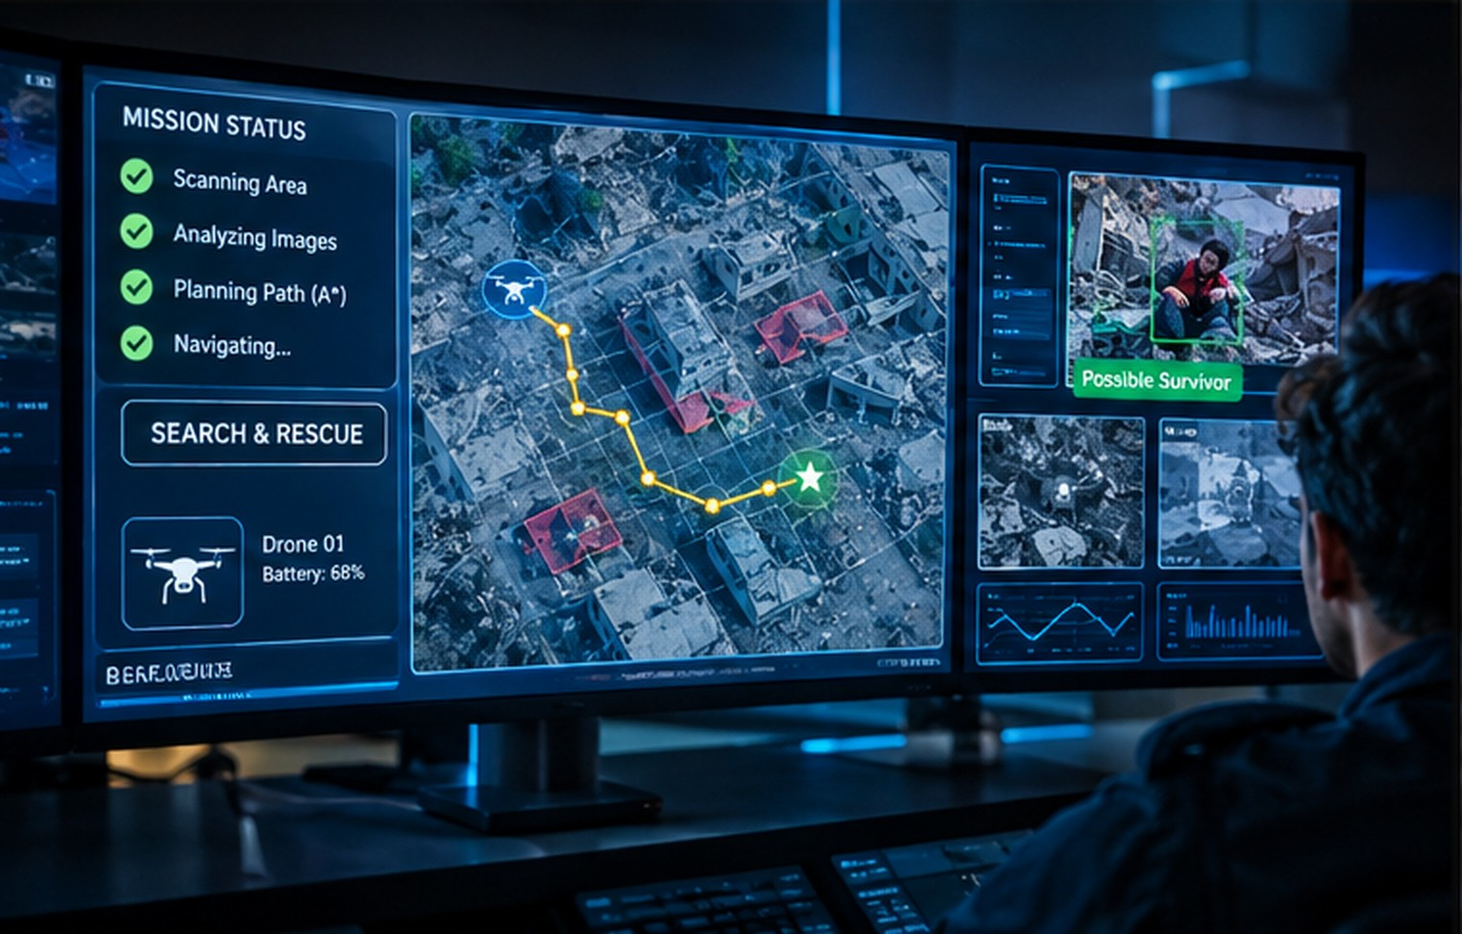








Limitations and where we go next
PHASE 07 · LIMITATIONS & FUTURE SCOPE
CHALLENGE
NEXT STEP
Battery limits
Multi-drone coordination
Share the search area
Weather conditions
More robust detection
Improved computer vision
Damaged or uncertain maps
Dynamic path planning
Re-plan when the map changes
MISSION CONTROL · COORDINATOR VIEW
Communication loss
Onboard real-time mapping
Build the map on the drone
HUMAN-IN-THE-LOOP
False survivor detection
The drone only reports a possible survivor. A coordinator confirms it on the mission screen before rescuers move.
Human confirmation
Confidence thresholds + coordinator check
RUBRIC · LIMITATIONS & FUTURE SCOPE
Notes:
PRESENTER: Ritesh Talpade
Be upfront about the limits, and read the rows as pairs: each challenge on the left has a next step on the right.
Battery: several drones can share the search area. Weather: improved computer vision. Damaged or uncertain maps: dynamic path planning (re-planning algorithms such as D* Lite exist for this). Communication loss: the drone builds its own map onboard. False detections: confidence thresholds, and a human confirming before rescuers move.
Point at the mission-control picture: this is the human-in-the-loop idea. The drone proposes, a coordinator confirms. Our grid is a simplification and real disaster maps are noisier.
KEY POINT: we understand the limits of our approach and have realistic ideas for improving it.

Slide 11
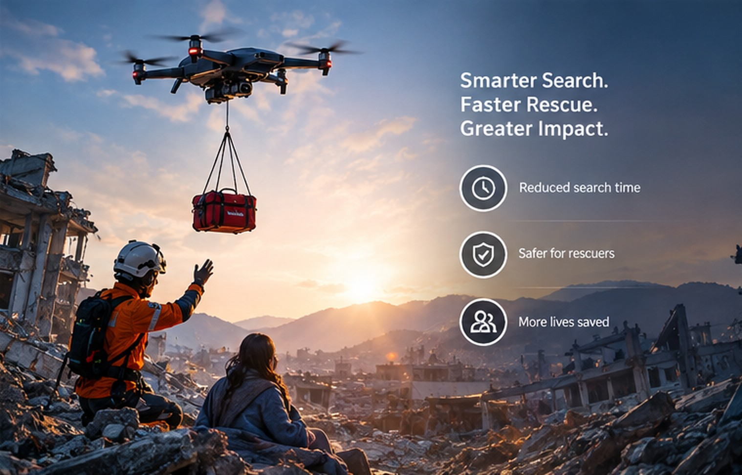



Expected impact of the proposed system
PHASE 08 · EXPECTED IMPACT
EXPECTED OUTCOMES · TO BE VALIDATED
Faster search
Efficient navigation
Aerial scouting covers ground before teams enter
A* plans a minimum-cost route to each target
Reduced search area
Lower rescuer exposure
Heuristic guidance avoids exploring everything
The drone checks unsafe zones first
OUTCOME · ILLUSTRATIVE
Better emergency response
Scalable assistance
Expected benefits of the proposed design, to be validated through simulation or field testing. No figures are claimed.
A clearer picture for coordinators
Larger zones, more drones, same planning idea
RUBRIC · SOLUTION IMPACT · 3 MARKS
Notes:
PRESENTER: Ritesh Talpade
Present these as EXPECTED outcomes and link each to a mechanism: aerial scouting (faster search), A* (efficient navigation), the heuristic (reduced search area), scouting before entry (lower rescuer exposure), a clearer picture on the coordinator's screen (better response), and more drones over larger zones (scalable).
The photo shows the goal: a drone supports the rescuer, who reaches the survivor. Do not quote percentages: we have no experimental results, and testing in simulation or the field would be needed.
KEY POINT: the impact is realistic and honest, and linked to the AI components we described.

Slide 12

AI + Drone + A* = Intelligent Disaster Response
MISSION COMPLETE
SENSE
THINK
SEARCH
REACH
RESCUE
Camera sees the zone
State space + goal
A* with f = g + h
Survivor located
Human team takes over
AI perceives, A* plans, the drone acts, and people rescue.
QUESTIONS WELCOME
RUBRIC TRAIL · WHERE EACH PART WAS COVERED
PROBLEM
SOLUTION
AI CONCEPTS
A* IDENTIFIED
A* APPLIED
A* JUSTIFIED
IMPACT
slide 2
slide 3
slides 4–5
slide 6
slides 7–8
slides 8–9
slides 10–11
Proposed system, academic case study: all benefits are expected, not measured.
Notes:
PRESENTER: Ritesh Talpade
One sentence per verb. SENSE: the camera sees the zone. THINK: we turn it into a state space with a goal. SEARCH: A* uses f = g + h to choose the route. REACH: the survivor location is reached. RESCUE: human teams take over.
Close: "AI perceives, A* plans, the drone acts, and people rescue. It is a proposed design, and we have shown exactly how the search works." Point to the rubric trail so the evaluator can see where each part was covered, then invite questions.
KEY POINT: the story is complete and every rubric area is visibly covered.

