Slide 1
Course : Engineering Plus Subject : Machine Learning
Subject Faculty : Dr. Gayatri S Pandi
Day 1

Slide 2




Key Takeaways for Day 1 : Session 1
Python Collection
Python DataFrames
Visualization
Assignments
Introduction to Machine Learning
Descriptive Statistics

Slide 3

Introduction to Data in Machine Learning
DATA:
Data refers to the set of observations or measurements that can be used to train a machine-learning model.
INFORMATION:
Data that has been interpreted and manipulated and has now some meaningful inference for the users.
KNOWLEDGE:
Combination of inferred information, experiences, learning, and insights.

Slide 4
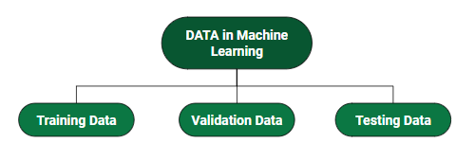
Data Split in Machine Learning
Training data is used to train a machine learning model to predict an expected outcome.
Testing Data is used to perform a realistic check on an algorithm.
It confirms if the machine learning model is accurate.
A validation dataset does not teach a model. Validation sets are used to reveal biases, so that the model can be adjusted to produce unbiased results.
A validation set indirectly affects a machine learning model.

Slide 5
Some Important Python libraries for Machine Learning
Scikit-learn (Sklearn)
NumPy
Matplotlib
Seaborn
Pandas
SciPy

Slide 6

Why Python?

Slide 7
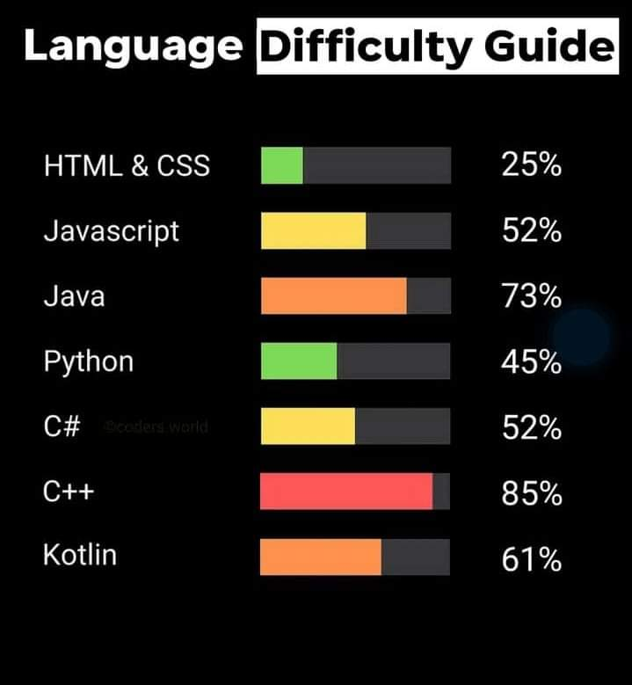
Why Python?

Slide 8
Example Aim : To know python version
from platform import python_version
print(python_version())
#Checking the version of python
#Output
3.11.4

Slide 9
Example Aim : To know python version
import sys
print(sys.version)
#Checking the version of python
#Output
3.11.4 | packaged by Anaconda, Inc. | (main, Jul 5 2023, 13:38:37) [MSC v.1916 64 bit (AMD64)]

Slide 10
Collections in Python Collections are the containers used for storing the data.
tuples
lists
sets
dictionaries
The built-in data structures in python are :

Slide 11
Python List
List is just like dynamic-sized arrays, declared in other languages (ArrayList in Java).
Lists need not be homogeneous always
The list is surrounded by brackets [] (square brackets)
List is a collection which is ordered and changeable. Allows duplicate members.
Applications of Python List
Useful for Array operations

Slide 12
Python code for List
# Lists
l = []
# Adding Element into list
l.append(5)
print("Adding in list", l)
# Popping Elements from list
l.pop()
print("Popped one element from list", l)
print(type(l))

Slide 13
Python Tuple
Tuples are used to store multiple items in a single variable.
Tuple items are ordered, unchangeable(immutable), and allow duplicate values.
The tuple is surrounded by parenthesis (round brackets).
Applications of Python Tuple
Used to insert records in the database through SQL query at a time. Ex: (1.’sravan’, 34).(2.’geek’, 35)
Used in parentheses checker

Slide 14
Python code for Tuple
# Tuple
tuple1 = ("apple", "banana", "cherry")
print(tuple1)
tuple2 = (1, 5, 7, 9, 3)
tuple3 = (True, False, False)

Slide 15
Python code for converting Tuple to list and back to tuple
# Tuple
thistuple = ("apple", "banana", "cherry")
print(type(thistuple))
print(thistuple)
y = list(thistuple)
print(type((y)))
y.append("orange")
print(y)
thistuple = tuple(y)
print(type(thistuple))
print(thistuple)= ("apple", "banana", "cherry")
print(tuple1)
tuple2 = (1, 5, 7, 9, 3)
tuple3 = (True, False, False)

Slide 16
Python Set
A Python Set is an unordered collection data type that is iterable, mutable and has no duplicate elements. Python’s set class represents the mathematical notion of a set.
Applications of Python Set
Finding unique elements
Join operations

Slide 17
Python Dictionary
Dictionaries are used to store data values in key:value pairs.
A dictionary is a collection which is ordered*, changeable and do not allow duplicates.
As of Python version 3.7, dictionaries are ordered. In Python 3.6 and earlier, dictionaries are unordered.
Applications of Python Dictionary
Used to create a data frame with lists

Slide 18
Python code for : Creating and printing a dictionary:
thisdict = {
"brand": "Ford",
"model": "Mustang",
"year": 1964
}
print(thisdict)

Slide 19
Pandas
A Pandas DataFrame is a 2 dimensional data structure, like a 2 dimensional array, or a table with rows and columns.
The name "Pandas" has a reference to both "Panel Data", and "Python Data Analysis" and was created by Wes McKinney in 2008.
This library is built on top of the NumPy library of Python. Pandas is fast and it has high performance & productivity for users.

Slide 20
Pandas
Pandas provide two data structures, which are supported by the pandas library:
Series, and
DataFrames.
Both of these data structures are built on top of the NumPy.
Series is a one-dimensional data structure in pandas.
DataFrame is the two-dimensional data structure in pandas.

Slide 21
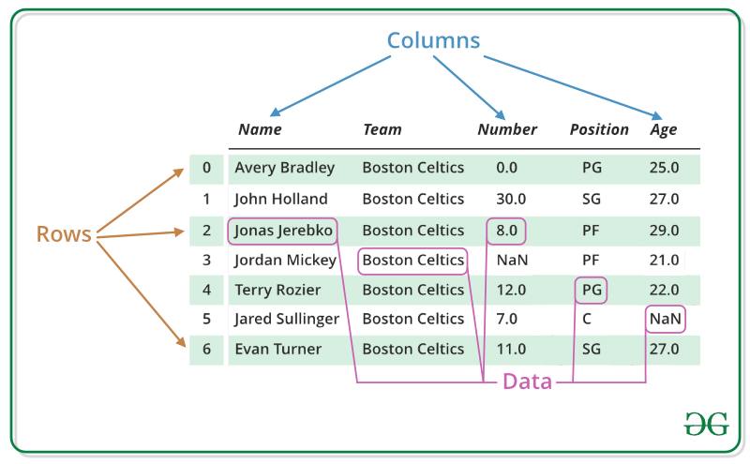
Pandas DataFrame

Slide 22

Python program to check pandas version
# importing pandas as pd
import pandas as pd
# Check the version
print(pd.__version__)
#1.5.3
#latest version

Slide 23
Python program for pandas
import pandas
mydataset = {
'cars': ["BMW", "Volvo", "Ford"],
'passings': [3, 7, 2]
}
myvar = pandas.DataFrame(mydataset)
print(myvar)

Slide 24
Python program for pandas
import pandas as pd
data = {
"calories": [420, 380, 390],
"duration": [50, 40, 45]
}
#load data into a DataFrame object:
df = pd.DataFrame(data)
print(df)

Slide 25
Dataframe Methods
Sr-No | FUNCTION | DESCRIPTION
1 | index() | Method returns index (row labels) of the DataFrame
2 | insert() | Method inserts a column into a DataFrame
3 | loc[] | Method retrieves rows based on index label
4 | iloc[] | Method retrieves rows based on index position
5 | ix[] | Method retrieves DataFrame rows based on either index label or index position. This method combines the best features of the .loc[] and .iloc[] methods
6 | isnull() | Method creates a Boolean Series for extracting rows with null values
7 | dropna() | Method allows the user to analyze and drop Rows/Columns with Null values in different ways
8 | info() | This method prints information about a DataFrame including the index dtype and columns, non-null values and memory usage. Print a concise summary of a DataFrame.
9 | describe() | The describe() method is used for calculating some statistical data like percentile, mean and std of the numerical values of the Series or DataFrame. It analyzes both numeric and object series and also the DataFrame column sets of mixed data types.

Slide 26
Python program for pandas Locate Row : Pandas use the loc attribute to return one or more specified row(s)
import pandas as pd
data = {
"calories": [420, 380, 390],
"duration": [50, 40, 45]
}
#load data into a DataFrame object:
df = pd.DataFrame(data)
print(df)
#refer to the row index: print(df.loc[0])

Slide 27

Python program for pandas Locate Row : Pandas use the loc attribute to return one or more specified row(s)
import pandas as pd
data = {
"calories": [420, 380, 390],
"duration": [50, 40, 45]
}
#load data into a DataFrame object:
df = pd.DataFrame(data)
print(df)
#refer to the row index: print(df.loc[0])
#use a list of indexes: print(df.loc[[0, 1]])

Slide 28
Dataframe Program
# Import pandas package
import pandas as pd
# Define a dictionary containing employee data
data = {'Name':['Jai', 'Princi', 'Gaurav', 'Anuj'],
'Age':[27, 24, 22, 32],
'Address':['Delhi', 'Kanpur', 'Allahabad', 'Kannauj'],
'Qualification':['Msc', 'MA', 'MCA', 'Phd']}
# Convert the dictionary into DataFrame
df = pd.DataFrame(data)
# select two columns
print(df[['Name', 'Qualification']])

Slide 29
Python program to know your working directory
import os
os.getcwd() # will provide the current working directory
#Keep your csv file in this directory

Slide 30
Python program to read a csv file
import pandas as pd df = pd.read_csv('data.csv') print(df)

Slide 31
max_rows
import pandas as pd print(pd.options.display.max_rows)
#The number of rows returned is defined in Pandas option settings.
#You can check your system's maximum rows with the #pd.options.display.max_rows statement
#default is 60

Slide 32
max_rows
import pandas as pd
pd.options.display.max_rows = 9999
df = pd.read_csv('data.csv')
print(df)
#Increase the maximum number of rows to display the entire DataFrame

Slide 33
Python program for mean median mode using auto-mpg csv file
import pandas as pd
pd.options.display.max_rows = 9999
df = pd.read_csv('data.csv')
print(df)
#Increase the maximum number of rows to display the entire DataFrame

Slide 34
Example of statistics library Aim : To find mean median mode
import statistics
statistics.mean([21, 89, 34, 67, 96])
#61.4
import statistics
statistics.median([21, 89, 34, 67, 96])
#67
import statistics
statistics.mode([21, 89, 34, 67, 96])
#21

Slide 35
Example Aim : To know numpy version
import numpy as np print(np.__version__)
#Checking the version of numpy
#Output
#1.24.3
#1.25.2 (31 Jul 2023) as per google

Slide 36
Example of numpy library Aim : To find mean using numpy
import numpy as np
# 1D array
arr = [21, 89, 34, 67, 96]
print("arr : ", arr)
print("mean of arr : ", np.mean(arr))

Slide 37

References
https://www.geeksforgeeks.org/differences-and-applications-of-list-tuple-set-and-dictionary-in-python/
https://www.geeksforgeeks.org/python-pandas-dataframe/?ref=lbp
https://www.w3schools.com/python/python_lists.asp

