Slide 1
Engineering Plus Phase IV Course Name: Machine Learning
Subject Faculty : Dr. Gayatri S Pandi
Day 2

Slide 2




Key Takeaways for Day 2 : Session 1
Linear Regression
Assignments
Introduction to Supervised Machine Learning
Multiple Linear Regression

Slide 3
What is Learning? (Types of task)
Learning is referred to as the process of gaining information through observation.
with more learning, tasks can be performed more efficiently.
Task can be :
Simple (walking down the street or doing the homework. )
Complex (deciding the angle in which a rocket should be launched so that it can have a particular trajectory)

Slide 4
What is Machine Learning?
Tom M. Mitchell, Professor of Machine Learning Department, School of Computer Science, Carnegie Mellon University.
Tom M. Mitchell has defined machine learning as
‘A computer program is said to learn from experience E with respect to some class of tasks T and performance measure P, if its performance at tasks in T, as measured by P, improves with experience E.’

Slide 5
How do machines learn?
The basic machine learning process can be divided into three parts.
1. Data Input: Past data or information is utilized as a basis for future decision-making.
2. Abstraction: The input data is represented in a broader way through the underlying algorithm.
3. Generalization: The abstracted representation is generalized to form a framework for making decisions.

Slide 6
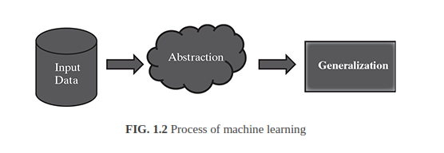
How do machines learn? Process of machine learning

Slide 7
How do machines learn? Example : image classification problem
In context of image classification:
E represents the past data with images having labels or assigned classes (for example whether the image is of a class cat or a class dog or a class elephant etc.).
T is the task of assigning class to new, unlabeled images and
P is the performance measure indicated by the percentage of images correctly classified.

Slide 8
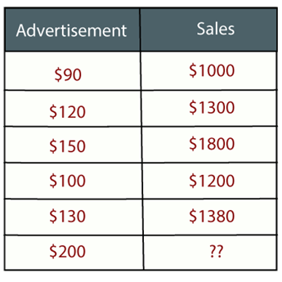
Regression Analysis in Machine learning
Example: Suppose there is a marketing company A, who does various advertisement every year and get sales on that. The below list shows the advertisement made by the company in the last 5 years and the corresponding sales:
Now, the company wants to do the advertisement of $200 in the year 2019 and wants to know the prediction about the sales for this year. So to solve such type of prediction problems in machine learning, we need regression analysis.

Slide 9
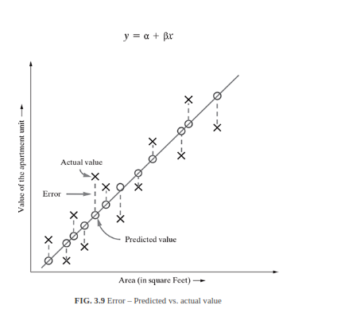
Supervised learning – Regression
For a certain value of x, say ^x, the value of y is predicted as
ŷ whereas the actual value of y is Y (say).
The distance between the actual value and the fitted or predicted value, i.e. ŷ is known as residual(error).
The regression model can be considered to be fitted well if the difference between actual and predicted value, i.e. the residual value is less.

Slide 10

Supervised learning – Regression Mean squared error (MSE)
Mean squared error (MSE) measures the amount of error in statistical models. It assesses the average squared difference between the observed and predicted values.
When a model has no error, the MSE equals zero. As model error increases, its value increases.
The mean squared error is also known as the mean squared deviation (MSD).
yi is the ith observed value.
ŷi is the corresponding predicted value.
n = the number of observations.

Slide 11
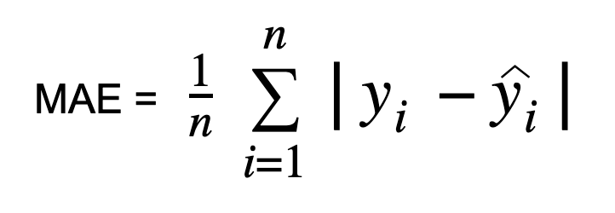
Supervised learning – Regression Mean Absolute Error
the sum of absolute errors divided by the sample size (number of observations)
yi is the ith observed value.
ŷi is the corresponding predicted value.
n = the number of observations.

Slide 12
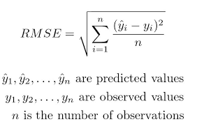
Supervised learning – Regression Root Mean Square

Slide 13
NumPy Array Shape
Get the Shape of an Array
NumPy arrays have an attribute called shape that returns a tuple with each index having the number of corresponding elements.
Print the shape of a 2-D array:
import numpy as np arr = np.array([[1, 2, 3, 4], [5, 6, 7, 8]]) print(arr.shape)
#Output
(2, 4)

Slide 14
NumPy Array Reshaping
Reshaping arrays
Reshaping means changing the shape of an array.
The shape of an array is the number of elements in each dimension.
By reshaping we can add or remove dimensions or change number of elements in each dimension.

Slide 15
NumPy Array Reshaping
Convert the following 1-D array with 12 elements into a 2-D array.
The outermost dimension will have 4 arrays, each with 3 elements:
import numpy as np arr = np.array([1, 2, 3, 4, 5, 6, 7, 8, 9, 10, 11, 12]) newarr = arr.reshape(4, 3) print(newarr)

Slide 16
NumPy Array Reshaping
When you use reshape(-1, 1), you are asking numpy to reshape your array with 1 column and as many rows as necessary to accommodate the data. This operation will result in a 2D array with a shape (n, 1), where n is the number of elements in your original array.
import numpy as np
# Original array
arr = np.array([1, 2, 3, 4, 5, 6])
print('Original array shape:', arr.shape)
# Reshape array
reshaped_arr = arr.reshape(-1, 1)
print('Reshaped array shape:', reshaped_arr.shape)
#Output:
Original array shape: (6,)
Reshaped array shape: (6, 1)

Slide 17
NumPy Array Reshaping
Reshape(1, -1) On the other hand, reshape(1, -1) reshapes your array with 1 row and as many columns as necessary to accommodate the data. This operation will result in a 2D array with a shape (1, n), where n is the number of elements in your original array.
import numpy as np
# Original array
arr = np.array([1, 2, 3, 4, 5, 6])
print('Original array shape:', arr.shape)
# Reshape array
reshaped_arr = arr.reshape(1, -1)
print('Reshaped array shape:', reshaped_arr.shape)
#Output:
Original array shape: (6,)
Reshaped array shape: (1, 6)

Slide 18
What is the Sklearn Diabetes Dataset?
The scikit-learn Diabetes Dataset or Sklearn Diabetes dataset consists of ten baseline variables, such as age, sex, body mass index (BMI), average blood pressure, and six blood serum measurements, obtained for 442 diabetes patients.
The target variable is a quantitative measure of disease progression one year after baseline.

Slide 19
Characteristics of Sklearn Diabetes Dataset
Number of Instances: 442
Number of Attributes: The first 10 columns are numeric predictive values.
Target: Column 11 represents a quantitative measure of disease progression one year after baseline.

Slide 20
Attribute Information of Sklearn Diabetes Dataset
The Sklearn Diabetes Dataset include following attributes:
age: Age in years
sex: Gender of the patient
bmi: Body mass index
bp: Average blood pressure
s1: Total serum cholesterol (tc)
s2: Low-density lipoproteins (ldl)
s3: High-density lipoproteins (hdl)
s4: Total cholesterol / HDL (tch)
s5: Possibly log of serum triglycerides level (ltg)
s6: Blood sugar level (glu)

Slide 21
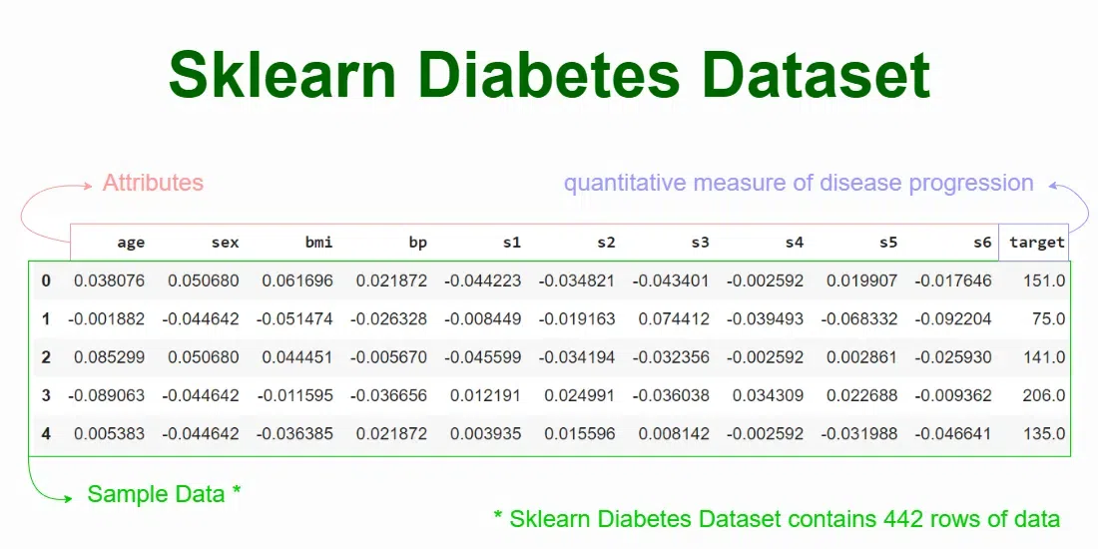

Slide 22
References
https://www.javatpoint.com/regression-analysis-in-machine-learning
https://www.geeksforgeeks.org/ml-classification-vs-regression/
https://www.kaggle.com/code/vivinbarath/simple-linear-regression-for-salary-data
https://www.w3schools.com/python/python_ml_multiple_regression.asp

