Slide 1
Engineering Plus Phase IV Course Name: Machine Learning
Subject Faculty : Dr. Gayatri S Pandi
Day 5
Ensemble techniques

Slide 2




Key Takeaways for Day 4 : Session 1
Bagging
Introduction to Ensemble techniques
Assignments
Boosting
Advance machine learning

Slide 3
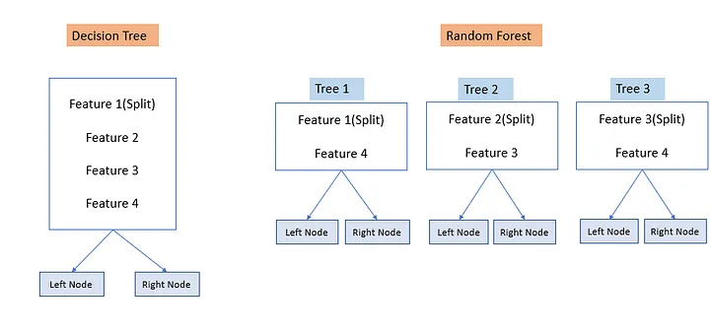
Decision Tree Vs Random Forest

Slide 4
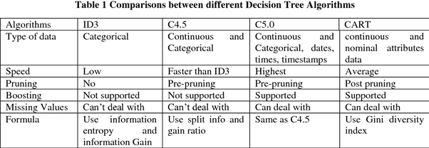

Slide 5
What is the difference between a decision tree and a regression tree?
A decision tree is a machine learning algorithm used for either classification or regression, and can handle categorical or continuous variables.
A regression tree is a type or variant of decision tree that handles continuous variables.
The methods to split the tree are different depending if we are in a classification or regression problem.

Slide 6
Over-fitting in Trees
Decision Trees are prone to over-fitting.
A decision tree will always overfit the training data if we allow it to grow to its max depth.
Overfitting in decision trees occurs when the tree becomes too complex and captures the noise in the training data, rather than the underlying pattern.
This can lead to poor generalization performance on new unseen data.

Slide 7
Techniques to avoid overfitting in Decision Trees
Ways to avoid overfitting in decision trees:
Pruning
In decision trees, pruning refers to the process of removing branches that do not provide much information gain or that are not necessary for the tree to make accurate predictions.
The goal of pruning is to simplify the tree and make it more generalizable to new unseen data.
There are two main types of pruning in decision trees:
pre-pruning and
post-pruning.
Random Forest

Slide 8
Techniques to avoid overfitting in Decision Trees
Pre-pruning
We usually apply this technique before the construction of a decision tree.
This is the process of early stopping the tree-growing process before it reaches its maximum depth.
The tree is stopped from growing by setting a stopping condition, such as a maximum depth or a minimum number of samples in a leaf node.
The hyperparameters that can be tuned for early stopping and preventing overfitting are:
max_depth, min_samples_leaf, and min_samples_split

Slide 9
Techniques to avoid overfitting in Decision Trees
The hyperparameters that can be tuned for early stopping and preventing overfitting are:
max_depth, min_samples_leaf, and min_samples_split
1. max_depth: This parameter controls the maximum depth of the tree. The deeper the tree, the more complex the model.
A deeper tree can fit the training data better, but it can also lead to overfitting.
In order to prevent overfitting, we can limit the depth of the tree by setting a maximum value for max_depth.
Example :
clf = DecisionTreeClassifier(max_depth=5) clf.fit(X_train, y_train)

Slide 10
Techniques to avoid overfitting in Decision Trees
The hyperparameters that can be tuned for early stopping and preventing overfitting are:
max_depth, min_samples_leaf, and min_samples_split
2. min_samples_leaf: This parameter controls the minimum number of samples that are required to be at a leaf node. A leaf node is a node that has no children. By setting a minimum number of samples required at a leaf node, we can prevent the tree from creating overfitting by creating branches with very few samples.
clf = DecisionTreeClassifier(min_samples_leaf=10)
clf.fit(X_train, y_train)
Here, the min_samples_leaf hyperparameter is set to 10. This means that a leaf node, or a terminal node, in the decision tree must have at least 10 samples in order for it to be created. If a certain split results in a leaf node with only 5 samples, the split will not be allowed.

Slide 11
Techniques to avoid overfitting in Decision Trees
The hyperparameters that can be tuned for early stopping and preventing overfitting are:
max_depth, min_samples_leaf, and min_samples_split
2. min_samples_leaf: This parameter controls the minimum number of samples that are required to be at a leaf node. A leaf node is a node that has no children. By setting a minimum number of samples required at a leaf node, we can prevent the tree from creating overfitting by creating branches with very few samples.
clf = DecisionTreeClassifier(min_samples_leaf=10)
clf.fit(X_train, y_train)
Here, the min_samples_leaf hyperparameter is set to 10. This means that a leaf node, or a terminal node, in the decision tree must have at least 10 samples in order for it to be created. If a certain split results in a leaf node with only 5 samples, the split will not be allowed.

Slide 12
Techniques to avoid overfitting in Decision Trees
The hyperparameters that can be tuned for early stopping and preventing overfitting are:
max_depth, min_samples_leaf, and min_samples_split
3. min_samples_split: This parameter controls the minimum number of samples that are required to split an internal node.
By setting a minimum number of samples required to split a node, we can prevent the tree from creating overfitting by creating branches with very few samples.
clf = DecisionTreeClassifier(min_samples_split=20) clf.fit(X_train, y_train)
Here, the min_samples_split hyperparameter is set to 20. This means that an internal node must have at least 20 samples to be split. If certain internal node has only 15 samples, the node will not be allowed to split further, meaning the decision for classifying a new sample will be based on the majority of the class in that leaf node.

Slide 13
Techniques to avoid overfitting in Decision Trees
Post-Pruning:
It is also known as backward pruning. The Post-pruning technique allows the decision tree model to grow to its full depth, then removes the tree branches that do not provide a significant increase in accuracy on the validation set to prevent the model from overfitting.
The process of post-pruning typically involves removing a node and its children from the tree, and then evaluating the impact on the accuracy of the tree using a validation set. If the accuracy does not decrease significantly, the node and its children are removed permanently. This process is repeated recursively for each node in the tree, starting from the bottom-most leaf nodes and moving upwards.
here we prune the branches of decision tree using Cost Complexity Pruning technique(CCP). In case of cost complexity pruning, the ccp_alpha can be tuned to get the best fit model. A smaller value of ccp_alpha results in more pruning, while a larger value results in less pruning.

Slide 14
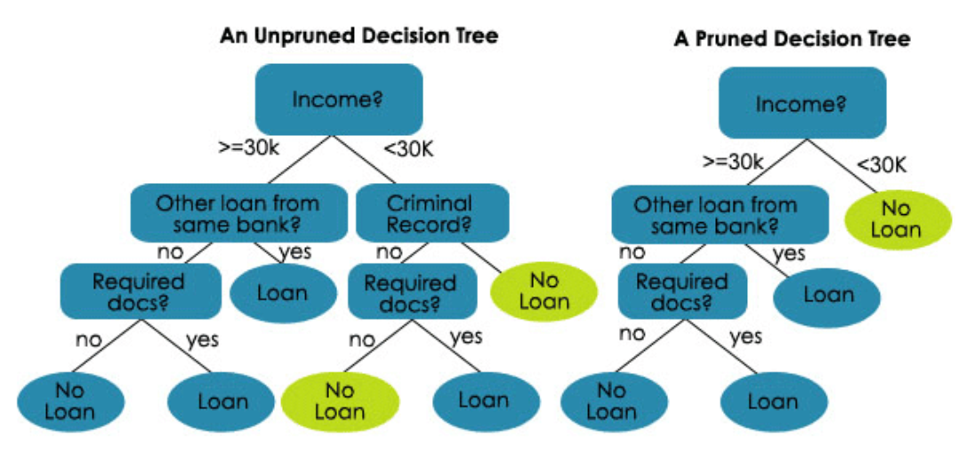
Tree Pruning

Slide 15
Techniques to avoid overfitting in Decision Trees
Random Forests is an ensemble method of implementation of tree-based algorithms used for both classification and regression. It uses bootstrapping multiple decision trees to prevent overfitting by sampling and aggregation techniques.

Slide 16
What is CART (classification and regression tree)?
CART is a decision tree algorithm that can be used for both classification and regression tasks.
It works by recursively partitioning the data into smaller and smaller subsets based on certain criteria.
The goal is to create a tree structure that can accurately predict the target variable for new data points.

Slide 17
Strengths of Regression trees
Advantages
The decision tree model can be used for both classification and regression problems, and it is easy to interpret, understand, and visualize.
The output of a decision tree can also be easily understood.
Compared with other algorithms, data preparation during pre-processing in a decision tree requires less effort and does not require normalization of data.
The implementation can also be done without scaling the data.
A decision tree is one of the quickest ways to identify relationships between variables and the most significant variable.
New features can also be created for better target variable prediction.
Decision trees are not largely influenced by outliers or missing values, and it can handle both numerical and categorical variables.
Since it is a non-parametric method, it has no assumptions about space distributions and classifier structure.

Slide 18
Weaknesses of Regression trees
Disadvantages
Overfitting is one of the practical difficulties for decision tree models. It happens when the learning algorithm continues developing hypotheses that reduce the training set error but at the cost of increasing test set error. But this issue can be resolved by pruning and setting constraints on the model parameters.
Decision trees cannot be used well with continuous numerical variables.
A small change in the data tends to cause a big difference in the tree structure, which causes instability.
Calculations involved can also become complex compared to other algorithms, and it takes a longer time to train the model.
It is also relatively expensive as the amount of time taken and the complexity levels are greater.

Slide 19
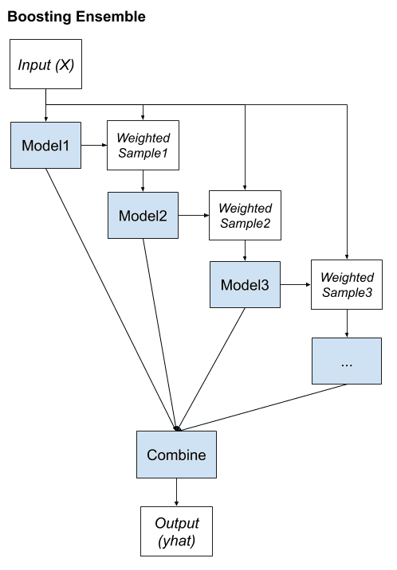
Boosting
Boosting is an ensemble learning method that involves training homogenous weak learners sequentially such that a base model depends on the previously fitted base models.
All these base learners are then combined in a very adaptive way to obtain an ensemble model.

Slide 20
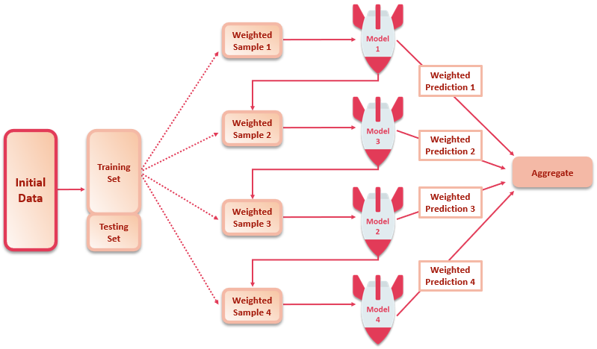
How Boosting Works?
Boosting consists of multiple weak learners that are fitted iteratively in a manner that each new learner gives more weight or is only trained with observations that have been poorly classified by the previous learners.
At the end of this process, we obtain a strong learner (ensemble model) with lesser bias than the individual base models composing it.
Hence, boosting techniques help avoid the underfitting of the model.
So, when a base model usually has low variance but high bias, we will implement boosting techniques.
Another reason is that such models are generally less computationally expensive to fit.

Slide 21
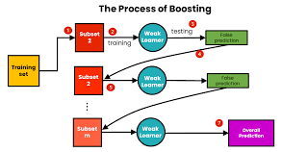
How Boosting Works?
Once we have decided upon the type of our base model, we need to ask a few questions:
What information from the previous learners will be considered when fitting the current learner?
How would the learners (base models) be aggregated?

Slide 22
Boosting (Example)
How would you classify an email as SPAM or not?
Our initial approach would be to identify ‘SPAM’ and ‘NOT SPAM’ emails using the following criteria. If:
Email has only one image file (promotional image), It’s a SPAM.
Email has only link(s), It’s a SPAM.
Email body consists of sentences like “You won a prize money of $ xxxxxx”, It’s a SPAM.
Email from our official domain “www.knowledgehut.com” , Not a SPAM.
Email from known source, Not a SPAM.
Individually, these rules are not powerful enough to classify an email into ‘SPAM’ or ‘NOT SPAM’. Therefore, these rules are called as weak learner.
To convert weak learner to strong learner, we’ll combine the prediction of each weak learner using methods like:
Using average/ weighted average
Considering prediction has higher vote
Example: Above, we have defined 5 weak learners. Out of these 5, 3 are voted as ‘SPAM’ and 2 are voted as ‘Not a SPAM’. In this case, by default, we’ll consider an email as SPAM because we have higher(3) vote for ‘SPAM’

Slide 23
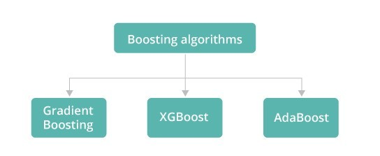
Boosting Algorithms

Slide 24
Bagging Classifier
A bagging classifier, in the context of classification, is an ensemble model formed by training multiple versions of a basic model / base estimator on various iterations of the training data set.
This data set is modified using a bagging sampling technique, where data is sampled with replacement, or through other methods. Each version of the basic model learns from a slightly different set of data, contributing to a more robust overall classification model.
The bagging sampling technique can result in a training set consisting of a duplicate dataset or a unique data set. This sampling technique is also called bootstrap aggregation.
The final predictor (also called a bagging classifier) combines the predictions made by each estimator/classifier by voting (classification) or by averaging (regression)

Slide 25
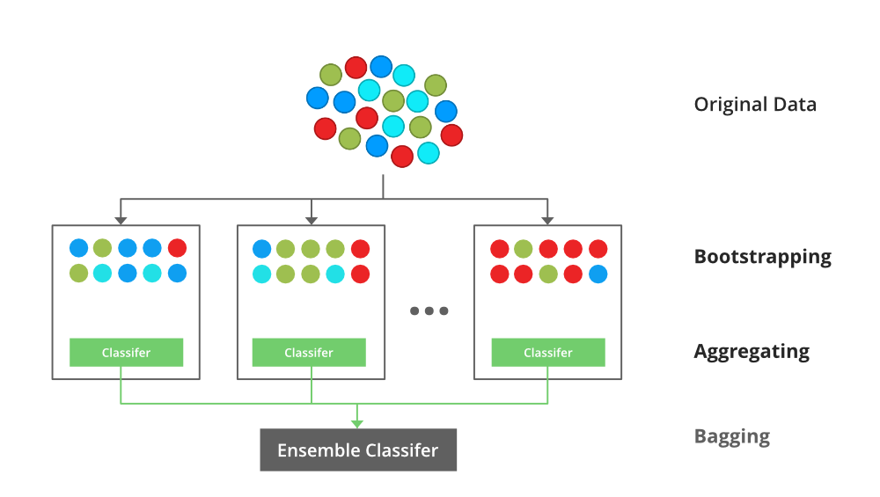
Bagging Classifier
Bagging classifier helps reduce the variance of individual estimators by sampling technique and combining the predictions.

Slide 26
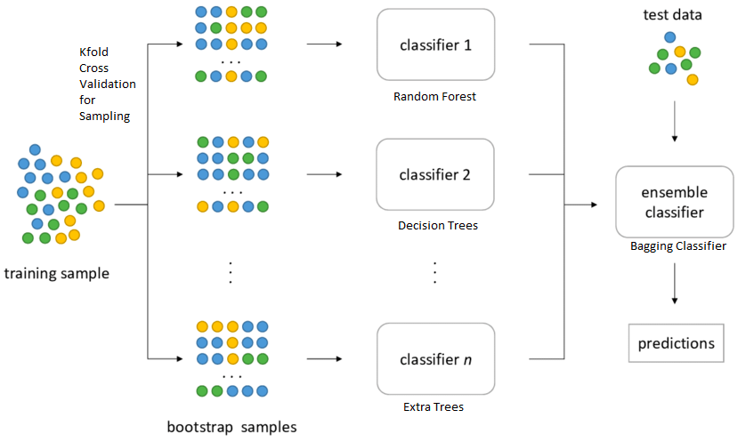
Introduction to Bagging Classifier

Slide 27
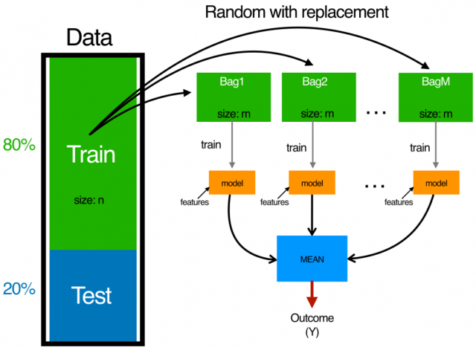
Introduction to Bagging Classifier

Slide 28

Bagging Classifier

Slide 29
Bagging Classifier Python Example
A model is fit using LogisticRegression algorithm
A model is fit using BaggingClassifier with base estimator as LogisticRegression

Slide 30
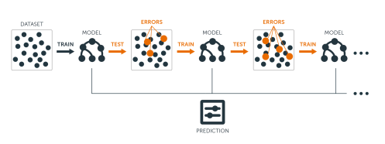
Gradient Boosting

Slide 31
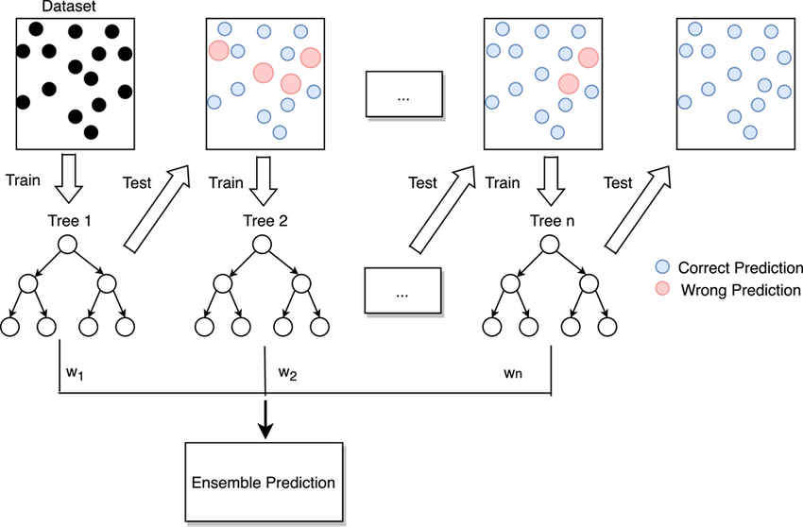
Gradient Boosting

Slide 32
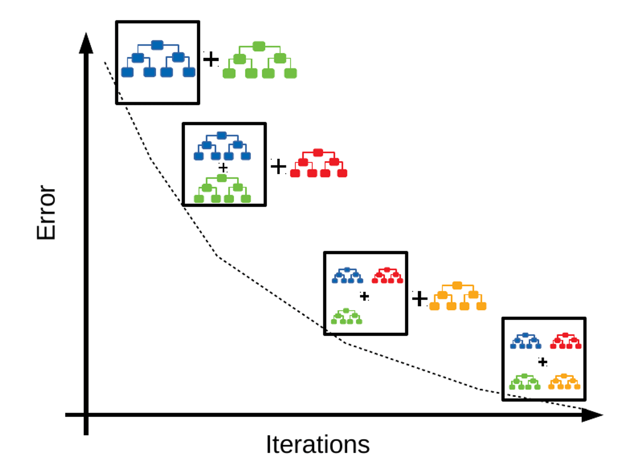
Gradient Boosting

Slide 33
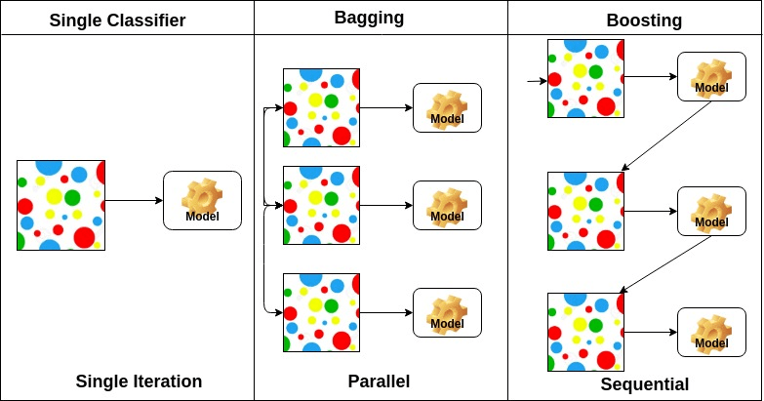

Slide 34
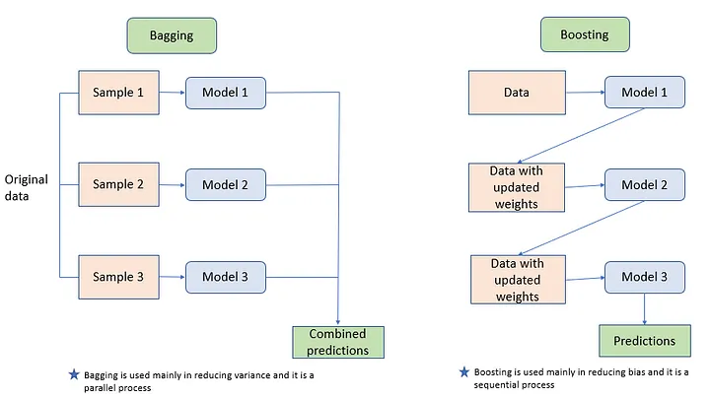

Slide 35
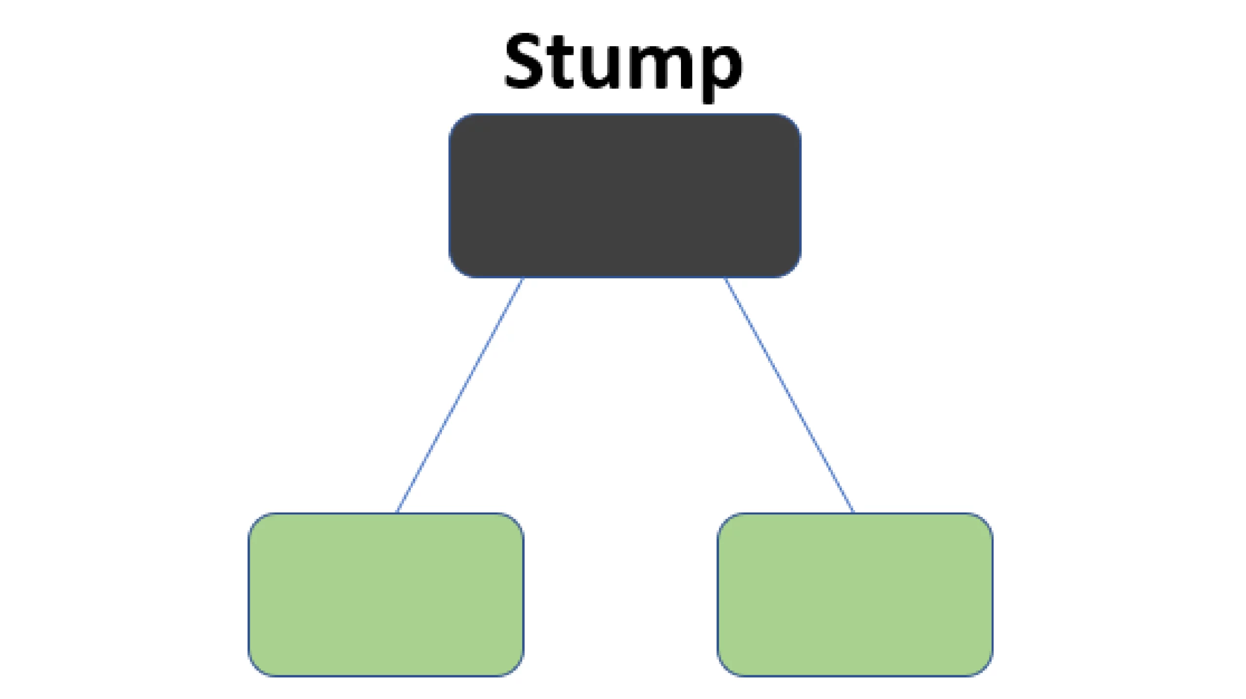
AdaBoost algorithm, short for Adaptive Boosting
It is called Adaptive Boosting as the weights are re-assigned to each instance, with higher weights assigned to incorrectly classified instances.
The most important parameters are base_estimator, n_estimators, and learning_rate." : Adaboost Classifier
base_estimator: It is a weak learner used to train the model. It uses DecisionTreeClassifier as default weak learner for training purpose. You can also specify different machine learning algorithms.
n_estimators: Number of weak learners to train iteratively.
learning_rate: It contributes to the weights of weak learners. It uses 1 as a default value.

Slide 36
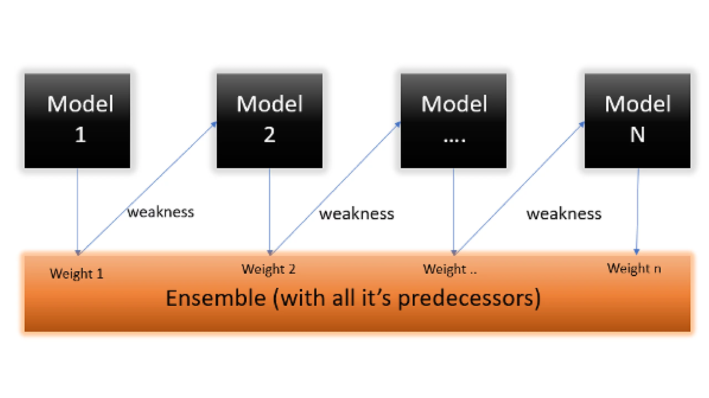
AdaBoost algorithm, short for Adaptive Boosting

Slide 37
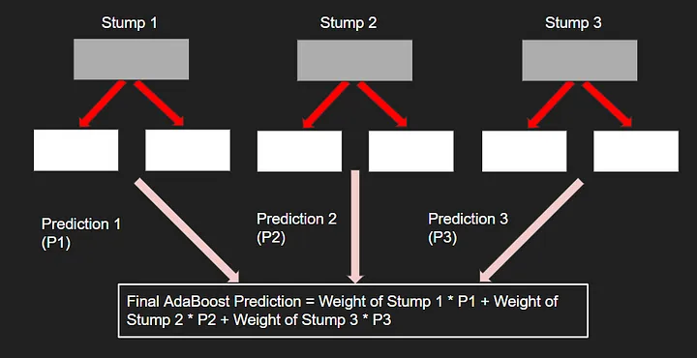
Working of Adaboost

Slide 38
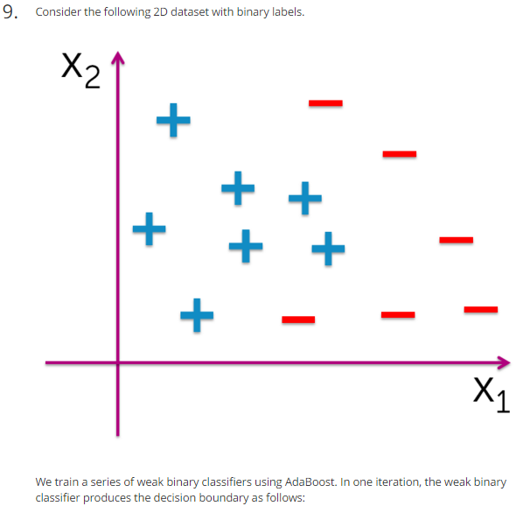
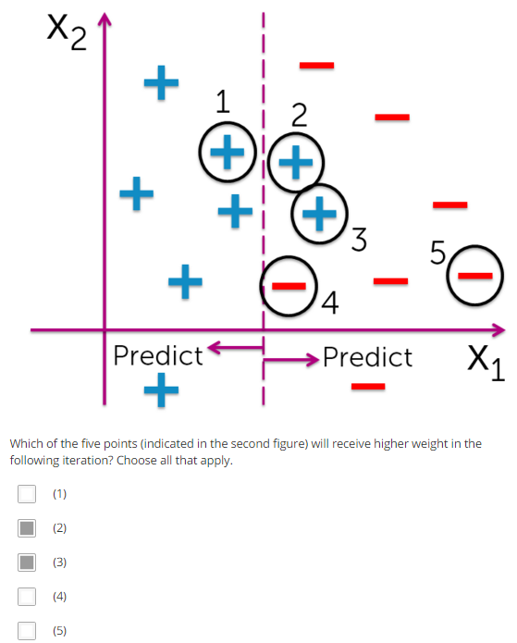
How AdaBoosting Works? Which sample nos will be given higher weights)

Slide 39
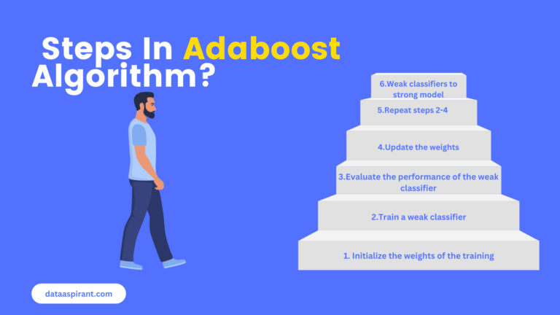
Steps in AdaBoost

Slide 40
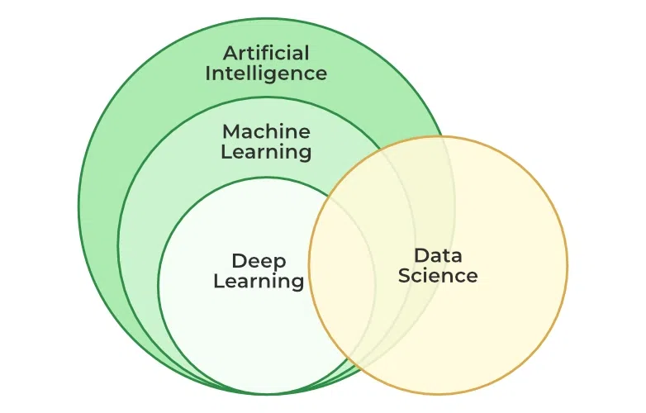
AI,ML,DL and DS

Slide 41
References
https://www.javatpoint.com/machine-learning-decision-tree-classification-algorithm
https://www.javatpoint.com/decision-tree-in-python-sklearn
https://www.kaggle.com/code/mohamedbelkheir/confusion-matrix-on-iris

