Slide 1
Engineering Plus Phase IV Course Name: Machine Learning
Subject Faculty : Dr. Gayatri S Pandi
Day 5
Introduction to Advance Machine Learning

Slide 2




Key Takeaways for Day 4 : Session 1
Bagging
Introduction to Ensemble techniques
Assignments
Boosting
Advance machine learning

Slide 3
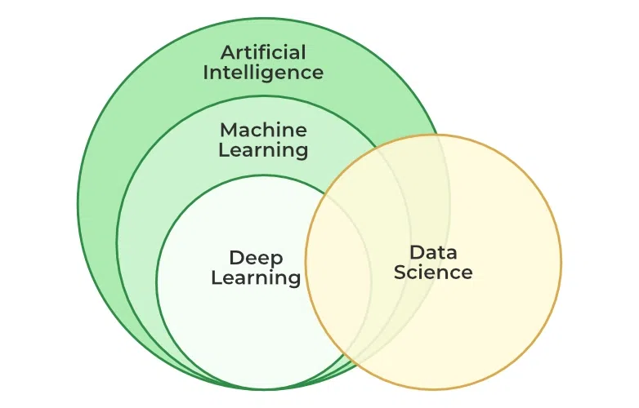
AI,ML,DL and DS

Slide 4
What is generative AI?
Generative AI is artificial intelligence designed to create unique text or image results in response to user prompts.
The technology uses machine learning to return an output based on the user’s prompt.
AI engineers train the technology using large data sets, which the model consults when determining the best possible answer to a prompt.

Slide 5
What is generative AI?
You can use generative AI to create new written, visual, or audio content, summarize complex data, generate code, assist with repetitive tasks, or make customer service more personalized.
Examples of generative AI
Google’s Bard, ChatGPT, or DALL-E from OpenAI.
Applications of generative AI
Health care and pharmaceuticals
Advertising and marketing
Manufacturing
Software development

Slide 6
What is Amazon Bedrock?
Bedrock is a service for building generative AI applications on Amazon’s cloud computing platform.
With Bedrock, Amazon is providing developers access to the tools and computing power needed to build their own generative AI applications.

Slide 7
Amazon provides the following examples:
Text generation. Create original stories, essays, emails, or web pages.
Chatbots. Build conversational bots or virtual assistants.
Search. Allow AI to synthesize information and provide answers based on large data sets.
Text summarization. Provide a summary of articles, books, blog posts, and other writing.
Image generation. Create photorealistic or artistic renderings of anything based on a natural language prompt.

Slide 8
Advancements in Deep Learning
Transformers and Natural Language Processing (NLP):NLP has come a long way thanks to creating transformer architectures, such as OpenAI’s GPT-3 and Google’s BERT. These models are well-suited for chatbots, translation services, and content creation tools since they can easily grasp and produce human language.
Generative Adversarial Networks (GANs):A GAN consists of a generator and a discriminator, two neural networks that compete to produce more realistic data. This technology advances creative industries through images and videos, including virtual reality, video game development, and graphic design.
Transfer Learning:Transfer learning lowers the quantity of data and processing power required for training by enabling models to apply information from one domain to another. This strategy has sped up the adoption of AI across a range of businesses and is especially helpful in situations when data is scarce.

Slide 9
Reinforcement Learning: Teaching Machines through Experience
Reinforcement learning (RL): This method aims to teach agents how to make a series of decisions by rewarding desired behaviors, similar to how people and animals learn environmental knowledge.

Slide 10
Reinforcement Learning: Teaching Machines through Experience
Key Developments in Reinforcement Learning
AlphaGo and Beyond:The promise of reinforcement learning was demonstrated by AlphaGo, a DeepMind machine that used RL to overcome global go champions. Since then, developments have produced uses for sophisticated simulations, driverless cars, and robots.
Deep Reinforcement Learning:Deep learning and reinforcement learning have been combined to create more potent models that can handle high-dimensional state spaces. Because of this integration, RL is now more widely applicable to tasks like dynamic resource allocation, personalized recommendations, and automated trading.
Meta-Reinforcement Learning:The goal of meta-reduction learning (RL) is to design agents that can leverage past knowledge to learn and adapt to new tasks. This capability is essential for creating broad AI systems that can carry out various tasks without requiring much retraining.

Slide 11
More Emerging Machine Learning Trends
These trends highlight the expanding capabilities of ML and its growing impact across various sectors.
1. Federated Learning: Decentralized Data Training
Federated learning trains models across several decentralized devices or servers without transferring raw data, addressing privacy and security issues. This method allows companies to work together on model training without jeopardizing confidential data. In the fields of healthcare and finance, where data protection is crucial, federated learning is especially relevant.
2. Explainable AI (XAI): Building Trust and Transparency
Understanding how ML models make decisions is essential as they grow in complexity. Explainable AI seeks to improve the interpretability and transparency of machine learning models so that users can validate and rely on their results. Explainability is a fundamental necessity in regulated areas like healthcare, banking, and law.

Slide 12
More Emerging Machine Learning Trends
3. AutoML: Democratizing Machine Learning
Feature selection, data preparation, and hyperparameter tweaking are just a few of the processes that automated machine learning (AutoML) streamlines. The accessibility and uptake of AI technologies can be increased when non-experts know how to create efficient ML models with the help of autoML tools.
4. Edge AI: Bringing Intelligence Closer to Data Sources
Using edge AI, machine learning models are installed locally on edge devices instead of centrally located servers. This trend facilitates real-time decision-making in IoT, autonomous cars, and smart city applications while lowering latency and enhancing data privacy.
5. Applications of Machine Learning in Business
Emerging machine learning trends are opening up new business possibilities across various sectors. By adopting ML technology, businesses can now gain a competitive edge, optimize processes, and improve customer experiences.

Slide 13
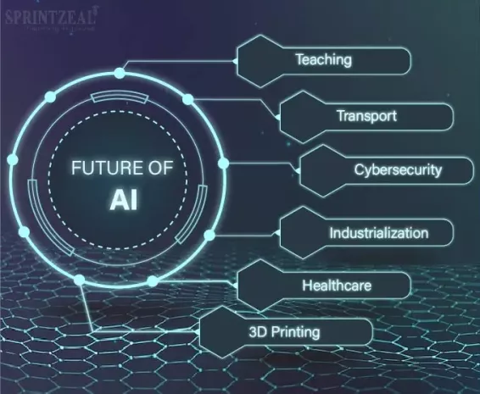
Future of AI

Slide 14
References
https://vates.com/the-future-of-machine-learning-emerging-trends-and-applications/

