Slide 1
Engineering Plus Phase IV Course Name: Machine Learning
Subject Faculty : Dr. Gayatri S Pandi
Day 3

Slide 2




Key Takeaways for Day 3 : Session 1
Logistic Regression
Assignments
Introduction to Supervised Machine Learning
KNN

Slide 3
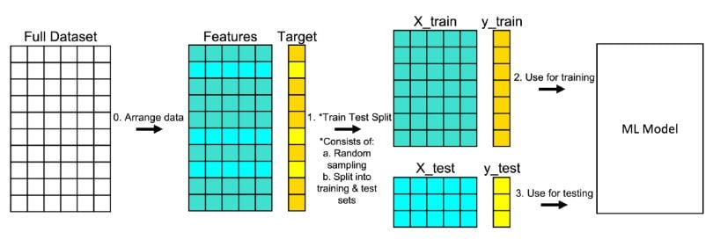
Train test split function

Slide 4
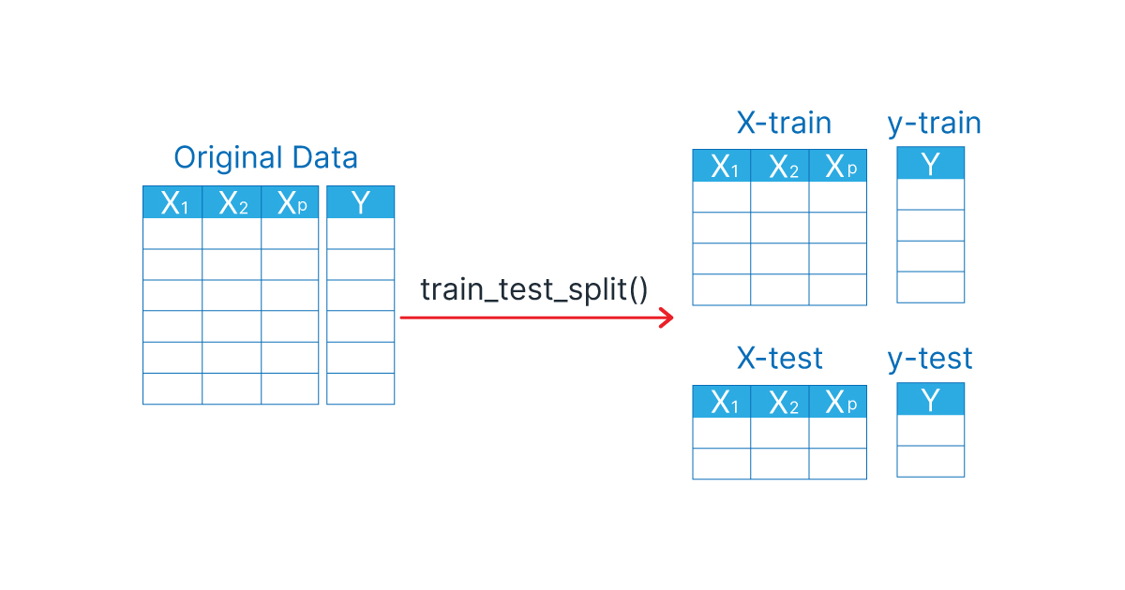
Train test split function
X_train: The training part of the first array (x)
X_test: The test part of the first array (x)
y_train: The training part of the second array (y)
y_test: The test part of the second array (y)

Slide 5
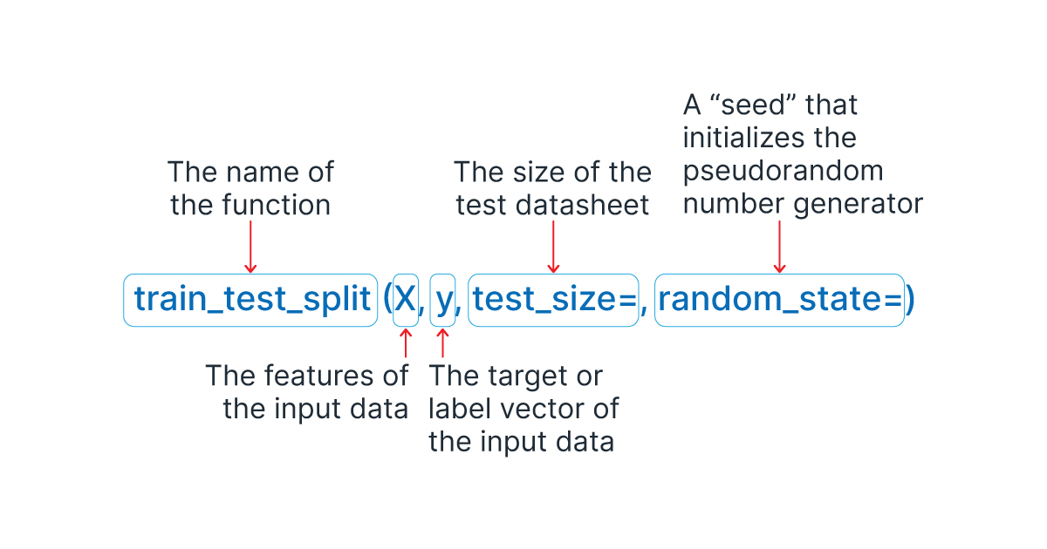
Train test split function

Slide 6
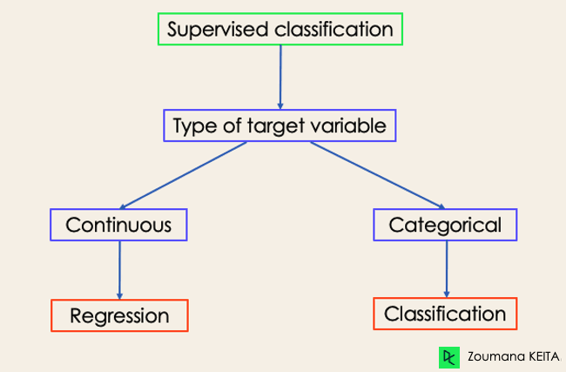
Classification

Slide 7
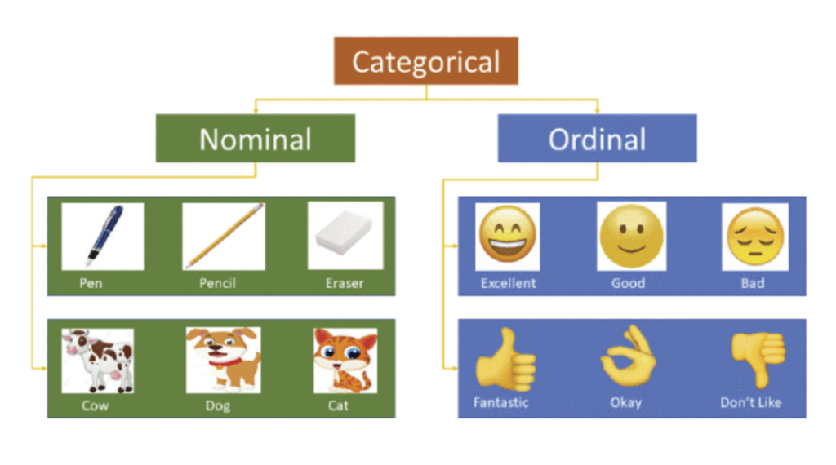
Nominal Vs Ordinal

Slide 8
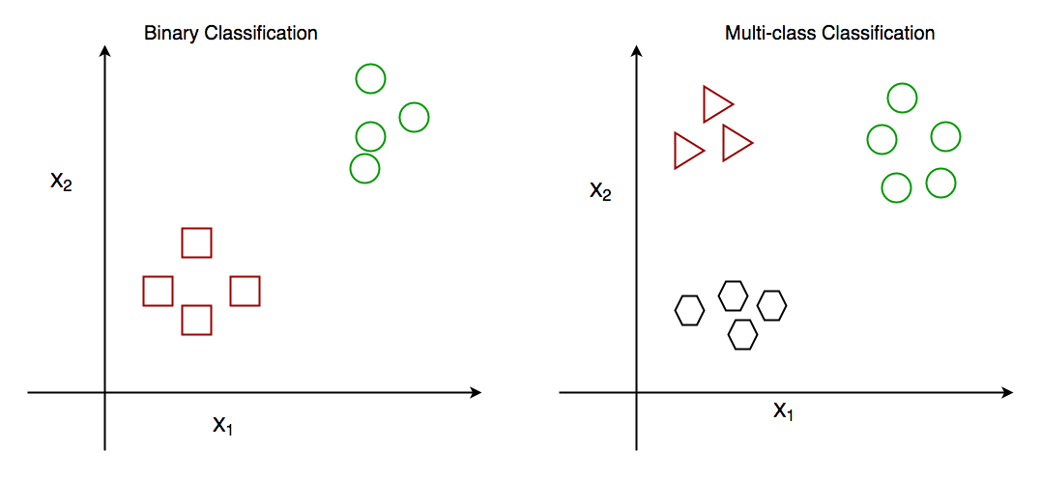
Classification

Slide 9
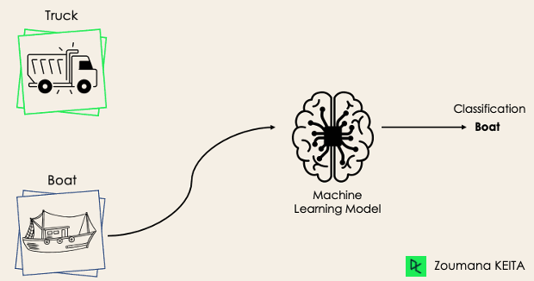
Binary Classification

Slide 10
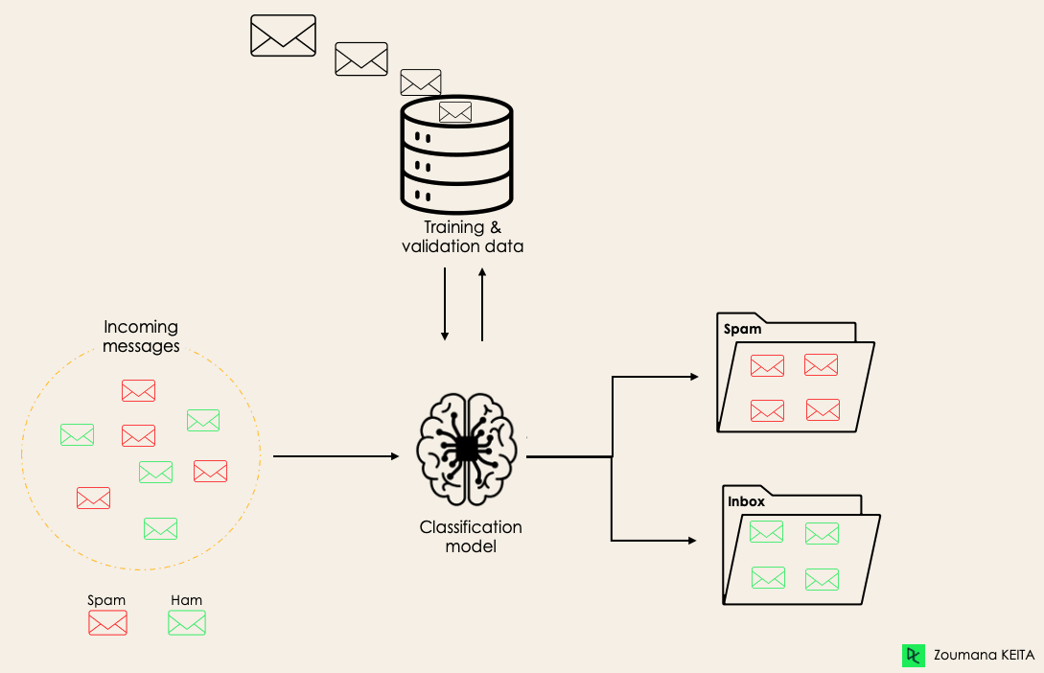
Mail Classification

Slide 11
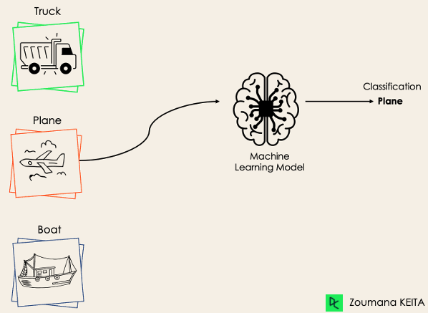
Multiclass Classification

Slide 12
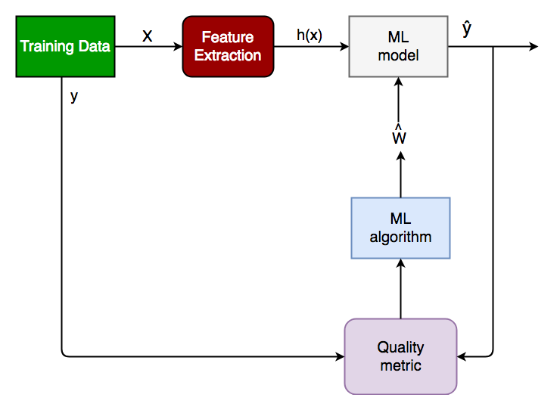
Training a classifier

Slide 13
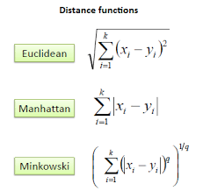
Distance formulas

Slide 14
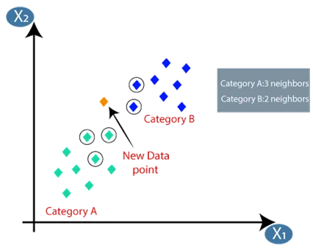
Classification

Slide 15
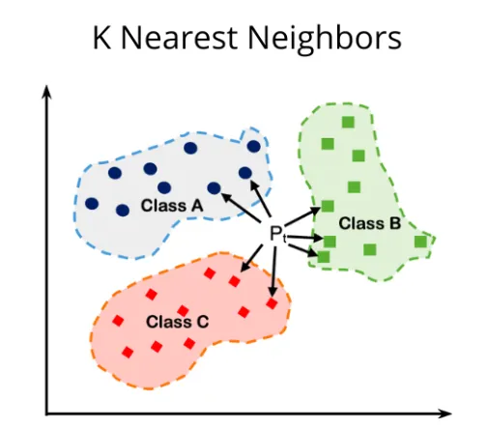
Classification

Slide 16
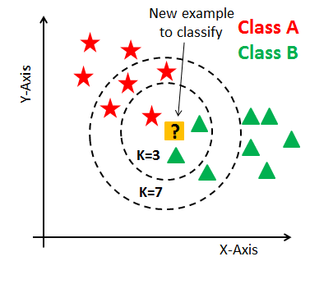
Classification using KNN

Slide 17
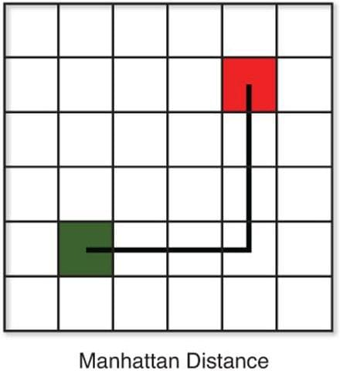
Manhattan Distance

Slide 18
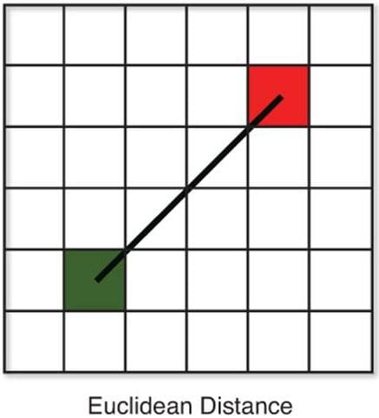
Euclidean Distance

Slide 19
KNN Example

Slide 20
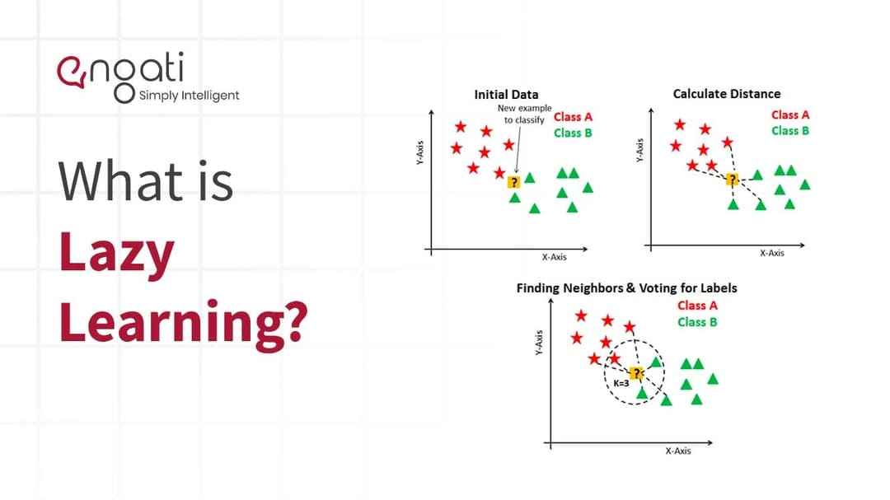
Lazy Learning

Slide 21
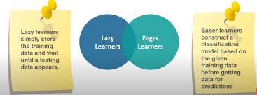
Lazy (KNN) Vs Eager Learners(Logistic Regression)

Slide 22
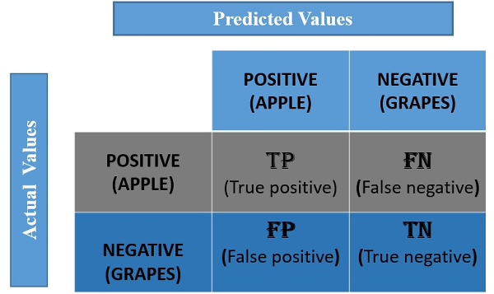
Confusion Matrix

Slide 23
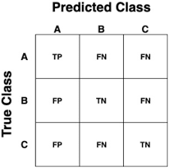
Confusion Matrix

Slide 24
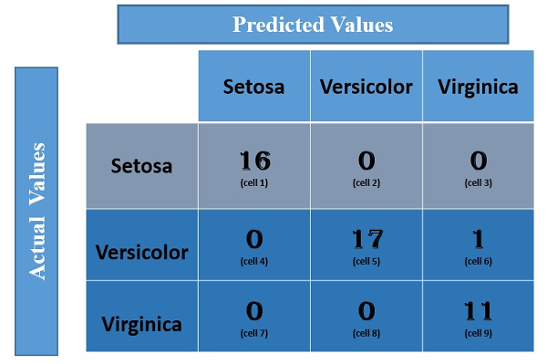
Confusion Matrix

Slide 25
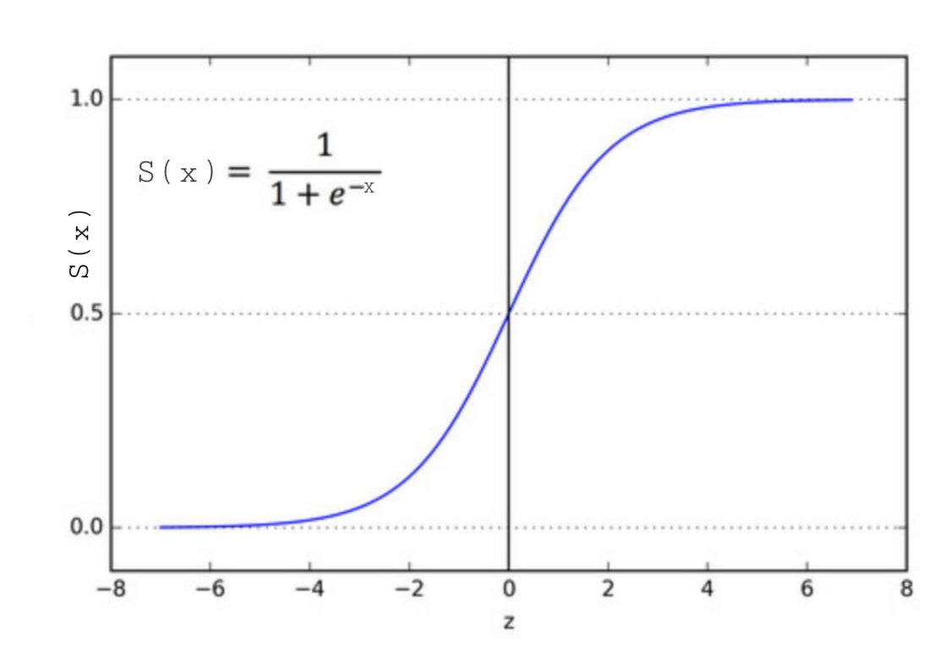
Sigmoid Function (Logistic Function )

Slide 26
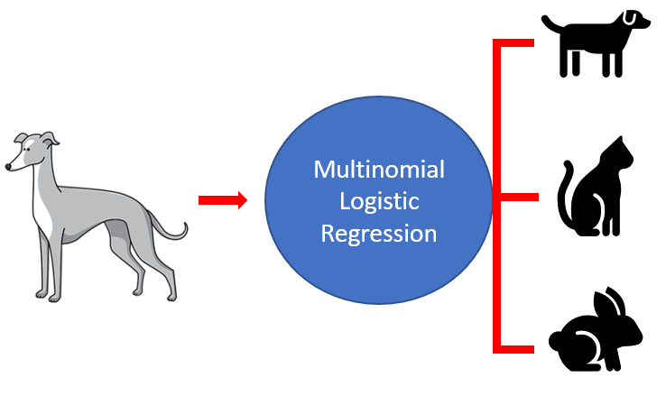
Multinomial Logistic Regression

Slide 27
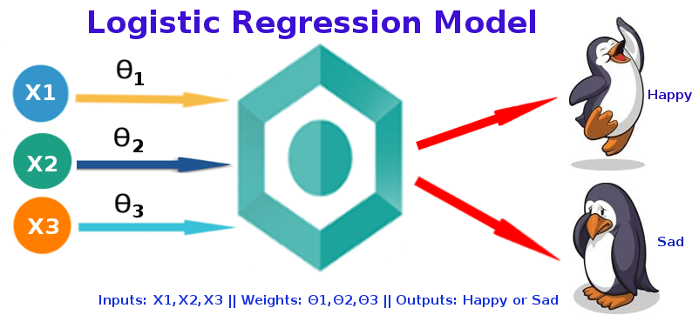
Logistic Regression

Slide 28
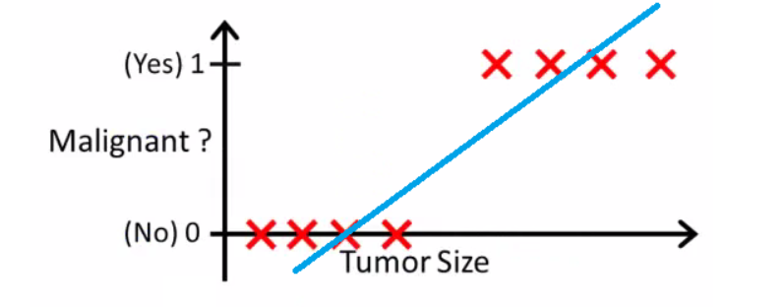
Logistic Regression for Tumors-Cancer

Slide 29
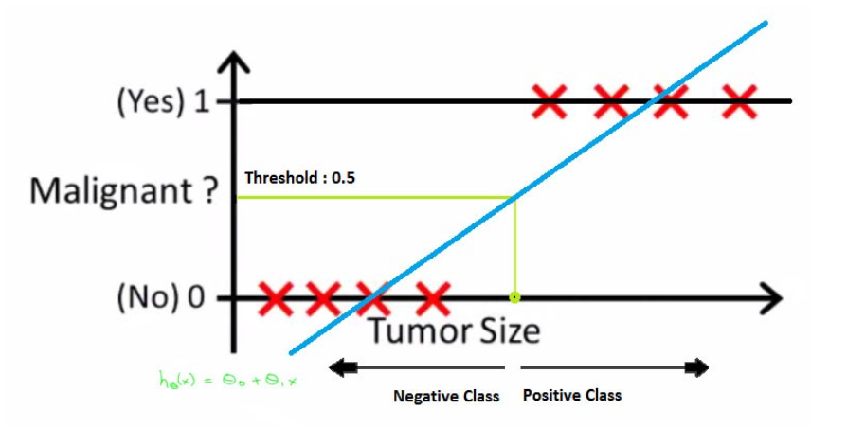
Logistic Regression for Tumors-Cancer

Slide 30
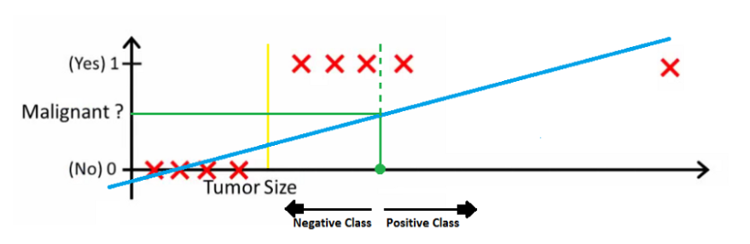
Logistic Regression for Tumors-Cancer

Slide 31
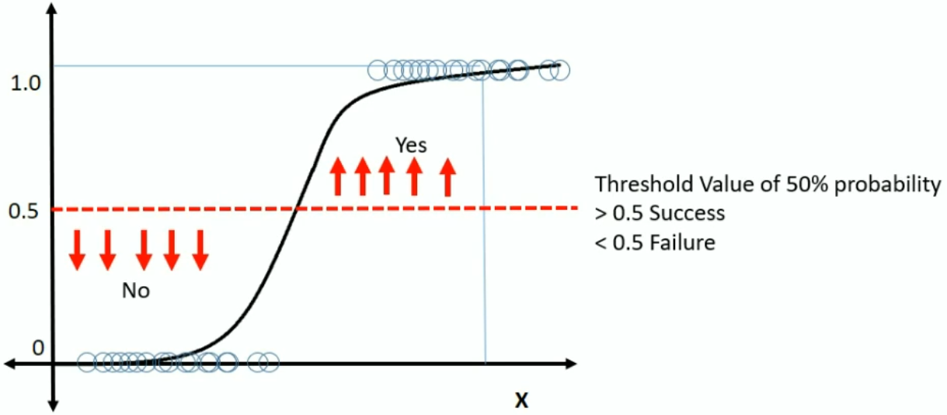
Threshold values

Slide 32
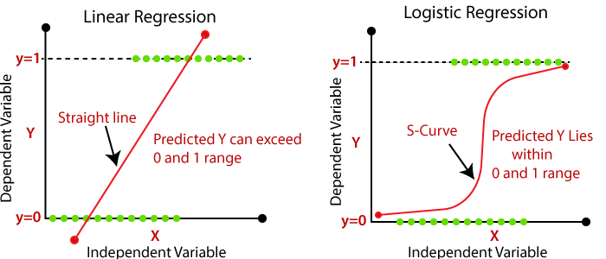
Linear Vs Logistic Regression

Slide 33
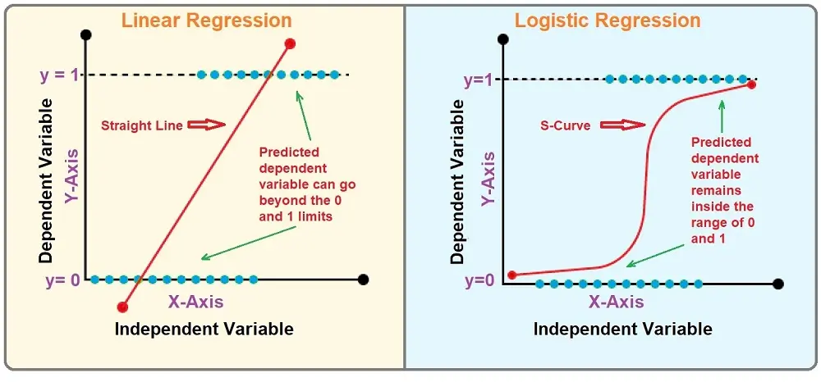
Linear Vs Logistic Regression

Slide 34
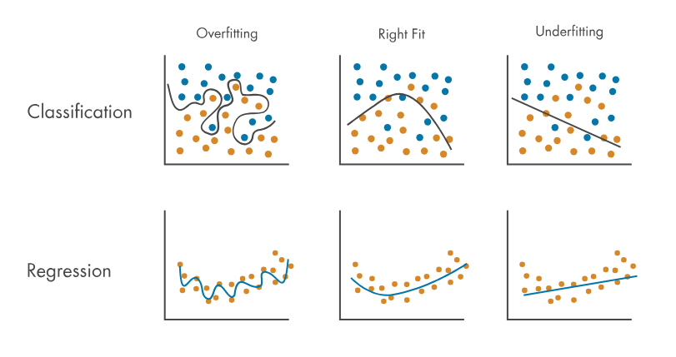
Overfitting, Right Fit and Underfitting and models

Slide 35
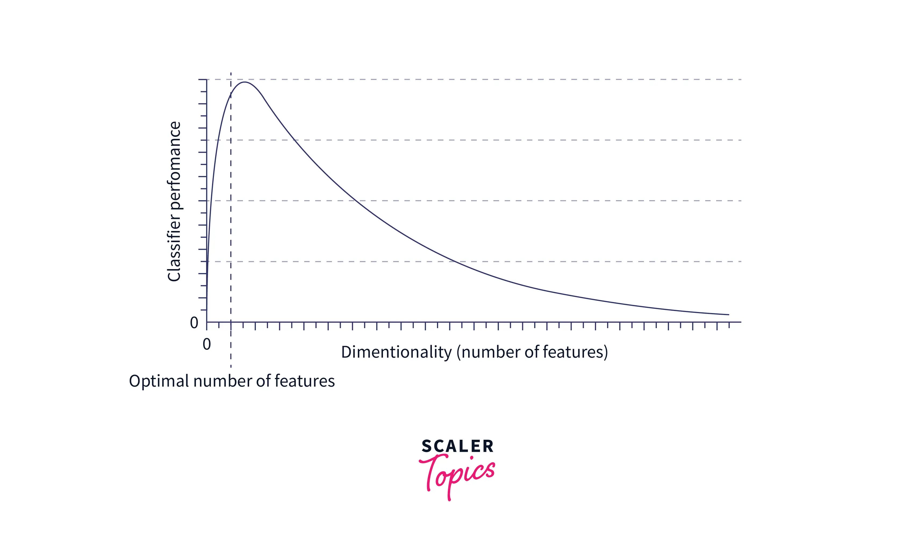
Curse of Dimensionality

Slide 36
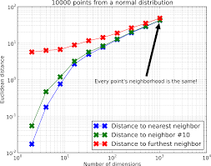
Curse of Dimensionality

Slide 37
References
https://www.datacamp.com/tutorial/understanding-logistic-regression-python

