Slide 1
Support Vector Machine Algorithm
Dr Gayatri S Pandi

Slide 2
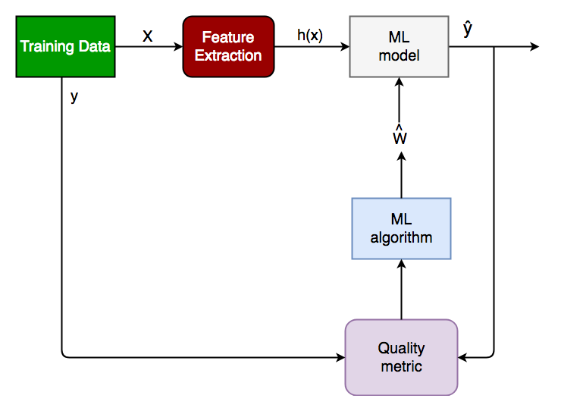
Training a classifier

Slide 3
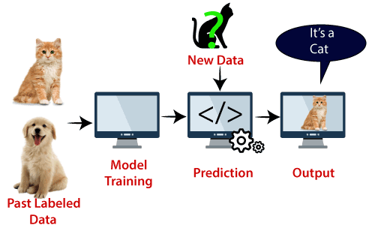
Classification Method

Slide 4
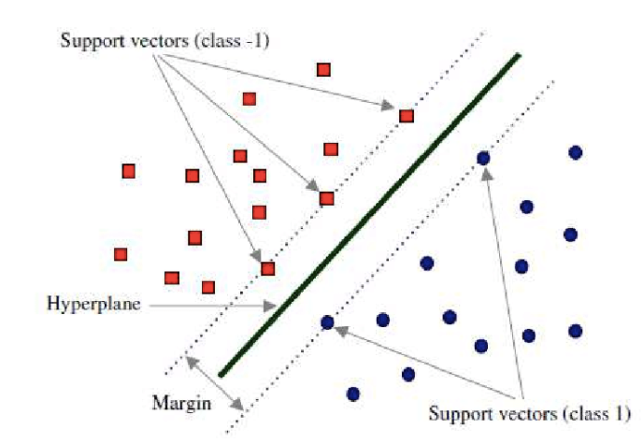
SVM Algorithm as Maximum Margin Classifier

Slide 5
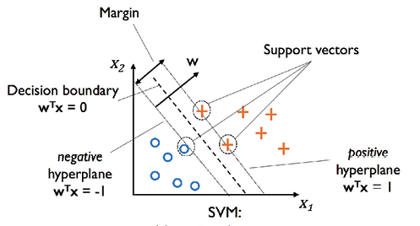
SVM Algorithm as Maximum Margin Classifier

Slide 6

Support Vector Machine Algorithm

Slide 7
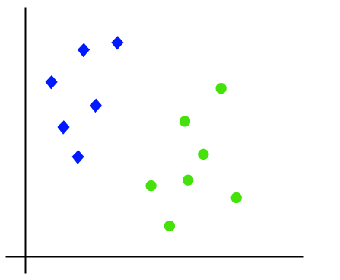
Dataset has two features x1 and x2

Slide 8
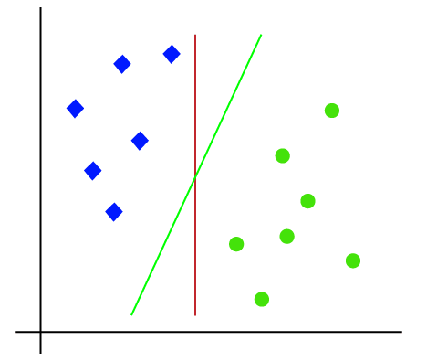
Dataset has two features x1 and x2

Slide 9
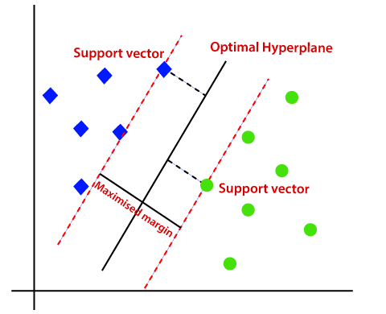
Dataset has two features x1 and x2

Slide 10
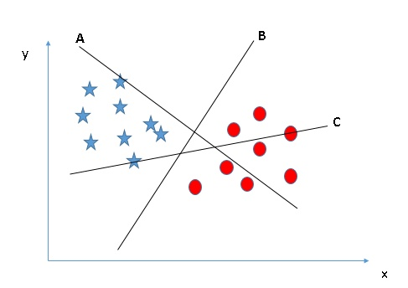
Identify the Right Hyper-plane (three hyper-planes (A, B, and C))

Slide 11
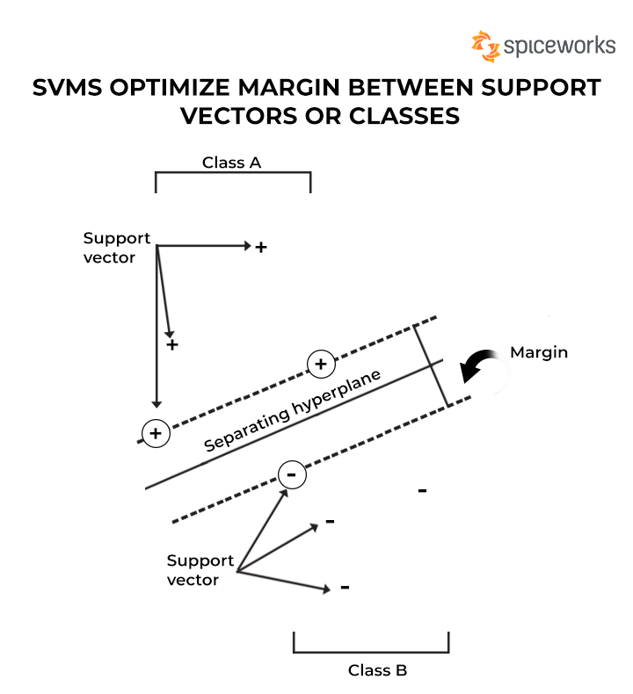
Support vectors and classes

Slide 12
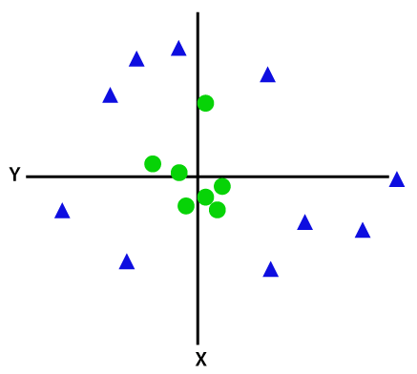
Non-Linear SVM

Slide 13
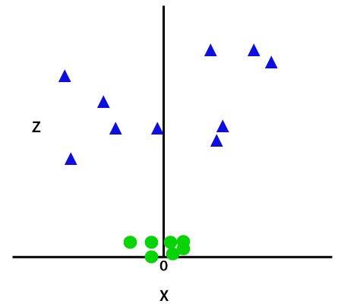
Non-Linear SVM

Slide 14
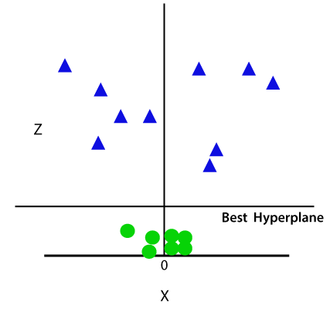
Non-Linear SVM

Slide 15
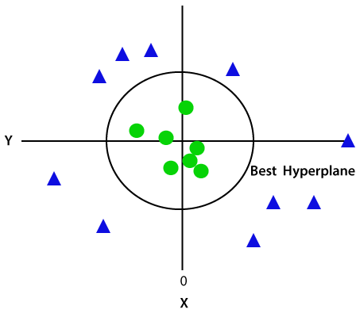
Non-Linear SVM

