Slide 1
Engineering Plus Phase IV Course Name: Machine Learning
Subject Faculty : Dr. Gayatri S Pandi
Day 4
Decision Trees
Random Forest

Slide 2




Key Takeaways for Day 4 : Session 1
Tree Classifier and Regressor
Introduction to Supervised Machine Learning
Model Performance And Tree Terminologies
Assignments
Random Forest

Slide 3
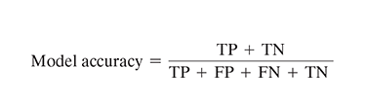
EVALUATING PERFORMANCE OF A MODEL (Model accuracy)
For any classification model, model accuracy is given by total number of correct classifications (either as the class of interest, i.e. True Positive or as not the class of interest, i.e. True Negative) divided by total number of classifications done.

Slide 4

Error rate
The percentage of misclassifications is indicated using
error rate which is measured as

Slide 5
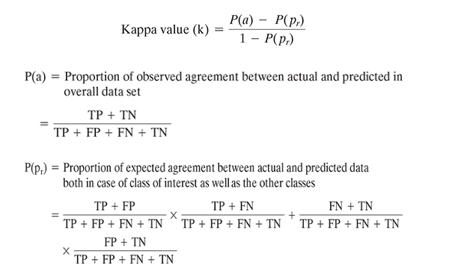
Kappa Value
Kappa value can be 1 at the maximum, which represents perfect agreement between model’s prediction and actual values.

Slide 6

Sensitivity
The sensitivity of a model measures the proportion of TP examples or positive cases which were correctly classified. It is measured as

Slide 7

Specificity
Specificity is also another good measure to indicate a good balance of a model being excessively conservative or excessively aggressive.
Specificity of a model measures the proportion of negative examples which have been correctly classified.
A higher value of specificity will indicate a better mode performance.

Slide 8


Precision and recall
Precision gives the proportion of positive predictions which are truly positive, recall gives the proportion of TP cases over all actually positive cases.
Recall indicates the proportion of correct prediction of positives to the total number of positives.

Slide 9

F-measure
F-measure is another measure of model performance which combines the precision and recall.
It takes the harmonic mean of precision and recall as calculated as :

Slide 10
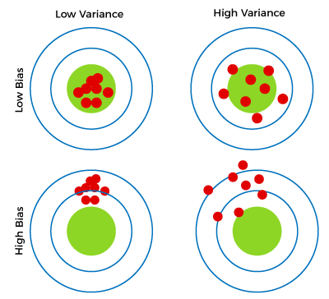
Bias Vs Variance

Slide 11
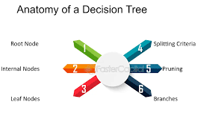
Decision Tree
Decision Trees is simple and flexible, it is greedy algorithm

Slide 12
Decision Tree Terminologies
There are specialized terms associated with decision trees that denote various components and facets of the tree structure and decision-making procedure. :
Root Node: A decision tree’s root node, which represents the original choice or feature from which the tree branches, is the highest node.
Internal Nodes (Decision Nodes): Nodes in the tree whose choices are determined by the values of particular attributes. There are branches on these nodes that go to other nodes.
Leaf Nodes (Terminal Nodes): The branches’ termini, when choices or forecasts are decided upon. There are no more branches on leaf nodes.
Branches (Edges): Links between nodes that show how decisions are made in response to particular circumstances.

Slide 13
Decision Tree Terminologies
Splitting: The process of dividing a node into two or more sub-nodes based on a decision criterion. It involves selecting a feature and a threshold to create subsets of data.
Parent Node: A node that is split into child nodes. The original node from which a split originates.
Child Node: Nodes created as a result of a split from a parent node.
Decision Criterion: The rule or condition used to determine how the data should be split at a decision node. It involves comparing feature values against a threshold.
Pruning: The process of removing branches or nodes from a decision tree to improve its generalisation and prevent overfitting.

Slide 14
Entropy and Information Gain
Entropy
It is a measure of randomness or unpredictability in the data set.
Information Gain
A measure of the decrease in the entropy after the data set is split is the information gain.

Slide 15

Tree Structure

Slide 16
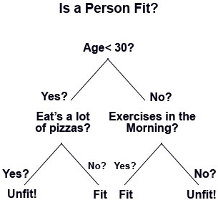
Tree Example

Slide 17
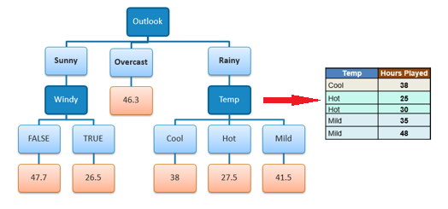
Decision Tree Regression

Slide 18
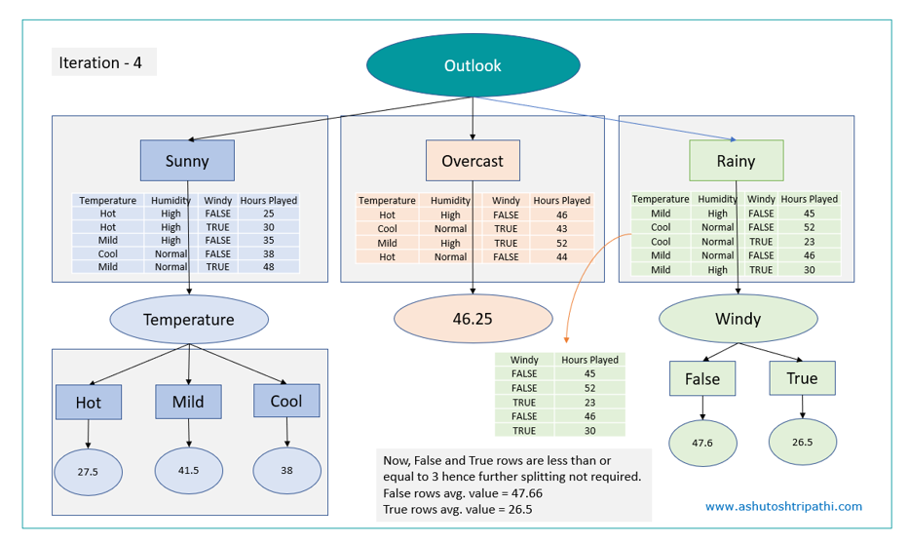
Decision Tree Regression

Slide 19
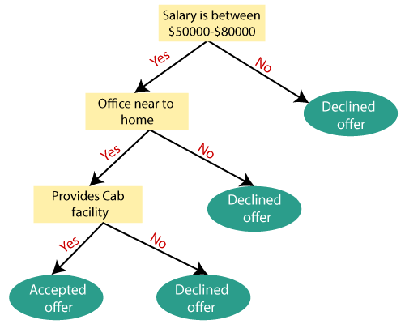
Decision Tree Classifier

Slide 20
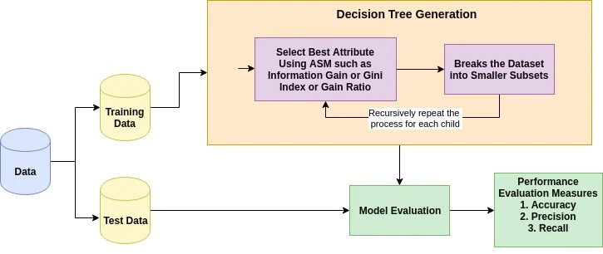
Decision Tree Generation

Slide 21
Random Forest
A random forest is an ensemble learning method that combines the predictions from multiple decision trees to produce a more accurate and stable prediction.
It is a type of supervised learning algorithm that can be used for both classification and regression tasks.

Slide 22
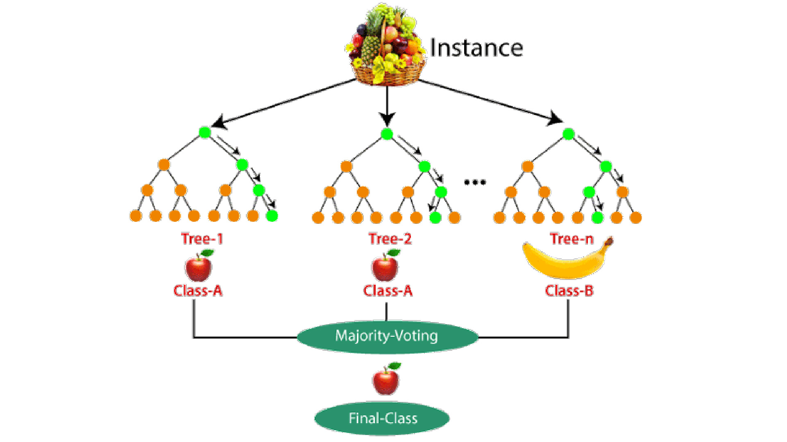
Random Forest

Slide 23
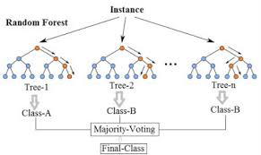
Random Forest

Slide 24
Applications of Random Forest
There are mainly four sectors where Random forest mostly used:
Banking: Banking sector mostly uses this algorithm for the identification of loan risk.
Medicine: With the help of this algorithm, disease trends and risks of the disease can be identified.
Land Use: We can identify the areas of similar land use by this algorithm.
Marketing: Marketing trends can be identified using this algorithm.

Slide 25
Pseudo-code, Random Forests algorithm follows these steps:
Take the original dataset and create N bagged samples of size n, with n smaller than the original dataset.
Train a Decision Tree with each of the N bagged datasets as input. But, when doing a node split, don’t explore all features in the dataset. Randomly select a smaller number, M features, from all the features in training set. Then pick the best split using impurity measures, like Gini Impurity or Entropy.
Aggregate the results of the individual decision trees into a single output.
Average the values for each observation, produced by each tree, if you’re working on a Regression task.
Do a majority vote across all trees, for each observation, if you’re working on a Classification task.

Slide 26
References
https://www.javatpoint.com/machine-learning-decision-tree-classification-algorithm
https://www.javatpoint.com/decision-tree-in-python-sklearn
https://www.kaggle.com/code/mohamedbelkheir/confusion-matrix-on-iris

