Slide 1
KNN images
Dr Gayatri S Pandi

Slide 2
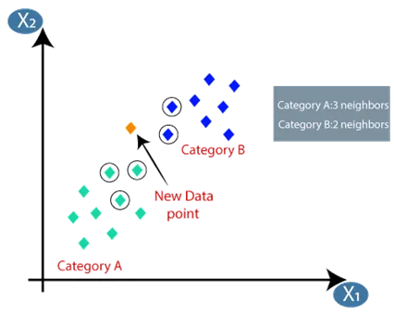
Classification

Slide 3
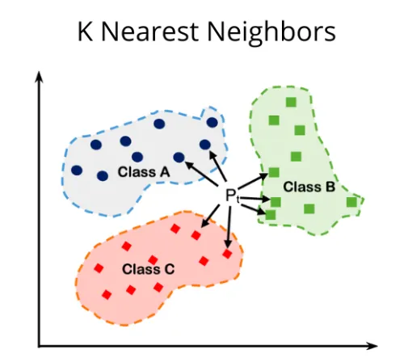
Classification

Slide 4
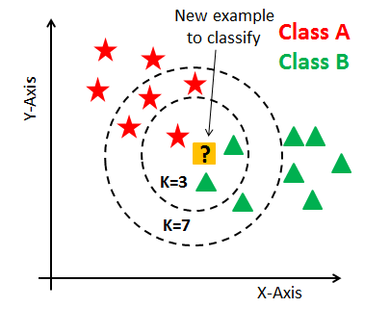
Classification using KNN

Slide 5
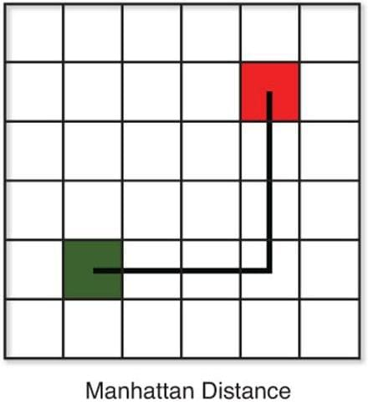
Manhattan Distance

Slide 6
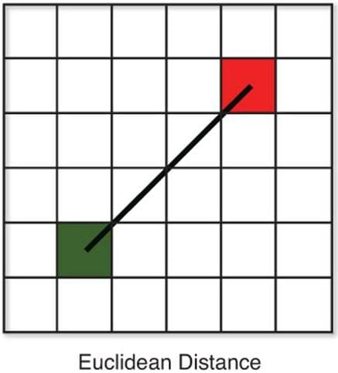
Euclidean Distance

Slide 7
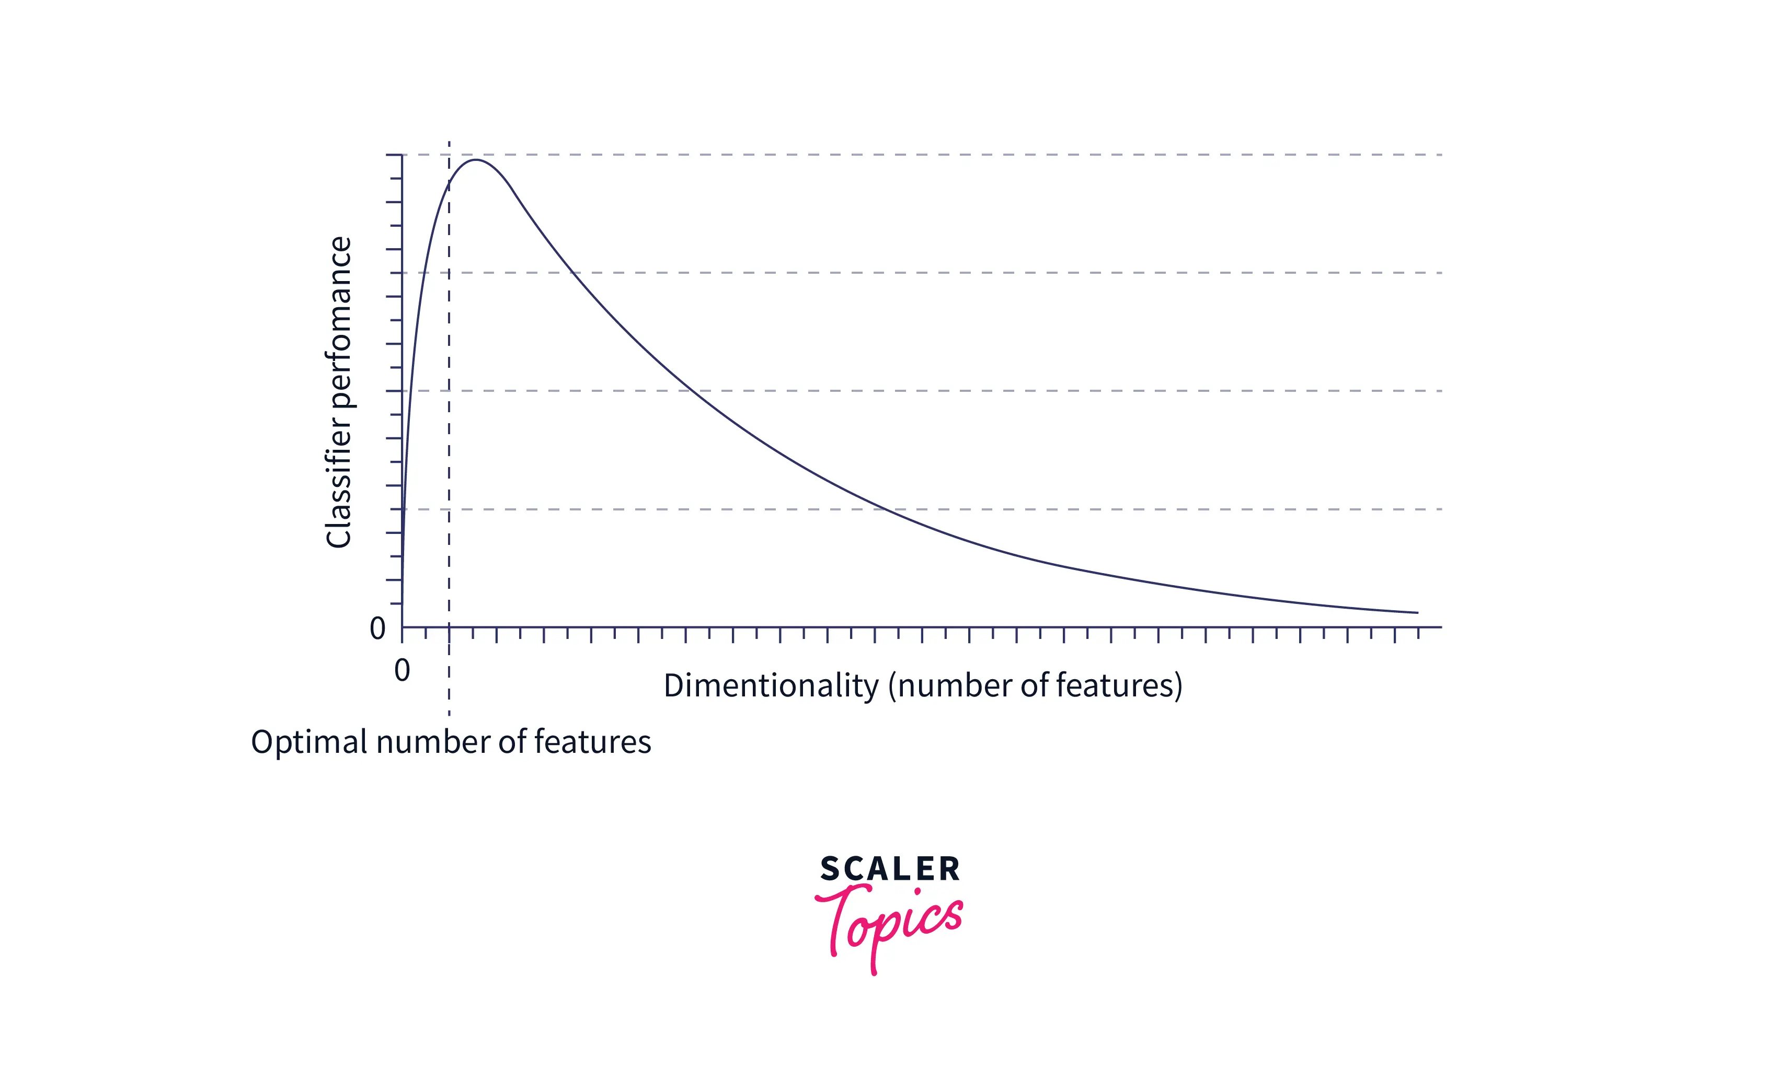
Curse of Dimensionality

Slide 8
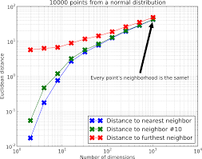
Curse of Dimensionality

