Slide 1
Logistic Regression
Dr Gayatri S Pandi

Slide 2
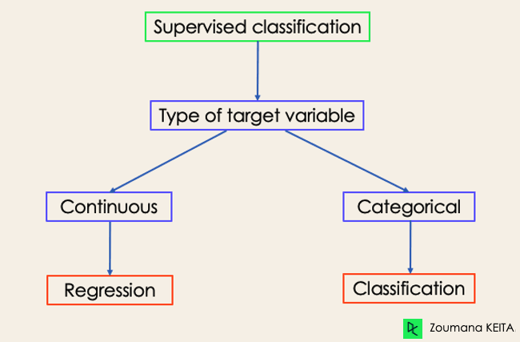
Classification

Slide 3
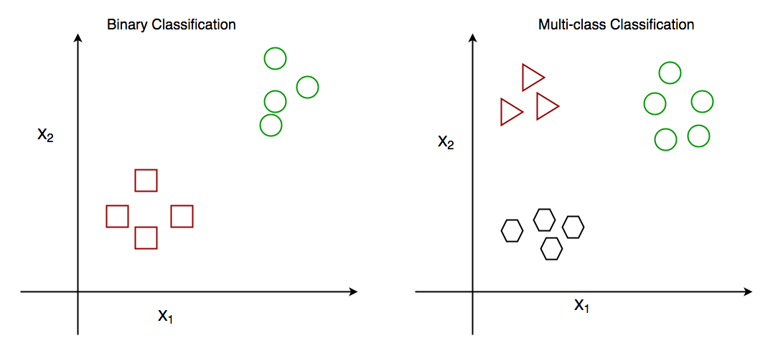
Classification

Slide 4
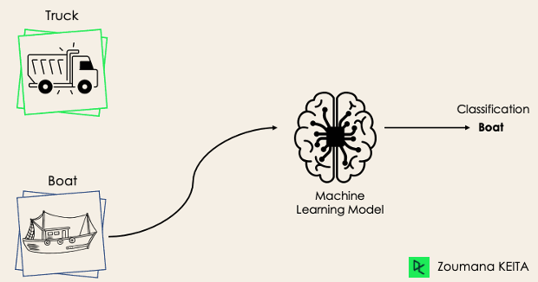
Binary Classification

Slide 5
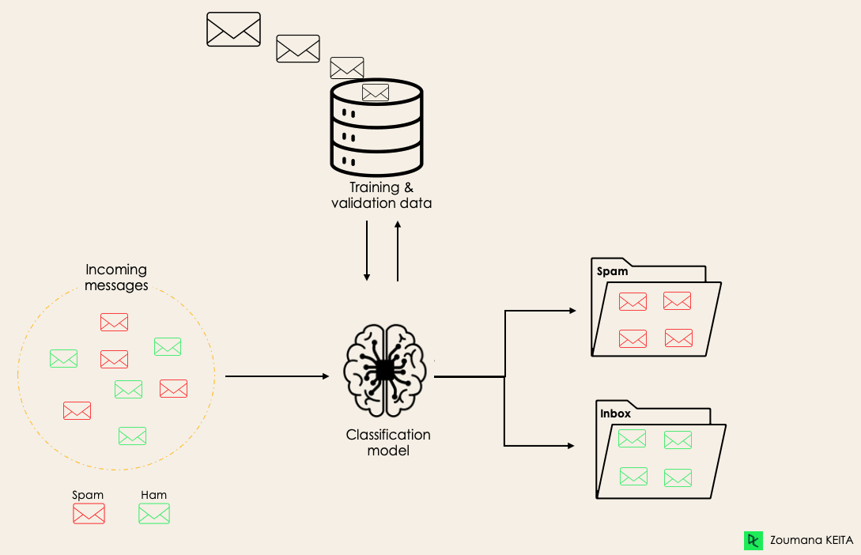
Mail Classification

Slide 6
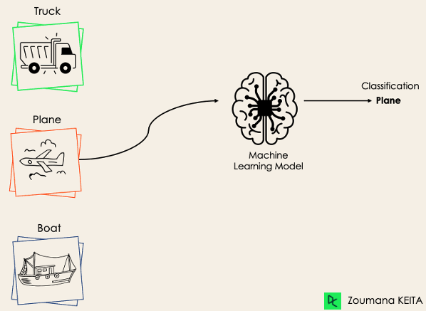
Multiclass Classification

Slide 7
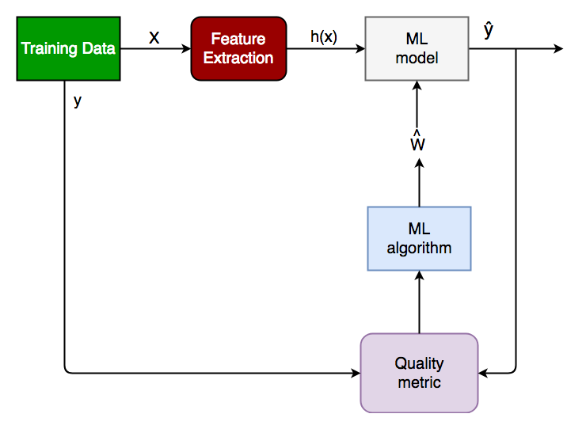
Training a classifier

Slide 8
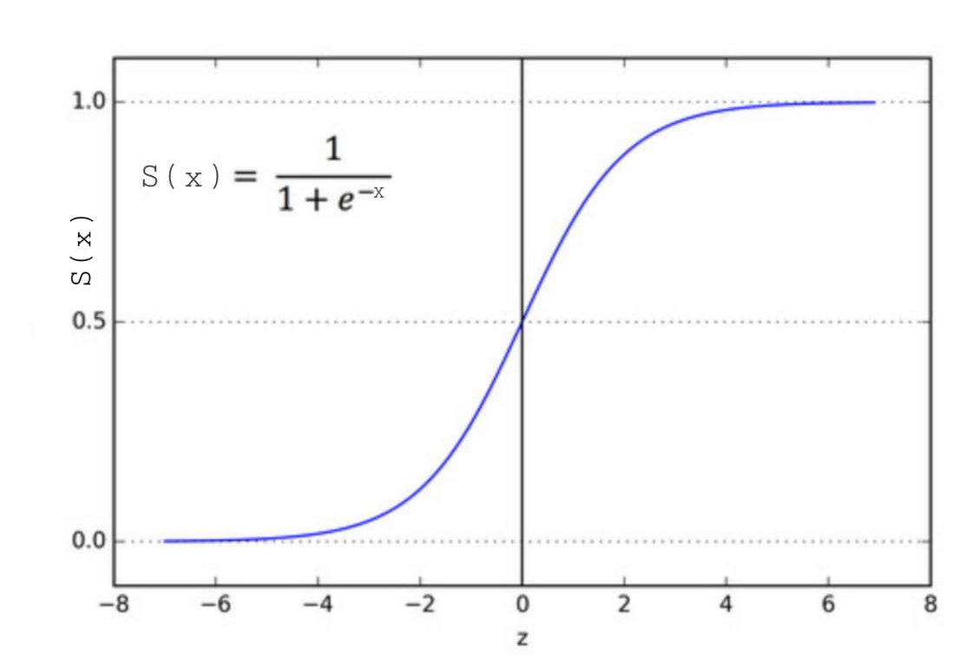
Sigmoid Function (Logistic Function )

Slide 9
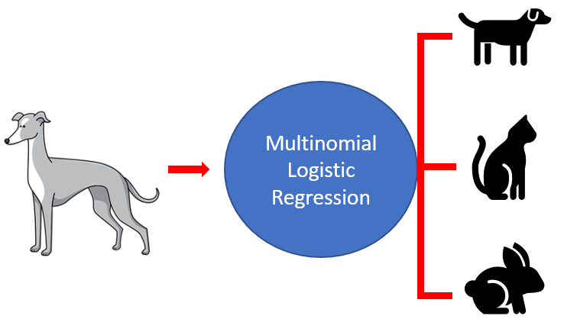
Multinomial Logistic Regression

Slide 10
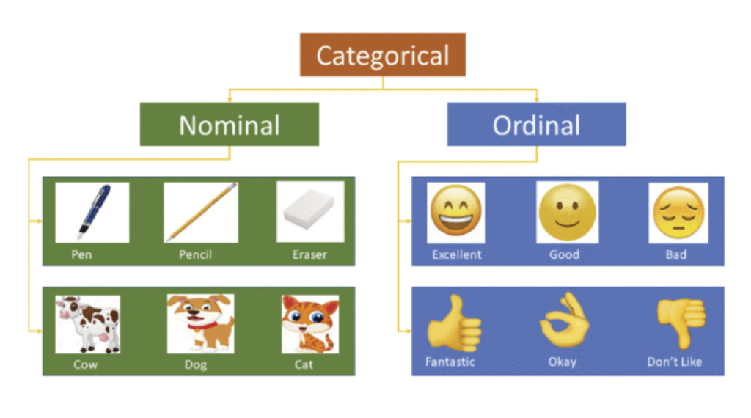
Nominal Vs Ordinal

Slide 11
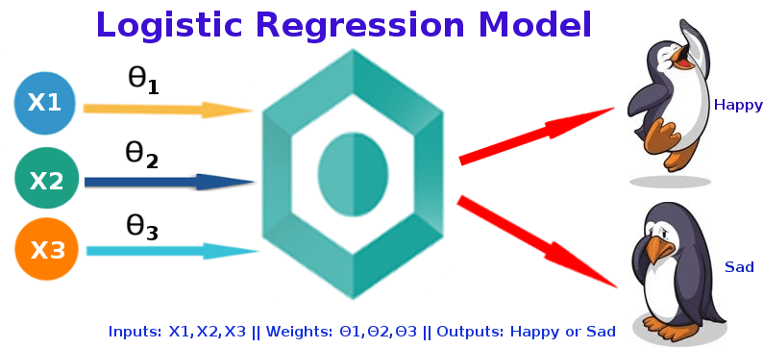
Logistic Regression

Slide 12
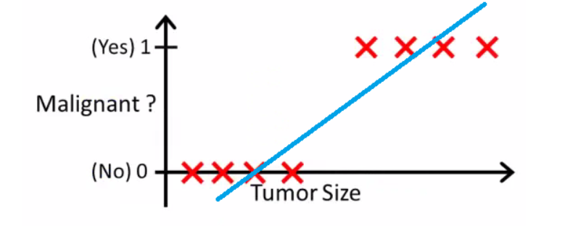
Logistic Regression for Tumors-Cancer

Slide 13
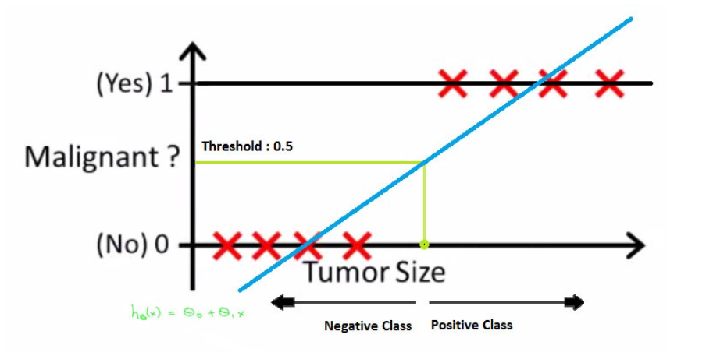
Logistic Regression for Tumors-Cancer

Slide 14
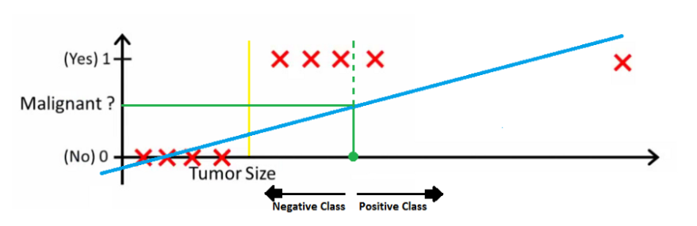
Logistic Regression for Tumors-Cancer

Slide 15
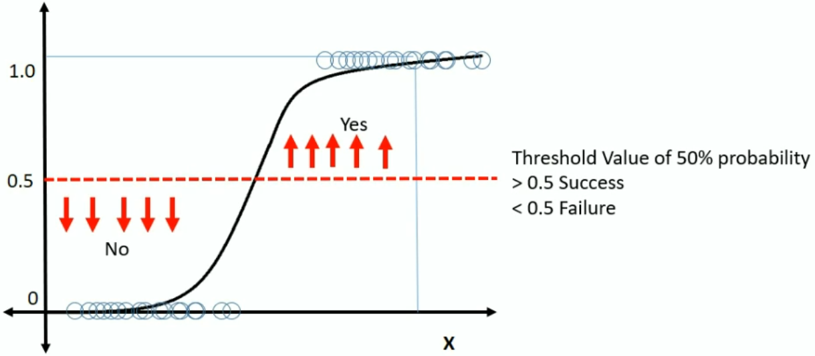
Threshold values

Slide 16
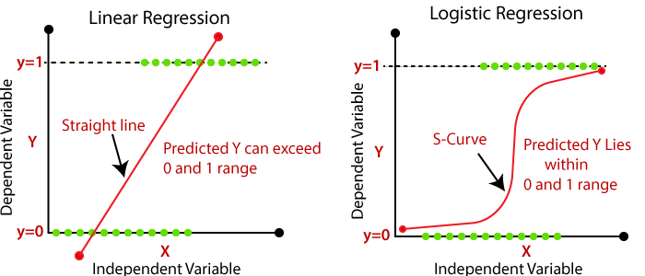
Linear Vs Logistic Regression

Slide 17
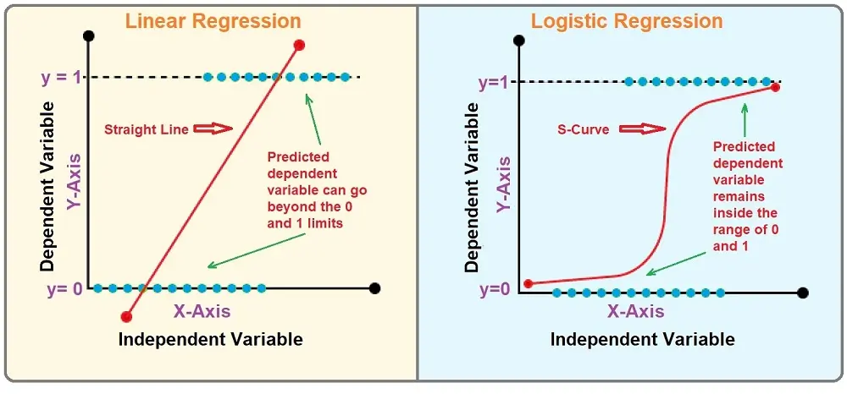
Linear Vs Logistic Regression

