Slide 1
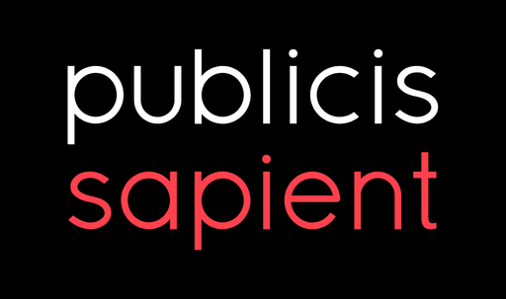
Reference Data Chat Box

Slide 2

Agenda
Introduction
Purpose and Value
Architecture
Product Demo
Q & A

Slide 3
Introduction
Our product combines cutting-edge AI technologies to streamline and optimize information retrieval processes.
By leveraging a powerful blend of Large Language Models (LLMs) and vector databases, we deliver precise and contextually relevant answers to user queries in real-time.
Key technologies:
LangChain: Framework for integrating LLMs with applications
Gemini LLM Model: Advanced model for nuanced understanding and generation
Vector Store: Efficiently stores and retrieves data using vectors
RAG (Retrieval-Augmented Generation): Ensures accurate and relevant results

Slide 4
Purpose & Value
Managing Overwhelming Documentation: Simplifies navigation through extensive wiki pages, reducing time spent searching for specific information and speeding up workflows.
Boosting Productivity and Efficiency: Provides quick access to essential functions for analysts and QA teams, streamlining rule implementation and enabling faster, high-quality support and query resolution.
Facilitating Domain Knowledge Acquisition: Reduces the complexity of learning domain-specific information by centralizing key resources, minimizing the need to reference multiple sources.

Slide 5
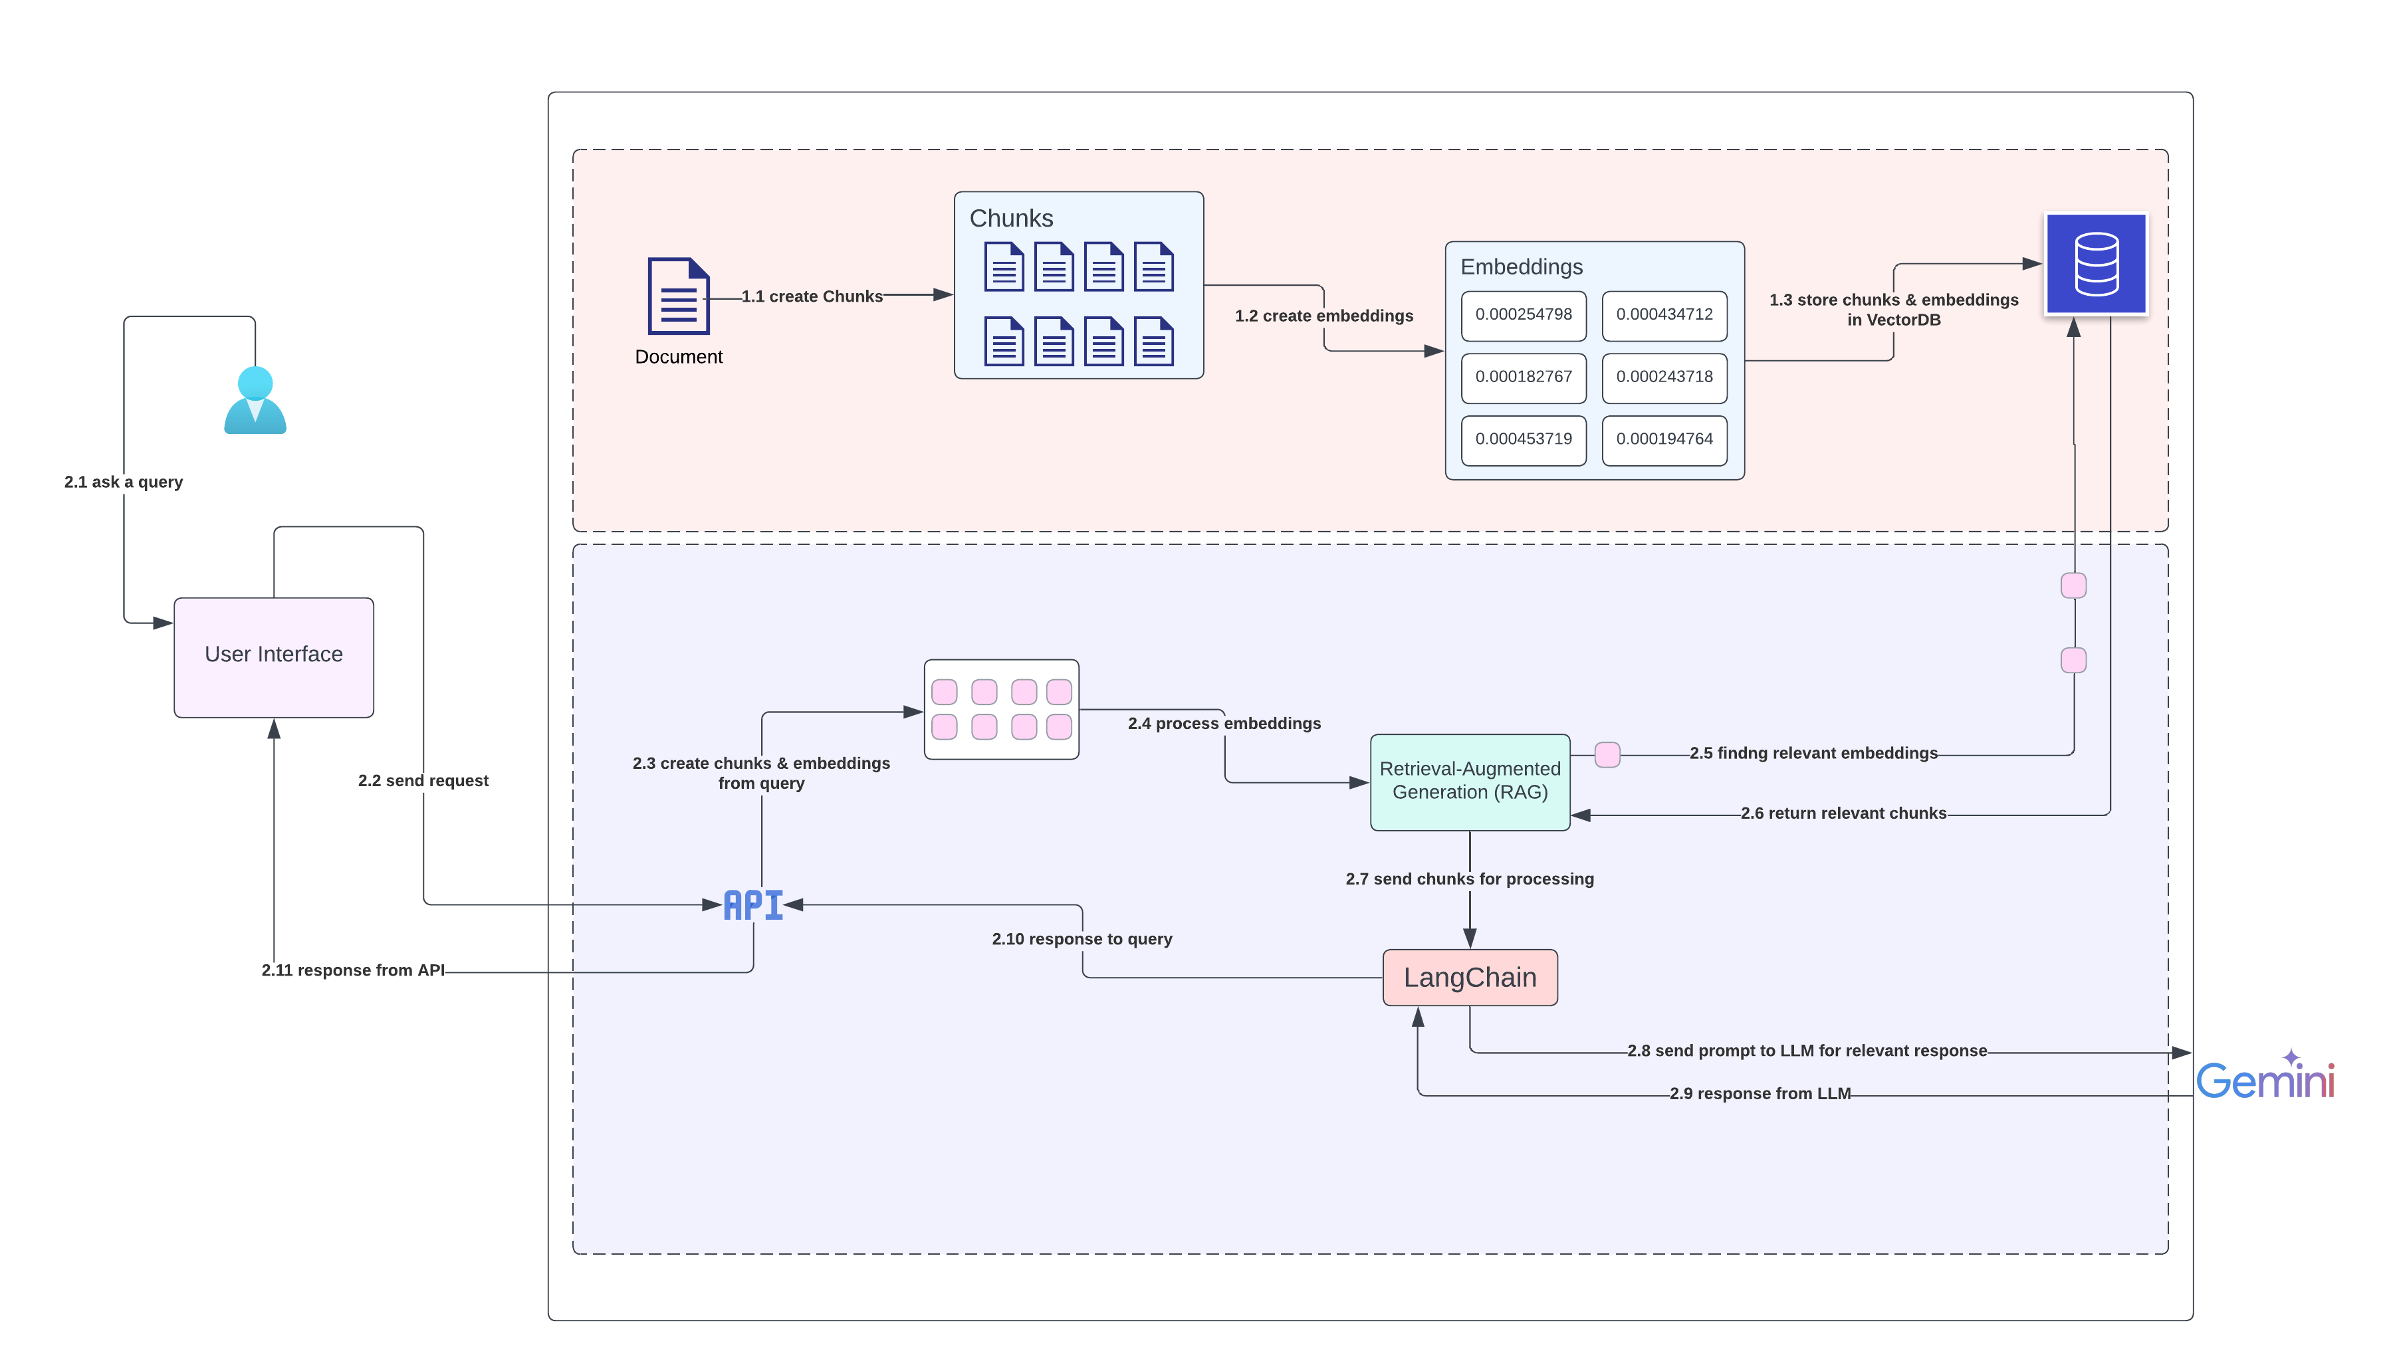
Architecture

Slide 6

Product Demo

Slide 7
References
Input (Text/PDF): The system starts with a large document or input text (such as a PDF or text file).
Text Splitter: The document is split into smaller, manageable chunks using a text-splitting mechanism. This is to ensure the system handles the document in parts.
Embedding the Chunks: Each chunk is transformed into embeddings (numerical representations) using an embedding model. These embeddings capture the semantic meaning of the text in a form that can be stored and searched.
Store in Vector Database (Vector Store): The embedded chunks are stored in a Vector Database or Vector Store, where they can be efficiently retrieved based on similarity to queries.

Slide 8
References
Query: A user sends a query or question that needs an answer. The query is converted into an embedding similar to the document chunks.
Retrieve Chunks from Vector Store: The system retrieves the most relevant chunks related to the user query from the vector store, based on the similarity of their embeddings.
LangChain & RAG: These frameworks are used to process and manage the interaction between the retrieved chunks and the query. They connect the system to the LLM and retrieve information for generation purposes.
Query to LLM: The retrieved relevant chunks and the original query are sent to a Large Language Model (LLM), which processes the input and generates an appropriate answer.
Answer: The system provides the generated response to the user based on the LLM's output.

Slide 9
Q & A

Slide 10
THANK YOU

