Slide 1
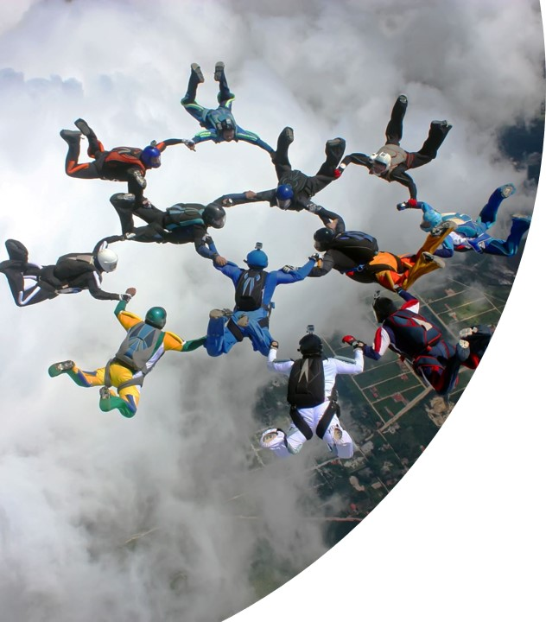

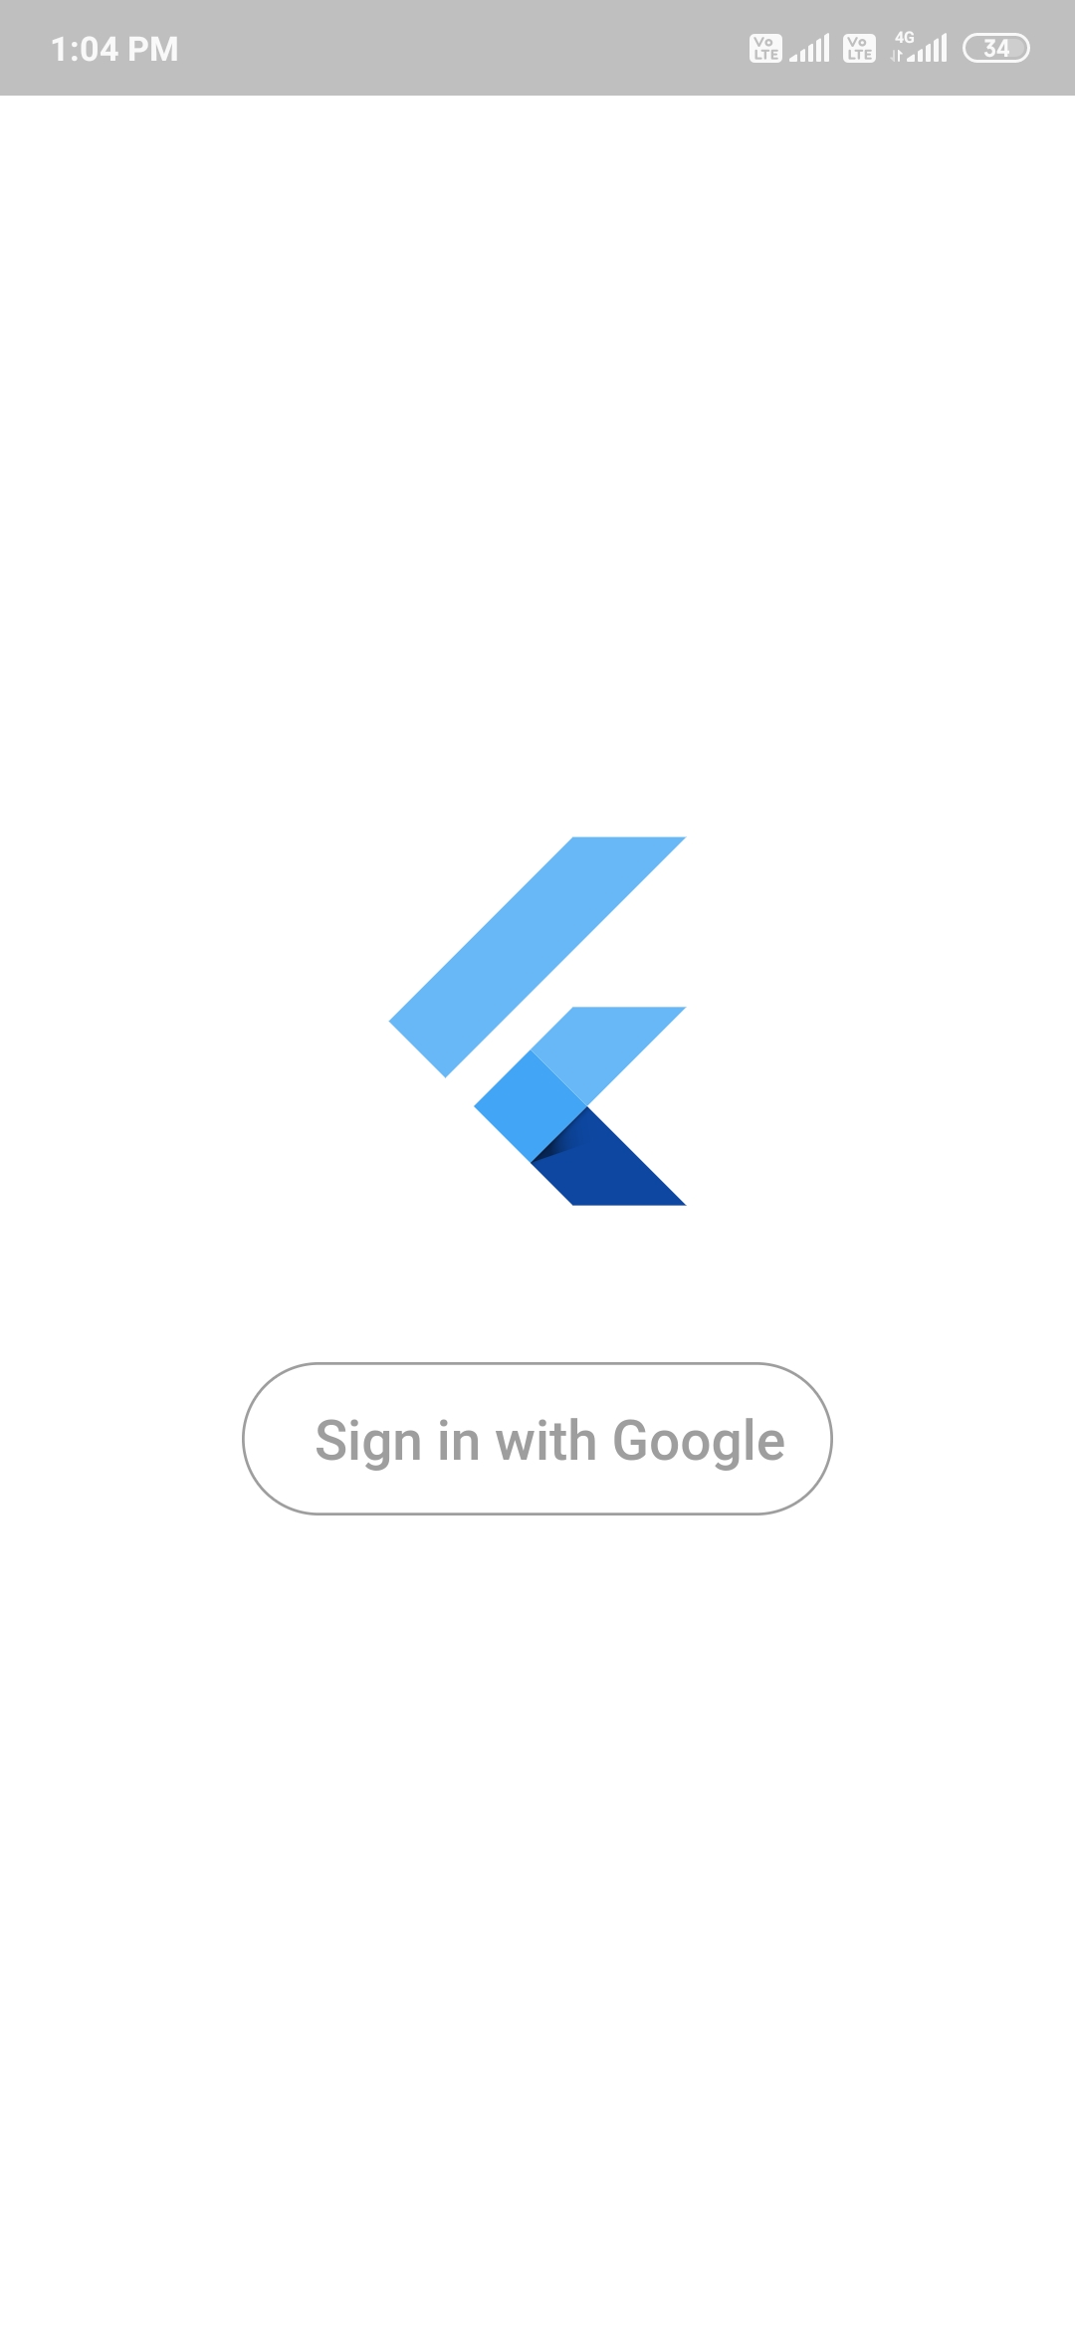
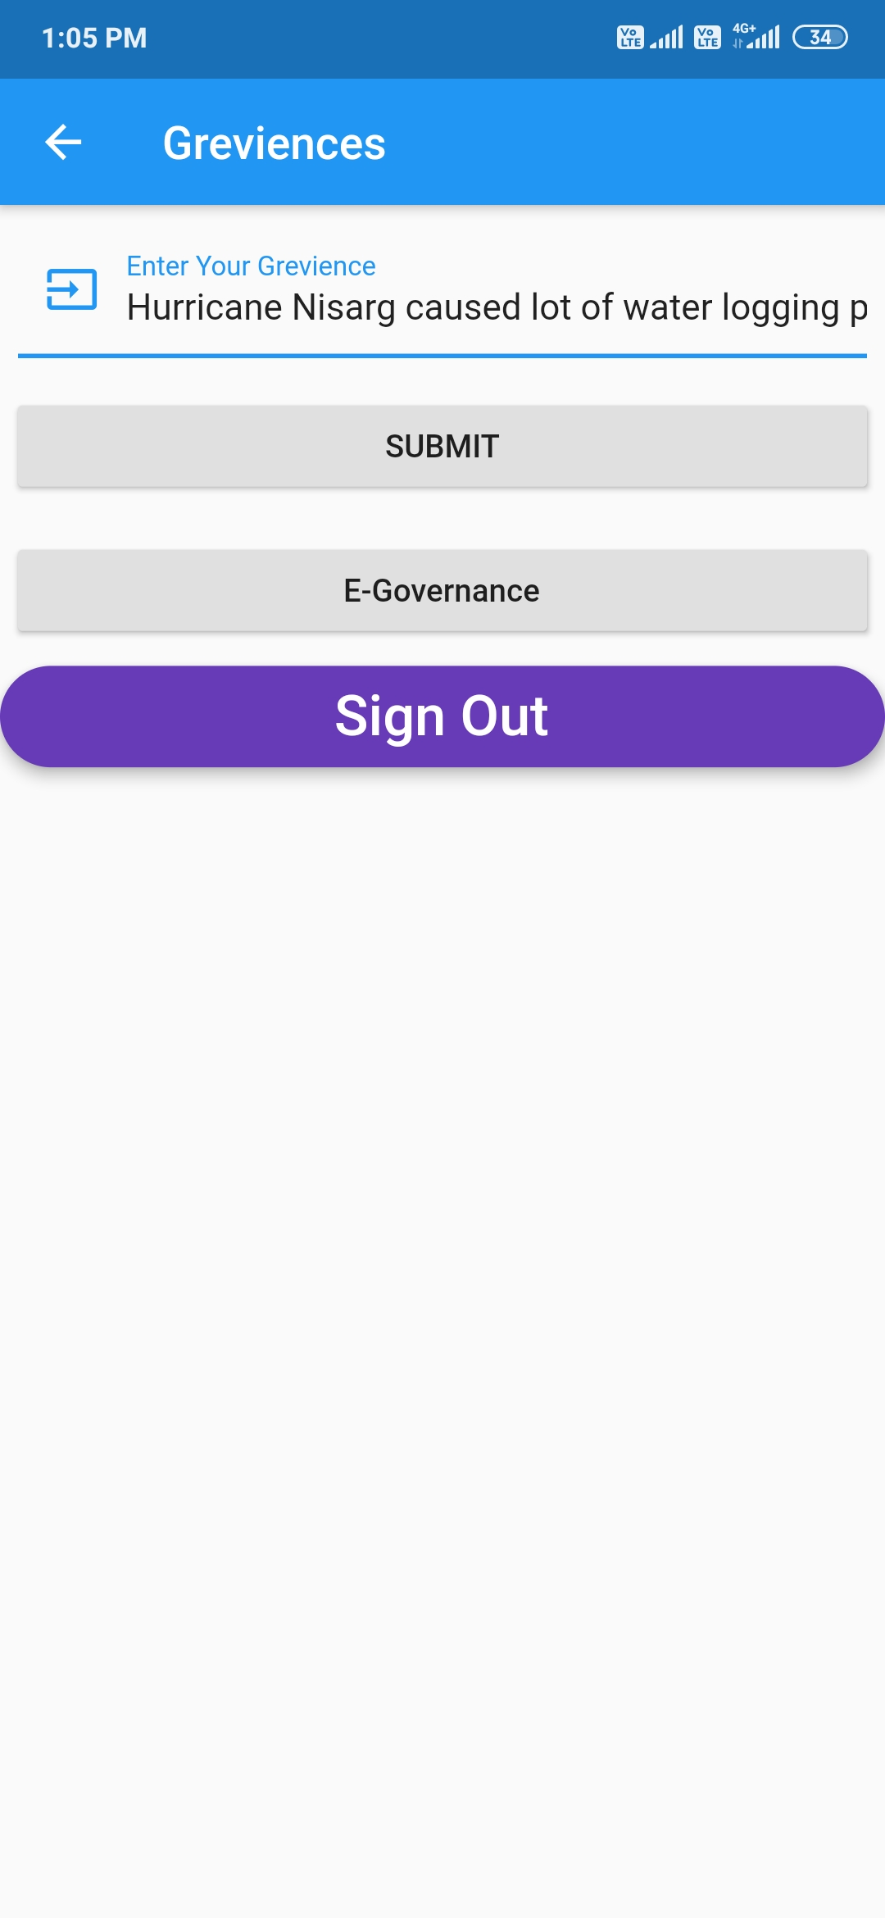
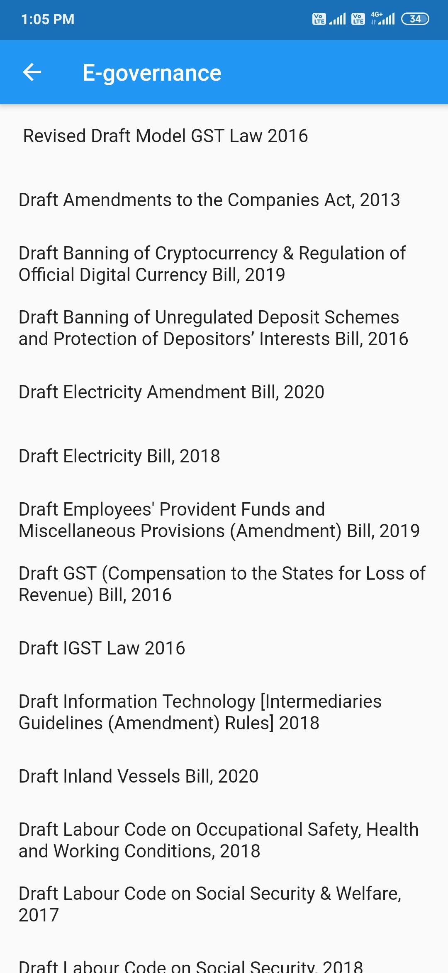
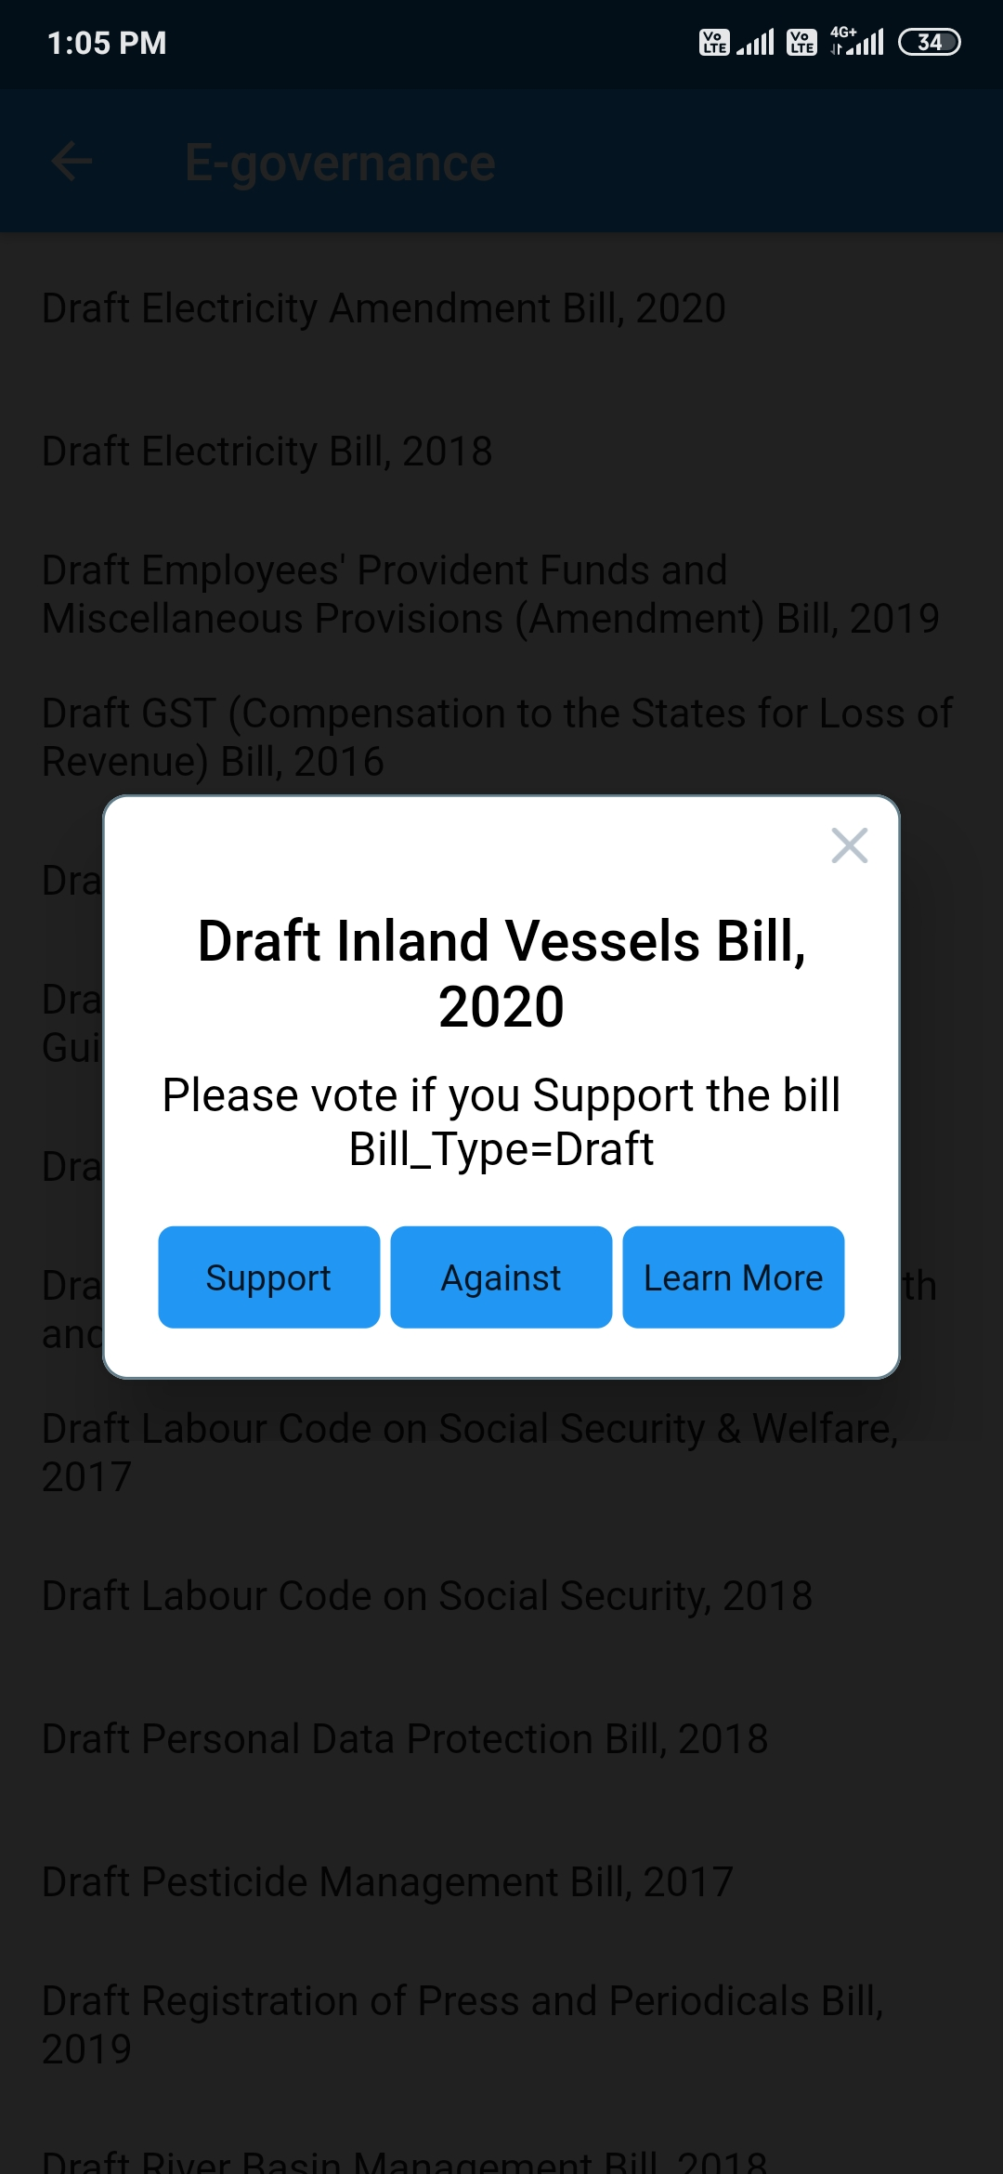
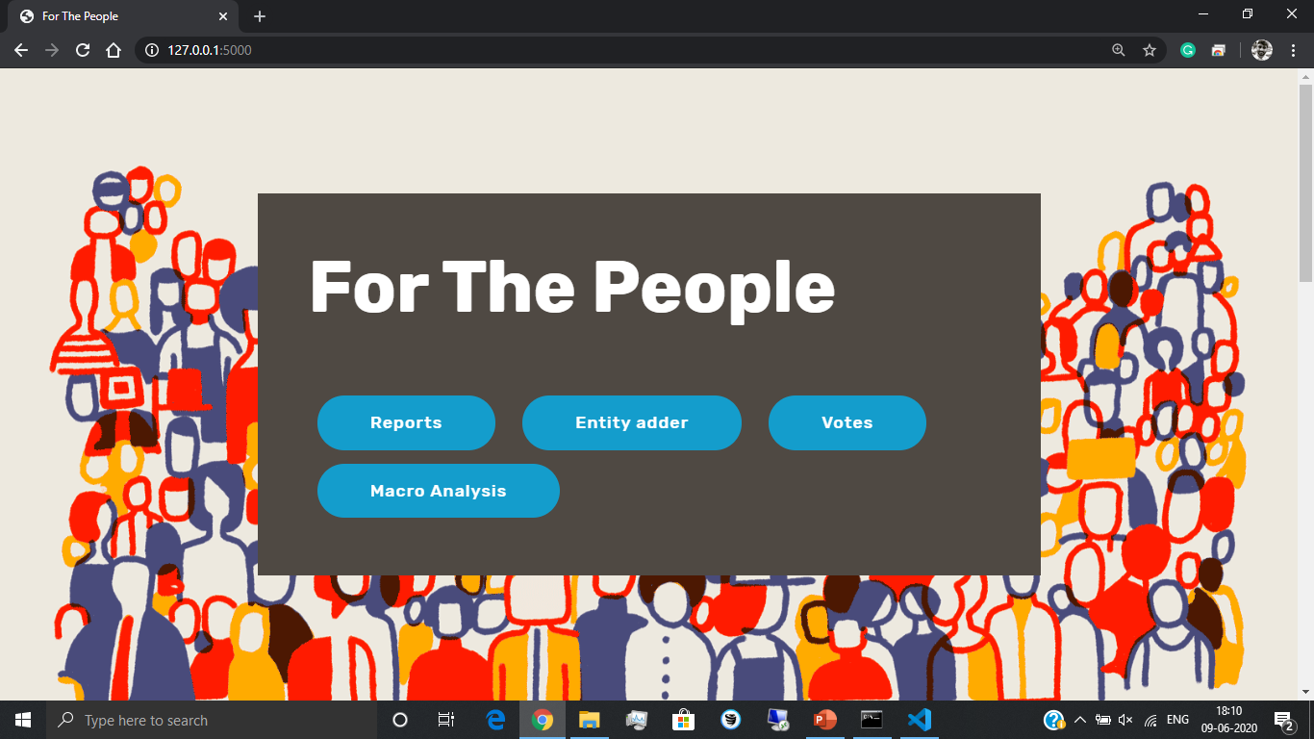
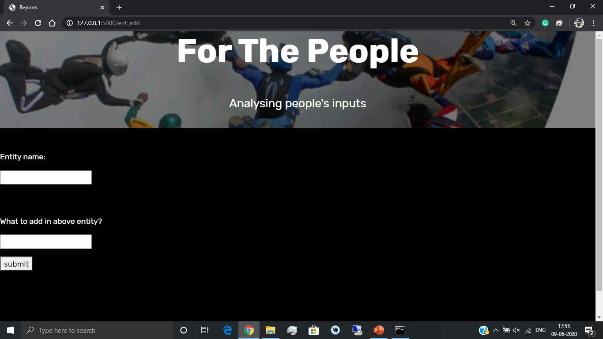

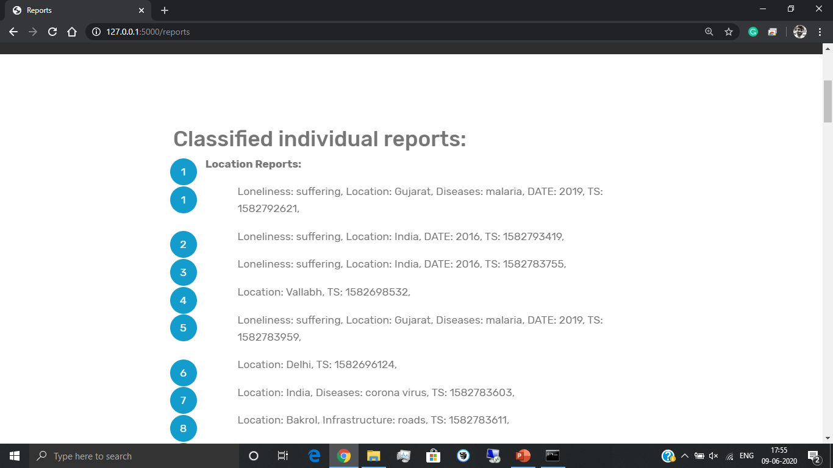
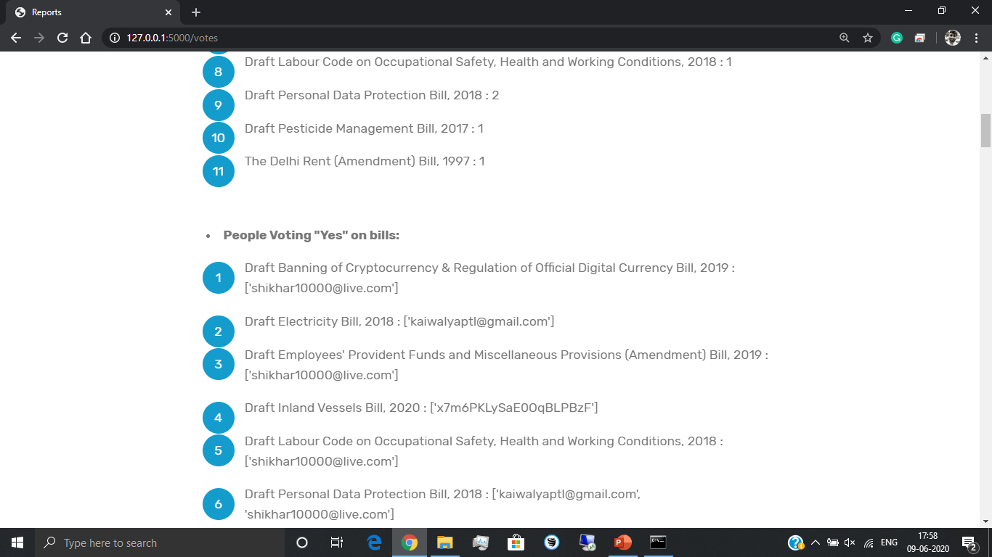
For the people
Sign in page Grievance Reporting
Bills to read and vote upon Vote Support/Against on any bill
Website Homepage Entity Adder page
Display all the classified reports Display voting data
Introduction:
Android based Application and Website:
Working:
The working goes like: People’s grievance/feedback on general issues as well as government bills is taken from various sources like social medial chatbots, multiplatform application.
Our app consists of sign-in page, grievance reporting page and government bills page.
This data from database is classified by the entity names by NLP engine. And the classified data is, again, stored into Firestore.
The classified data is further displayed on website in various forms. This includes showing reports based on entity, counts of entities. Other page show all the votes and corresponding number of votes all the users who are either on supporting or opposing side.
There is also a webpage for unclassified data and adding entity, on which admin can manually classify the report. Hence even if something new, like COVID 19 comes into existence, we can easily classify.
People’s feedback is an important aspect of democracy and this often gets overlooked in India.
In this project, we aim to get feedback of willing people by making certain online platforms that are open to all. We plan to closely analyse these inputs from the people and extract important parameters, like the problem, location, which department/ministry it is falling under, frequency of submission.
Hence by getting such feedbacks, analysing them closely and solving problems, we aim to help people resolve their problems and work as a stepping stone towards perfect democracy
Working of our system
Social Media Chatbots
Multi platform Application
User Inputs
Classification Parameters
Update
Classification Parameters
NLP Engine
Classified Parameters
Firestore
Scope/Applications:
Public Grievance reporting system
Anonymous crime reporting Fasttrack
Quantitively analysis of Individual govt. bodies
Macro Analysis of individual Grievances report to help better allocate budget of Country
Expansion on the E-Governance
Outbreak Prediction
Firestore
On web UI
Web UI For Institutions(E.g. :- Municipal Corp. , Police)
Human Classifier
The central intuition behind the working of this system is to let people enjoy real democracy. We observed that a lot of recent movements and bills targeted the citizen's privacy or were against the will of citizens.
Other than that the genal grievances of the people remain unheard by the intuitions that were established to solved them.
The major reason behind all the above being lack of a system that can meaning fully collect, organise and represent to the above mentioned authorities
The services which are provided by the government with an assurance “For the People” are built and never looked upon unless there is wreckage in their daily functioning.
Since we live in a democracy, it becomes our right to enjoy every service in its best possible way. Hence we aim to solve this problem by creating online platforms immersed with data analytics.
Made by:
Students:
Shikhar Maheshwari(16ET415)
Kaiwalya Patil(16ET430)
Guided by:
Prof. Amit Choksi
Notes:
You can add your presentation notes here. This presentation template for research posters is fully editable so text, graphics and content can be updated to fit your own research needs.
Download more poster presentation templates from FPPT.com

