Slide 1
Android System Internals
kaiwang.chen@gmail.com
2014.9.10

Slide 2
Agenda
Source overview
System overview
Application overview
Binder IPC
System bootup

Slide 3
Android Open Source Project
https://source.android.com
repo tool
git clone, https_proxy aware
Kernel tree excluded by default
28G work directory
13GB android source, 700MB kernel source (goldfish)
Checkouts
100GB free disk space recommended
case-sensitive file system
No Windows, no Mac
Notes:
https://source.android.com/source/index.html

Slide 4
Recommended Readings
Inside Android’s Dalvik VM, by Douglas Q. Hawkins
老罗的Android之旅
Samchen2009 图解 Android
elinux.org
Notes:
http://www.slideshare.net/dougqh/inside-androids-dalvik-vm-nejug-nov-2011
http://blog.csdn.net/luoshengyang/
http://www.cnblogs.com/samchen2009/tag/Android/

Slide 5
Workspace
cd /aosp/repo
source build/envsetup.sh
sgrep startService
find . -name ContextImpl.java
Notes:
https://source.android.com/source/index.html
https://github.com/kaiwangchen/kaiwangchen.github.io/tree/master/presentations/android-internals/Vagrantfile
https://github.com/kaiwangchen/kaiwangchen.github.io/tree/master/presentations/android-internals/aosp.sh

Slide 6
Agenda
Source overview
System overview
Application overview
Binder IPC
System bootup
Notes:
History, architecture, static view, runtime view

Slide 7
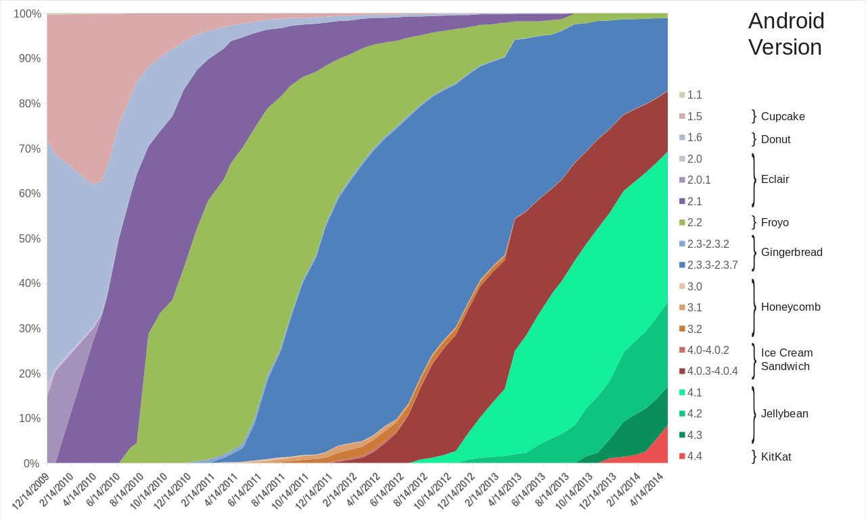
Android Version History
Notes:
http://en.wikipedia.org/wiki/Android_version_history
http://developer.android.com/guide/topics/manifest/uses-sdk-element.html#ApiLevels
The framework API consists of: packages, classes, manifest file, resources management, Intents, permissions

Slide 8
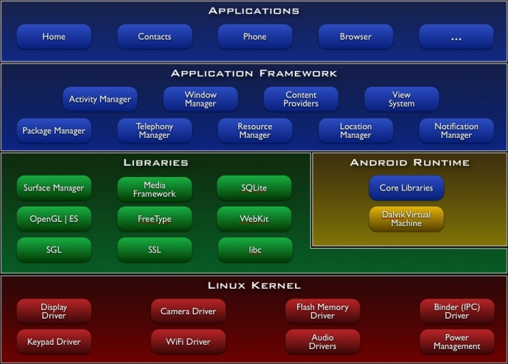
Android System Architecture
Notes:
http://elinux.org/Android_Architecture
http://kobablog.wordpress.com/2011/05/22/android-is-not-just-java-on-linux/

Slide 9
Users
root
system
radio
…
app_N
Each application is assigned a different Linux user ID.
Each application runs in its own Linux process.
Notes:
system/core/include/private/android_filesystem_config.h
Linux process isolation vs SELinux

Slide 10
File System Layout
/system/{bin, xbin, lib, etc, app, framework, …}
/etc -> /system/etc
/vendor -> /system/vendor
/data/{app, app-private, data, user, dalvik-cache, …}
/data/user/0 -> /data/data
/data/local/tmp/
/data/app/*.apk
/data/data/*/{lib, databases, cache, shared_prefs, files}
/init, /init.rc
/sbin/ueventd, /ueventd.rc
/sbin/adbd

Slide 11
Processes
init(1) and /init.rc
vold, netd, rild, servicefinger, qemud, installd, adbd, …
servicemanager
zygote
system_server
ActivityManager, PackageManager, AssetManager, etc.
Applications
com.android.{phone, launcher, contact, settings}, …
Notes:
http://benno.id.au/blog/2007/11/13/android-under-the-hood
http://www.slideshare.net/opersys/understanding-the-android-system-server

Slide 12
Demo
Explore android system in emulator

Slide 13
Agenda
Source overview
System overview
Application overview
Binder IPC
System bootup
Notes:
Apk format, adb install,

Slide 14
Android application package (APK)
Zip archive
Directory layout
META-INF/{MANIFEST.MF, CERT.*}
AndroidManifest.xml
classes.dex
lib/armeabi/*.so
resources.arsc
res/{layout, xml, drawable, anim, …}
assets
bin/Data/{Managed, …}
Notes:
http://en.wikipedia.org/wiki/APK_(file_format)

Slide 15
Install HelloJni.apk
Install by sdk\platform-tools\adb.exe
adb install HelloJni.apk
adb push HelloJni.apk /data/local/tmp/HelloJni.apk
adb shell pm install /data/local/tmp/HelloJni.apk
Files
/data/local/tmp/HelloJni.apk
/data/app/com.example.hellojni-1.apk
/data/data/com.example.hellojni/lib/{libhello-jni.so, gdbserver}
/data/dalvik-cache/data@app@com.example.hellojni-1.apk@classes.dex
Notes:
http://developer.android.com/tools/help/adb.html
http://developer.android.com/tools/device.html

Slide 16
Android Debug Bridge
service thread
PC
Phone or emulator
sync: …
fork
/data/local/tmp/HelloJni.apk
ADB client
ADB Server
ADB daemon
USB
or
TCP
fork
localhost:5037
shell: pm install …
ADB client forks ADB server
ADB Server detects USB and emulator ports
binder IPC
PackageManagerService
installPackage
/dev/socket/installd
installd
Prepare directories
Notes:
system/core/adb/OVERVIEW.TXT, SERVICES.TXT, protocol.txt, SYNC.TXT
adt-bundle-windows-x86_64-20140702\sdk>platform-tools\adb.exe shell
* daemon not running. starting it now on port 5037 *
daemon started successfully *
system/core/adb/services.c
/system/bin/pm
frameworks/base/cmds/app_process/app_main.cpp
frameworks/base/cmds/pm/src/com/android/commands/pm/Pm.java
frameworks/base/services/java/com/android/server/pm/PackageManagerService.java:installPackageWithVerificationEncryptionAndAbiOverride
frameworks/native/cmds/installd/commands.c: install( )

Slide 17
Application components
AndroidManifest.xml
components, permissions, API levels, required features, …
Activities
Services
Content providers
Broadcast receivers
Notes:
http://developer.android.com/guide/components/fundamentals.html
PackageManager.hasSystemFeature( )
Each component is a different point through which the system can enter your app.
A unique aspect of the Android system design is that any app can start another app’s component.

Slide 18
Application processes
system events
most important, killed last
Process 2
Foreground
main thread (UI)
system callbacks
Visible
worker thread
worker thread
Service
async tasks, …
Background
Empty
Importance of a process
components in the process and their state
inter-process dependency
least important, killed first
Notes:
http://developer.android.com/guide/components/processes-and-threads.html

Slide 19
Context.startActivity( )
Intent
ActivityManagerService
Zygote
fork
binder IPC
/dev/socket/zygote
RuntimeInit.zygoteInit( )
--runtime-init
--setuid=
--setgid=
…
android.app.ActivityThread
ActivityThread.main( )
Notes:
http://www.cnblogs.com/bastard/archive/2012/09/03/2668579.html

Slide 20
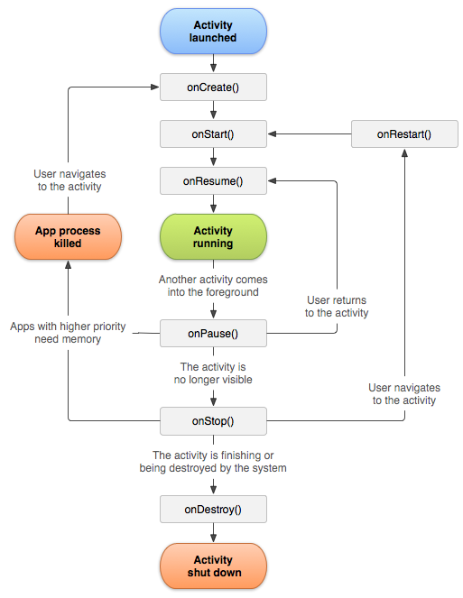
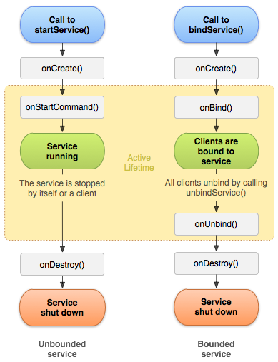
Notes:
http://developer.android.com/guide/components/activities.html
http://developer.android.com/guide/components/services.html

Slide 21
Agenda
Source overview
System overview
Application overview
Binder IPC
System bootup
Notes:
Binder overview, use cases, handle, binder driver, IPC development

Slide 22
Binder IPC
/dev/binder
Binder protocol stack
ioctl(2) command
Binder write/read command
Binder transaction and reply
Intent is part of Binder transaction payload
Development
Hand-craft
AIDL
Notes:
Intent is part of Binder IPC payload
AIDL is to simplify developing with binder protocol

Slide 23
Typical Use Cases
client
binder driver
service
manager
service
1. become handle_0
2. handle_0, please add binder obj(ptr) as ServiceA
3. please add handle_m as ServiceA
4. Add handle_m as ServiceA
6. handle_0, where is ServiceA
7. where is ServiceA
8. ServiceA is at handle_m
5. wait for message
9. ServiceA is at handle_c
10. handle_c, please do X
11. do X
14. done X
13. done X
12. do X

Slide 24
Binder and handle
Service process owns binder node
Handle(desc) refers to the node
Valid in its own process space
Auto-installed
service manager tracks services in user space
service
binder_proc
task_struct
nodes
service manager
binder_node
binder_proc
binder_ref
ptr
cookie
death
task_struct
refs_by_node
refs_by_desc
node
desc
client
binder_proc
binder_ref
task_struct
refs_by_node
refs_by_desc
node
desc
Notes:
flat_binder_object is recognized in driver:
binder_new_node( ) to create the node in the service process,
binder_get_ref_for_node( ) to install a new reference into any other process involved.

Slide 25
ioctl(2) commands
BINDER_WRITE_READ
argp: struct binder_write_read
BINDER_SET_MAX_THREADS
BINDER_SET_CONTEXT_MGR
BINDER_THREAD_EXIT
BINDER_VERSION
ioctl(int fd, int request, void *argp)
Command = BINDER_WRIE_READ
argp buffer length
argp is for read or write
binder_write_read
consumed
Commands to driver
consumed
Replies from driver
write buffer
read buffer
Notes:
binder_ioctl(BINDER_WRITE_READ) writes command then reads reply.

Slide 26
BINDER_WRITE_READ data transfer
write buffer of proc A
Commands (BC_) and Replies (BR_)
Node references
Buffer deallocation
Looper state
Transaction and reply
struct binder_transaction_data
Death notification
binder_write_read and read / write buffers are always copied
transaction data are copied once into kernel space and mapped to reader’s user space
consumed
BC_
binder_transaction_data
read buffer of proc B
consumed
BR_
binder_transaction_data
data
data
User space
Kernel space
data
shared physical pages

Slide 27
Example: add service against service manager
binder-mapped (instead of copied) user space buffer
The “add service” message
binder_transaction_data
code = add service
data
offsets
User space
Kernel space
data
n
offsets
policy
android.os.IServiceManager
service name
flat binder object
isolation
n
binder_buffer
data and offsets
binder_transaction
binder_proc
Notes:
binder_transaction_data is copied per ioctl call.

Slide 28
Example: start service against activity manager
Code is defined by interface
FIRST_CALL_TRANSACTION = 0x00000001
LAST_CALL_TRANSACTION = 0x00ffffff
binder_transaction_data
code = start service
data
offsets
action
Uri
…
data
n
offsets
caller
android.app.IActivityManager
flat binder object
service intent
mime
User id
n
binder_buffer
data and offsets
Notes:
frameworks/base/core/java/android/os/Parcel.java
frameworks/base/core/java/android/content/Intent.java
http://developer.android.com/reference/android/content/Intent.html

Slide 29
open(2)
file
binder_thread
poll(2)
task_struct
private_data
proc
rb_node
transaction_stack
todo
wait
stats
pid =
ioctl(2)
binder_deferred_list
binder_proc
binder_procs
deferred_work_node
proc_node
binder_proc
binder_last_id
deferred_work_node
proc_node
pid
threads
nodes
refs_by_desc
refs_by_node
refs
buffer
buffers
free_buffers
allocated_buffers
pages
todo
wait
stats
binder_transaction
debug_id
work.entry
work.type
from
to_proc
to_thread
buffer
binder_node
debug_id
work.entry
work.type
rb_node
ptr =
cookie
refs
async_todo
binder_ref
debug_id
rb_node_desc
rb_node_node
node_entry
proc
node =
desc =
mmap(2)
Kernel space
User space
Notes:
binder_open( ) shall kzalloc a binder_proc
binder_poll( ) and binder_ioctl( ) calls binder_get_thread( ) which may kzalloc a binder_thread into threads of binder_proc
binder_ioctl( ) BINDER_WRITE_READ command writes to do node, buffer, transaction ( copy to buffer and ), and reads
debug_id is binder_last_id++ for binder_node, binder_ref, binder_buffer, binder_transaction, transaction_log_entry
binder_get_ref_for_node( ) creates a binder_ref if necessary, links to _by_node tree, calculates desc, and links to _by_desc tree
binder_inc_ref( ) increase res, and adds dangling binder_node (has_strong/weak_ref is false, i.e. release a node) to todo list of a proc or thread
Todo list may have node operations, transactions, etc.

Slide 30
BINDER_WRITE_READ interaction
sender
Work queue
binder_proc
binder_thread
binder_node
TRANSACTION_COMPLETE
threads
todo
todo
receiver
Work queue
binder_proc
binder_thread
binder_transaction
threads
todo
todo
Data in kernel space
firstly writes to work queue
secondly reads from work queue
Notes:
binder_transaction( )

Slide 31
Binder IPC Development
Proc A
Proc B
Binder Proxy
Binder IPC
Binder
remote : IBinder
transact( )
onTransact( )
Notes:
Service manager is the start point of Binder IPC

Slide 32
C++
Java
RefBase
IInterface
IBinder
BpRefBase
IInterface
IBinder
asBinder( )
remote : IBinder
asBinder( )
onAsBinder( )
FIRST_CALL_TRANSACTION
LAST_CALL_TRANSACTION
transact( ) = 0
Binder
IFooService
fooBar( )
IFooService
descriptor
asInterface(IBinder&)
fooBar() = 0
BBinder
transact( )
onTransact( )
IFooService.Stub.Proxy
IFooService.Stub
remote: Ibinder
fooBar( )
DESCRIPTOR
TRANSACTION_foo
asInterface(IBinder)
onTransact( )
BpInterface<IFooService>
BnInterface<IFooService>
AIDL
onAsBinder( ) = remote
onAsBinder( ) = this
FooService
BpFooService
BnFooService
fooBar( )
fooBar( )
onTransact( )
service manager = IPCThreadState::self()->transact(0, …)
service manager = BinderInternal.getContextObject( )
Notes:
Parcel.readStrongBinder is native method.

Slide 33
Demo
Notes:
frameworks/base/core/java/com/android/internal/statusbar/IStatusBar.aidl
frameworks/base/core/java/android/app/StatusBarManager.java
frameworks/base/services/java/com/android/server/StatusBarManagerService.java
frameworks/base/core/java/android/app/IActivityManager.java (interface)
frameworks/base/core/java/android/app/ActivityManagerNative.java (stub, proxy)
frameworks/base/services/java/com/android/server/am/ActivityManagerService.java (service)

Slide 34
Agenda
Source overview
System overview
Application overview
Binder IPC
System bootup
Notes:
system/core/rootdir/init.rc

Slide 35
System boot up
/init.rc
Environment
Fs, mounts, …
Properties
Daemons
on <trigger>
<command>
<command>
service <name> <pathname> [ <argument> ]*
<option>
<option>
...
Notes:
system/core/init/readme.txt
system/core/init/keywords.h

Slide 36
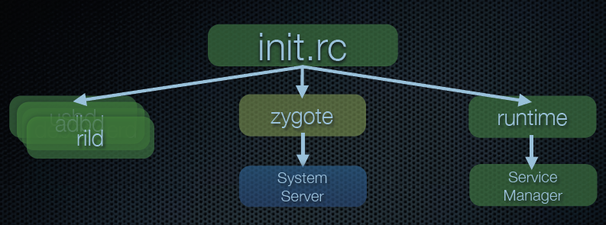
Notes:
Page 13~25, Inside Android’s Dalvik VM, by Douglas Q. Hawkins
http://www.cnblogs.com/bastard/archive/2012/09/03/2668579.html
http://www.cnblogs.com/samchen2009/p/3294713.html

Slide 37
Global environment by init.rc
PATH /sbin:/vendor/bin:/system/sbin:/system/bin:/system/xbin
ANDROID_BOOTLOGO 1
ANDROID_ROOT /system
ANDROID_ASSETS /system/app
ANDROID_DATA /data
ANDROID_STORAGE /storage
ASEC_MOUNTPOINT /mnt/asec
LOOP_MOUNTPOINT /mnt/obb
BOOTCLASSPATH %BOOTCLASSPATH%
LD_PRELOAD libsigchain.so
Notes:
system/core/rootdir/init.environ.rc.in

Slide 38
Agenda
Source overview
System overview
Application overview
Binder IPC
System bootup

Slide 39
Thanks

