Slide 1
Cover slide

Slide 2
Summary
Problem definition
Data preprocessing
Data exploration
Model selection
Random Forest
If we have time, change it to a flowchart

Slide 3

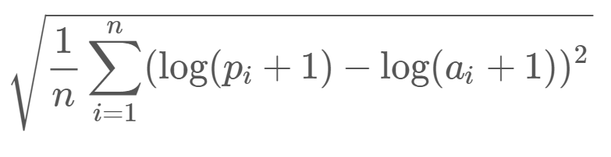
Problem definition
Bike Sharing Demand problem (Capital Bikeshare program in Washington, D.C).
Input: historical usage & weather data from the first 19 days of each month in 2011 and 2012.
Only past data can be applied.
Output: bike rental demand prediction for the last days of each month in 2011 and 2012.
Proposed approach: regression methods.
Linear model, SVM, decision trees, kNN, neural networks.
Value opportunity
studying the mobility in the city and improving the bike sharing systems logistics and costs.
by optimizing its operation, more users might feel attracted to use sustainable and eco-friendly transportation systems.
Evaluation based on Root Mean Squared Logarithmic Error (RMSLE)
n is the number of hours in the test set
pi is your predicted count
ai is the actual count
log(x) is the natural logarithm

Slide 4
Data fields and data preprocessing
Independent variables
Dependent variables
datetime | Hourly date + timestamp
season | 1; 2; 3; 4.
holiday | binary (holiday or not)
workingday | binary (working day or not)
weather | 1; 2; 3; 4.
temp | temperature (C)
atemp | “feels like” temperature (C)
humidity | relative humidity
windspeed | wind speed
casual | number of non-registered user rentals initiated
registered | number of non-registered user rentals initiated
count | number of total rentals initiated
Break down datetime into 5 new variables: hour, day, month, year, weekday.
Split the data into train set (12 days) x test set (7 days).
Interpolate missing values.
System does not keep record of data if count = 0 in a particular hour.

Slide 5
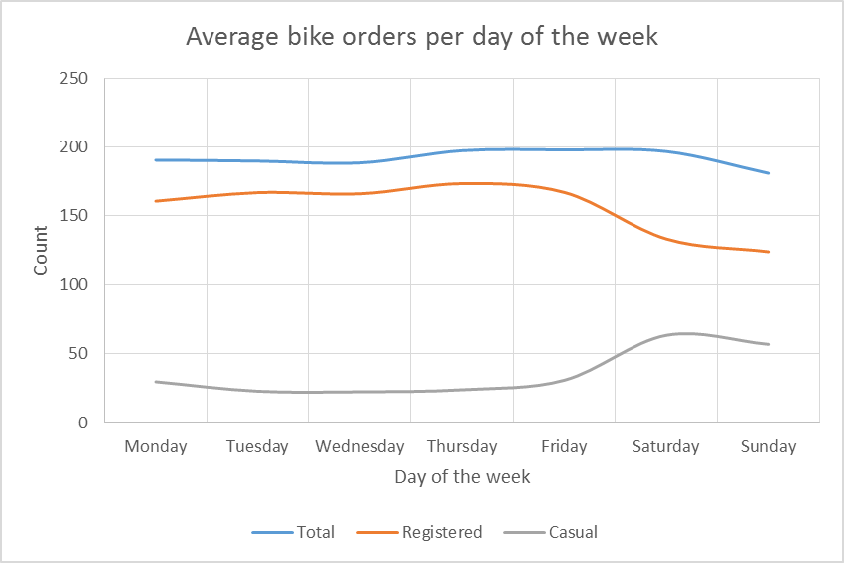
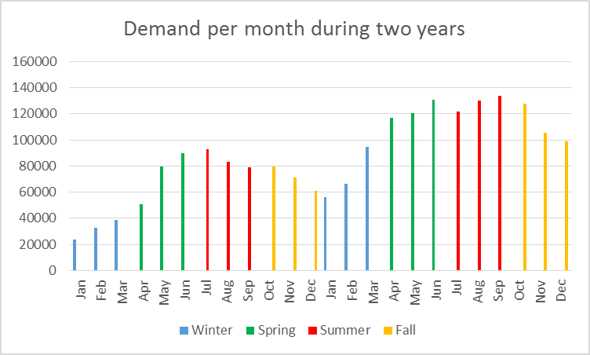
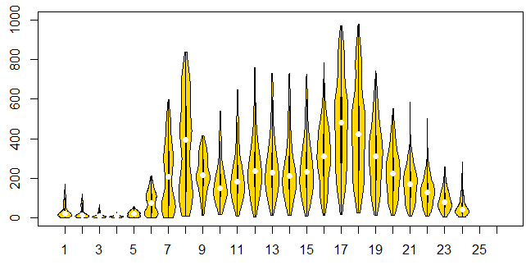
Data exploration

Slide 6
Data exploration
Mention something else?
Relationships we found?
Feature selection? Which features are more relevant? And how their importance change over time?

Slide 7
Model selection
Not possible to use cross-validation, given the time factor.
Models trained on a train set (days 1-12), RMLSE computed on a test set (days 13-19).
Random Forest
Blablabla
RMSLE | Kaggle
Neural network
Blablabla
RMSLE | Kaggle
Linear model
Combined with classical decomposition (seasonality for “hour” and “season”).
RMSLE | Kaggle
K-NN
Even though dimensional space is reasonable, performing
RMSLE | Kaggle
Linear SVM
Blablabla
RMSLE | Kaggle

Slide 8
Model selection
Not possible to use cross-validation, given the time factor.
Models trained on a train set (days 1-12), RMLSE computed on a test set (days 13-19).
Random Forest
Blablabla
RMSLE | Kaggle
Neural network
Blablabla
RMSLE | Kaggle
Linear model
Combined with classical decomposition (seasonality for “hour” and “season”).
RMSLE | Kaggle
K-NN
Even though dimensional space is reasonable, performing
RMSLE | Kaggle
Linear SVM
Blablabla
RMSLE | Kaggle

Slide 9
Random Forest
…

Slide 10
Neural Network
…

Slide 11
Best model: combining Random Forest and Neural Network
Neural network works better with less data, for the first 5 months…

