Slide 1
GPU Parallel Computing
Zehuan Wang HPC Developer Technology Engineer

Slide 2
Access The Power of GPU
Application
Matlab, AutoCAD, LAMMPS….
cuFFT, cuBLAS, cuSPARSE, OpenCV..
Library
CUDA C/C++, OpenACC, CUDA Fortran, Python
Language

Slide 3
Access The Power of GPU
Applications
Libraries
OpenACC Directives
Programming Languages

Slide 4

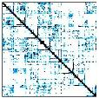




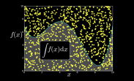





GPU Accelerated Libraries “Drop-in” Acceleration for your Applications
NVIDIA cuBLAS
NVIDIA cuSPARSE
NVIDIA NPP
NVIDIA cuFFT
Matrix Algebra on GPU and Multicore
GPU Accelerated
Linear Algebra
Vector Signal Image Processing
NVIDIA cuRAND
Building-block Algorithms
C++ Templated Parallel Algorithms
IMSL Library
CenterSpace NMath
Notes:
S3461A - CUDA Accelerated Compute Libraries (Maxim Naumov: new features, how to use)
Monday, 10:30am in 210H
Monday, 2:30pm in 212A
There are a wide variety of computational libraries available.
You are probably familiar with the FFTW Fast Fourier Transform library, the various BLAS linear algebra libraries, Intel’s Math Kernel Library and Integrated Performance Primitives libraries, to name a few.
But what you might not know is that there are compatible GPU-accelerated libraries available as drop-in replacements for all of these libraries, and many more.
Including both open source and commercially supported libraries.
e.g. IMSL – International Mathematics & Statistics Library
GPU-accelerated libraries are the most straightforward way to add GPU acceleration to applications, and in many cases their performance cannot be beat.
Background:
* cuBLAS is NVIDIA’s GPU-accelerated BLAS linear algebra library, which includes very fast dense matrix and vector computations.
* cuSPARSE is NVIDIA’s Sparse matrix library, which includes sparse matrix-vector multiplication, fast sparse linear equation solvers, and tridiagonal solvers.
* NVIDIA Performance Primitives (NPP) includes literally thousands of signal and image processing functions.
* cuFFT is NVIDIA’s GPU-accelerated Fast Fourier Transform Library.
* cuRAND is NVIDIA’s GPU-accelerated random number generation library, which is useful in Monte Carlo algorithms and financial applications, among others.
* Thrust is an open-source C++ Template library of parallel algorithms such as sorting, reductions, searching, and set operations.
All are FREE and included in the CUDA Toolkit, available at www.nvidia.com/getcuda

Slide 5
GPU Programming Languages
Numerical analytics
MATLAB, Mathematica, LabVIEW
Fortran
OpenACC, CUDA Fortran
C
OpenACC, CUDA C
C++
CUDA C++, Thrust, Hemi, ArrayFire
Python
Anaconda Accelerate, PyCUDA, Copperhead
.NET
CUDAfy.NET, Alea.cuBase
developer.nvidia.com/language-solutions
Notes:
Doesn’t show Java, or the growing list of DSLs being developed to address domain-specific challenges in many fields.
GTC Dinner with Strangers last night and met Phil Pratt-Szeliga, who created the Rootbeer compiler for running Java code on GPUs.
S3058 - Rootbeer: Seamlessly Using GPUs from Java (Phil Pratt-Szeliga, Syracuse)
Wednesday, 9:30am in 231
That covers the Libraries, OpenACC Directives and Programming Language solutions… the 3 approaches to accelerating your applications.

Slide 6
GPU Architecture

Slide 7
GPU: Massively Parallel Coprocessor
A GPU is
Coprocessor to the CPU or Host
Has its own DRAM
Runs 1000s of threads in parallel
Single Precision: 8.74TFlop/s （k80）
Double Precision: 2.91TFlop/s

Slide 8
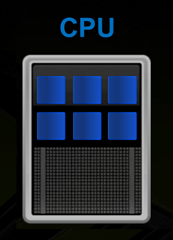
Heterogeneous Parallel Computing
Logic()
Compute()
Latency-Optimized
Fast Serial Processing

Slide 9
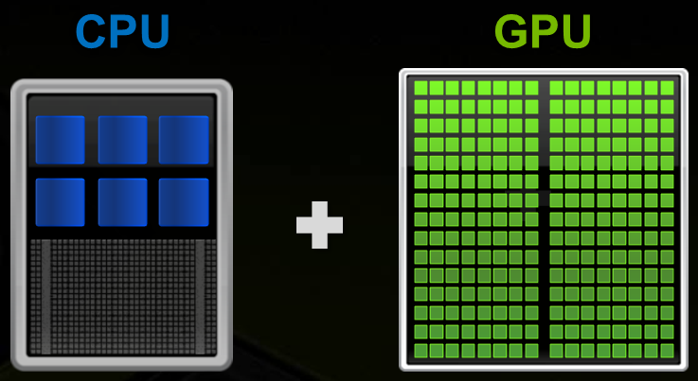
Heterogeneous Parallel Computing
Logic()
Compute()
Latency-Optimized
Fast Serial Processing
Throughput-Optimized
Fast Parallel Processing
Notes:
CPU是针对穿行程序对延迟进行优化的处理器。

Slide 10
Heterogeneous Parallel Computing
Logic()
Compute()
Latency-Optimized
Fast Serial Processing
Throughput-Optimized
Fast Parallel Processing

Slide 11
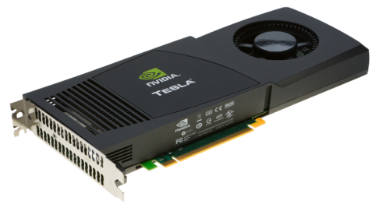

GPU in Computer System
PCIe
CPU
DDR3
DRAM
Connected to CPU chipset by PCIe
16GB/s One Way, 32GB/s in both way

Slide 12
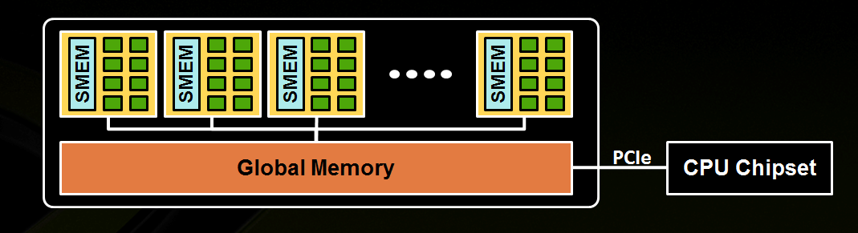
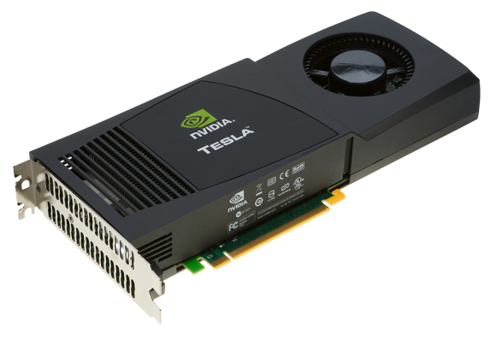
GPU High Level View
Streaming Multiprocessor (SM)
A set of CUDA cores
Global memory

Slide 13
Basic Concepts
CPU Memory
Transfer data
GPU Memory
PCI Bus
CPU
GPU
Offload computation
GPU computing is all about 2 things:
Transfer data between CPU-GPU
Do parallel computing on GPU
Notes:
!这样的硬件设计也导致了，我们的GPU程序可以分为两个部分。

Slide 14
GPU Programming Basics

Slide 15
How To Get Start
CUDA C/C++: download CUDA drivers & compilers & samples free from:
http://developer.nvidia.com/cuda/cuda-downloads
CUDA Fortran: PGI
OpenACC: PGI, CAPS, Cray

Slide 16
CUDA Programming Basics
Hello World
Basic syntax, compile & run
GPU memory management
Malloc/free
memcpy
Writing parallel kernels
Threads & block
Memory hierarchy

Slide 17
Heterogeneous Computing
C Program Sequential Execution
Serial code
Parallel kernel
Kernel0<<<>>>()
Serial code
Parallel kernel
Kernel1<<<>>>()
Host
Executes on both CPU & GPU
Similar to OpenMP’s fork-join pattern
Accelerated kernels
CUDA: simple extensions to C/C++
Device
Grid 0
Block (0, 0)
Block (1, 0)
Block (2, 0)
Block (0, 1)
Block (1, 1)
Block (2, 1)
Host
Device
Grid 1
Block (0, 0)
Block (1, 0)
Block (0, 1)
Block (1, 1)
Block (0, 2)
Block (1, 2)

Slide 18
Hello World on CPU
hello_world.c:
#include <stdio.h>
void hello_world_kernel() {
printf(“Hello World\n”);
}
int main() { hello_world_kernel(); }
Compile & Run:
gcc hello_world.c
./a.out

Slide 19
Hello World on GPU
hello_world.cu:
#include <stdio.h>
__global__ void hello_world_kernel() {
printf(“Hello World\n”);
}
int main() { hello_world_kernel<<<1,1>>>(); }
Compile & Run:
nvcc hello_world.cu
./a.out

Slide 20
Hello World on GPU
hello_world.cu:
#include <stdio.h>
__global__ void hello_world_kernel() {
printf(“Hello World\n”);
}
int main() { hello_world_kernel<<<1,1>>>(); }
Compile & Run:
nvcc hello_world.cu
./a.out
CUDA kernel within .cu files
.cu files compiled by nvcc
CUDA kernels preceded by “__global__”
CUDA kernels launched with “<<<…,…>>>”

Slide 21
Memory Spaces
CPU and GPU have separate memory spaces
Data is moved across PCIe bus
Use functions to allocate/set/copy memory on GPU
Very similar to corresponding C functions

Slide 22
CUDA C/C++ Memory Allocation / Release
Host (CPU) manages device (GPU) memory:
cudaMalloc (void ** pointer, size_t nbytes)
cudaMemset (void * pointer, int value, size_t count)
cudaFree (void* pointer)
int nbytes = 1024*sizeof(int);
int * d_a = 0;
cudaMalloc( (void**)&d_a, nbytes );
cudaMemset( d_a, 0, nbytes);
cudaFree(d_a);

Slide 23
Data Copies
cudaMemcpy( void *dst, void *src, size_t nbytes, enum cudaMemcpyKind direction);
returns after the copy is complete
blocks CPU thread until all bytes have been copied
doesn’t start copying until previous CUDA calls complete
enum cudaMemcpyKind
cudaMemcpyHostToDevice
cudaMemcpyDeviceToHost
cudaMemcpyDeviceToDevice
Non-blocking memcopies are provided

Slide 24
Code Walkthrough 1
Allocate CPU memory for n integers
Allocate GPU memory for n integers
Initialize GPU memory to 0s
Copy from GPU to CPU
Print the values

Slide 25
Code Walkthrough 1
#include <stdio.h>
int main()
{
int dimx = 16;
int num_bytes = dimx*sizeof(int);
int *d_a=0, *h_a=0; // device and host pointers

Slide 26
Code Walkthrough 1
#include <stdio.h>
int main()
{
int dimx = 16;
int num_bytes = dimx*sizeof(int);
int *d_a=0, *h_a=0; // device and host pointers
h_a = (int*)malloc(num_bytes);
cudaMalloc( (void**)&d_a, num_bytes );

Slide 27
Code Walkthrough 1
#include <stdio.h>
int main()
{
int dimx = 16;
int num_bytes = dimx*sizeof(int);
int *d_a=0, *h_a=0; // device and host pointers
h_a = (int*)malloc(num_bytes);
cudaMalloc( (void**)&d_a, num_bytes );
cudaMemset( d_a, 0, num_bytes );
cudaMemcpy( h_a, d_a, num_bytes, cudaMemcpyDeviceToHost );

Slide 28
Code Walkthrough 1
#include <stdio.h>
int main()
{
int dimx = 16;
int num_bytes = dimx*sizeof(int);
int *d_a=0, *h_a=0; // device and host pointers
h_a = (int*)malloc(num_bytes);
cudaMalloc( (void**)&d_a, num_bytes );
cudaMemset( d_a, 0, num_bytes );
cudaMemcpy( h_a, d_a, num_bytes, cudaMemcpyDeviceToHost );
for(int i=0; i<dimx; i++)
printf("%d ", h_a[i] );
printf("\n");
free( h_a );
cudaFree( d_a );
return 0;
}

Slide 29
Compile & Run
nvcc main.cu
./a.out
0000000000000000
Notes:
编译

Slide 30
Thread Hierarchy
2-level hierarchy: blocks and grid
Block = a group of up to 1024 threads
Grid = all blocks for a given kernel launch
E.g. total 72 threads
blockDim=12, gridDim=6
A block can:
Synchronize their execution
Communicate via shared memory
Size of grid and blocks are specified during kernel launch
dim3 grid(6,1,1), block(12,1,1); kernel<<<grid, block>>>(…);
Grid 0
Block (0,0)
Block (1, 0)
Block (2, 0)
Block (0, 1)
Block (1, 1)
Block (2, 1)
Notes:
不是，而是，假设block中有12个线程
像我们这个例子

Slide 31
IDs and Dimensions
Threads:
3D IDs, unique within a block
Blocks:
3D IDs, unique within a grid
Built-in variables:
threadIdx: idx within a block
blockIdx: idx within the grid
blockDim: block dimension
gridDim: grid dimension
Device
Grid 1
Block
(0, 0)
Block
(1, 0)
Block
(2, 0)
Block
(0, 1)
Block
(1, 1)
Block
(2, 1)
Block (1, 1)
Thread
(0, 0)
Thread
(1, 0)
Thread
(2, 0)
Thread
(3, 0)
Thread
(4, 0)
Thread
(0, 1)
Thread
(1, 1)
Thread
(2, 1)
Thread
(3, 1)
Thread
(4, 1)
Thread
(0, 2)
Thread
(1, 2)
Thread
(2, 2)
Thread
(3, 2)
Thread
(4, 2)
Notes:
Block 1~3都支持
告诉

Slide 32

GPU and Programming Model
Software
GPU
CUDA Core
Threads are executed by scalar processors
Thread
Thread blocks are executed on multiprocessors
Thread
Block
Multiprocessor
...
A kernel is launched as a grid of thread blocks
Grid
Device
Notes:
因为~

Slide 33
Which thread do I belong to?
blockDim.x = 4, gridDim.x = 4
threadIdx.x:
0
1
2
3
0
1
2
3
0
1
2
3
0
1
2
3
blockIdx.x:
0
0
0
0
1
1
1
1
2
2
2
2
3
3
3
3
idx = blockIdx.x*blockDim.x + threadIdx.x:
0
1
2
3
4
5
6
7
8
9
10
11
12
13
14
15

Slide 34
Code Walkthrough 2: Simple Kernel
Build on Walkthrough 1
Write a kernel to initialize integers
Copy the result back to CPU
Print the values

Slide 35
Kernel Code (executed on GPU)
__global__ void kernel( int *a )
{
int idx = blockIdx.x*blockDim.x + threadIdx.x;
a[idx] = 7;
}

Slide 36
#include <stdio.h>
__global__ void kernel( int *a, int n )
{
int idx = blockIdx.x*blockDim.x + threadIdx.x; if (idx < n)
a[idx] = 7;
}
int main()
{
int dimx = 16;
int num_bytes = dimx*sizeof(int);
int *d_a=0, *h_a=0; // device and host pointers
h_a = (int*)malloc(num_bytes);
cudaMalloc( (void**)&d_a, num_bytes );
cudaMemset( d_a, 0, num_bytes );
dim3 grid, block;
block.x = 4;
grid.x = dimx / block.x;
kernel<<<grid, block>>>( d_a, dimx );
cudaMemcpy( h_a, d_a, num_bytes, cudaMemcpyDeviceToHost );
for(int i=0; i<dimx; i++)
printf("%d ", h_a[i] );
printf("\n");
free( h_a );
cudaFree( d_a );
return 0;
}

Slide 37
Kernel Variations and Output
__global__ void kernel( int *a )
{
int idx = blockIdx.x*blockDim.x + threadIdx.x;
a[idx] = 7;
}
__global__ void kernel( int *a )
{
int idx = blockIdx.x*blockDim.x + threadIdx.x;
a[idx] = blockIdx.x;
}
__global__ void kernel( int *a )
{
int idx = blockIdx.x*blockDim.x + threadIdx.x;
a[idx] = threadIdx.x;
}
Output: 7 7 7 7 7 7 7 7 7 7 7 7 7 7 7 7
Output: 0 0 0 0 1 1 1 1 2 2 2 2 3 3 3 3
Output: 0 1 2 3 0 1 2 3 0 1 2 3 0 1 2 3

Slide 38
CUDA Fortran
Kernels: add attributes(global) to subroutine
Kernels should be put into a module
Same built-in variables
threadIdx, blockIdx, blockDim, gridDim
Now starts from 1

Slide 39
module cuda_kernels
contains
attributes(global) subroutine kernel(a,n)
implicit none
integer, value :: n
integer :: a(n)
integer :: idx
idx = (blockIdx%x-1)*blockDim%x + threadIdx%x
if (idx .le. N) a(idx) = 7
end subroutine kernel
end module cuda_kernels
program main
use cuda_kernels
implicit none
integer, parameter :: dimx = 16 integer, allocatable :: h_a(:)
integer, allocatable, device :: d_a(:) type(dim3) grid, block
allocate(h_a(dimx))
allocate(d_a(dimx))
block=dim3(4,1,1)
grid=dim3(dimx/block%x,1,1)
call kernel<<<grid,block>>>(d_a,dimx)
h_a = d_a
print *, h_a
deallocate(h_a)
deallocate(d_a)
end program main
#include <stdio.h>
__global__ void kernel( int *a, int n )
{
int idx = blockIdx.x*blockDim.x + threadIdx.x;
if (idx < n)
a[idx] = 7;
}
int main()
{
int dimx = 16;
int num_bytes = dimx*sizeof(int);
int *d_a=0, *h_a=0; // device and host pointers
h_a = (int*)malloc(num_bytes);
cudaMalloc( (void**)&d_a, num_bytes );
cudaMemset( d_a, 0, num_bytes );
dim3 grid, block;
block.x = 4;
grid.x = dimx / block.x;
kernel<<<grid, block>>>( d_a, dimx );
cudaMemcpy( h_a, d_a, num_bytes, cudaMemcpyDeviceToHost );
for(int i=0; i<dimx; i++)
printf("%d ", h_a[i] );
printf("\n");
free( h_a );
cudaFree( d_a );
return 0;
}

Slide 40
CUDA Fortran “cuf” directive
Similar to OpenACC, just add a directive to the loop.
!$cuf kernel do(1) <<<*,128>>> do I=1,n a(i) = a(i)+b(i) enddo

Slide 41
GPU Memory Hierarchy: 3 Levels
Register
Cache
L1/L2
Shared memory
Constant cache
Texture cache
DRAM/Global Memory

Slide 42
GPU Memory Model Review
Thread
Per-thread
Local
Memory
Block
Per-block Shared
Memory
Kernel 0
Sequential
Kernels
Per-device
Global
Memory
. . .
Kernel 1
. . .
Notes:
哪些存储空间对于哪些线程是可见的呢

Slide 43
Global Memory
Kernel 0
Per-device Global
Memory
Sequential
Kernels
. . .
Kernel 1
. . .
Accessible by all threads as well as host (CPU)
Data lifetime = from allocation to deallocation

Slide 44
Shared Memory
Block
C/C++: __shared__ int a[SIZE]; Fortran: shared
Allocated per threadblock
Data lifetime = block lifetime
Accessible by any thread in the threadblock
Not accessible to other threadblocks
Per-block Shared
Memory
Notes:
对所对应的的block中每个线程是可见的。

Slide 45
Registers and Local Memory
Thread
Per-thread Local Storage
Automatic variables (scalar/array) inside kernels
Spills to local memory
Data lifetime = thread lifetime

Slide 46
Example of Using Shared Memory
Applying a 1D stencil to a 1D array of elements:
Each output element is the sum of all elements within a radius
For example, for radius = 3, each output element is the sum of 7 input elements:
radius
radius
Notes:
是计算输入数据一定半径内所有数据之和

Slide 47
Kernel Code Using Global Memory
One element per thread
__global__ void stencil(int* in, int* out) {
int globIdx = blockIdx.x * blockDim.x + threadIdx.x;
int value = 0;
for (offset = - RADIUS; offset <= RADIUS; offset++)
value += in[globIdx + offset];
out[globIdx] = value;
}
A lot of redundant read in neighboring threads: not an optimized way

Slide 48
Implementation with Shared Memory
One element per thread
Read (BLOCK_SIZE + 2 * RADIUS) elements from global memory to shared memory
Compute BLOCK_SIZE output elements in shared memory
Write BLOCK_SIZE output elements to global memory
“halo”
= RADIUS elements on the left
The BLOCK_SIZE input elements corresponding to the output elements
“halo”
= RADIUS elements on the right

Slide 49
Kernel Code
RADIUS = 3
BLOCK_SIZE = 16
__global__ void stencil(int* in, int* out) {
__shared__ int shared[BLOCK_SIZE + 2 * RADIUS];
int globIdx = blockIdx.x * blockDim.x + threadIdx.x;
int locIdx = threadIdx.x + RADIUS;
shared[locIdx] = in[globIdx];
if (threadIdx.x < RADIUS) {
shared[locIdx – RADIUS] = in[globIdx – RADIUS];
shared[locIdx + BLOCK_DIMX] = in[globIdx + BLOCK_SIZE];
}
__syncthreads();
int value = 0;
for (offset = - RADIUS; offset <= RADIUS; offset++)
value += shared[locIdx + offset];
out[globIdx] = value;
}

Slide 50
Thread Synchronization Function
void __syncthreads();
Synchronizes all threads in a thread block
Since threads are scheduled at run-time
Once all threads have reached this point, execution resumes normally
Used to avoid RAW / WAR / WAW hazards when accessing shared memory
Should be used in conditional code only if the conditional is uniform across the entire thread block
Otherwise may lead to deadlock
Notes:
当一个线程运行到

Slide 51
Thank you
Notes:
Try out OpenACC directives today. Thanks for listening, and remember: you can access all the presentations in this series by clicking the attachments link in your viewing window.

