Slide 1
Take a Close Look at
MapReduce
Xuanhua Shi

Slide 2
Acknowledgement
Most of the slides are from Dr. Bing Chen, http://grid.hust.edu.cn/chengbin/
Some slides are from SHADI IBRAHIM, http://grid.hust.edu.cn/shadi/

Slide 3
What is MapReduce
用于大规模数据处理
利用大量的商用计算机
以分布式方式执行流程
提供高可用性
  利用大量的商用计算机
  以分布式方式执行流程
  提供高可用性

Slide 4
Motivation
对超大规模数据处理的大量需求
这些需求有一个共同的主题
需要大量的机器(扩展)
输入的两个基本操作
    Map
    Reduce

Slide 5
Distributed Grep
Split data
grep
matches
Split data
grep
matches
Very
big
data
All
matches
Split data
grep
matches
cat
Split data
grep
matches

Slide 6
Distributed Word Count
Split data
count
count
Split data
count
count
Very
big
data
merged
count
Split data
count
count
merge
Split data
count
count

Slide 7
Map+Reduce
Map:
  接收输入键值对
  产生中间键/值对
R
E
D
U
C
E
Reduce :
  接收中间键值对
  发出输出键/值对
Very
big
data
M
A
P
Partitioning
Function
Result

Slide 8
The design and how it works

Slide 9

Architecture overview
体系结构概述
Master node
user
Job tracker
Slave node 1
Slave node 2
Slave node N
任务跟踪器
Task tracker
Task tracker
Task tracker
Workers
Workers
Workers

Slide 10
GFS: 底层存储系统
Goal
  global view 全局视图
  make huge files available in the face of node failures
  在节点出现故障时，使大型文件可用
Master Node (meta server)主节点 （元数据服务器）
  Centralized, index all chunks on data servers
  中心化，索引数据服务器上的所有块
Chunk server (data server)块服务器 （数据服务器 ）
  File is split into contiguous chunks, typically 16-64MB.
  文件被分割成连续的块
  每个块被复制(通常为2x或3x)
  Try to keep replicas in different racks.尽量把复制品放在不同的架子上。

Slide 11
GFS architecture
GFS Master
Client
C₀
C₁
C₁
C₀
C₅
…
C₅
Chunkserver 1
Chunkserver 2
Chunkserver N
C₂
C₅
C₃
C₂

Slide 12
Functions in the Model
Map
  Process a key/value pair to generate处理要生成的键/值对
  intermediate key/value pairs中间键/值对
Reduce
  Merge all intermediate values associated with the same key合并与同一键关联的所有中间值
Partition
  By default : hash(key) mod R
  Well balanced 均衡的

Slide 13
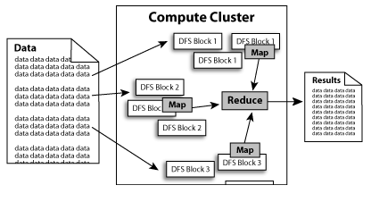
Diagram (1)

Slide 14
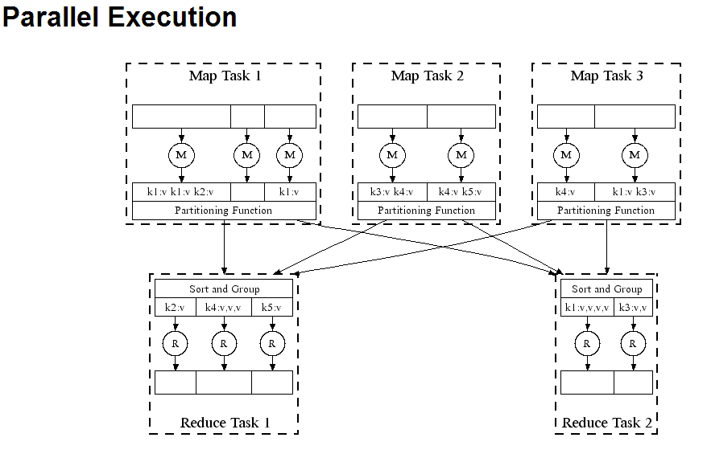
Diagram (2)

Slide 15
A Simple Example
Counting words in a large set of documents 统计一大堆文档中的单词
map(string value)‏
  //key: document name
  //value: document contents
  for each word w in value
    EmitIntermediate(w, “1”);
reduce(string key, iterator values)‏
  //key: word
  //values: list of counts
  int results = 0;
  for each v in values
    result += ParseInt(v);
  Emit(AsString(result));

Slide 16
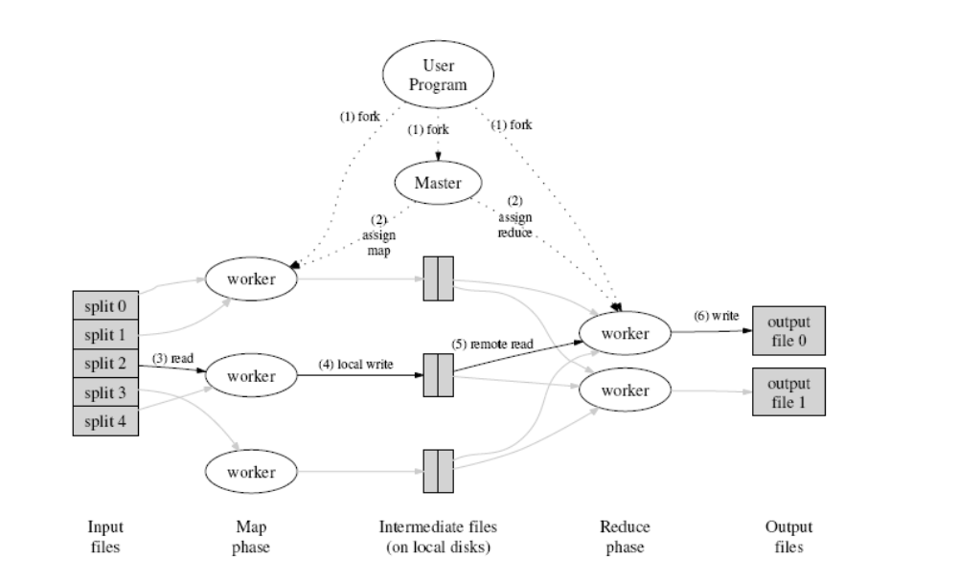
How does it work?

Slide 17
Locality issue 位置问题
Master scheduling policy主调度策略
  Asks GFS for locations of replicas of input file blocks询问GFS输入文件块副本的位置
  Map tasks typically split into 64MB (== GFS block size) 映射任务通常被划分为64MB
  Map tasks scheduled so GFS input block replica are on same machine or same rack
  映射任务被调度，以使GFS输入块副本位于相同的机器或机架上
Effect
  Thousands of machines read input at local disk speed
  Without this, rack switches limit read rate

Slide 18
Fault Tolerance
容错
Reactive way被动的方法
  Worker failure （worker节点失效）
    Heartbeat（心跳）, Workers are periodically（定期） pinged by master
      NO response = failed worker
    如果某个worker的处理器发生故障，则将该worker的任务重新分配给另一个worker。
  Master failure（主节点失效）
    Master writes periodic checkpoints（ Master编写定期检查点）
    Another master can be started from the last checkpointed state可以从最后一个检查点状态启动另一个主服务器
    If eventually the master dies, the job will be aborted
    如果主进程最终死亡，作业将被终止

Slide 19
Fault Tolerance
主动方式(Redundant Execution) (冗余执行)
  The problem of “stragglers” (slow workers)掉队者问题
    Other jobs consuming resources on machine
    其他消耗机器资源的作业
    Bad disks with soft errors transfer data very slowly
    带有软错误的坏磁盘传输数据非常慢
    Weird things: processor caches disabled (!!)
    奇怪的事情:处理器缓存被禁用
    当计算快完成时，重新安排正在进行的任务Whenever either the primary or the backup executions finishes, mark it as completed
    当主执行或备份执行完成时，将其标记为已完成》

Slide 20
Fault Tolerance
Input error: bad records（输入错误:错误的记录）
  Map/Reduce functions sometimes fail for particular inputs（对于特定的输入，Map/Reduce函数有时会失败）
  Best solution is to debug & fix, but not always possible最好的解决方案是调试和修复，但并不总是可行的
  On segment fault
    Send UDP packet to master from signal handler
    从信号处理器发送UDP数据包到主机
    Include sequence number of record being processed
    包括正在处理的记录的序列号
  Skip bad records （跳过不良记录）
    如果master看到同一记录有两个失败，则告诉下一个worker跳过该记录

Slide 21
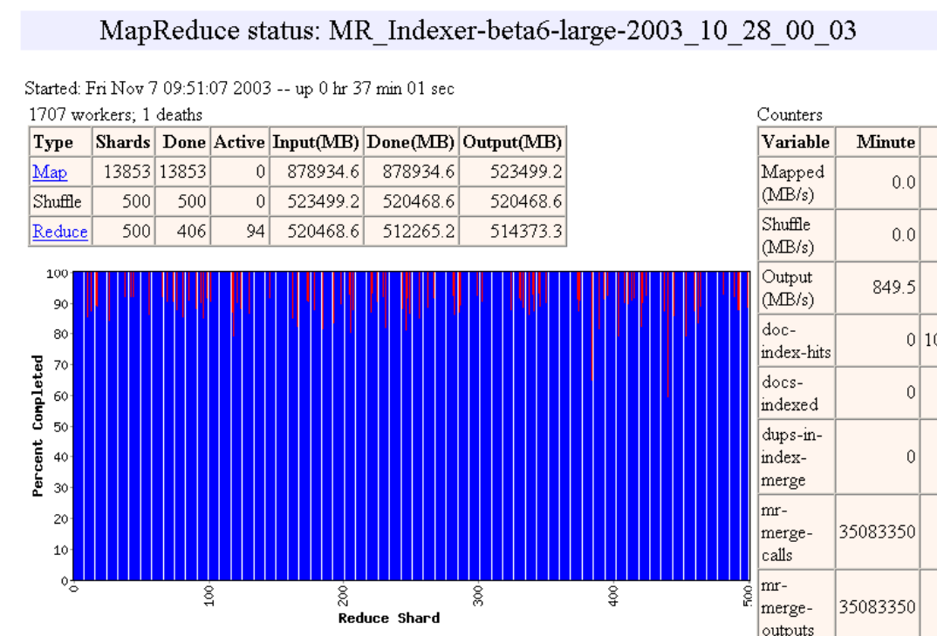
Status monitor
状态监控

Slide 22
Refinements细化
Task Granularity 任务粒度
  Minimizes time for fault recovery最小化故障恢复时间
  load balancing 负载平衡
Local execution for debugging/testing
用于调试/测试的本地执行
Compression of intermediate data
中间数据压缩

Slide 23
需要强调几点
在map完成之前不能开始reduce
主程序master必须传递中间文件的位置
Tasks scheduled based on location of data
基于数据位置调度的任务
If map worker fails any time before reduce finishes, task must be completely rerun
如果map worker在reduce完成之前失败，则必须完全重新运行任务
MapReduce库为我们做了大部分艰苦的工作!

Slide 24
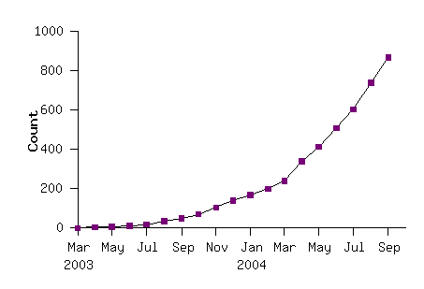
Model is Widely Applicable
模型适用范围广
MapReduce Programs In Google Source Tree
例子如下
Examples as follows
distributed grep |  | distributed sort |  | web link-graph reversal
term-vector / host |  | web access log stats 访问日志统计信息 |  | inverted index construction 反向索引结构
document clustering 文档聚类 |  | machine learning |  | statistical machine translation 统计机器翻译
... |  | ... |  | ...

Slide 25
How to use it
User to do list:
  indicate:说明
    Input/output files
    M: number of map tasks
    R: number of reduce tasks
    W: number of machines
  Write map and reduce functions
  Submit the job

Slide 26
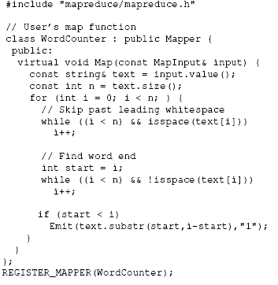
Detailed Example: Word Count(1)
Map

Slide 27
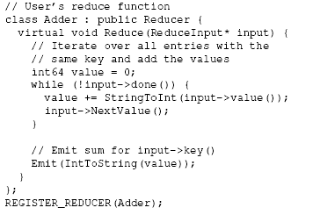
Detailed Example: Word Count(2)
Reduce

Slide 28
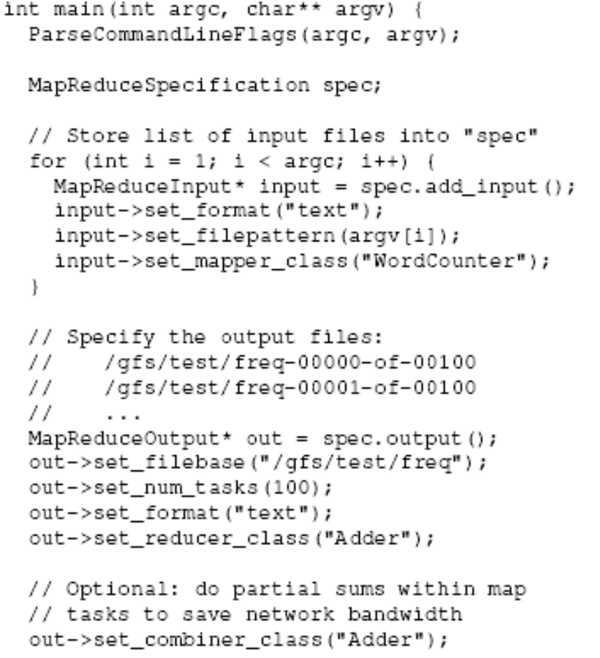
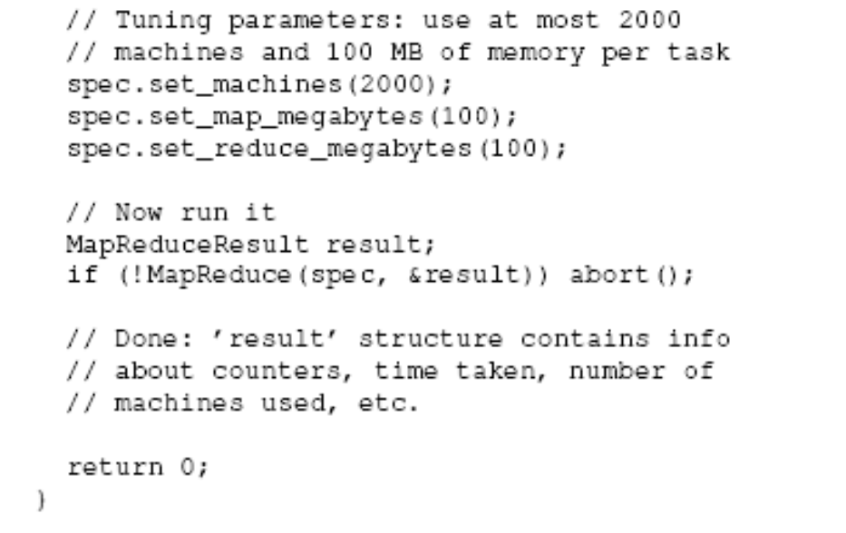
Detailed Example: Word Count(3)
Main

Slide 29
Applications
字符串匹配，如Grep,
Reverse index 反向索引
Count URL access frequency 计数URL访问频率
Lots of examples in data mining 数据挖掘

Slide 30

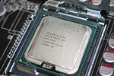
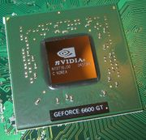
MapReduce 实现
MapReduce
Cluster,
1, Google
2, Apache Hadoop
Multicore CPU,
Phoenix @ stanford
GPU,
Mars@HKUST

Slide 31

Hadoop
Open source
Java-based implementation of MapReduce
Use HDFS as underlying file system
使用HDFS作为底层文件系统

Slide 32
Hadoop
Google | Yahoo
MapReduce | Hadoop
GFS | HDFS
Bigtable | HBase
Chubby | ZooKeeper

Slide 33
Recent news about Hadoop
Apache Hadoop Wins Terabyte Sort Benchmark
Apache Hadoop赢得了tb级的排序基准测试
排序使用1800个map和1800个reduce，并分配足够的内存给缓冲区来保存内存中的中间数据。.
Yarn is launching

Slide 34
Phoenix
The best paper at HPCA’07
MapReduce for multiprocessor systems
用于多处理器系统的MapReduce
Shared-memory implementation of MapReduce
共享内存实现MapReduce
  SMP, Multi-core（多核）
Features（特性）
  Uses thread instead of cluster nodes for parallelism
  使用线程而不是集群节点实现并行
  Communicate through shared memory instead of network messages 通过共享内存而不是网络消息进行通信
  Dynamic scheduling, locality management, fault recovery
  动态调度，位置管理，故障恢复

Slide 35
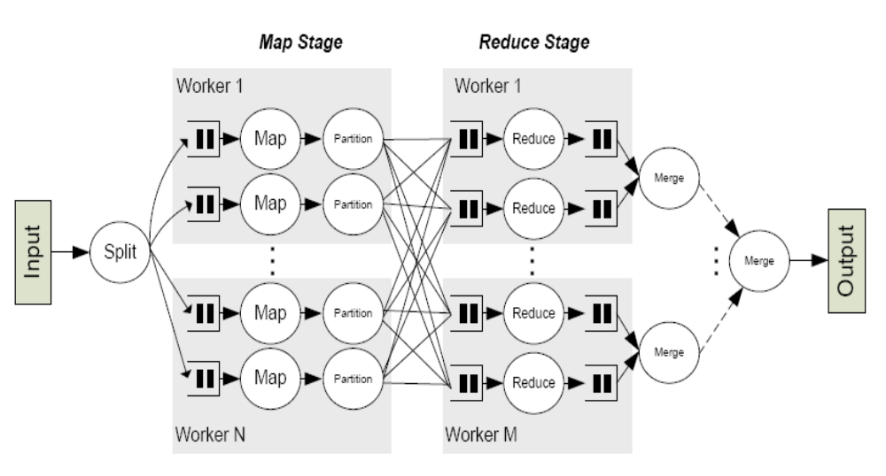
Workflow

Slide 36
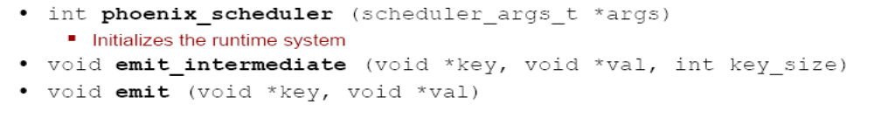
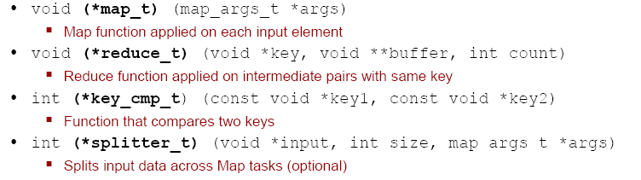
The Phoenix API
System-defined functions
User-defined functions

Slide 37
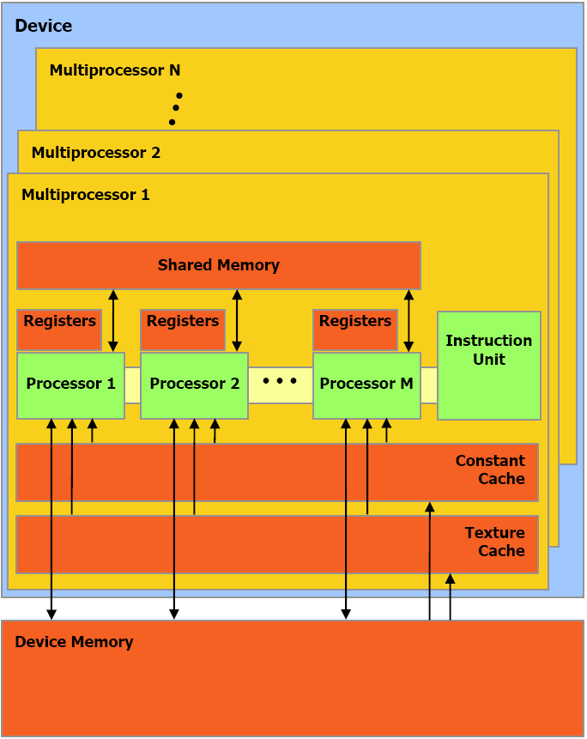

Mars: MapReduce on GPU
PACT’08
GeForce 8800 GTX, PS3, Xbox360

Slide 38
Implementation of Mars
User applications.
MapReduce
CUDA
System calls
Operating System (Windows or Linux)
NVIDIA GPU (GeForce 8800 GTX)
CPU (Intel P4 four cores, 2.4GHz)

Slide 39
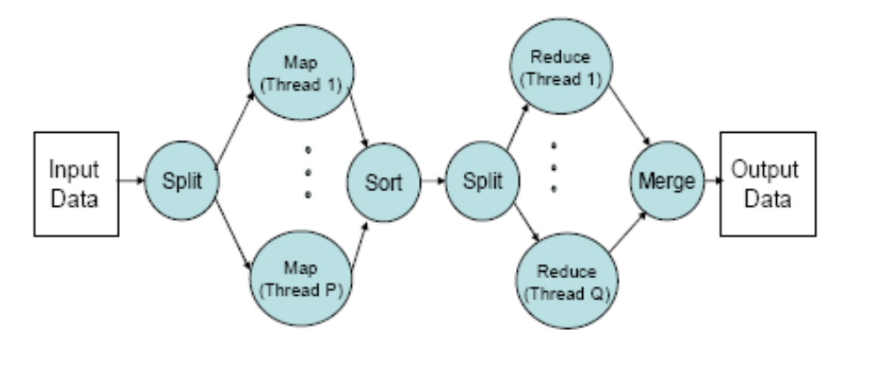
Implementation of Mars

Slide 40
Discussion
We have MPI and PVM,Why do we need MapReduce?
我们有MPI和PVM，为什么我们需要MapReduce?
 | MPI, PVM | MapReduce
Objective | General distributed programming model 通用分布式编程模型 | Large-scale data processing 大规模数据处理
Availability | Weaker, harder 弱,难 | Better
Data Locality | MPI-IO | GFS
Usability 可用性 | Difficult to learn 难学 | Easier

Slide 41
Conclusions
Provide a general-purpose model to simplify large-scale computation
提供一个通用模型来简化大规模计算
Allow users to focus on the problem without worrying about details
允许用户关注问题而不必担心细节

Slide 42
References
Original paper (http://labs.google.com/papers/mapreduce.html)
On wikipedia (http://en.wikipedia.org/wiki/MapReduce)
Hadoop – MapReduce in Java (http://lucene.apache.org/hadoop/)
http://code.google.com/edu/parallel/mapreduce-tutorial.html

