Slide 1
Chapter 1: Ever Wonder How It Works?
Networking Essentials
Notes:
Cisco Networking Academy Program
Networking Essentials
Chapter 1: Ever Wonder How It Works?

Slide 2
Chapter 1 - Sections & Objectives
1.1 Communicating in a Connected World
Explain the concept of network communication.
1.2 Local Networks
Explain the roles of devices in a network.
1.3 Building a Simple Network
Build a functioning network.
Notes:
2

Slide 3
1.1 Communicating in a Connected World
Notes:
Cisco Networking Academy Program
Networking Essentials
Chapter 1: Ever Wonder How It Works?

Slide 4
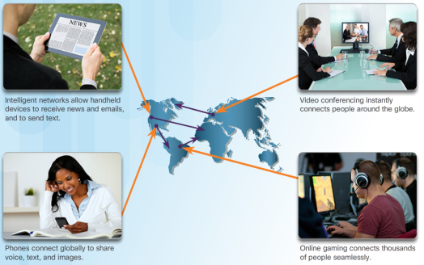
Communicating in a Connected World What is the Network?
Are you Online?
For most of us, the Internet has become a large part of everyday life.
Who owns the Internet?
No one owns the Internet.
It is a worldwide collection of interconnected networks exchanging information using common standards over telephone wires, fiber-optic cables, wireless transmissions, and satellite links.
Notes:
1.1 – Communicating in a Connected World
1.1.1 – What is the Network?

Slide 5
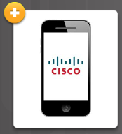



Communicating in a Connected World What is the Network?
Local Networks
Local networks come in all sizes from peer-to-peer (two interconnected device), to home networks, SOHO, and large organization networks.
Making Connections
All types of devices connect to local networks.
Notes:
1.1 – Communicating in a Connected World
1.1.1 – What is the Network?

Slide 6
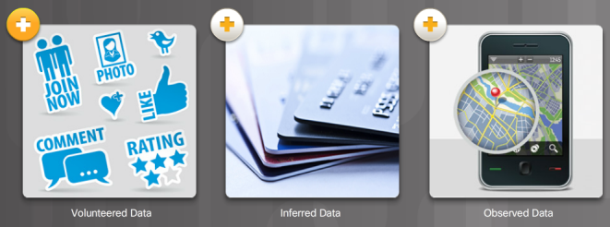
Communicating in a Connected World Transmitting Data on the Network
What Exactly is Data?
Data is a value that represents something.
Networks to transmit their data in order to share with others or for long-term storage.
Notes:
1.1 – Communicating in a Connected World
1.1.2 – Transmitting Data on the Network

Slide 7
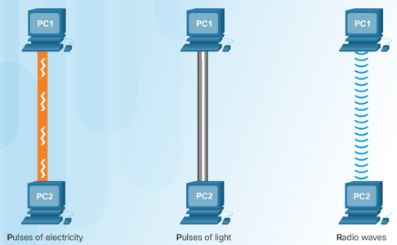
Communicating in a Connected World Transmitting Data on the Network
The Mighty Bit
Computers use binary codes to represent and interpret letters, numbers and special characters with bits.
Each group of eight bits, such as the representations of letters and numbers, is known as a byte.
Getting Bits Moving
Bits are transmitted as signals over copper wire (electrical pulses), fiber- optic cable (light pulses), and wireless (radio waves).
Notes:
1.1 – Communicating in a Connected World
1.1.2 – Transmitting Data on the Network

Slide 8
Communicating in a Connected World It’s All About the Speed
Measuring Bandwidth
Digital bandwidth is the amount of data that can flow from one place to another in a given amount of time measured in the number of bits that (theoretically) can be sent across the media in a second.
Measuring Throughput
Throughput is the actual measure of the transfer of bits across the media over a given period of time.
Many factors influence throughput including the amount of data being sent / received, the types of data being transmitted, and the accumulated latency created by the number of network devices encountered between source and destination.
Notes:
1.1 – Communicating in a Connected World
1.1.3 – It’s All About the Speed

Slide 9
1.2 Local Networks
Notes:
Cisco Networking Academy Program
Networking Essentials
Chapter 1: Ever Wonder How It Works?

Slide 10
Local Networks Network Components
Clients and Servers
Servers are hosts that have software installed that enable them to provide information, like email or web pages, to other hosts on the network.
Clients are computer hosts that have software installed that enable them to request and display the information obtained from the server.
Multiple Roles in the Network
Servers can provide multiple services in a network
Notes:
1.2 – Local Network
1.2.1 – Network Components

Slide 11
Local Networks Building Blocks of a Network
Network Infrastructure
This is the platform that supports the network containing end devices, intermediate devices (routers, switches, access points, …) interconnected using network media (wired and wireless).
End Devices
Includes computers, laptops, printers, tablets, smart devices, …
Form the interface between users and the underlying communication network.
Notes:
1.2 – Local Network
1.2.2 – Building Blocks of a Network

Slide 12
1.3 Building a Simple Network
Notes:
Cisco Networking Academy Program
Networking Essentials
Chapter 1: Ever Wonder How It Works?

Slide 13
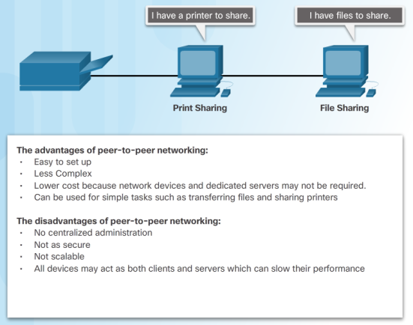
Building a Simple Network Peer-to-Peer Networking
What does Peer-to-Peer mean?
Network in which a host can be a client and a server for other hosts.
Notes:
1.3 – Building a Simple Network
1.3.1 – Peer-to-Peer Networking

Slide 14
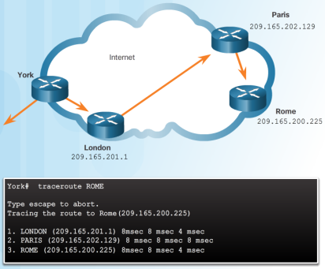
Building a Simple Network Does It Work?
Using the Ping Command
Use the ping utility to test end-to-end IP connectivity between a source and destination IP address.
Following the Path
Use the traceroute utility to display each hop in the path to the destination.
Notes:
1.3 – Building a Simple Network
1.3.2 – Does It Work?

Slide 15


Slide 16


