Slide 1
Chapter 5: Providing Network Services
Networking Essentials
Notes:
Cisco Networking Academy Program
Networking Essentials
Chapter 5: Providing Network Services

Slide 2
Chapter 5 - Sections & Objectives
5.1 How Clients and Servers Work Together
• Explain how clients access Internet services.
5.2 Internet Protocols at Work
Explain how the protocols of the transport layer support network communications.
5.3 Application Protocols and Services
Explain the function of common Internet client/server applications.
Notes:
2

Slide 3
5.1 How Clients and Servers Work Together
Notes:
Cisco Networking Academy Program
Networking Essentials
Chapter 5: Providing Network Services

Slide 4
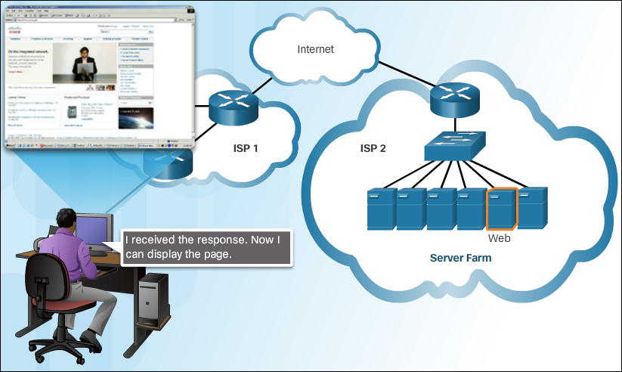
How Clients and Servers Work Together The Client Server Relationship
There are millions of servers connected to the Internet, providing services such as
web sites, email, financial transactions, and music downloads to clients.
The primary characteristic of client/server systems is that the client sends a
request to a server, and the server responds by carrying out a function, such as
sending the requested document back to the client.
Notes:
5.1 – How Clients and Servers Work Together
5.1.1 – The Client Server Relationship

Slide 5
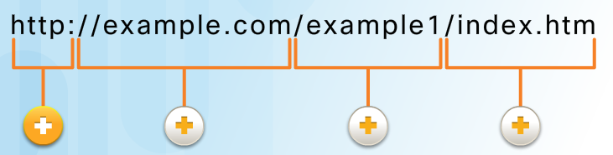
How Clients and Servers Work Together The Client Server Relationship
A uniform resource locator (URL) is used to locate the server and a specific resource. The URL identifies:
Protocol being used, usually HTTP (Hypertext Transfer Protocol) for web pages
Domain name of the server being accessed
Location of the resource on the server
Resource
Notes:
5.1 – How Clients and Servers Work Together
5.1.1 – The Client Server Relationship

Slide 6
How Clients and Servers Work Together TCP/IP Protocols for Internet Services
Some of the protocols used for Internet services are:
Domain Name System (DNS) - Resolves Internet names to IP addresses.
Secure Shell (SSH) - Used to provide remote access to servers and networking devices.
Simple Mail Transfer Protocol (SMTP) - Sends email messages and attachments from clients to
servers and from servers to other email servers.
Post Office Protocol (POP) - Used by email clients to retrieve email and attachments from a remote
server.
Internet Message Access Protocol (IMAP) - Used by email clients to retrieve email and attachments
from a remote server.
Dynamic Host Configuration Protocol (DHCP) - Used to automatically configure devices with IP
addressing and other necessary information to enable them to communicate over the Internet.
Web Server - Transfers the files that make up the web pages of the World Wide Web using Hypertext
Transfer Protocol (HTTP).
File Transfer Protocol (FTP) - Used for interactive file transfer between systems.
Notes:
5.1 – How Clients and Servers Work Together
5.1.2 – TCP/IP Protocols for Internet Services

Slide 7
5.2 Internet Protocols at Work
Notes:
Cisco Networking Academy Program
Networking Essentials
Chapter 5: Providing Network Services

Slide 8
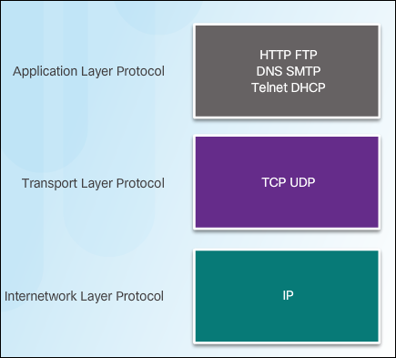
Internet Protocols at Work The TCP/IP Protocol Suite
The various protocols necessary to deliver a web page function at the four
different levels of the TCP/IP model are: application layer protocol, transport layer
protocol, Internetwork layer protocol, and network access layer.
The two most common transport protocols are Transmission Control Protocol
(TCP) and User Datagram Protocol (UDP). The IP protocol uses these transport
protocols to enable hosts to communicate and transfer data.
When an application requires acknowledgment that a message is delivered, it uses TCP.
UDP is a 'best effort' delivery system that does not require acknowledgment of receipt.
Notes:
5.2 – Internet Protocols at Work
5.2.1 – The TCP/IP Protocol Suite

Slide 9
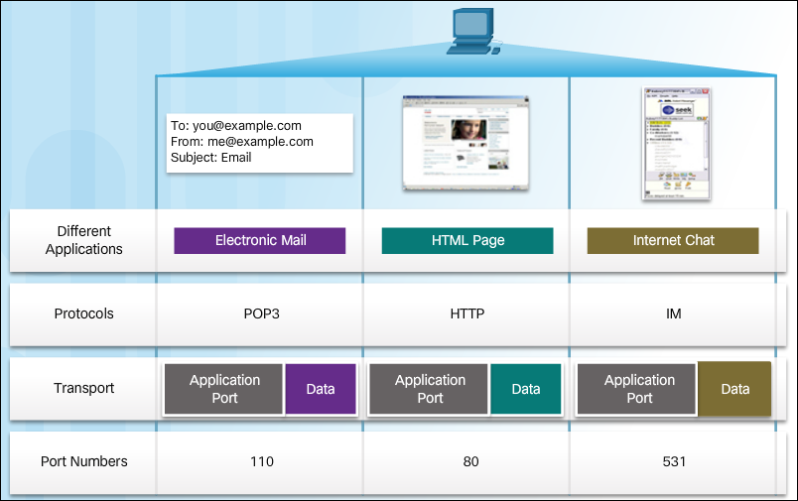
Internet Protocols at Work Keeping Track of the Conversation
A port is a numeric identifier within each segment that is used to keep track of
specific conversations between a client and server.
Ports are categorized into three groups: Well-known, registered, and private.
Every message that a host sends contains both a source and destination port.
The source port number is dynamically generated by the sending device to identify a conversation between two devices.
The client places a destination port number in the segment to tell the destination server what service is being requested.
Notes:
5.2 – Internet Protocols at Work
5.2.2 – Keeping Track of the Conversation

Slide 10
5.3 Application Protocols and Services
Notes:
Cisco Networking Academy Program
Networking Essentials
Chapter 5: Providing Network Services

Slide 11
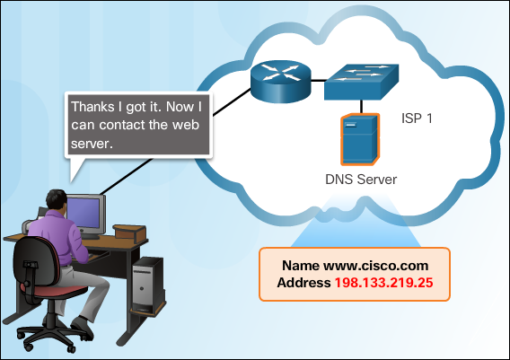
Application Protocols and Services Domain Name System
The Domain Name System (DNS) names are registered and
organized on the Internet within specific high level groups, or domains. Some of the
most common high level domains on the Internet are .com, .edu, and .net.
A DNS server contains a table that associates hostnames in a domain with
corresponding IP addresses. When the DNS server receives a request, it checks
its table to determine the IP address associated with that server.
Notes:
5.3 – Application Protocols and Services
5.3.1 – Domain Name System

Slide 12
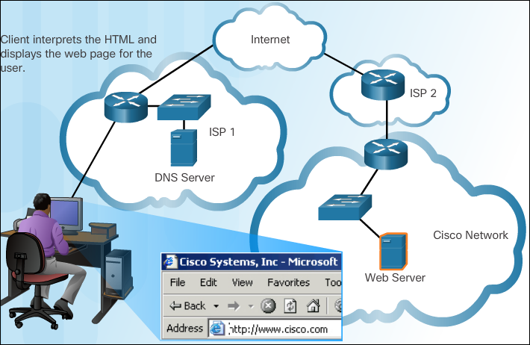
Application Protocols and Services Web Clients and Servers
When a web client receives the IP address of a web server, the client browser
uses that IP address and port 80 to request web services using the Hypertext
Transfer Protocol (HTTP).
The HyperText Markup Language (HTML) coding tells the browser how to format
the web page and what graphics and fonts to use.
There are many different web servers and web clients available on the market. The HTTP protocol and HTML standards make it possible for these servers and clients from many different manufacturers to work together seamlessly.
Notes:
5.3 – Application Protocols and Services
5.3.2 – Web Clients and Servers

Slide 13
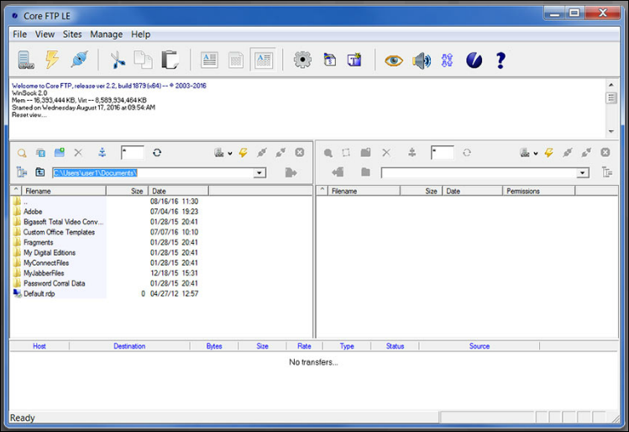
Application Protocols and Services FTP Clients and Servers
The File Transfer Protocol (FTP) provides an easy method to transfer files from
one computer to another. It also enables clients to manage files remotely by
sending file management commands such as delete or rename. To accomplish this,
the FTP service uses two different ports to communicate between client and server.
Notes:
5.3 – Application Protocols and Services
5.3.3 – FTP Clients and Servers

Slide 14
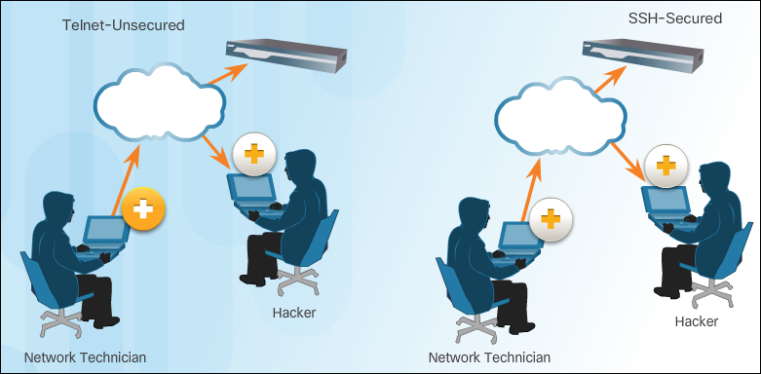
Application Protocols and Services Virtual Terminals
Telnet uses software to create a virtual device that provides the same features of
a terminal session with access to the server’s command line interface (CLI).
SSH provides for secure remote login and other secure network services. It also
provides stronger authentication than Telnet and supports the transport of session
data using encryption. Network professionals should always use SSH in place of
Telnet, whenever possible.
Notes:
5.3 – Application Protocols and Services
5.3.4 – Virtual Terminals

Slide 15
Application Protocols and Services Email and Messaging
Email Clients and Servers - Each mail server receives and stores mail for users
who have mailboxes configured on that mail server. Each user with a mailbox must
then use an email client to access the mail server and read these messages.
Email Protocols - Various application protocols used in processing email include
SMTP, POP3, and IMAP4.
Instant Messaging (IM) – IM applications require minimal configuration to
operate. After the client is downloaded, all that is required is to enter username and
password information. In addition to text messages, IM can support the transfer of
documents, video, music, and audio files.
Internet Phone Calls - An Internet telephony client uses peer-to-peer technology
similar to that used by instant messaging. IP telephony makes use of Voice over IP
(VoIP) technology which converts analog voice signals into digital data. The voice
data is encapsulated into IP packets which carry the phone call through the network.
Notes:
5.3 – Application Protocols and Services
5.3.5 – Email and Messaging

Slide 16


Slide 17


