Slide 1
Chapter 7: Network Security
Networking Essentials
Notes:
Cisco Networking Academy Program
Networking Essentials
Chapter 7: Network Security

Slide 2
Chapter 7 - Sections & Objectives
7.1 Am I at Risk?
Explain network security threats.
7.2 Methods of Attack
Explain other types of network security threats.
7.3 How Can I Protect My Network?
Explain how software tools can mitigate network security threats.
7.4 How Do Firewalls Protect Networks?
Configure a firewall to control network traffic.
Notes:
2

Slide 3
7.1 Am I at Risk?
Notes:
Cisco Networking Academy Program
Networking Essentials
Chapter 7: Network Security

Slide 4
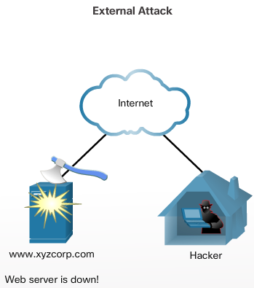
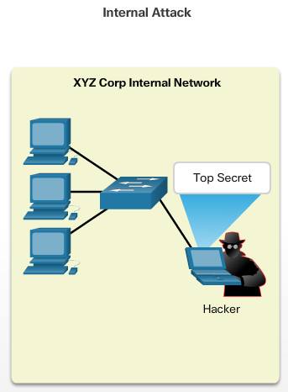
Am I at Risk? Hackers and Intruders
What Do They Want?
When the hacker gains access to the network, four types of threat may arise: Information theft, Identity theft, Data loss / manipulation, and Disruption of service
Where Do They Come From?
External threats arise from individuals working outside of an organization.
Internal threats occur when someone has authorized access to the network through a user account or has physical access to the network equipment.
Notes:
7.1 – Am I at Risk?
7.1.1 – Hackers and Intruders

Slide 5
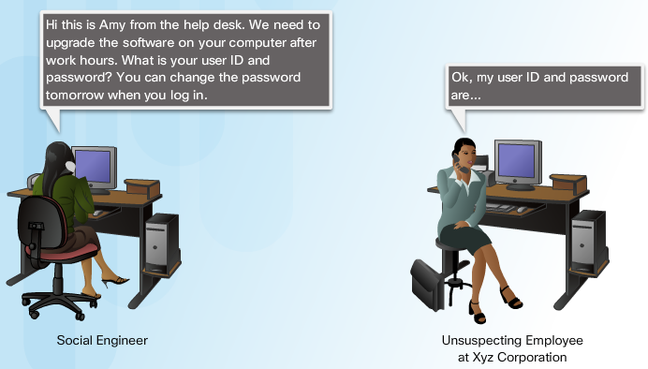
Am I at Risk? Social Engineering Attacks
Social Engineering
In the context of computer and network security, social engineering refers to a collection of techniques used to deceive internal users into performing specific actions or revealing confidential information.
Types of Social Engineering
Three of the most common methods hackers use to obtain information directly from authorized users go by unusual names: pretexting, phishing, and vishing.
Notes:
7.1 – Am I at Risk?
7.1.2 – Social Engineering Attacks

Slide 6
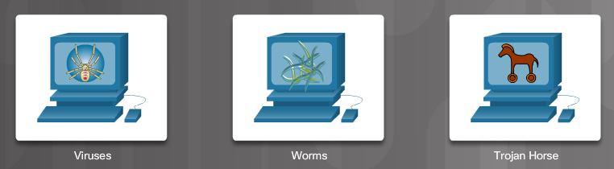
Am I at Risk? Virus, Worms, and Trojan Horses
Other Types of Attacks
Malicious software can damage a system, destroy data, as well as deny access to networks, systems, or services. They can also forward data and personal details from unsuspecting PC users to criminals.
A worm is similar to a virus, but unlike a virus does not need to attach itself to an existing program.
A Trojan horse is program that is written to appear like a legitimate program, when in fact it is an attack tool.
A virus is a program that spreads by modifying other programs or files.
Notes:
7.1 – Am I at Risk?
7.1.3 – Virus, Worms, and Trojan Horses

Slide 7
7.2 Methods of Attack
Notes:
Cisco Networking Academy Program
Networking Essentials
Chapter 7: Network Security

Slide 8
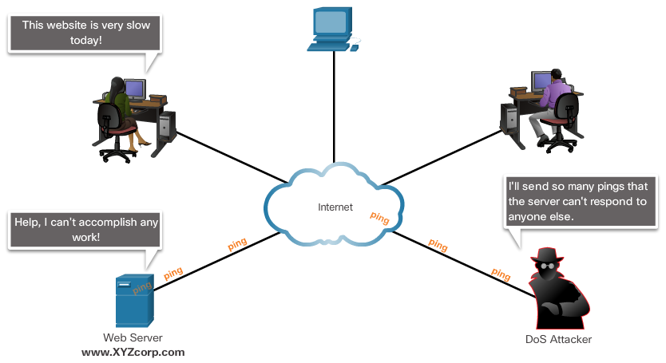
Methods of Attack Denial of Service and Brute Force Attacks
An attacker uses a DoS attack to perform these functions:
Flood a system or network with traffic to prevent legitimate network traffic from flowing
Disrupt connections between a client and server to prevent access to a service
Notes:
7.2 – Methods of Attack
7.2.1 – Denial of Service and Brute Force Attacks

Slide 9
Methods of Attack Denial of Service and Brute Force Attacks (Cont.)
DDoS
DDoS is a more sophisticated and potentially damaging form of the DoS attack. It is designed to saturate and overwhelm network links with useless data.
Brute Force
With brute force attacks, a fast computer is used to try to guess passwords or to decipher an encryption code. The attacker tries a large number of possibilities in rapid succession to gain access or crack the code.
Notes:
7.2 – Methods of Attack
7.2.1 – Denial of Service and Brute Force Attacks (Cont.)

Slide 10

Methods of Attack Other Types of Malware
Spyware
Spyware is any program that gathers personal information from your computer without your permission or knowledge. This information is sent to advertisers or others on the Internet and can include passwords and account numbers.
Adware
Adware is a form of spyware used to collect information about a user based on websites the user visits. That information is then used for targeted advertising.
Notes:
7.2 – Methods of Attack
7.2.2 – Other Types of Malware

Slide 11
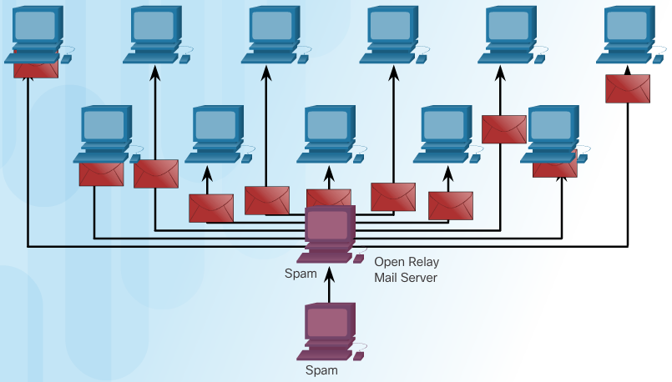
Methods of Attack Other Types of Malware (Cont.)
Botnets and Zombies
When infected, the “zombie” computer contacts servers managed by the botnet creator. These servers act as a command and control (C&C) center for an entire network of compromised devices, or "botnet."
Notes:
7.2 – Methods of Attack
7.2.2 – Other Types of Malware (Cont.)

Slide 12
7.3 How Can I Protect My Network?
Notes:
Cisco Networking Academy Program
Networking Essentials
Chapter 7: Network Security

Slide 13
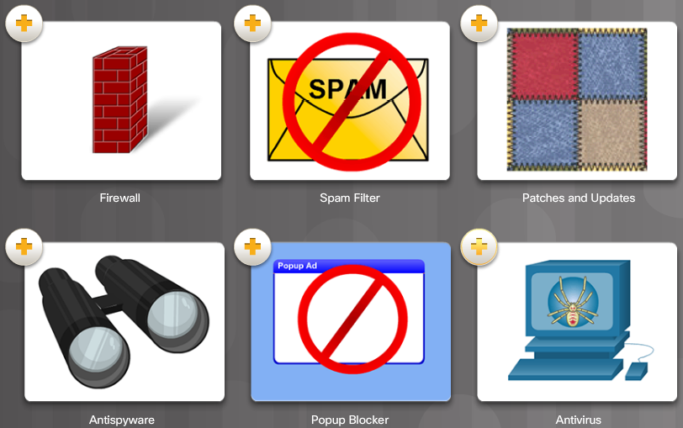
How Can I Protect My Network? Security Tools
Security Practices
Security procedures can range from simple, inexpensive tasks such as maintaining up-to-date software releases, to complex implementations of firewalls and intrusion detection systems.
Security Tools
Many tools are available to network users to protect the devices from attacks and to help remove malicious software from infected machines.
Notes:
7.3 – How Can I Protect My Network?
7.3.1 – Security Tools

Slide 14
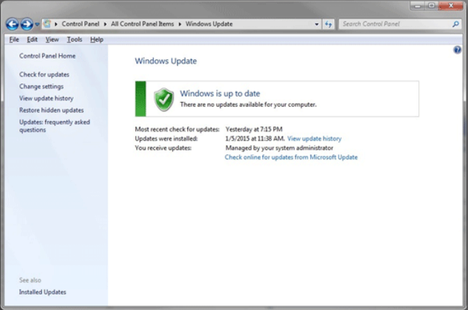
How Can I Protect My Network? Security Tools (Cont.)
Patches and Updates
A patch is a small piece of code that fixes a specific problem. An update, on the other hand, may include additional functionality to the software package as well as patches for specific issues.
Notes:
7.3 – How Can I Protect My Network?
7.3.1 – Security Tools (Cont.)

Slide 15
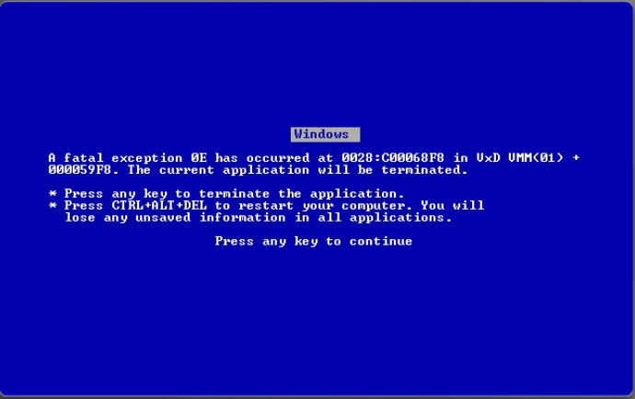
How Can I Protect My Network? Antivirus Software
Infection Detection
Any device that is connected to a network is susceptible to viruses, worms and Trojan horses. So how do you know if your computer has been infected?
Computer starts acting abnormally
Program does not respond to mouse and keystrokes
Programs starting or shutting down on their own
Email program begins sending out large quantities of email
CPU usage is very high
There are unidentifiable, or a large number of processes running
Computer slows down significantly or crashes
Notes:
7.3 – How Can I Protect My Network?
7.3.2 – Antivirus Software

Slide 16

How Can I Protect My Network? Antivirus Software (Cont.)
Antivirus Software
Antivirus software relies on known “virus signatures” in order to find and prevent new viruses from infecting the computer.
Antispam Software
Protects hosts by identifying spam and performing an action, such as placing it into a junk folder or deleting it.
Additional Safeguards
Before forwarding virus warning emails, check a trusted source to see if the virus is a hoax.
Notes:
7.3 – How Can I Protect My Network?
7.3.2 – Antivirus Software (Cont.)

Slide 17
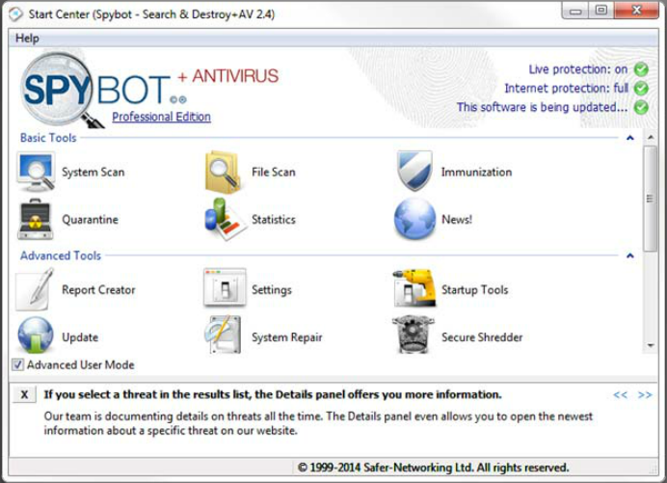
How Can I Protect My Network? Removing Spyware
Antispyware, Adware, and Popup Blockers
Antispyware detects and deletes spyware applications. Many antispyware applications also include detection and deletion of cookies and adware. Popup blocking software can be installed to prevent popups and pop-unders.
Notes:
7.3 – How Can I Protect My Network?
7.3.3 – Removing Spyware

Slide 18
7.4 How Do Firewalls Protect Networks?
Notes:
Cisco Networking Academy Program
Networking Essentials
Chapter 7: Network Security

Slide 19
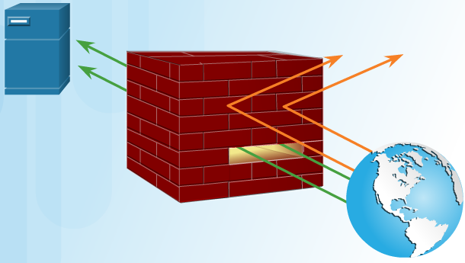
How Do Firewalls Protect Networks? Firewall Basics
What is a Firewall?
A firewall prevents undesirable traffic from entering protected areas of the network. A firewall is usually installed between two or more networks and controls the traffic between them as well as helps prevent unauthorized access.
Firewalls can be implemented in software. Firewalls may also be hardware devices.
A hardware firewall is a freestanding unit.
Firewalls often perform Network Address Translation.
Notes:
7.4 – How Do Firewalls Protect Networks?
7.4.1 – Firewall Basics

Slide 20
How Do Firewalls Protect Networks? Firewall Basics (Cont.)
DMZ
In computer networking, a DMZ refers to an area of the network that is accessible to both internal and external users.
With the wireless router, a simple DMZ can be set up that allows an internal server to be accessible by outside hosts.
The wireless router isolates traffic destined to the IP address specified. This traffic is then forwarded only to the switch port where the server is connected.
Notes:
7.4 – How Do Firewalls Protect Networks?
7.4.1 – Firewall Basics (Cont.)

Slide 21
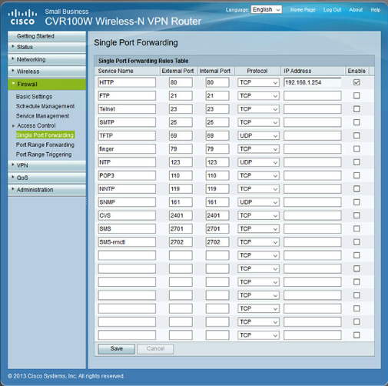
How Do Firewalls Protect Networks? Configuring Firewalls
Port Forwarding
Port forwarding is a rule-based method of directing traffic between devices on separate networks. This method of exposing your devices to the Internet is much safer than using a DMZ.
The rules that you configure in the firewall settings determine which traffic is permitted on to the LAN.
Port Triggering
Port triggering allows the router to temporarily forward data through inbound TCP or UDP ports to a specific device. You can use port triggering to forward data to a computer only when a designated port range is used to make an outbound request.
Notes:
7.4 – How Do Firewalls Protect Networks?
7.4.2 – Configuring Firewalls

Slide 22
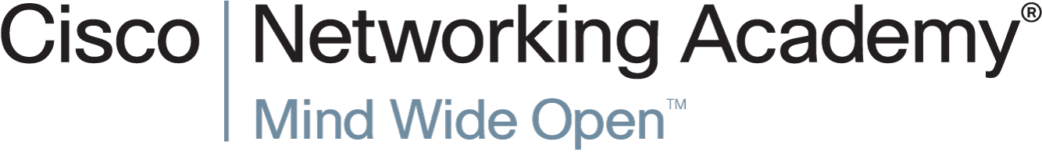

Slide 23
