Slide 1
Chapter 8: Configuring Cisco Devices
Networking Essentials
Notes:
Cisco Networking Academy Program
Networking Essentials
Chapter 8: Configuring Cisco Devices

Slide 2
Chapter 8 - Sections & Objectives
8.1 Cisco LAN Devices
Explain the basic features of Cisco LAN switches.
8.2 Internetworking Devices
Explain the features of a Cisco router.
8.3 Exploring the Cisco IOS
Explain how to use the Cisco IOS
8.4 Using Show Commands
Use common show commands to view device status.
8.5 Configuring a Cisco Network
Build a switch and router network.
Notes:
2

Slide 3
8.1 Cisco LAN Devices
Notes:
Cisco Networking Academy Program
Networking Essentials
Chapter 8: Configuring Cisco Devices

Slide 4
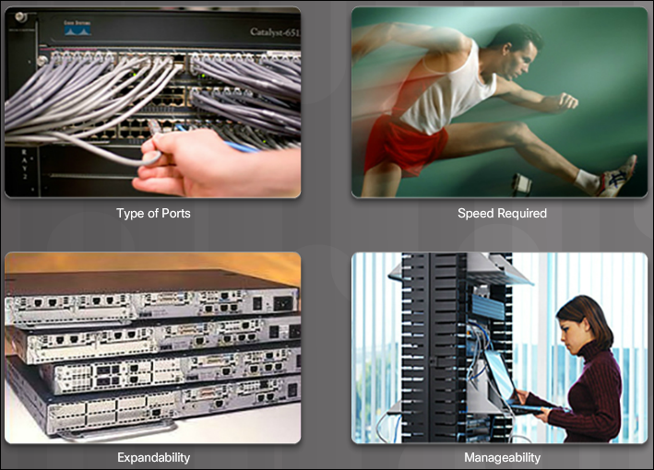
Cisco LAN Devices LAN Switches and Wireless Devices
A switch is used to connect devices on the same network. A router is used to connect multiple networks to each other.
When choosing a switch for a particular LAN, there are a number of factors to consider: types and number of ports, the speed required, expandability and manageability.
Cisco Catalyst 2960 Series Ethernet switches are suitable for small and medium sized networks. They provide 10/100 Fast Ethernet and 10/100/1000 Gigabit Ethernet LAN connectivity.
Notes:
8.1 – Cisco LAN Devices
8.1.1 – LAN Switches and Wireless Devices

Slide 5
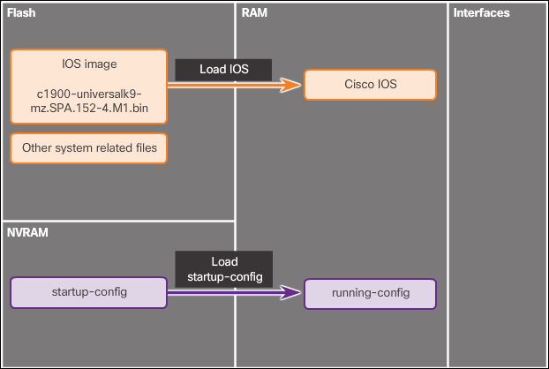
Cisco LAN Devices Connecting to the Switch
When the switch is on, the power-on self-test (POST) begins. During POST, the LEDs blink while a series of tests determine that the switch is functioning properly. POST is completed when the SYST LED rapidly blinks green. If the switch fails POST, the SYST LED turns amber.
Out-of-band management requires a computer to be directly connected to the console port of the network device that is being configured. Use in-band management to monitor and make configuration changes to a network device over a network connection.
A Cisco device loads the following two files into RAM when it is booted:
IOS Image file
Startup configuration file
Notes:
8.1 – Cisco LAN Devices
8.1.2 – Connecting to the Switch

Slide 6
8.2 Internetworking Devices
Notes:
Cisco Networking Academy Program
Networking Essentials
Chapter 8: Configuring Cisco Devices

Slide 7
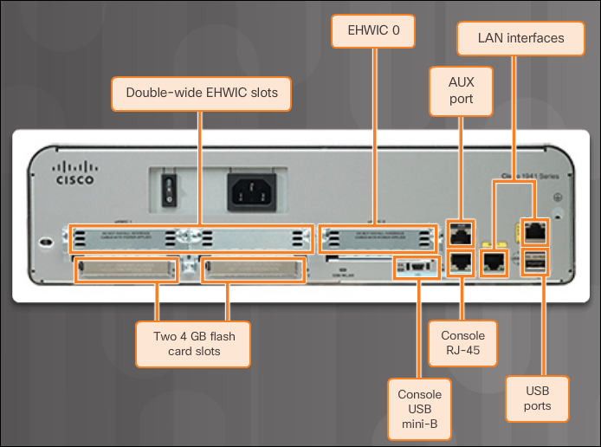
Internetworking Devices Cisco Routers
All routers are essentially computers. Just like computers, routers require: operating systems (OS), central processing units (CPU), random-access memory (RAM), read-only memory (ROM), and nonvolatile random-access memory (NVRAM).
Every Cisco router has the same general hardware components, and these connections: console ports, 2 LAN interfaces, and enhanced high-speed WAN interface card (EHWIC) slots.
Notes:
8.2 – Internetworking Devices
8.2.1 – Cisco Routers

Slide 8
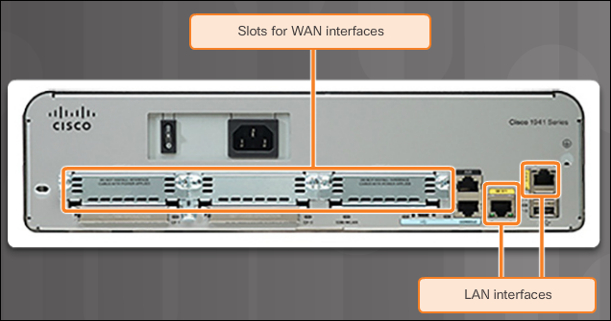
Internetworking Devices Setting Up the Router
Follow these steps to power up a Cisco router:
Mount and ground the device chassis.
Seat the external compact flash card.
Connect the power cable.
Configure the terminal emulation software on the PC and connect the PC to the console port.
Turn on the router.
Observe the startup messages on the PC as the router boots up.
The two most
common methods to access the command line interface are
console and SSH.
Notes:
8.2 – Internetworking Devices
8.2.2 – Setting Up the Router

Slide 9
8.3 Exploring the Cisco IOS
Notes:
Cisco Networking Academy Program
Networking Essentials
Chapter 8: Configuring Cisco Devices

Slide 10
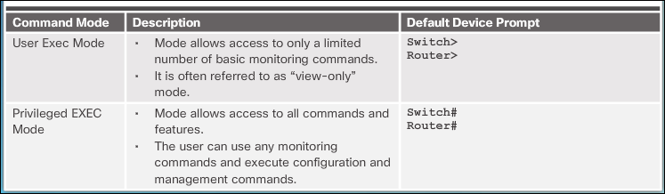
Exploring the Cisco IOS Navigate the IOS
The Cisco IOS command line interface (CLI) is a text-based program that enables entering and executing Cisco IOS commands to configure, monitor, and maintain Cisco devices.
To initially configure a Cisco device, a console connection must be established.
As a security feature, the Cisco IOS software separates management access into the following two command modes: user EXEC mode and privileged EXEC mode.
Global configuration mode is identified by a prompt that ends with (config)# after the device name, such as Switch(config)#.
Notes:
8.3 – Exploring the Cisco IOS
8.3.1 – Navigate the IOS

Slide 11
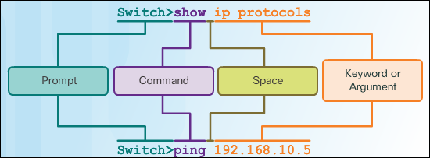
Exploring the Cisco IOS The Command Structure
The general syntax for a command is the command followed by any appropriate keywords and arguments:
Keyword - a specific parameter defined in the operating system (in the figure, ip protocols)
Argument - not predefined; a value or variable defined by the user (in the figure, 192.168.10.5)
ping ip-address - The command is ping and the user-defined argument is the ip-address of the destination device.
traceroute ip-address - The command is traceroute and the user-defined argument is the ip-address of the destination device.
The Cisco IOS has both context sensitive help and command syntax check.
Commands and keywords can be shortened to the minimum number of characters that identify a unique selection.
Notes:
8.3 – Exploring the Cisco IOS
8.3.2 – The Command Structure

Slide 12
8.4 Using Show Commands
Notes:
Cisco Networking Academy Program
Networking Essentials
Chapter 8: Configuring Cisco Devices

Slide 13
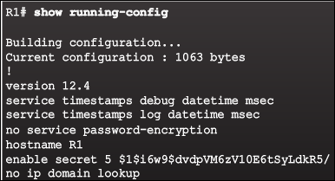
Using Show Commands Viewing Device Information
To verify and troubleshoot network operation, examine the operation of the devices using the show command:
show running-config
show interfaces
show arp
show ip route
show protocols
show version
If you are logged into a router
or switch remotely, the show version command is an excellent means of quickly finding useful summary information about the particular device to which you are connected.
Notes:
8.4 – Using Show Commands
8.4.1 – Viewing Device Information

Slide 14
8.5 Configuring a Cisco Network
Notes:
Cisco Networking Academy Program
Networking Essentials
Chapter 8: Configuring Cisco Devices

Slide 15
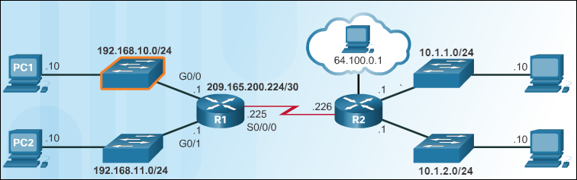
Configuring a Cisco Network Basic Switch Configuration
Configure the device name.
Secure the user EXEC mode.
Secure remote Telnet/SSH access.
Secure privileged EXEC mode.
Secure all passwords in the config file.
Provide legal notification.
Configure the management SVI.
Save the configuration.
Notes:
8.5 – Configuring a Cisco Network
8.5.1 – Basic Switch Configuration

Slide 16
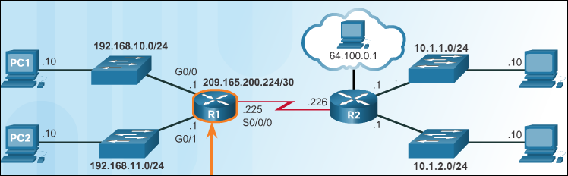
Configuring a Cisco Network Basic Router Configuration
Configure the device name.
Secure the user EXEC mode.
Secure remote Telnet/SSH access.
Secure privileged EXEC mode.
Secure all passwords in the config file.
Provide legal notification.
Save the configuration.
Notes:
8.5 – Configuring a Cisco Network
8.5.2 – Basic Router Configuration Steps

Slide 17
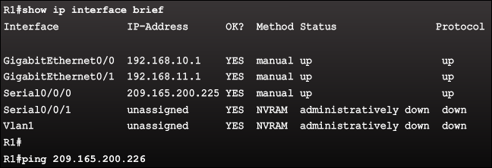
Configuring a Cisco Network Basic Router Configuration (Cont.)
Configure the interface:
interface type-and-number
description description-text
ip address ipv4-address subnet-mask
no shutdown
One of the most useful commands for verifying interface configuration is the show ip interface brief command. The output displays all interfaces, their IPv4 address, and their current status. The configured and connected interfaces should display a Status of “up” and Protocol of “up”.
Other interface verification commands include:
show ip route - Displays the contents of the IPv4 routing table stored in RAM.
show interfaces - Displays statistics for all interfaces on the device.
show ip interface - Displays the IPv4 statistics for all interfaces on a router.
Notes:
8.5 – Configuring a Cisco Network
8.5.2 – Basic Router Configuration Steps

Slide 18
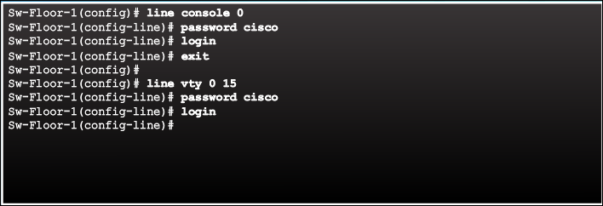
Configuring a Cisco Network Securing the Devices
As good practice, use different authentication passwords for each of these levels of access.
Setting a password for console connection access is done in global configuration mode. These commands prevent unauthorized users from accessing user mode from the console port.
Switch(config)# line console 0
Switch(config)# password [password]
Switch(config)# login
Notes:
8.5 – Configuring a Cisco Network
8.5.3 – Securing the Devices

Slide 19
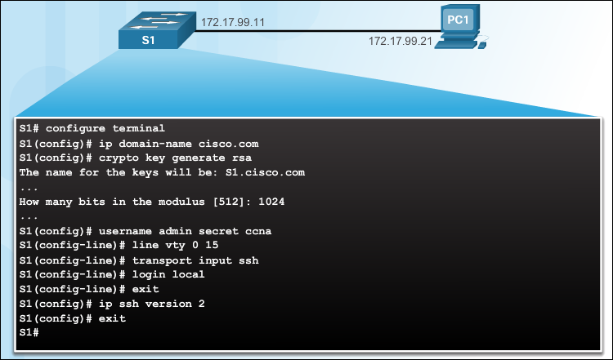
Configuring a Cisco Network Securing the Devices (Cont.)
Verify SSH support.
Configure the IP domain.
Generate RSA key pairs.
Configure user authentication.
Configure the vty lines.
Enable SSH version 2.
Notes:
8.5 – Configuring a Cisco Network
8.5.3 – Securing the Devices

Slide 20
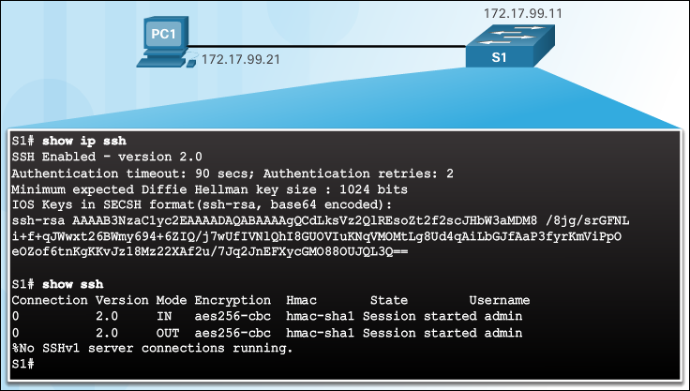
Configuring a Cisco Network Securing the Devices (Cont.)
To display the version and configuration data for SSH on the device that you configured as an SSH server, use the show ip ssh command.
Notes:
8.5 – Configuring a Cisco Network
8.5.3 – Securing the Devices

Slide 21
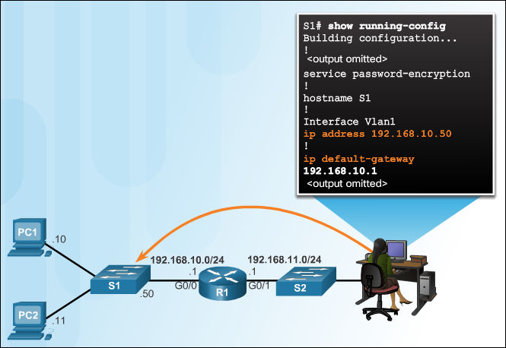
Configuring a Cisco Network Connecting the Switch to the Router
The default gateway address is generally the router interface address attached to the local network of the host. The IP address of the host device and the router interface address must be in the same network.
To configure a default gateway on a switch, use the ip default-gateway global configuration command. The IP address configured is that of the router interface of the connected switch.
Notes:
8.5 – Configuring a Cisco Network
8.5.4 – Connecting the Switch to the Router.\

Slide 22


Slide 23


