Slide 1
Chapter 9: Testing and Troubleshooting
Networking Essentials 1.0
Notes:
Cisco Networking Academy Program
Networking Essentials 1.0
Chapter 9: Testing and Troubleshooting

Slide 2
Chapter 9 - Sections & Objectives
9.1 What to Do When It Does not Work
Explain the steps to take when a new configuration does not work as expected.
9.2 Troubleshooting Issues in Networks
Troubleshoot network problems with common network utilities.
9.3 Identifying and Fixing Common Problems
Troubleshoot a network connectivity problem.
9.4 Working with Customer Support
Explain how to work with customer support.
Notes:
2

Slide 3
9.1 What To Do When It Does Not Work
Notes:
Cisco Networking Academy Program
Networking Essentials 1.0
Chapter 9: Testing and Troubleshooting

Slide 4
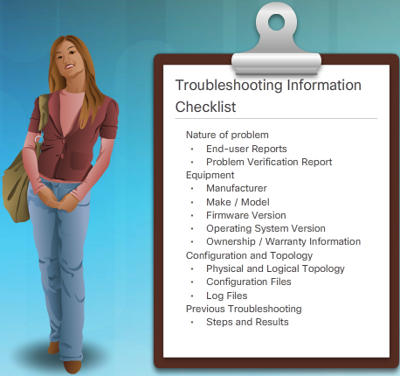
What to Do When it Does not Work The Troubleshooting Process
What is Network Troubleshooting?
Process of identifying, locating and correcting the problems.
Maintain good documentation when troubleshooting.
Gathering Information
Question the individual who reported
the problem as well as any other
affected users.
Collect information about any
equipment that may be affected
Notes:
9.1 – What to Do When it Does not Work
9.1.1 – The Troubleshooting Process

Slide 5
What to Do When it Does not Work Approaches to Troubleshooting
Choose a troubleshooting approach
Top-down
Divide-and conquer
Bottom-up
Other Good Approaches
Trial and Error
Substitution
Notes:
9.1 – What to Do When it Does not Work
9.1.2 – Approaches to Troubleshooting

Slide 6
9.2 Troubleshooting Issues in Networks
Notes:
Cisco Networking Academy Program
Networking Essentials 1.0
Chapter 9: Testing and Troubleshooting

Slide 7




Troubleshooting Issues in Networks Detecting Physical Layer Problems
Using Your Senses
Sight
Smell
Touch
Hear
Using Software Tools
and Utilities
ipconfig
ping
netstat
tracert
nslookup
Notes:
9.2 – Troubleshooting Issues in Networks
9.2.1 – Detecting Physical Layer Problems

Slide 8
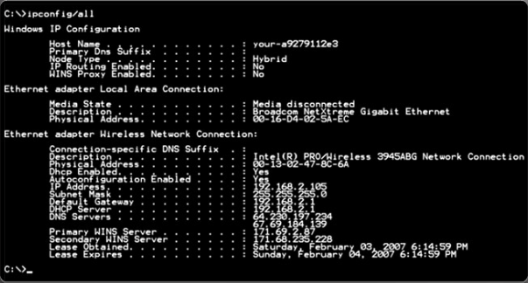
Troubleshooting Issues in Networks Troubleshooting Utilities
Windows IP Information
ipconfig
ipconfig /all
ipconfig /release and ipconfig /renew
Notes:
9.2 – Troubleshooting Issues in Networks
9.2.2 – Troubleshooting Utilities

Slide 9
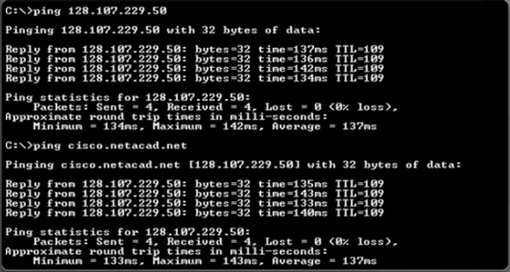
Troubleshooting Issues in Networks Testing Network Connectivity
Using the ping Command
Ping is used to test if a destination host is reachable.
The ping command can be followed by either an IP address or the name of a destination host.
Notes:
9.2 – Troubleshooting Issues in Networks
9.2.3 – Testing Network Connectivity

Slide 10
Troubleshooting Issues in Networks Testing Network Connectivity (Cont.)
What do ping Results Tell Us?
If pings to both the name and IP address are successful, but the user is still unable to access the application, then the problem most likely resides in the application on the destination host
If neither ping is successful, then network connectivity along the path to the destination is most likely the problem
If the ping to the default gateway is successful, the problem is not local. If the ping to the default gateway fails, the problem resides on the local network.
A ping may fail due to the firewall on the sending or receiving device, or a router along the path blocking the pings.
Notes:
9.2 – Troubleshooting Issues in Networks
9.2.3 – Testing Network Connectivity

Slide 11

Troubleshooting Issues in Networks Other Useful IP Utilities
Can I Get to My Destination?
The tracert utility provides connectivity information about the path a packet takes to reach the destination and about every router (hop) along the way.
Identifying Active Connections
netstat lists the protocol in use, the local address and port number, the foreign address and port number, and the state of the connection.
Troubleshooting DNS
The nslookup utility allows
an end-user to look up information
about a particular DNS name in
the DNS server.
Notes:
9.2 – Troubleshooting Issues in Networks
9.2.4 – Other Useful IP Utilities

Slide 12
9.3 Identifying and Fixing Common Problems
Notes:
Cisco Networking Academy Program
Networking Essentials 1.0
Chapter 9: Testing and Troubleshooting

Slide 13
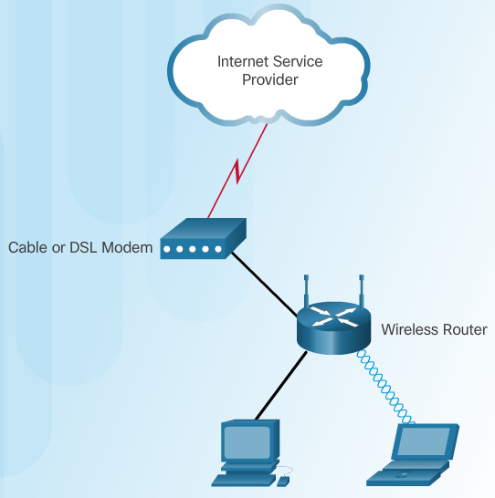
Identifying and Fixing Common Problems Connectivity Issues
Divide and Conquer
Ping from a wireless client
to the default gateway
Ping from a wired client to
the default gateway
Ping from the wireless
client to a wired client
Bottom Up
Examine the LEDs
LEDs may change color or
flash to convey information.
Notes:
9.3 – Identifying and Fixing Common Problems
9.3.1 – Connectivity Issues

Slide 14
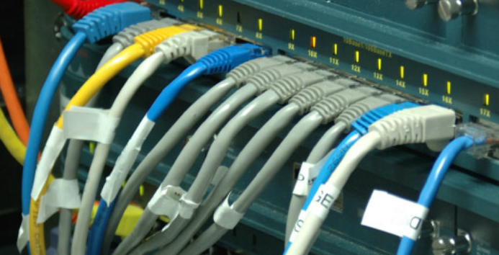
Identifying and Fixing Common Problems How to Solve Common Issues
Cabling Problems
Be sure to use the correct type of cable.
Terminate cables via T568A or T568B termination standard.
Do not exceed maximum cable run lengths.
Verify that the correct ports are being used.
Protect cables and connectors from physical damage.
Notes:
9.3 – Identifying and Fixing Common Problems
9.3.2 – How to Solve Common Issues

Slide 15
Identifying and Fixing Common Problems Troubleshooting Wireless
Causes of Wireless Issues
Not all wireless standards are compatible.
Each wireless conversation must occur on a separate, non-overlapping channel.
The strength of an RF signal decreases with distance.
RF signals are susceptible to interference from outside sources
APs share the available bandwidth between devices.
Authentication and Association Errors
The SSID must match on both the AP and client.
Both the client and the AP must be configured with the same authentication key.
The same encryption key must be configured on both the AP and the client.
Notes:
9.3 – Identifying and Fixing Common Problems
9.3.3 – Troubleshooting Wireless

Slide 16
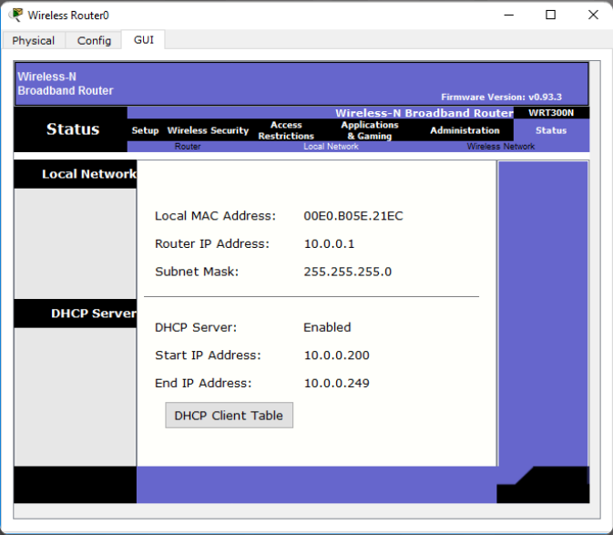
Identifying and Fixing Common Problems DHCP and IP Address Issues
DHCP Server Configuration Errors
The client table information should match the local host information
Check to make sure that the router has an IP address
The LAN interface of the wireless router should be set as the default gateway.
Notes:
9.3 – Identifying and Fixing Common Problems
9.3.4 - DHCP and IP Address Issues

Slide 17
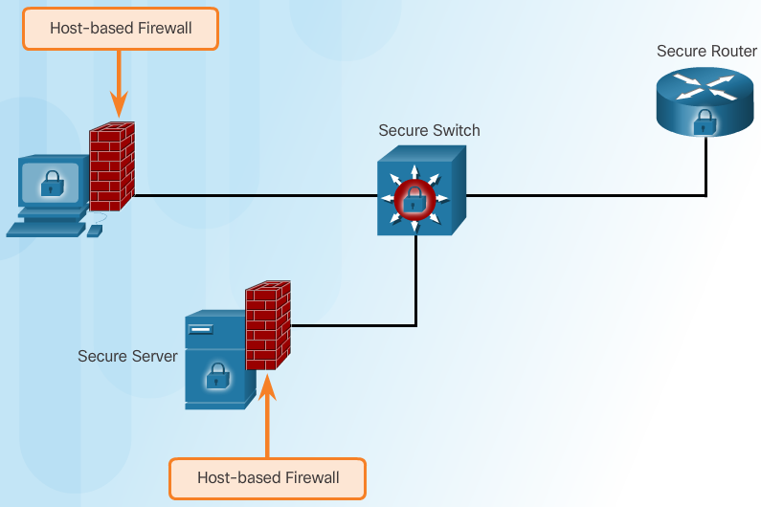
Identifying and Fixing Common Problems DHCP and IP Address Issues (Cont.)
Why Can’t We Get to the Internet?
Examine the router status page.
Check all physical connections and LED indicators.
Try to re-establish connectivity
Could it be the Firewall?
Check that the application
TCP or UDP port is open
and no filter lists are
blocking traffic to that port.
Check all settings on the
router to ensure no
security restrictions could
be causing the issue.
Notes:
9.3 – Identifying and Fixing Common Problems
9.3.4 - DHCP and IP Address Issues

Slide 18
9.4 Working with Customer Support
Notes:
Cisco Networking Academy Program
Networking Essentials 1.0
Chapter 9: Testing and Troubleshooting

Slide 19




Working with Customer Support Using Outside Sources for Help
Where Can I Get Help?
It might be necessary to obtain assistance from outside sources.
When to Call for Help
It may be necessary to contact the vendor or ISP support desk for assistance.
Using the Support Desk
It is important to give the support desk as much information as possible.
Notes:
9.4 - Working with Customer Support
9.4.1 - Using Outside Sources for Help

Slide 20
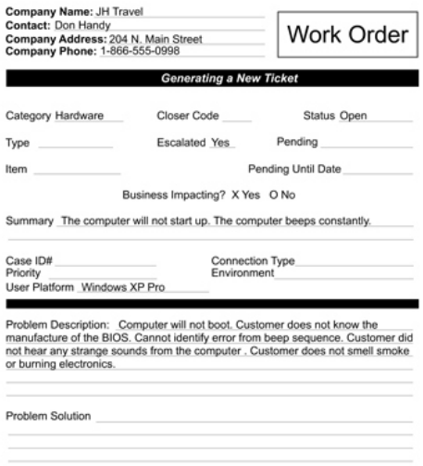
Working with Customer Support Keeping Good Records
Resolving the Issue
They may escalate the problem to a higher level.
Record all information regarding the interaction with the support desk.
Tickets and Work Orders
When the customer identifies
who they are, the technician
accesses the relevant customer
information.
The information is transferred to
a trouble ticket, or incident report.
When an on-site call is required,
the trouble ticket information can
be converted to a work order.
Notes:
9.4 - Working with Customer Support
9.4.2 – Keeping Good Records

Slide 21


Slide 22


