Slide 1
THESIS PRESENTATION · 10 MINUTES
Fintech Two-Wave
Disruption Index
Has fintech disruption of traditional banking already run its course — or is a second, AI-native wave only now beginning?
Kai Tee · Summer 2026 Intern Thesis · 2026-07-17

Slide 2
02
THE QUESTION
Two waves, not one
Asking “did fintech disrupt banking?” is trivial — yes. This project tests for two separate, dateable structural breaks instead.
WAVE 1 · 2010–2021
WAVE 2 · 2024–
App-based disruption
AI-native finance
Payments, neobanks, embedded finance — PayPal, Block, SoFi, Nubank. Won on user experience, not a fundamentally different banking model. Did it hold?
AI-native underwriting and advisory. Mostly private, newly public, or not yet public at all. Early signal, or hype with no company behind it yet?

Slide 3
03
METHOD
Three sources → one index → a statistical test
Three independent data sources are collected, normalised to monthly frequency and z-scored, combined into a Fintech Disruption Index (FDI) with two sub-indices, then tested for structural breaks — not eyeballed off a chart.
Collect
Z-score
Composite FDI
Break test
Market prices, Google Trends, SEC EDGAR filings — independently pulled, monthly-resampled.
→
Each series standardised, then combined into Wave 1 / Wave 2 sub-indices.
→
W1_WEIGHT × Wave1 + (1−W1_WEIGHT) × Wave2, default 50/50.
→
PELT change-point on 12-month momentum, confirmed with a Chow test (F, p).

Slide 4
04
DATA PULLED · MARKETS
Prices & profitability, 7 tickers since 2018
collect_market_data.py pulls daily close prices (via yfinance) and annual net income for seven tickers across three categories, then rebases each price series to 100 at its own start date so wildly different price levels sit on one comparable axis.
CATEGORY
TICKERS
WHAT IT TESTS
traditional_bank
JPM · HSBC · BCS
Did incumbents catch back up?
neobank
SOFI · NU
Did the challenger model hold?
embedded_finance
PYPL · XYZ (Block)
Did the 2021 boom last?
Outputs: prices.csv, fundamentals.csv, indexed_performance.csv

Slide 5
05
DATA PULLED · ATTENTION & FILINGS
Search interest & SEC disclosure language
Google Trends
SEC EDGAR full-text search
collect_trends.py — weekly search interest since 2018, two keyword groups:
collect_edgar.py — 10-K / 20-F filings, 5 companies, since 2019, two query sets:
Wave 1: “neobank”, “digital bank app”, “mobile banking”
Wave 2: “AI agent finance”, “agentic AI banking”, “autonomous wealth management”
agentic: the “AI agent” phrase family — Wave-2-specific
ai_broad: “artificial intelligence” — saturated baseline
collect_edgar_marketwide.py reruns agentic with no company filter, across every 10-K filer in EDGAR.

Slide 6
06
ANALYSIS
How the index & the breaks are computed
Wave 1 sub-index
z(market relative strength) + z(Wave 1 search interest)
Wave 2 sub-index
z(Wave 2 search interest) + z(EDGAR ai_broad intensity)
Composite FDI
W1_WEIGHT × Wave1 + (1−W1_WEIGHT) × Wave2
Break detection runs in two stages, not one eyeballed chart: PELT (via ruptures) scans each sub-index’s 12-month momentum for candidate change-points, then a classical Chow test confirms each candidate is a statistically significant break in trend — reported as an F-statistic and p-value, not just a marked date.

Slide 7
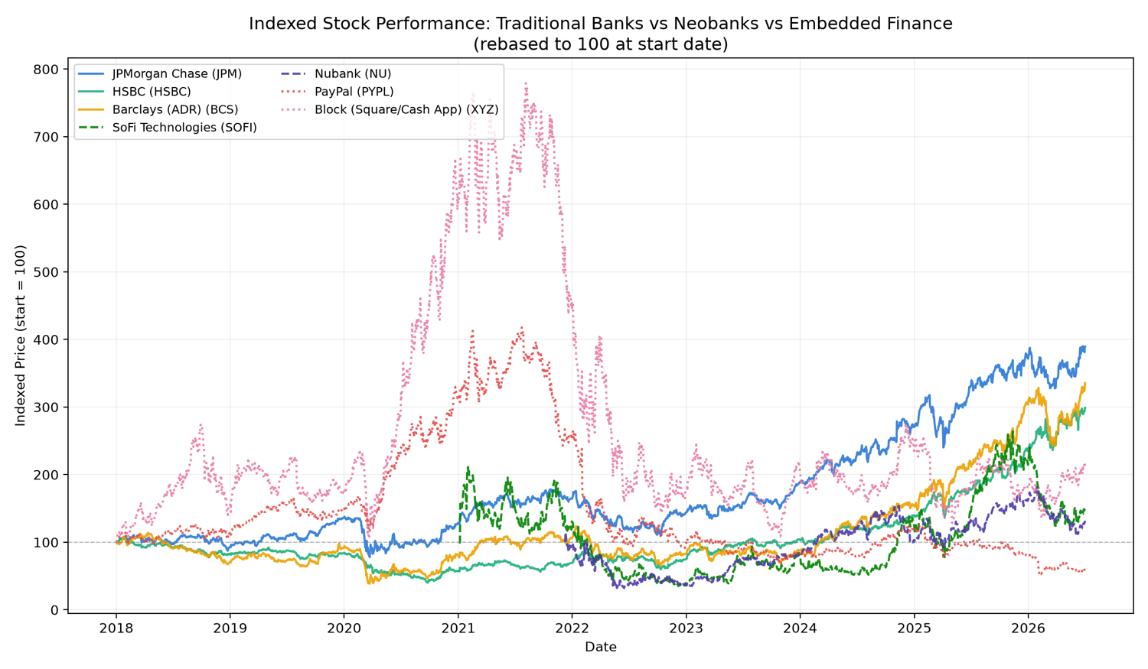
07
FINDING · WAVE 1
The 2021 boom didn’t hold
TICKER
CATEGORY
PEAK(IDX)
PEAK DATE
VALUE 7/2/26
XYZ (Block)
embedded fin.
779
2021-08-05
218
PYPL
embedded fin.
418
2021-07-23
62 ↓ start
SOFI
neobank
264
2025-11-12
150
NU
neobank
182
2026-01-28
132
JPM
trad. bank
—
steady climb
389 ↑ best
BCS
trad. bank
—
steady climb
335
HSBC
trad. bank
—
steady climb
299
Exhibit A Indexed performance, rebased to 100 at start

Slide 8
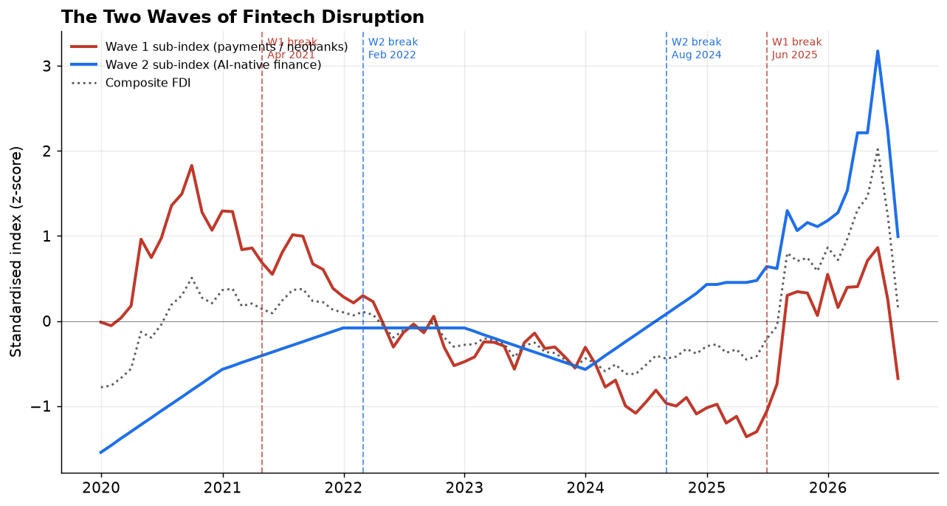
08
FINDING · WAVE 1
A dated rollover, and a losing year
STRUCTURAL BREAK
2022 NET INCOME
April 2021 — F = 9.094, p < 0.001. Wave 1 index rolls over from rising to declining.
June 2025 — F = 54.151, p < 0.001. Partial, abrupt rebound.
Momentum is negative through most of 2021–2025 — literally losing ground year over year.
SOFI
−$320M
XYZ (Block)
−$541M
NU (Nubank)
−$365M
JPM
+$37.7B
HSBC
+$15.6B
Exhibit B Wave 1 sub-index with confirmed break dates

Slide 9
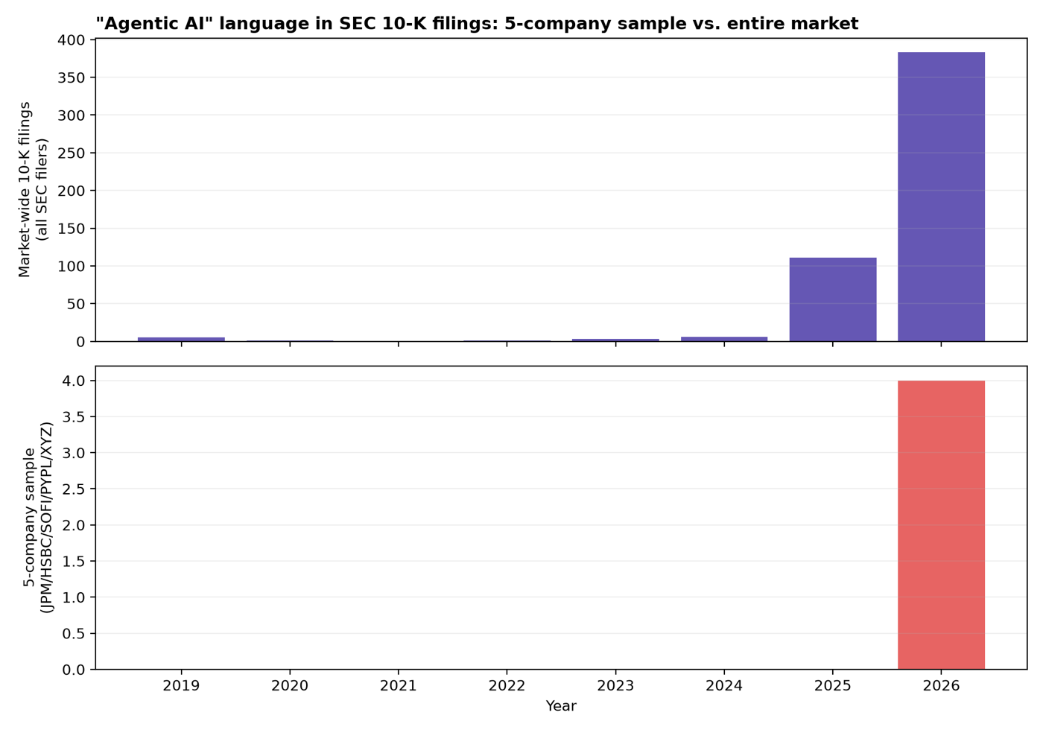
09
FINDING · WAVE 2
Thin by design, not by accident
5-company sample, agentic mentions in annual filings: zero every year, 2019–2025 — then 4 in 2026 (JPM, HSBC, PayPal, Block). Checked market-wide, no company filter, across every 10-K filer in EDGAR:
2019
2020
2021
2022
2023
2024
2025
2026
5
1
0
1
3
6
111
383
Same near-zero-then-jump shape, found independently at a completely different scale — roughly an 18× jump in 2025. Strongest evidence the thinness is early, not a 5-company artifact.
Exhibit C 5-company sample vs. market-wide, “agentic” query

Slide 10
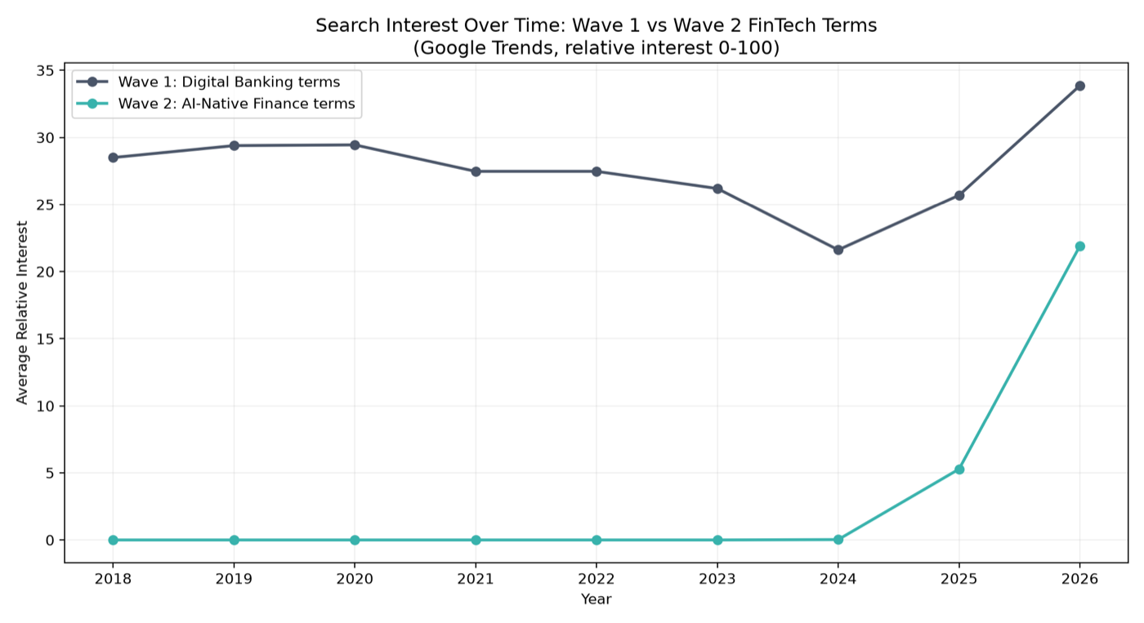
10
FINDING · WAVE 2
Search attention turns on in 2024
Wave 2 terms — “AI agent finance,” “agentic AI banking,” “autonomous wealth management” — register literally zero search interest every year from 2018 through 2023. Interest turns on in 2024–2025 and reaches ~22 by 2026: real, but from a standing start, and still below Wave 1’s level.
No market proxy exists for Wave 2 — there is no “AI-native fintech” stock basket in this project, because the relevant companies mostly aren’t public yet.
Exhibit D Search interest, Wave 1 vs. Wave 2 keyword groups

Slide 11
11
VERDICT
Fintech didn’t die. AI hasn’t taken over — yet.
“Incumbent banks are better positioned to absorb AI than to be displaced by it.”
1. Wave 1 has largely lost its edge
By price and by 2022 profitability, the app-based challengers have been substantially reabsorbed by the banks they once threatened. PayPal sits below its 2018 start; JPM is now the best performer.
2. Wave 2 is not yet measurable — and that’s itself a finding
Most AI-native firms are private or too young for market data. The thin evidence that exists (EDGAR agentic language, search interest) is consistent with a real, early inflection starting around 2024.
3. Likely winner: banks capture this wave too — a prediction, not a finding
All four companies whose 2026 filings mention agentic language are already-established incumbents. Consistent with “incumbents move first,” not proof of it.

Slide 12
12
READ BEFORE OVER-CITING THIS
Limitations
—
Proxies, not ground truth. Search interest measures attention, not adoption. Filing language measures what companies say, not what they ship. Only four fiscal years of net income are available per company.
—
Short Wave 2 window. The acceleration signal covers roughly 2024–2026 — about two years. A single flat year would meaningfully change the picture.
—
Small, hand-picked, public-only sample. 5 companies for EDGAR, 7 tickers for prices. The market-wide EDGAR check mitigates but doesn’t remove this — there’s no way to see a winning private challenger.
—
Part 3 is a prediction, explicitly labeled as such. “Banks absorb the AI wave” should not be cited with the same confidence as what already happened in Wave 1.

Slide 13
13
CLOSE
Two waves, two different kinds of confidence
Wave 1: measured, and it’s over. Wave 2: real, but too early to price. The smart bet is that banks capture this wave the same way they captured the last one — but that part is outside what this data can prove.
Thank you — questions.

