Slide 1
Buried Point Monitor
Knowing What/Where/How when remote service is slow
2/3/2021

Slide 2
T1
T2
T3
T4
T5
Team
Project team members
Xuan Dong

Slide 3
What’s our problem?
Slowness can propagate, for example:
Once TM return sitemap slowly, and too many home pages hanging, then every page become slow.
Server to server calls has been everywhere:
Ex. ESB load sitemap from TM; the usage of Solr, GAM or Redis.
Robustness can be improved.
Distributed system can be hard to debug:
We don’t know root cause when slowness, no useful debug info can be logged without performance hit.
Caller need to be able to meltdown:
When TM already overloaded, ESB should stop sending sitemap request, TM also recovers quicker.
Notes:
This Ideathon targets at improving our product’s robustness, and more precisely, it solves three problems when our architecture become more distributed …
Problem 1..
Problem 2..
Problem 3..
So isn’t that wonderful, if ESB can monitor the response time of TM sitemap call, and conditionally skip requesting TM sitemap if it will timeout anyway, or selectively capture request/Response attributes into log to reproduce/analyze the slowness, this is idea is called..
Do not dive into how slowness happened technically like synchronous, memory, blocking context switch.
Better to keep the continuity at this very beginning, and we will call back to explain before the DEMO1, as part of context to understand its setup.

Slide 4
Buried point monitor
Need to down-sample to achieve O(1) memory complexity, and only discard requests that came too quickly to exceed memory allocation.
Buried point monitor is an SDK for caller to detect slowness in its dependent remote service, so that caller can leave useful debug information, or do things differently to avoid propagation of slowness.
Need O(1) time complexity, so that it can be thread-safe without hurting throughput.
API need to be highly extendable to be useful, ex. Allow caller to specify when to log what, or take what action.
Notes:
Read the definition quickly.
So, what would be the challenges to do so, why we haven’t been buried point monitor for so long?
Challenge 1 - Memory,
Imaging ESB send out 1000 sitemap calls per second, and each of them taking 20 sec to timeout, then ESB will hold 20K object to track their starting time, and make ESB memory blow up more quickly. We need to discard requests that came too quickly to exceed memory allocation.
Challenge 2 – need to be thread safe, and whatever in the critical section need to be super fast.
I will present the algorithm in next slide which is constant time complexity.
Challenge 3 – it need to be highly extendable, since cannot assume what action is needed to take when slowness identified
Melt-down is just one extension that I implemented, and I will demo it in the very end.

Slide 5
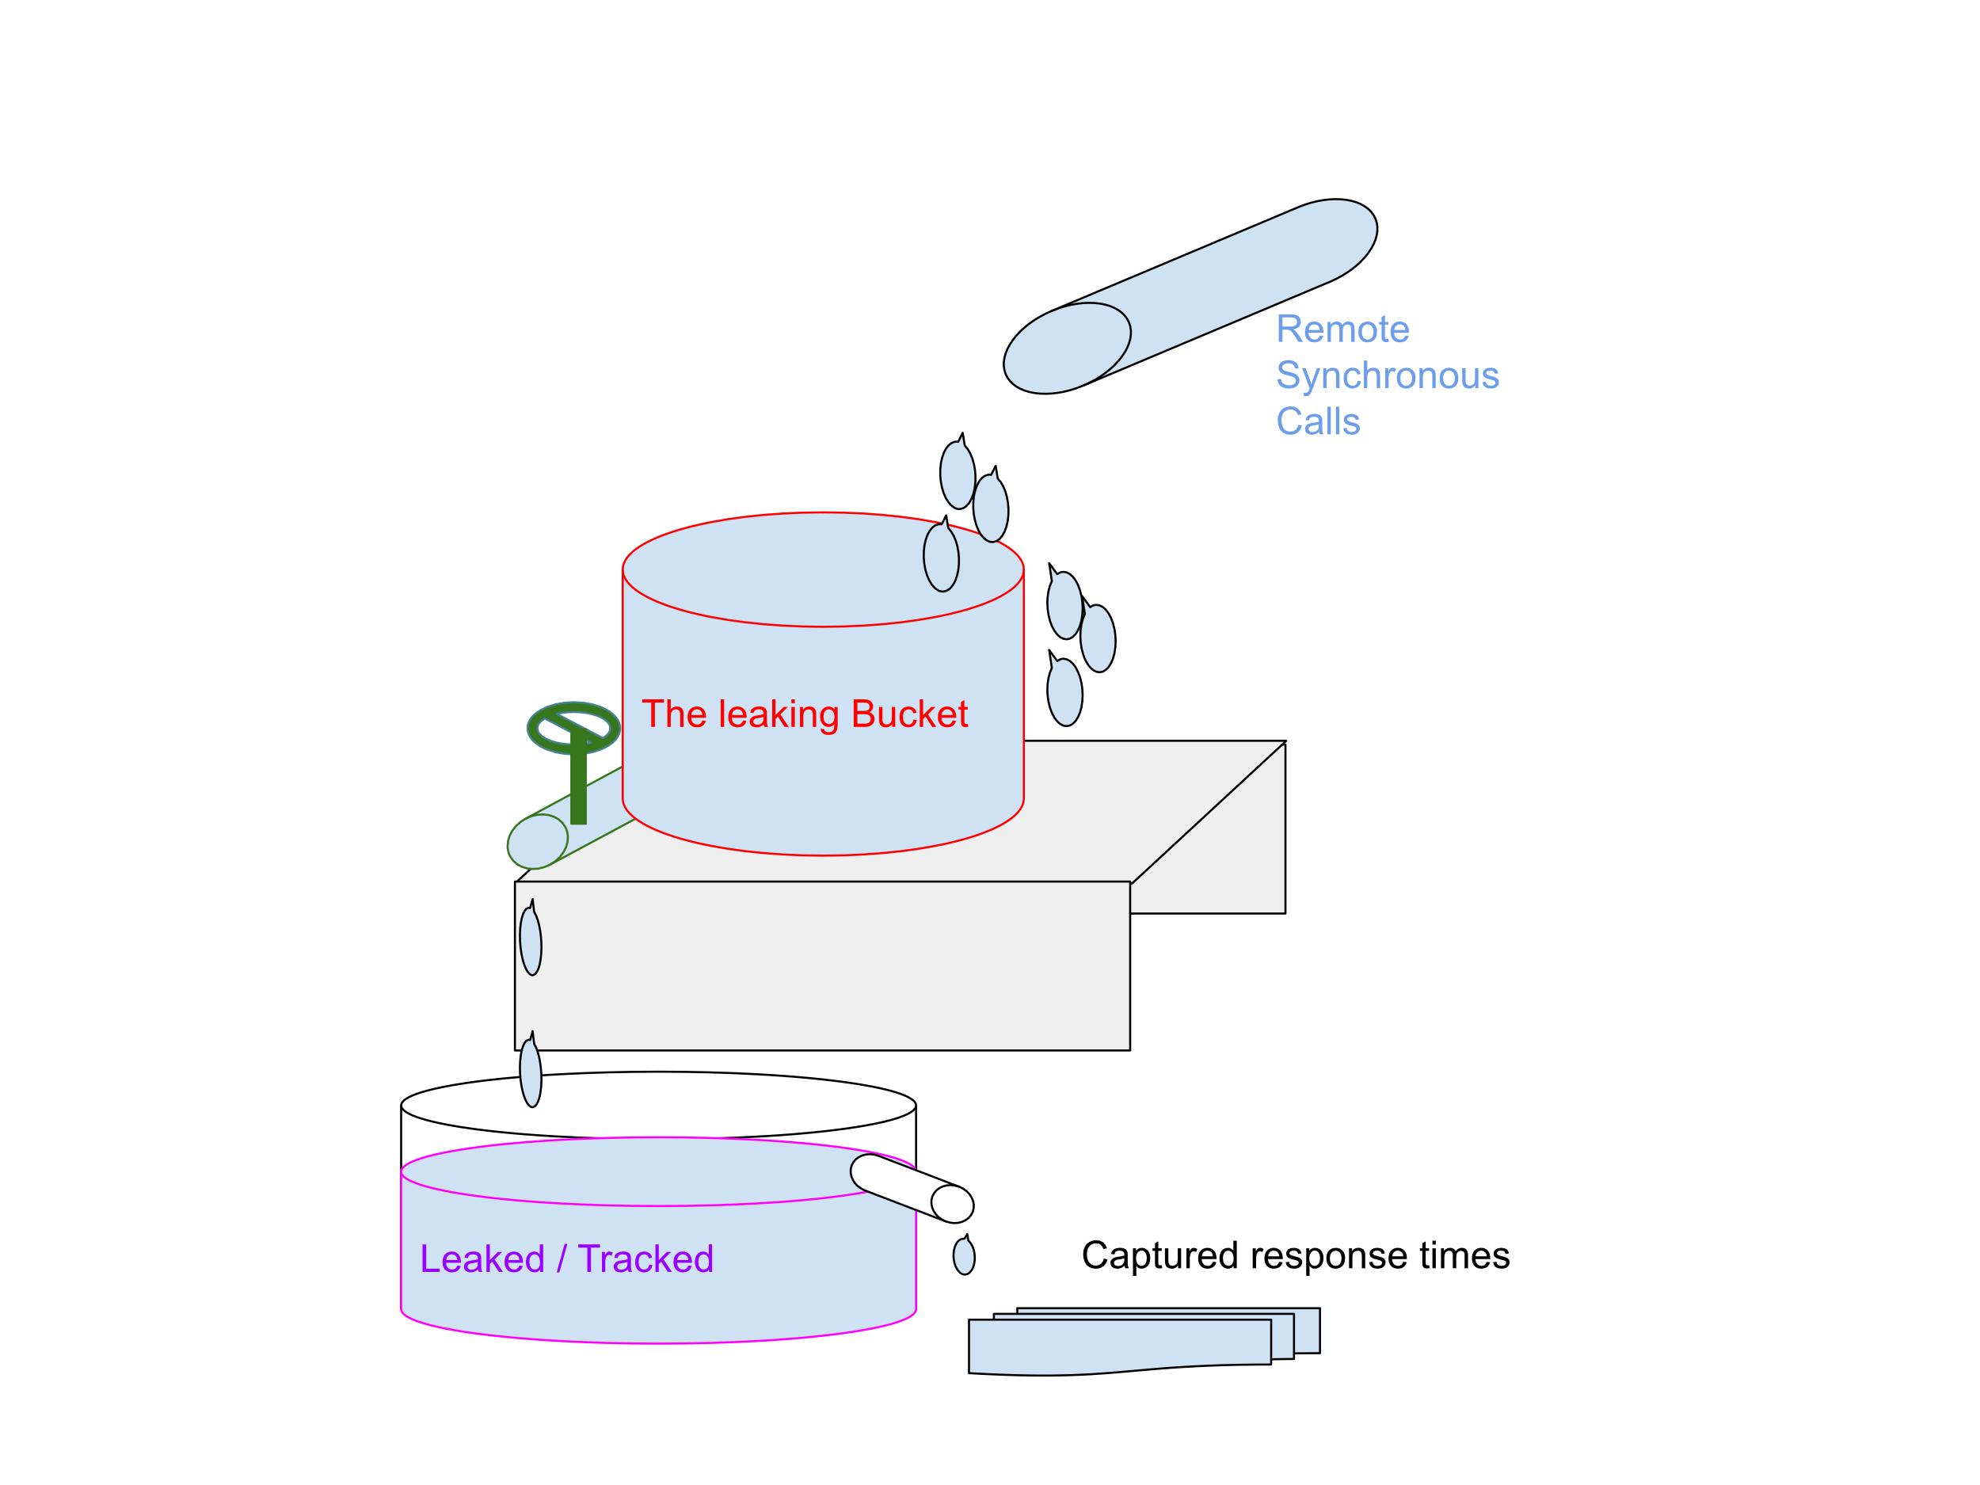
A Leaking Bucket Design
BucketSize:
A traffic cannot enter the bucket if the number of traffics in bucket is exceeding BucketSize.
QPS:
Only QPS number of traffic will be leaked in a second, we only track response time for a leaked traffic.
TimeOutInSecond:
Recycle and log a leaked traffic if it’s older that TimeOutInSecond.
Notes:
So back to the basic question: how we are going to down sampling, say to monitor one request’s response time each second, no more on less.
Can we only monitor requests sent at the last millisecond of each second?
But what if all requests within first 999 ms, we won’t capture nothing;
Can we only monitor another request after one second passed since last monitored?
What if there are just two requests send out in that second, and I’m interested in capturing both of them, no reason I cannot.
So if both above cannot work, how we are going to down sampling?

Slide 6
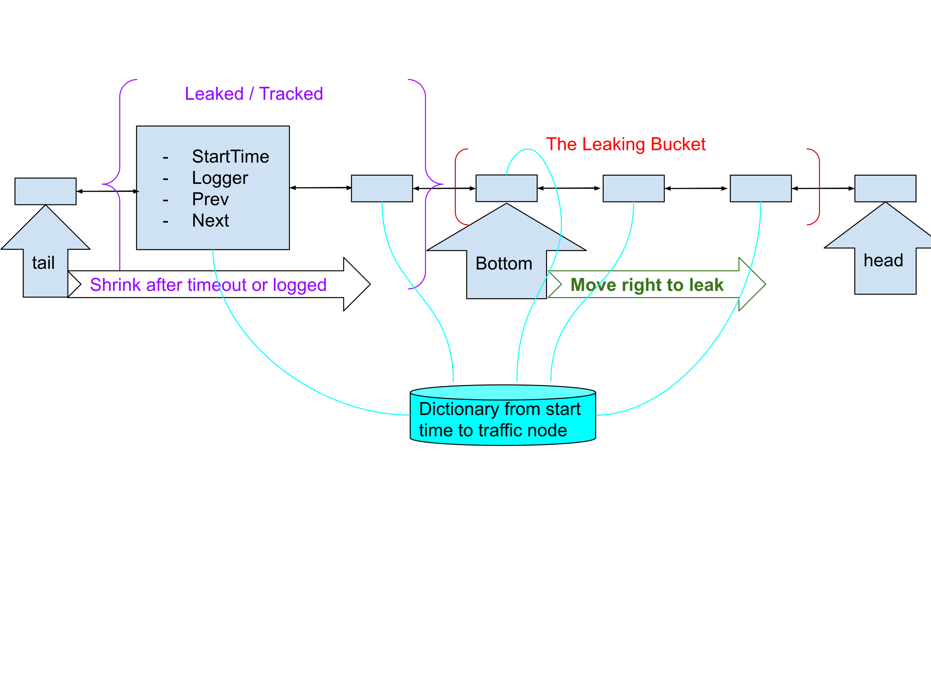
A Leaking Bucket Design
BucketSize:
A traffic cannot enter the bucket if the number of traffics in bucket is exceeding BucketSize.
TimeOutInSecond:
Recycle and log a leaked traffic if it’s older that TimeOutInSecond.
QPS:
Only QPS number of traffic will be leaked in a second, we only track response time for a leaked traffic.
Available in Xuan’s Github at: https://github.com/kaixinxiaomao/Burrid-Point-Monitor/blob/main/BurriedPointMonitor/ResponseTracker.cs

Slide 7
DEMO 1 – c10K performance testing
Setup:
With 128 threads and 5 CPUs to mimic typical caller (ESB) sending requests to remote-service (TM) 10000 times per second.
Each thread will iterate a randomized array of blocking periods around 12.5 ms.
Thread.Sleep() is used to emulate the blocking time when ESB waiting for TM.
Test Goal:
Run two tests with same setup as above, the first test is without buried point monitoring, the second is with buried point monitoring. The increased CPU and memory will show the cost to do monitoring.
Expected Result:
The CPU usage stabilized below 1%, memory usage stabilized to 4 MB.
Blocking period will be logged to console every second during second test.
Notes:
In TurnKey.cs, confirm the logLevel is Traffic and perfTest.DisableMonitor() is uncommented;
run ResponseDurationTrackerPressureTest with LogLevels.Traffic, and with monitor disabled;
to show how quickly the ESB is blocking on synchronous request to TM;
Explain printing to console burdened CPU, thus change log level to LogLevels.LogEvent to find out CPU/MEM without monitoring;
point to the profiler to note down the memory and cpu baseline without monitoring
Enable monitor by comment out perfTest.DisableMonitor();
point to the profiler to note the memory by 3MB, and CPU still around 0%

Slide 8
DEMO 2 – Circuit break meltdown
Setup:
With 128 threads and 5 CPUs to mimic typical caller (ESB) sending requests to remote-service (TM).
Each thread will iterate a randomized array of blocking periods, which will increase from 15 ms to 16000 ms, then decrease to 15ms in the end.
Expected Result :
Run one test with buried point monitor, to show meltdown logic kicking after blocking time exceeded 10000 ms;
The meltdown will be lifted after the blocking time decreased back to 15ms.

Slide 9
It’s implemented and tested, ready for Architect’s review.
It can make our product more stable and scalable.
It will make our engineers’ life more productive and easier.
Welcome to review the implementation on my GitHub at https://github.com/kaixinxiaomao/Burrid-Point-Monitor.
Ready to Use
var tracker = Provider.CreateTracker(config);
var watcher = Tracker.Start();
SitemapService.call(); // wait for TM
tracker.Finish(watcher);
Notes:
Have no time to show the API signature, so source code uploaded to GitHub so that people can read it from unit test.
Current I subclassed the algorithm twice to log blocking time and to meltdown, feel free to extend it to do more, say, sample on Nhib query and capture the parameters combination that slower to run; or collect statistics to find out user’s preference on an API usage.

Slide 10
THANK YOU

