Slide 1



Examining the Impact of Limited Weekend Imaging Service Availability on Discharge Delays
Enoch Appiah, Rohan Mahendra, Kaixin Zeng
09/30/2025

Slide 2
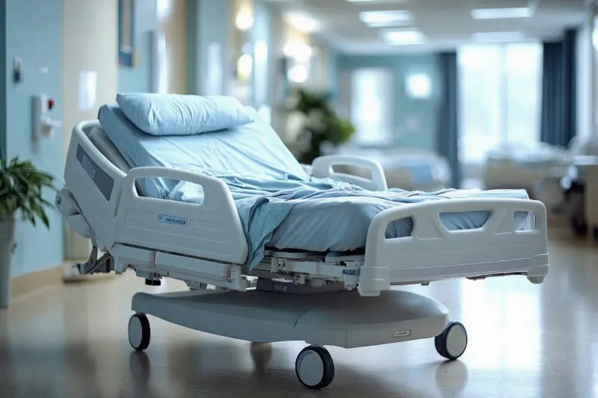
Context
Delays in inpatient discharges intensify on weekends
Decreases hospital capacity and limits Emergency Department (ED) flow
Services like MRI, ECHO, X-Ray, etc. operate on limited hours on weekend
For patients who require testing prior to discharge, limited services on weekend create bottleneck
Notes:
Add more context and then use a graph to

Slide 3
Why is this bottleneck a problem?
Prolonged Length of Stay (LOS)
Blocked beds for new admits
Missed opportunity to increase cash flow
Overflow inpatients are boarded in ED
Impacts EDs flow and capacity
Delays = $↑$ Lower Level of Care (LLOC) days
Delays = ↑ Lower Level of Care (LLOC) days
Insurance denials = $↓$ amount billable
Insurance denials = ↓ amount billable
Limited Services on Weekend
Notes:
Add more context and then use a graph to

Slide 4

Initial Problem Statement
Assuming gaps in weekend service availability contribute to discharge delays
Quantify impact of gaps
Identify frequency and cost of delays
Explore benefits of expanding service availability
Notes:
Needs to connect with last slide

Slide 5
Methodology – How did we tackle this issue?
Addressing Weekend Discharge Delays
Limited Weekend Imaging Services
MRI & Echo
High Imaging Demand
Workflow Inefficiencies
Patient Preparation
Ordering & Scheduling

Slide 6
Methodology
Imaging
Learned procedural workflow of imaging services
Business Intelligence
Defined scope of investigation
Admins
Learned scope and context of issue
Finance
Measures already taken to address issue
Potential areas of opportunity
Learned of data limitations
Gained access to imaging data and insights
Learned of financial impact of delays
Insights into MRI demand vs operational constraints
Preliminary Problem Definition
Interviews with stakeholders to refine problem and define context

Slide 7
Methodology
Date Range
08/01/2024 – 08/31/2025
Filtered by Order and Procedure Weekday
Patient Class
Inpatient at time of discharge
Order Types
Echocardiography
Imaging
MRI, CT, Ultrasound(US), Interventional Radiology(IR)
Did not include X-Ray
Order Info
Order2Procedure
Ordering Department
Order2Result
Result2Discharge
Analyzed imaging data to identify trends and insights of wait times and discharges

Slide 8
Redefined Problem Statement
Weekend service availability gaps and pre-procedural inefficiencies contribute to discharge delays
Capacity and Demand of MRI and Echo services
Ordering & Scheduling
Notes:
Needs to connect with last slide

Slide 9
Methodology
Performed regression analysis on key metrics of imaging orders
Conducted observations and interviews of MRI and ECHO services
Redefined problem statement and narrowed scope

Slide 10
Methodology - Established Imaging Workflow
Order Placement
Scheduling
Pre Imaging Preparation
Transport to imaging department
Imaging procedure
Patient Communication
Clinical Decision Making
Interpretation and Reporting
Post imaging care
Discharge
Notes:
Change heading, use click delay

Slide 11
Methodology - Scope of Focus in Imaging Workflow
Order Placement
Scheduling
Pre Imaging Preparation
Transport to imaging department
Imaging procedure
Notes:
Change heading, use click delay

Slide 12
Imaging Analysis
Service | Count
CT | 21,691
Ultrasound | 5,532
ECHO | 5,405
MRI | 3,397
Interventional Radiology | 1,024
Order Frequency
Order to Procedure hours
Service | Order to Procedure (Median across all order weekdays)
Interventional Radiology | 19.2 hours
ECHO | 17 hours
MRI | 7.5 hours
Ultrasound | 2.4 hours
CT | 1 hours
Notes:
Change heading, use click delay

Slide 13
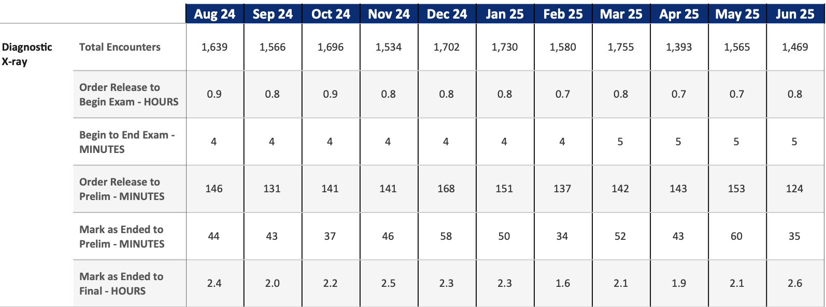
Imaging Analysis: X-Ray & MRI
Turn Around Time (TAT)
Notes:
Change heading, use click delay

Slide 14
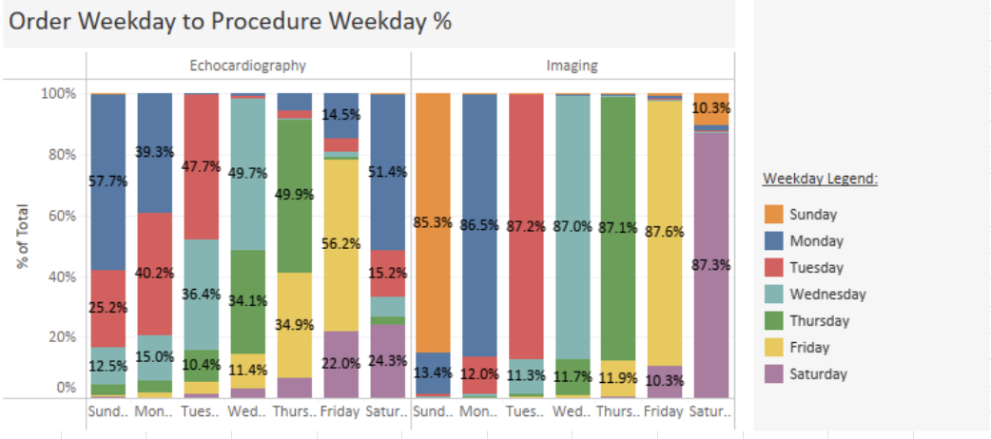
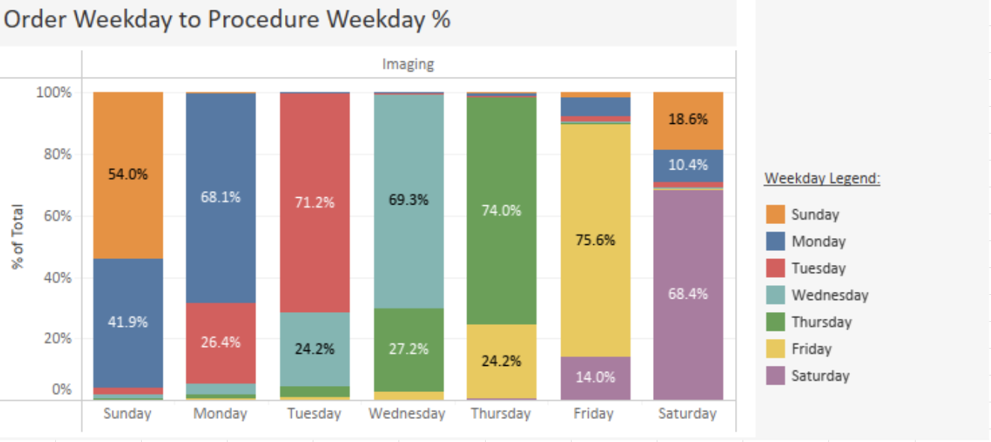
Imaging Analysis: Order vs Procedure Weekday
Order Weekday to Procedure Weekday
  ECHO, CT, and MRI
  IR and US
Notes:
Change heading, use click delay

Slide 15
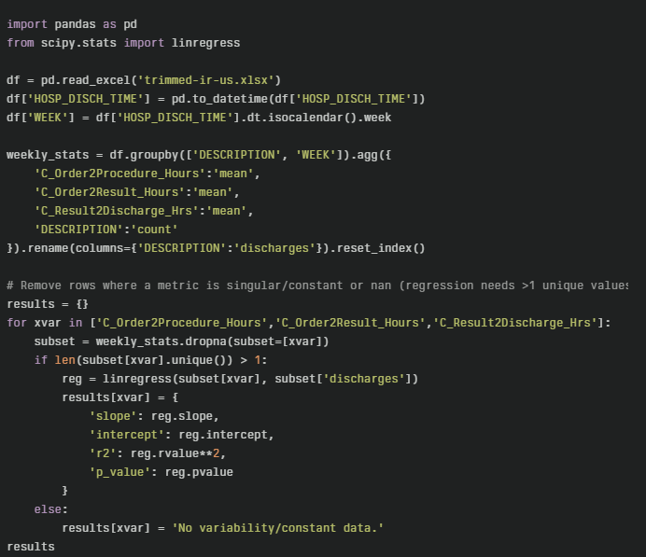
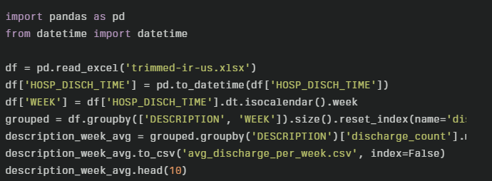

Statistical Analysis: Establishing Impact of Imaging Order To Procedure
Regression Analysis
  Moderately negative correlation between Order to Procedure time and imaging order outcomes with high significance
  $discharges=−0.329 ∗Order2Procedure+20.18$
    $R^{2}$ = 0.34, p < 1 * ${10}^{−9}$
Notes:
Change heading, use click delay

Slide 16
Analysis – Pre-Procedural Inefficiencies of MRI and ECHO services
Order 2 Procedure vs Order Weekday
Delay | Frequency
CT | ECHO
ECHO | IR
MRI | MRI
US | US
IR | CT
MRI and Echo stands out as leading imaging sources of delay.
Notes:
Remove table of hours, add count of orders, improve visibility, click delay needs to be added

Slide 17

Analysis – Capacity and Demand of ECHO Services
Loss of Sonographer to Weekend
Different Weekend Efficiency
5 techs per day
1 tech
Due to competing testing modalities, about 6-7 orders are completed per day.
0 tech
Weekday
Due to limited availability of other testing modalities, about 8 orders are completed on Sat.
Weekend
Mon
Tue
Wed
Thu
Fri
Sat
Sun
ECHO workflow has reached max operational efficiency, but workflow remains heavy for one sonographer on Sat and none for Sun

Slide 18
Analysis – Ordering & Scheduling of ECHO Service
Order Priority Name
STAT
Large quantity:
Many non-urgent tests are being marked as STAT.
Process interruption:
The abuse of STAT prioritization in orders creates a misalignment between scheduling and procedure execution.
Urgent
Discharge

Slide 19

Analysis – Capacity & Scheduling of MRI Service
Limited-Service Availability
Tech Decision-Making
Brain/Spinal Examination
Others
M-F: 7a – 10p & Overnight
Sat-Sun: 7a – 7p
TAT declined with addition of overnight weekend tech and rose with vacancy
Studies show weekend MRI availability reduces TAT from 98 to 65 hours by adding one weekend shift
Tech prioritization of patients is based solely on discretion of order severity, without consideration of discharge-related factors.
Resource: Garrahy, D., Doran, S., O'Neill, H., Dennan, S., & Beddy, P. (2024). Towards 24/7 MRI: the effect of routine weekend inpatient MRI scanning on patient waiting times. Irish journal of medical science, 193(4), 1697–1701. https://doi.org/10.1007/s11845-024-03647-z
Notes:
https://pmc.ncbi.nlm.nih.gov/articles/PMC11294432/

Slide 20
Analysis – Ordering & Scheduling of MRI Service
Order Priority Name
Emergent
Unneeded orders:
Providers issue unnecessary orders for the same patient , with the same priority name “STAT”.
Urgent
STAT
(highest volume)
Immediate

Slide 21
Findings
Limited staffing in echocardiography contributes to a bottleneck.
MRI service availability is limited, contributing to procedural delays
Imaging prioritization lacks clarity, extending discharge timelines.
Delays arise from cumulative inefficiencies in multi-step communication.

Slide 22
Recommendations
Addressing Operating Constraints
Expanding MRI Weekend Service Availability
Sonographer Shortage
Scheduling & Priority Clarity
Adding LOS as factor
Restraint on STAT classification
Effective Order Placing
Reducing Redundant Ordering
Considering more efficient procedures

Slide 23
Improving Ordering & Scheduling
Ordering & Scheduling
Adding LOS as decision factor
Restraint on STAT classification
Implementing best practices from ECHO services to MRI service
Prioritize by STAT, Urgent, Discharge and then by dates and diagnosis
Order Placement
Scheduling
Pre Imaging Preparation
Transport to imaging department
Imaging procedure

Slide 24
Improving Ordering & Scheduling
Ordering & Scheduling
Adding LOS as decision factor
Restraint on STAT classification
Reducing abuse of STAT orders which delays techs to call for clarification
Techs also push orders with lesser urgency farther down the queue
Order Placement
Scheduling
Pre Imaging Preparation
Transport to imaging department
Imaging procedure

Slide 25
Addressing Demand of MRI Services
Effective Order Placement
Reducing Redundant Ordering
Considering more efficient procedures
Ordering of multiple MRI tests at a time drives demand and creates backlog
Order Placement
Scheduling
Pre Imaging Preparation
Transport to imaging department
Imaging procedure
Notes:
Rethink or remove colors here
Rethink recommendations as a heading

Slide 26
Addressing Demand of MRI Services
Effective Order Placement
Reducing Redundant Ordering
Considering more efficient procedures
If not completely necessary, Tech spends time communicating with provider for verification
Order Placement
Scheduling
Pre Imaging Preparation
Transport to imaging department
Imaging procedure
Notes:
Rethink or remove colors here
Rethink recommendations as a heading

Slide 27
Addressing Demand of MRI Services
Effective Order Placement
Reducing Redundant Ordering
Considering more efficient procedures
Emphasis on considering more time/cost/information efficient procedures
Order Placement
Scheduling
Pre Imaging Preparation
Transport to imaging department
Imaging procedure
Notes:
Rethink or remove colors here
Rethink recommendations as a heading

Slide 28
Addressing Operating Constraints
Capacity and Demand of MRI and ECHO
Adding 1 weekend overnight MRI tech
Adding 1 sonographer
To meet already high demand for MRI services
To reduce weekday scheduling constraint and take advantage of weekend efficiency
Order Placement
Scheduling
Pre Imaging Preparation
Transport to imaging department
Imaging procedure

Slide 29
Next Steps
Looking deeper into the pre-procedure MRI workflows…
Description | Count
MRI BRAIN W/WO CONTRAST | 761
MRI BRAIN WO CONTRAST | 525
MRI C-SPINE WO CONTRAST | 193
Ordering Department | Count of MRI BRAIN W/WO CONTRAST
Emergency Services | 211
Neurosciences CCU | 180
Neurosciences Unit | 89
Finding opportunities for process optimization in workflow of most frequent ordering departments

Slide 30
Next Steps
Now looking deeper into the pre-procedure ECHO workflows…
Description | Count
ECHO TRANSTHORACIC COMPLETE (TTE) (ADULT LAB) | 4,296
ECHO TRANSTHORACIC LIMITED (TTE) (ADULT LAB) | 700
ECHO TRANSTHORACIC W/ AGITATED SALINE COMPLETE (ADULT LAB) | 162
Ordering Department | Count of ECHO TRANSTHORACIC COMPLETE (TTE) (ADULT LAB)
Emergency Services | 1806
Cardiac ICU | 399
Medical ICU | 328
Progressive Care Unit | 234
Bridgeview Unit | 216
Finding opportunities for process optimization in workflow of most frequent ordering departments

Slide 31
Questions?

Slide 32
Acknowledgement
We extend our heartfelt thanks to everyone who made this project possible through their time, expertise, and collaboration:
Randy Komenski – For his leadership, support, and valuable guidance throughout the project
Dr. Venkat Gundareddy – For sharing the physician’s perspective and helping us understand key process challenges
Angel Sampedro – For data expertise and constant analytical support that shaped our recommendations.
Dena Dempster – For leading workflow walkthroughs and sharing her strong understanding of Imaging Services.
Madison Quinn Gaskin – For helping clarify and provide imaging timing data.
Barbara Feege – For financial insights and helping us understand cost impacts.
Imaging Technicians – For openly sharing your daily experiences, challenges, and ideas during interviews and shadowing, especially Arthur Komeni and Haley Johnson (MRI).
Echocardiography Leadership – For providing valuable operational insights and day to day information, from Ronald Okorie (Administrative Director, Echocardiography) and Kenneth E. Ridley (Supervisor, Cardiac Sonographer).
Your generous participation and candor were essential to our understanding of the real problems and in co-creating effective, meaningful solutions. Thank you!

Slide 33
References
Meeting with Venkat (09/09/25)
Meeting with Dena Dempster (09/14/2025)
Meeting with Angel (09/05/2025)
Meeting with Barbara and Luis Gonzalez.(09/23/2025)
Meeting with Echo team (Ronald Okorie and Kenneth E. Ridley) (09/26/2025)
Meeting with MRI Technician – Arthur Komeni (09/27/2025)
Ir J Med Sci. 2024 Mar 9;193(4):1697–1701. doi: 10.1007/s11845-024-03647-z
Bidgood, W D Jr et al. “Understanding and using DICOM, the data interchange standard for biomedical imaging.” Journal of the American Medical Informatics Association : JAMIA vol. 4,3 (1997): 199-212. doi:10.1136/jamia.1997.0040199
Amoroso, Alvin. “The Definitive Guide to Mastering Radiology Workflow Optimization & Revolutionizing Your Medical Imaging Workflow.”Curogram, https://curogram.com/blog/mastering-radiology-workflow-optimization-medical-imaging#:~:text=In%20the%20context%20of%20a,(creating%20the%20diagnostic%20report)%20*
Nadler, Adam D et al. “Categorizing Care Delays and Their Impact on Hospital Length of Stay.” Quality management in health care, 10.1097/QMH.0000000000000503. 5 Nov. 2024, doi:10.1097/QMH.0000000000000503
Nadler AD, Eid SM, Kisuule F, Michtalik HJ, Kantsiper ME, Harris CM, Gundareddy VP. Categorizing Care Delays and Their Impact on Hospital Length of Stay. Qual Manag Health Care. 2024 Nov 5. doi: 10.1097/QMH.0000000000000503. Epub ahead of print. PMID: 39531669.

