Slide 1


00 Month, 2030
#01
#01
KARAORCHEE.INC
Go To Market Strategy and path to Competitive market for
Devothama Gundugurki Narasimhamurthy
Kaixin Zeng
Billy Presume
Wandong Zhang
@reallygreatsite
reallygreatsite.com
Notes:
"Good morning Crystal, and thank you for having us. We are excited to present the ultimate Go-to-Market strategy for KaraOrchee. Over the past few weeks, our team has dug deep into the music education landscape. We’ve moved beyond just assumptions; we’ve validated our findings through direct interviews and surveys at the Peabody Institute. Today, we will show you how KaraOrchee can bridge the gap between innovation and traditional practice to capture a significant share of the music technology market."

Slide 2


#03
YOUR LOGO.
#02
Table of Contents
The Problem Musicians Face
Market Opportunity
Customer Segments
Customer Discovery Outcomes
Competitors Comparison
What Makes KaraOrchee Different
7. Go to Market Strategy
8. Implementation Strategy
9. Risks & Mitigations
10. A bright future
Notes:
We started by asking: Why is this product necessary now? We interviewed 25 musicians, and 16 of them identified scheduling and scarcity as their primary barriers. Currently, if a student wants to practice a concerto, they face two bad options:
High Costs: Hiring a medium-sized live orchestra costs between $600 and $1,200 per hour. That is simply inaccessible for daily practice.
Low Quality: They resort to static backing tracks that don't listen or adapt. As one jazz student told us, these tracks force the musician to follow a robot, rather than leading the performance. KaraOrchee solves this by being the affordable, responsive alternative."

Slide 3
#03
YOUR LOGO.
#03
The Problem Musicians Face
• 16 musicians out of 25 interviewed expressed strong experience regarding scheduling and scarcity barriers with live accompanists
• High Costs : Orchestras cost $600-$1,200/hour (30 musicians)
• Low Quality : Static backing tracks lack responsiveness
Notes:
We started by asking: Why is this product necessary now? We interviewed 25 musicians, and 16 of them identified scheduling and scarcity as their primary barriers. Currently, if a student wants to practice a concerto, they face two bad options:
High Costs: Hiring a medium-sized live orchestra costs between $600 and $1,200 per hour. That is simply inaccessible for daily practice.
Low Quality: They resort to static backing tracks that don't listen or adapt. As one jazz student told us, these tracks force the musician to follow a robot, rather than leading the performance. KaraOrchee solves this by being the affordable, responsive alternative."

Slide 4
#04
Market Opportunity
• K-12 Schools: $500M-$1B (54,000 schools)
• Conservatories: $300-400M (1,600 academies)
• Universities: $500M-$1B (4,200 institutions)
• Individual Learners: $500M-$1B (12.4M users)
@reallygreatsite
reallygreatsite.com
Notes:
The problem is real, and the market opportunity is massive. While we are launching our pilot at conservatories like Peabody, our analysis shows that the K-12 and Individual Learner segments represent our largest scaling opportunities, valued between $500 million and $1 billion each. The online music education market is currently growing at a CAGR of 10.5%, faster than the traditional instrument market. This confirms that the industry is shifting toward digital-first solutions, and KaraOrchee is positioned to catch this wave

Slide 5

#05
Customer Segments
STUDENTS
TEACHERS
INSTITUTIONS
Notes:
To capture this market, we have identified three distinct customer segments that interact with our platform differently:
Students: Who need affordable, on-demand practice partners.
Teachers: Who need tools to assign practice and track progress.
Institutions: Who need a cost-effective alternative to hiring live accompanists for every rehearsal. Our strategy addresses the specific needs of all three.

Slide 6
#06
Customer Discovery Outcomes
(23 Interviews + 34 Surveys)
Students
Need of Scheduling and finding the partner
Lack of Responsive Backing Tracks
Difficulty maintaining motivation without ensemble interaction
Need of Automatic music note sharing
@reallygreatsite
reallygreatsite.com
Notes:
We didn't just guess what these segments wanted; we asked them. We conducted 25 interviews and 34 surveys, primarily at Peabody. The validation was strong:
85% of students indicated they are willing to pay our proposed price point of $12.99/month.
100% of respondents demanded real-time responsiveness. If the AI doesn't adapt to their tempo, they won't use it.
."

Slide 7
#07
Customer Discovery Outcomes
(3 Interviews)
Faculty/Administrators
AI will hinder the original creativity of the students
Need of Easy Accessibility of Repertoire
Need for Better Tempo Control Quality in the music tool
Administrators need wide range of consensus within the institution
@reallygreatsite
reallygreatsite.com

Slide 8
#08
Competitors Comparison
• Tomplay ($14.99/month): Static recordings, no AI
• Metronaut ($20-53/month): AI tempo only, no marketplace
• Smart Accompanist ($8.99/month): Requires hardware to work properly
KaraOrchee: Real-time AI + Gesture + Marketplace at $12.99
@reallygreatsite
reallygreatsite.com

Slide 9
#09
What makes KaraOrchee different ?
• Head pose detection (hands-free control)
• Real-time beat detection (adapts to your tempo)
• Creator marketplace (70/30 revenue share)
• Institutional licensing (B2B focus)
• Building music community around world
@reallygreatsite
reallygreatsite.com

Slide 10
#10
Go-to-Market Strategy (5 P's)
Product: Real-time AI + gesture + marketplace
Price: $12.99-$24.99/mo (B2C), $399-$2,500/yr (B2B)
Place: Direct web, app stores, Peabody pilot
Promotion: Pilot → Regional → National
Person : Customer Persona
@reallygreatsite
reallygreatsite.com

Slide 11

#11
Product Strategy
Months 1-3
Months 4-6
Months 7-12
Head pose detection
Creator marketplace
beta launch
VR Orchestra
experiences
MVP (real-time AI,
50+ library pieces)
DAW integration
(Logic Pro,Abelton Live)
Library expansion to 300 + pieces
@reallygreatsite
reallygreatsite.com

Slide 12
#12
Pricing Strategy(B2C)
Learner
Professional
Creator
$12.99/mo
$18.99/mo
$24.99/mo
60% of users
25% of users
15% of users
Hobbyists/Students
Teachers/Students
Creator
@reallygreatsite
reallygreatsite.com
Notes:
Customers would be selecting the pricing based on their needs. Based on the features they want to utilize from karaorchee

Slide 13
#13
Pricing Strategy(B2B)
Private Studio
K-12 School
Conservatory/University
$399/yr
$499-1k/yr
$2500/yr
All Learner Features
All Learner &
Professional Feature
All Learner &
Professional &
Creator Feature
@reallygreatsite
reallygreatsite.com
Notes:
Customers would be selecting the pricing based on their needs. Based on the features they want to utilize from karaorchee

Slide 14
#14
Place Strategy(Distribution)
  Direct Website
  App Stores
  Social media
  Peer Referral
  Music Education Platforms
B2C Distribution
@reallygreatsite
reallygreatsite.com

Slide 15
#15
Place Strategy(Distribution)
  Direct Sales
  Professional Associations
  Studio Alliances
  Case Studio
B2B Distribution
@reallygreatsite
reallygreatsite.com

Slide 16
#16
Promotion Strategy
Pilot Focus
Local Expansion
National Scaling
(Months 1-3)
(Months 4-6)
(Months 7-12)
  • On-campus visibility
  • Faculty support
  • Local partnerships
  • Targeted ads
  • Nationwide marketing
  • Industry collaborations
@reallygreatsite
reallygreatsite.com

Slide 17
#17
Customer Personas
1. Student Musician (Alex Meyer)
• Age: 24, Berlin, Germany
• Income: $25K/year (university student + part-time barista)
• Pain: Cannot afford live accompanists to practice Sibelius violin concerto
• Value: $12.99/month affordable, recording feature for audition prep
• Acquisition: Instagram content from peer users, music school referrals
@reallygreatsite
reallygreatsite.com

Slide 18
#18
Customer Personas
2. Professional Teacher (Sophia Chen)
• Age: 38, San Francisco, USA
• Income: $85K/year (freelance pianist + music educator)
• Pain: Spends 2 hours/week finding backing tracks for 20+ students
• Value: Creator marketplace generates $200-500/month passive income
• Acquisition: LinkedIn ads, music teacher Facebook groups, MTNA conferences
@reallygreatsite
reallygreatsite.com

Slide 19
#19
Customer Personas
3. Harmony Academy (Institution)
• Organization: Private music school, 150+ students
• Budget: $3K/year technology budget (post-pandemic cuts)
• Pain: Post-pandemic ensemble shortage, live accompanist costs $5-8K/year
• Value: $1,500/year license reduces accompanist costs 70%
• Acquisition: Direct outreach, Peabody case study, peer referrals
@reallygreatsite
reallygreatsite.com

Slide 20
#20
Implementation Strategy
Pilot Implementation
Month 1: Foundation
Build Internal processes and finalize pilot logistics
Recruit early faculty champions at Peabody
Establish baseline success metrics
Create content (posters, email and demo videos )
@reallygreatsite
reallygreatsite.com

Slide 21
#21
Implementation Strategy
Pilot Implementation
Month 2: Launch & Feedback
Soft launch with pilot cohort
Gather qualitative user feedback weekly
Iterate on UX based on student/faculty insights
Document case studies and testimonials
@reallygreatsite
reallygreatsite.com

Slide 22
#22
Implementation Strategy
Pilot Implementation
Month 3: Measurement & Decision
Analyze the adoption rates and engagement metrics
Collect pilot outcome data for external promotion
Decide go/no-go for regional expansion
Prepare case study for Phase 2 outreach
@reallygreatsite
reallygreatsite.com

Slide 23
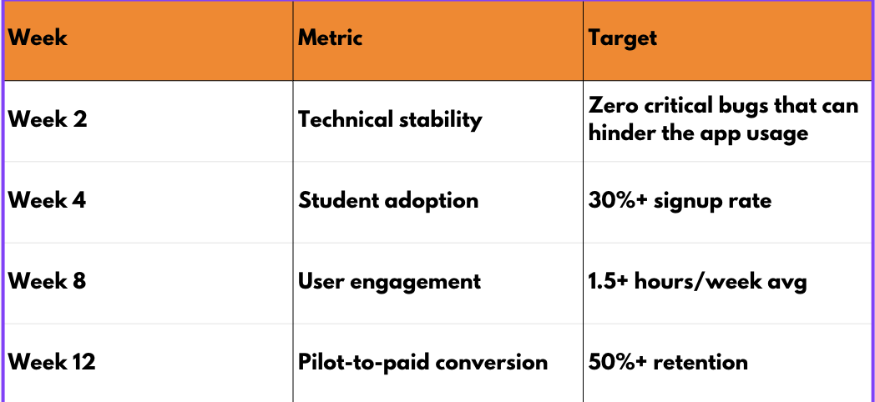
#23
Go/No-Go Decision Points:
@reallygreatsite
reallygreatsite.com

Slide 24
#24
Implementation Strategy
  Short- term Expansion
Feature Prioritization
@reallygreatsite
reallygreatsite.com
Notes:
As we finish the pilot, our short-term focus is strategic: Feature Prioritization. We are stabilizing the core AI and then integrating the highest-value features that were demanded by our customers to drive retention and institutional buy-in

Slide 25
#25
Orchestral Trackbacking
Evolution of Practice: Transform static tracks into dynamic ensemble
Multitrack Control: Isolate, mute or adjust individual instrument sections
High- Level Rehearsal: Enables complex tasks previously requiring a live orchestra
Jumps Retention: Deepens engagement beyond simple tempo matching
@reallygreatsite
Notes:
Orchestral Trackbacking is the evolution of the basic backing track that is Transform static tracks into dynamic ensemble
. Next the The core feature here is Multitrack Control. This is essential for quality control in high-level practice. A musician can selectively mute, solo, or adjust the volume of instrument sections—for example, isolating the flute line or practicing against only the rhythm section.
High-Level Rehearsal:."This directly enables high-level rehearsal tasks that were previously only possible with a live orchestra—which, as we noted, costs $600 to $1,200 per hour. This feature alone justifies our subscription model by providing that access affordably.”
Jumps Retention: By offering this depth of control, we significantly deepen the musician's engagement. This moves us beyond simple tempo-matching and is a key driver for B2C retention and achieving long-term user satisfaction."

Slide 26
#26
Annotation Music Sharing
Facilitates Feedback Loop: Enables teachers to provide the marked up scores
directly to the students
Critical for B2B Adoption: Integrates platform into faculty workflow for
assignments and assessment]
Drive Consensus: Addresses the need for faculty buy-in mentioned in customer
discovery
Strengthens IP: Teacher- created annotations and arrangements stay within
The platform ecosystem
@reallygreatsite
reallygreatsite.com
Notes:
Annotation Music Sharing is strategically designed to facilitate the feedback loop—the most time-consuming part of a music teacher's day. It allows faculty to mark up a digital score with dynamic changes or notes, and then share that annotated version directly with the student.”
Critical for B2B Adoption:This is our critical feature for B2B institutional adoption. It embeds KaraOrchee into the faculty's daily workflow for assignments and assessment, moving us beyond being a mere practice tool to an essential teaching utility
Drives Consensus: His feature directly addresses the key finding that Administrators require a wide range of consensus from faculty. By making the teachers' lives easier, we turn them into champions who advocate for the platform, which accelerates the slow institutional sales cycle
Strengthens IP: As a long-term benefit, the notes and customized arrangements stay within the KaraOrchee ecosystem, strengthening our content library and creating defensible Intellectual Property tied to our platform

Slide 27
#27
Automatic Music Sheet Scrolling
Hands–Free Experience: Removes the physical task of turning pages during practice
Integrated with AI: Scrolls music in real –time based on the musician’s adapted tempo
Enhances Focus & Immersion: Essential for continuous, uninterrupted high-level rehearsal.
Supports Core Value: Reinforces the platform’s ablitity to seamlessly follow the musician
@reallygreatsite
reallygreatsite.com
Notes:
"Automatic Music Sheet Scrolling is a crucial quality-of-life feature that enables a truly hands-free experience. It removes the physical necessity of turning pages, which is a major point of friction for musicians trying to maintain concentration.
"Integrated with AI: ."This feature is integrated directly with our AI's real-time tempo data. The system doesn't scroll at a fixed pace; it adapts to the musician's tempo changes, including pauses, accelerations, and decelerations.”
Enhances Focus & Immersion: ."By minimizing interruptions and maintaining flow, this feature significantly enhances the musician's focus and immersion. This is essential for continuous, high-level rehearsal and strongly supports user retention, making KaraOrchee a preferred tool over simple PDFs or static players.”
Supports Core Value: ."Ultimately, this feature reinforces our core product value: a seamless practice partner that listens and adapts. The scrolling becomes an invisible, expected utility that solidifies our premium position in the market."

Slide 28
#28
Long-term Expansion
Music Community Development
Monetization
Expansion
@reallygreatsite
reallygreatsite.com
Notes:
Long-term Strategy"Looking at the long-term, our strategy is built around three interdependent pillars: Community, Monetization, and Expansion. This plan moves us from a regional pilot project to a globally scalable music tech enterprise."Music Community Development"Our long-term scalability depends on cultivating an active and self-sustaining user community. This means building a space where students, alumni, teachers, and creators can interact, share practice tips, and engage with new arrangements. By fostering this ecosystem, we reduce our customer acquisition costs and build a strong network effect, making the platform increasingly valuable as more people join."Monetization (Creator Marketplace Focus)"Our monetization strategy moves beyond B2C subscriptions and institutional licensing to focus on the Creator Marketplace. This is our content scaling solution. We will incentivize teachers and composers to upload and sell their custom orchestrations and arrangements. This crowdsources our library expansion, and our proposed 70/30 revenue share (70% to the creator) is designed to be highly competitive, attracting the best talent and generating a substantial, diversified revenue stream for KaraOrchee."Expansion (Targeted Scaling)"Finally, our Expansion plan is targeted and disciplined. After the successful pilot, we will scale nationally, focusing on universities and K-12 schools with similar music program structures to the Peabody Institute. This allows us to reuse our marketing and sales blueprints for maximum efficiency. Concurrently, we will seek strategic, global partnerships with major music publishers and technology companies to accelerate our reach into the $1 billion-plus international individual learner market."

Slide 29
#29
Risks & Mitigations
  Begin discussions with American Society of Composers, Authors and Publishers (ASCAP) and Broadcast Music (BMI) Inc,.
  2. Start with royalty-free
  3. Hire consultant
  Music licensing challenges
@reallygreatsite
reallygreatsite.com

Slide 30
#30
Risks & Mitigations
  Over-invest pilot support
  Weekly feedback
  Realistic targets
  Clear success metrics
  Slow institutional adoption
@reallygreatsite
reallygreatsite.com

Slide 31
#31
Risks & Mitigations
  Low-latency cloud infrastructure
  Extensive beta testing
  Offline mode option
  Technology latency issues
@reallygreatsite
reallygreatsite.com

Slide 32
#32
Risks & Mitigations
  Launch with 50 best-sellers; Enable teacher
  Uploads from users
  Publisher partnerships
  Monthly growth of 100 pieces
  Limited content library
@reallygreatsite
reallygreatsite.com

Slide 33
#33
Risks & Mitigations
  Fast market entry; strong institutional
  Relationships
  Creator network effects
  IP protection
  Competitive threat
@reallygreatsite
reallygreatsite.com

Slide 34
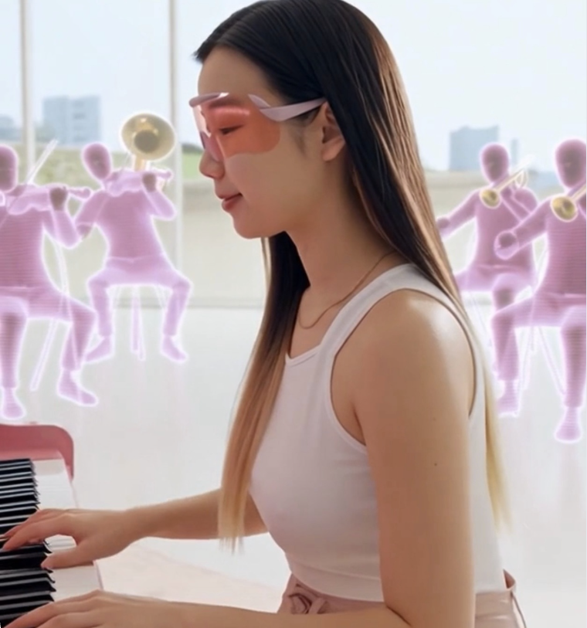






#32
A Bright Future
#34
A Passionate & Resilient Leader
Founded on Connection
Built with Quality & Care
Creators earn 70% of copyright
An ecosystem of talented creators
Leaping into a successful future

Slide 35
#35
References
Topic | Source (URL) | Data Point Referenced in Presentation
Online Music Education Market | https://dataintelo.com/report/global-online-music-education market. (Data Intelo) | Global market projected to grow from $1.75B (2023) to $4.25B (2032). (CAGR 10.5%)
Music Software Market | https://marketresearchfuture.com/(Market Research Future) | Music Production Software Market projected to grow from $6.5B (2023) to $12.8B (2032). (CAGR 7.5%)
Traditional Music Market | https://www.grandviewresearch.com(Grand View Research) | Global Classical Music Market projected to grow from $11.86B (2021) to $30.49B (2028). (CAGR 14.4%)
Market Segments | Internal Primary Research (KaraOrchee Draft Report) | Market Size: K-12, Individual Learners, and Universities are all valued in the $500M–$1B range. (Slide 3)
Cost & Problem | Internal Primary Research (KaraOrchee Draft Report) | Live Orchestral Accompaniment costs $600–$1,200 per hour for 30 musicians. (Slide 2)
Customer Barriers | Internal Primary Research (KaraOrchee Draft Report) | 80% of interviewed musicians cited strong experience regarding scheduling barriers. (Slide 2)
Pricing Validation | Internal Primary Research (KaraOrchee Draft Report) | Willingness to Pay (WTP): 85% of respondents are willing to pay $12.99/month. (Slide 5)
Core Product Requirement | Internal Primary Research (KaraOrchee Draft Report) | Responsiveness: 100% of respondents demand real-time responsiveness and flawlessness. (Slide 5)
Licensing Risk | Internal Primary Research (KaraOrchee Draft Report) | All risk mitigation plans, including contact with ASCAP/BMI and low-latency cloud investment. (Slides 23-24)
Content Strategy | Internal Primary Research (KaraOrchee Draft Report) | Creator Marketplace and 70/30 revenue share for scalable content growth. (Slide 24)

Slide 36
#36
Thank you!

