Slide 2
Some important things to notice about this week’s topic

Slide 3
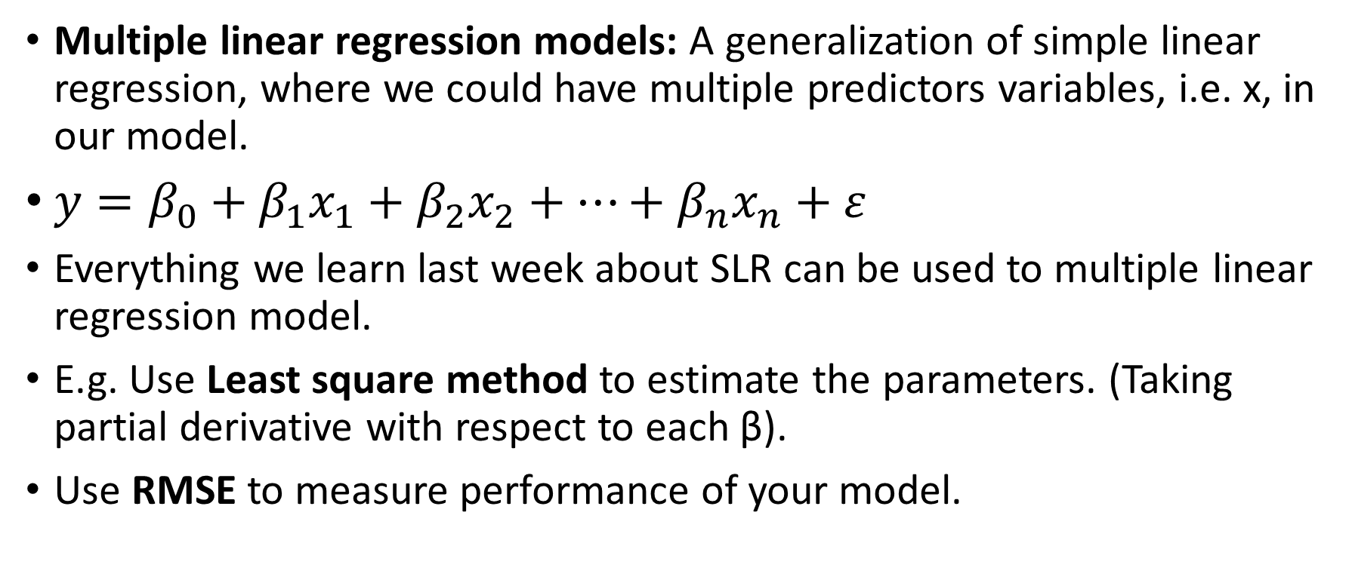
Multiple linear regression models: A generalization of simple linear regression, where we could have multiple predictors variables, i.e. x, in our model.
$y=β_{0}+β_{1}x_{1}+β_{2}x_{2}+⋯+β_{n}x_{n}+ε$
Everything we learn last week about SLR can be used to multiple linear regression model.
E.g. Use Least square method to estimate the parameters. (Taking partial derivative with respect to each β).
Use RMSE to measure performance of your model.

Slide 4
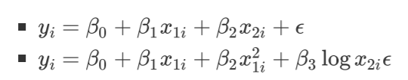
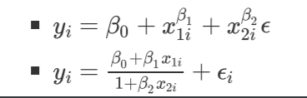
What we mean by linear?
The "linear" in linear regression means that the equation is linear in the parameters β.
Example of linear models:
Example of non linear models

Slide 5
In class writing exercise

Slide 6
Prepare a short paragraph written response based on Practice Problem 2. it should be complete, concise, clear and cohesive and to include:
1. The purpose. What are you studying? Why should we care about the analysis you’ve done?
2. A summary of the methods used. What did you do? Why did you do it this way?
3. A summary of the results. We don’t need to know everything you found – only the most critical things relating to your purpose! Remember, sometimes less is more! If they include a figure, it should be clear and able to stand on its own (e.g. contain proper titles).
4. A conclusion. What is your take away message? Remember, a conclusion is not the place to present new findings.

Slide 7
Final project
Use the remaining time to start preparing for the final poster project with their group.

Slide 8
Things to note about the final project
You are required to give a 5-minute (max) presentation on your project. You will be marked by 2 TAs and your peers. There will be time for questions after the presentation.
A poster board with Velcro strips to hang up your printed sheets will be provided.
Their oral presentation will be marked on several aspects:
Preparedness
Speech clarity
Content clarity
Use of transitional words/ phrases. Refer to the Resources uploaded to Quercus (Under Course Syllabus and Help).
Use of statistical vocabulary
Delivery
The WOW factor. Extra points for doing something very impressive.
REMINDER: Every group member is expected to speak. Members who do not speak will be penalized. See the poster page on Quercus for further details.

Slide 9
Your poster (rmd and pdf) will also be marked on the following aspects:
Reasonable scope: your research question should be clear and answerable
Data wrangling: creative use of data wrangling to produce informative variables. Think about if your variables make sense and how they are useful for answering your research question.
Graphical display. Use appropriate (and creative) figures to tell your story. Remember, these need to have clear and meaningful titles (i.e., don’t label with an R variable name if it doesn’t make sense). CRITICALLY, your figures need to stand alone. Not that providing pages of data tables is not very meaningful for your reader. It’s your job as a data scientist to turn this into something your reader can easily understand.
Statistical methods. The choice of methods should be appropriate, complete and creative. You shouldn’t do EVERYTHING you’ve learned this term, but pick the methods that make the most sense. You will be penalized if you use EVERY method – because this doesn’t make sense. Also, think about what a “method” is. Using an R command is NOT a method. Developing a linear regression model to study the relationship between X and Y, for example, IS a method.
Appropriate conclusion. Your conclusion should clearly follow the work you’ve done and your results. State any limitations. For example, maybe there is something you’d like to study but it is not available in the data.
Organization. The contents should be ordered logically, use of sub-headers is recommended. E.g. Background, Methods, Results, Discussion, Conclusions.
Overall writing. The #1 mistake we see if that people do not proofread their work.
WOW Factor: bonus points for doing something very creative, e.g. using an additional data source, creating a new (meaningful) variable, etc.
REMEMBER: the poster needs to stand on its own. Your TA will be marking the poster and will not be attending your presentation.
Your rmd file will also be marked, so make sure it runs smoothly. We suggest annotating your code so that the TA can navigate it better.

Slide 10
Other things to note:
Pay attention to the deadlines for submitting your work. These are STRICT.
Submit 1 poster per group through Quercus (Quercus groups to be made soon).
Each of you will also be acting as a peer reviewer (rubrics will be available on poster day and to be submitted BY THE STUDENT through Quercus).
Arrive on time to put up and take down your poster. Any work left will be discarded.
Arrive early for your scheduled poster presentation time. If you arrive late, you will not be marked. This is a large class which requires a lot of coordination. As such, you have a designated presentation time for a reason.
We will have extra TAs in the Stats Aid center the week before the poster to help you. Come prepared. It is NOT the TA’s job to work on your project for you!
We can also answer questions through Piazza all week, but this is not an appropriate forum for extensive programming help.
DO NOT LEAVE THE PROJECT UNTIL THE LAST MINUTE. It takes time to do this properly and if you run into any last-minute issues, we will not be there to help you.
PRACTICE, PRACTICE, PRACTICE! :D Ideally, practice as a group as many times as you can so that your transitions seem more naturally.

