Slide 1

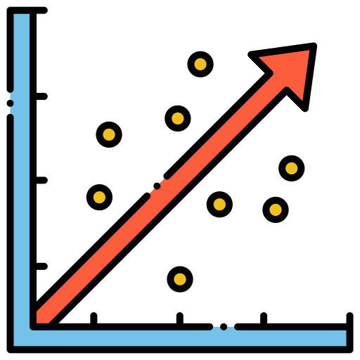



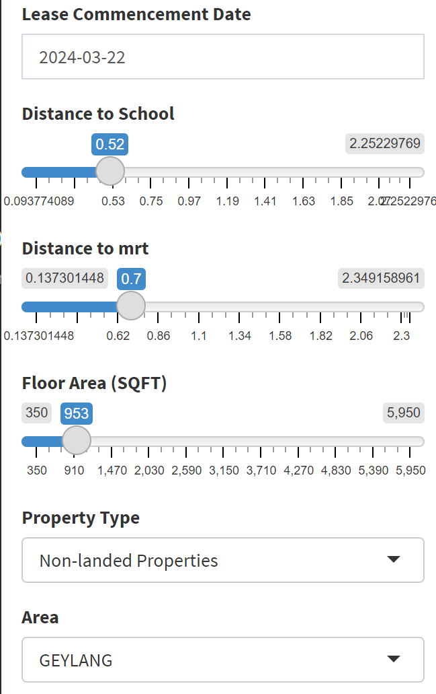
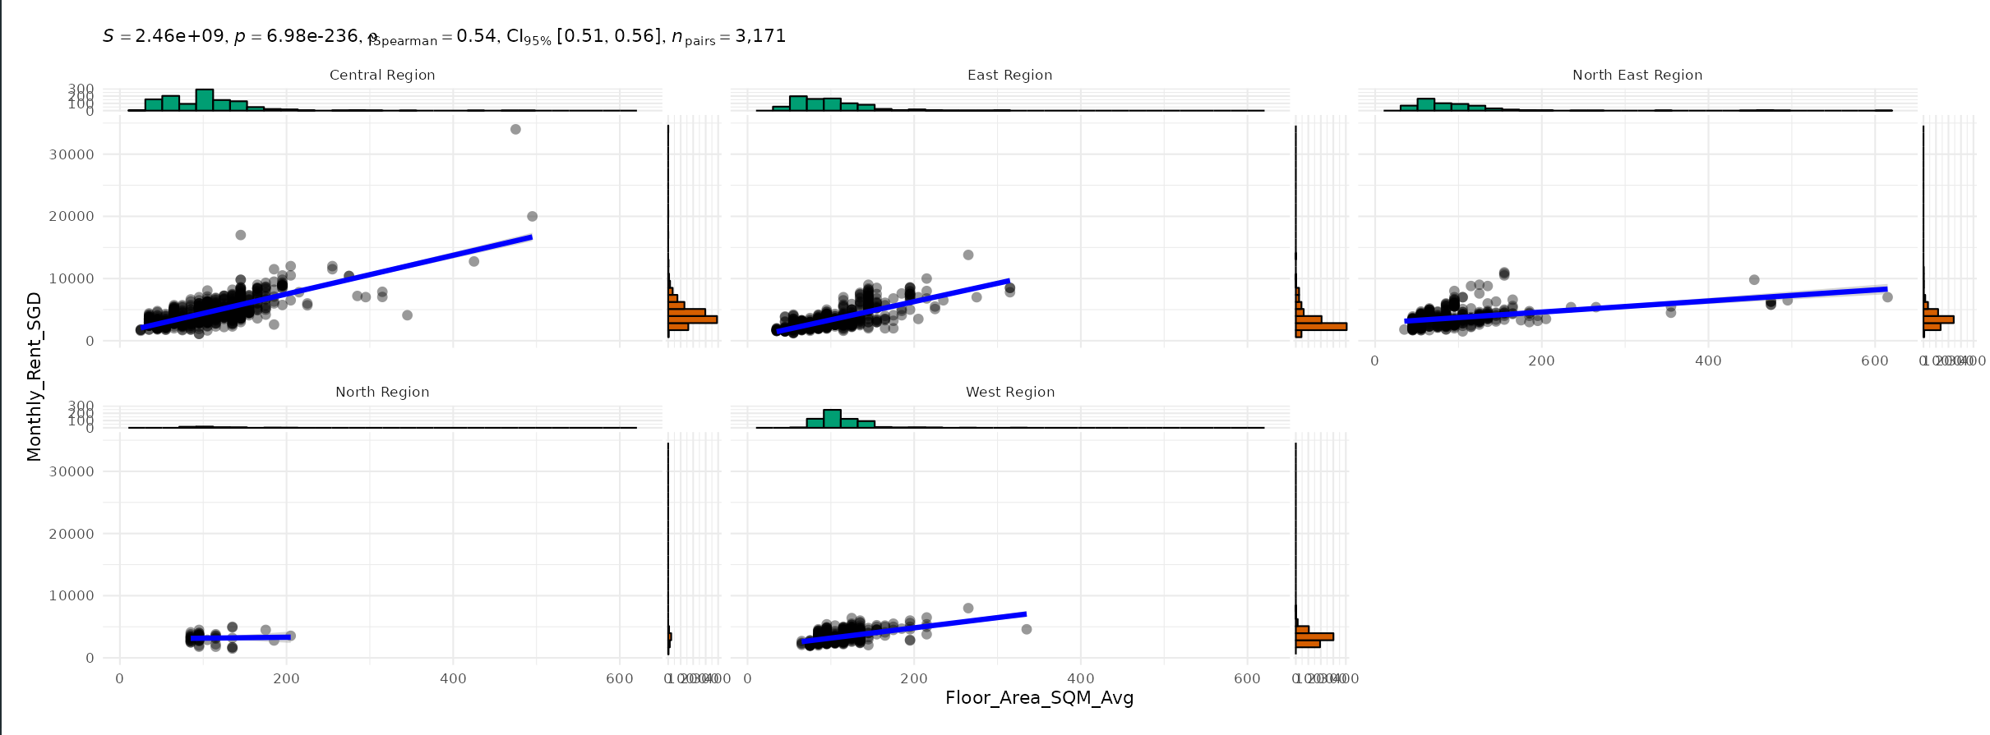
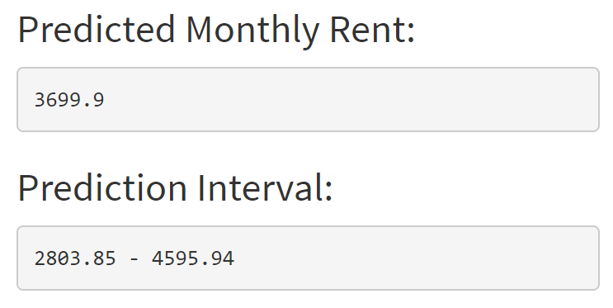
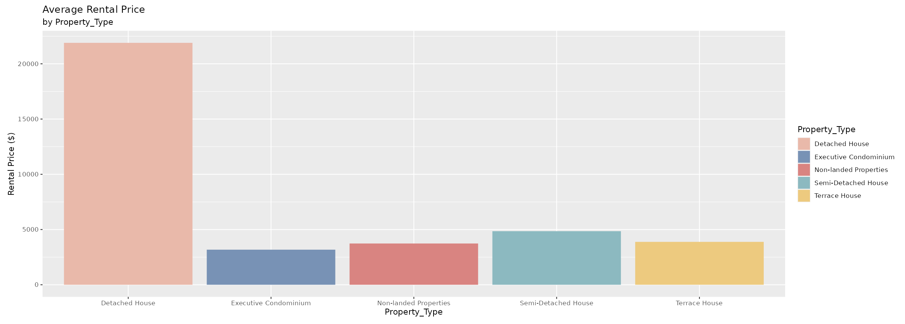
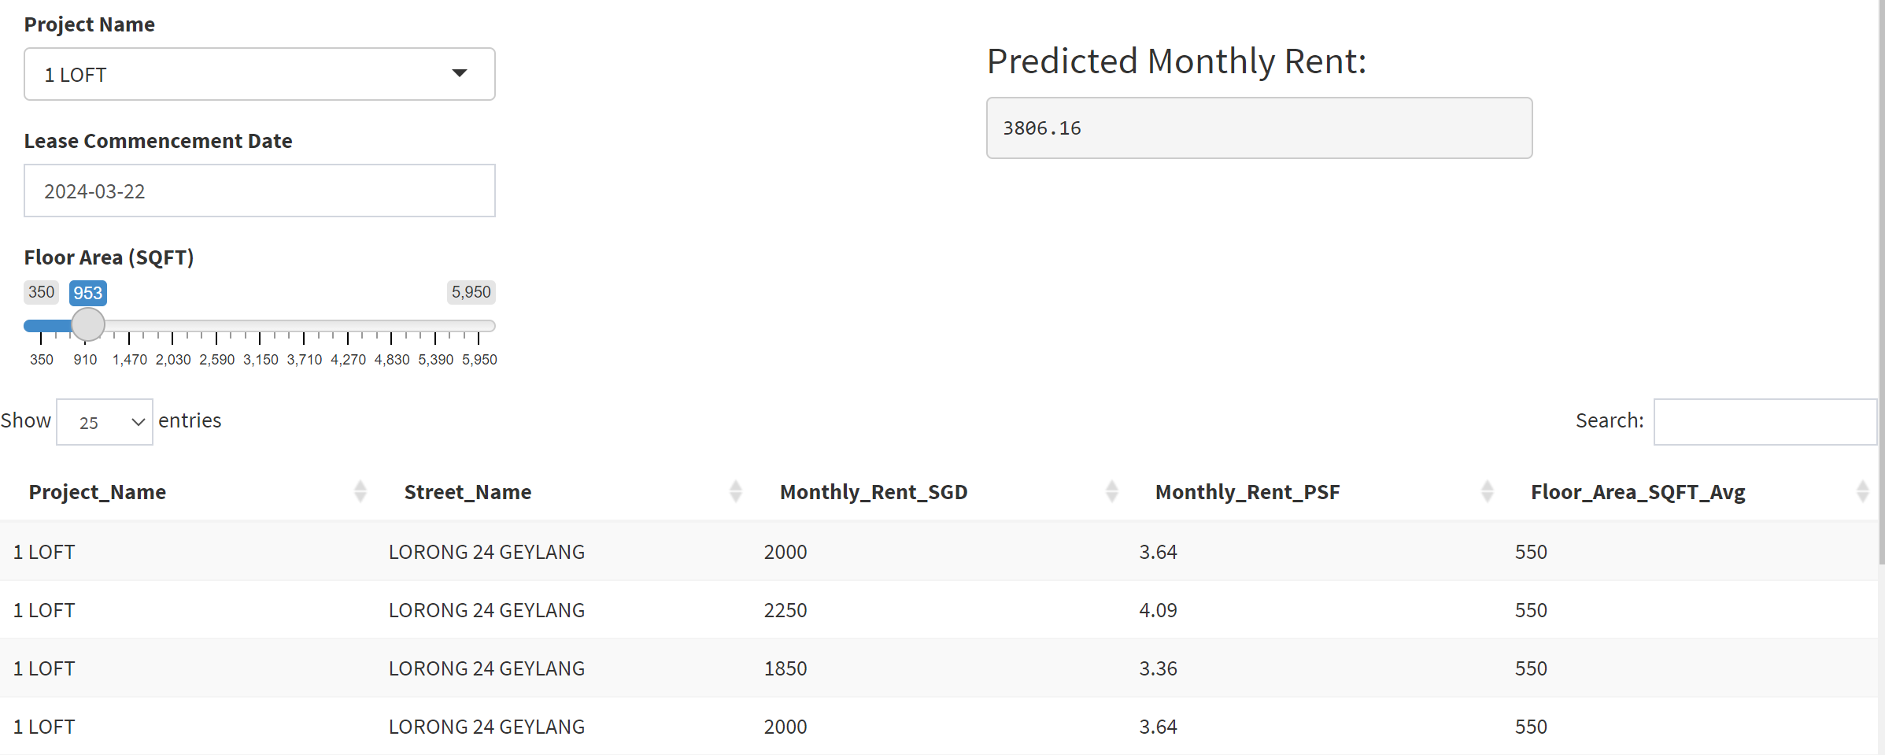
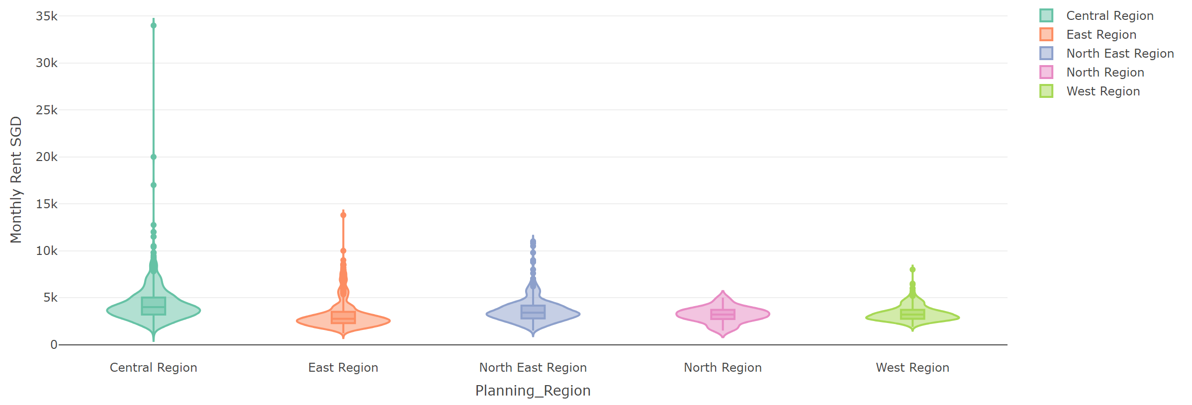
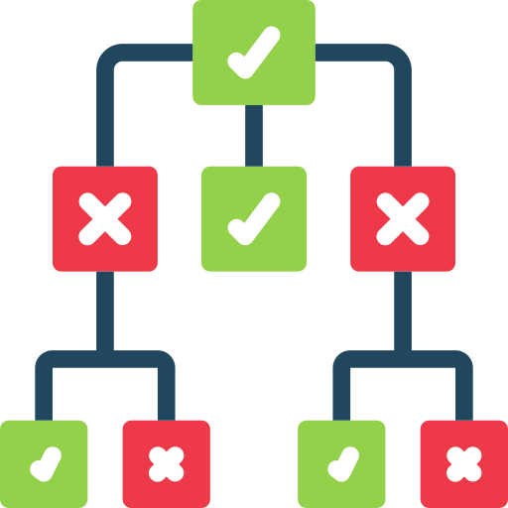

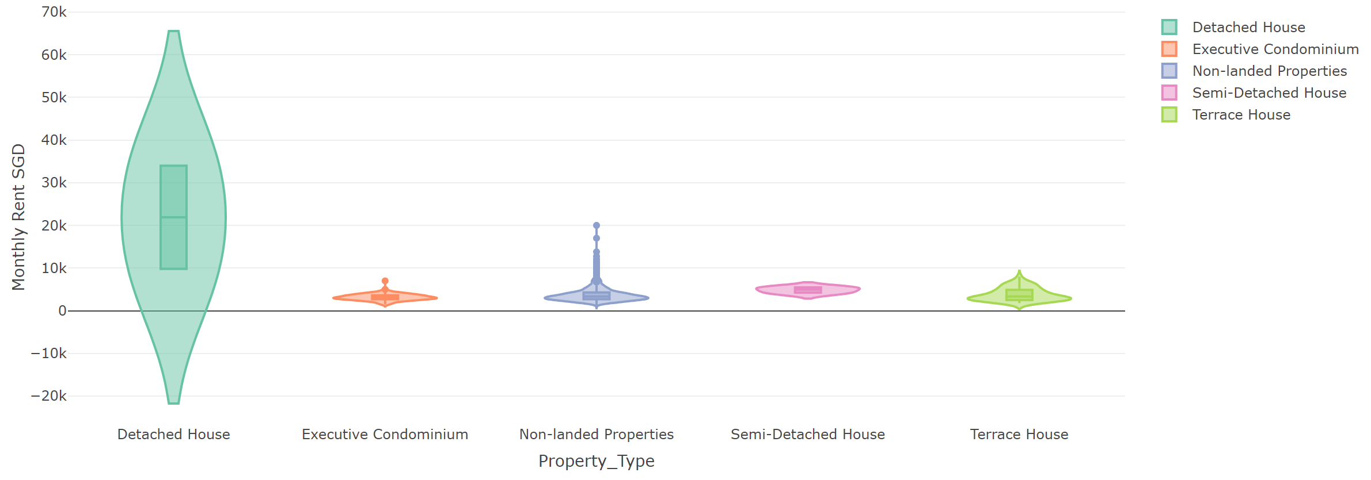
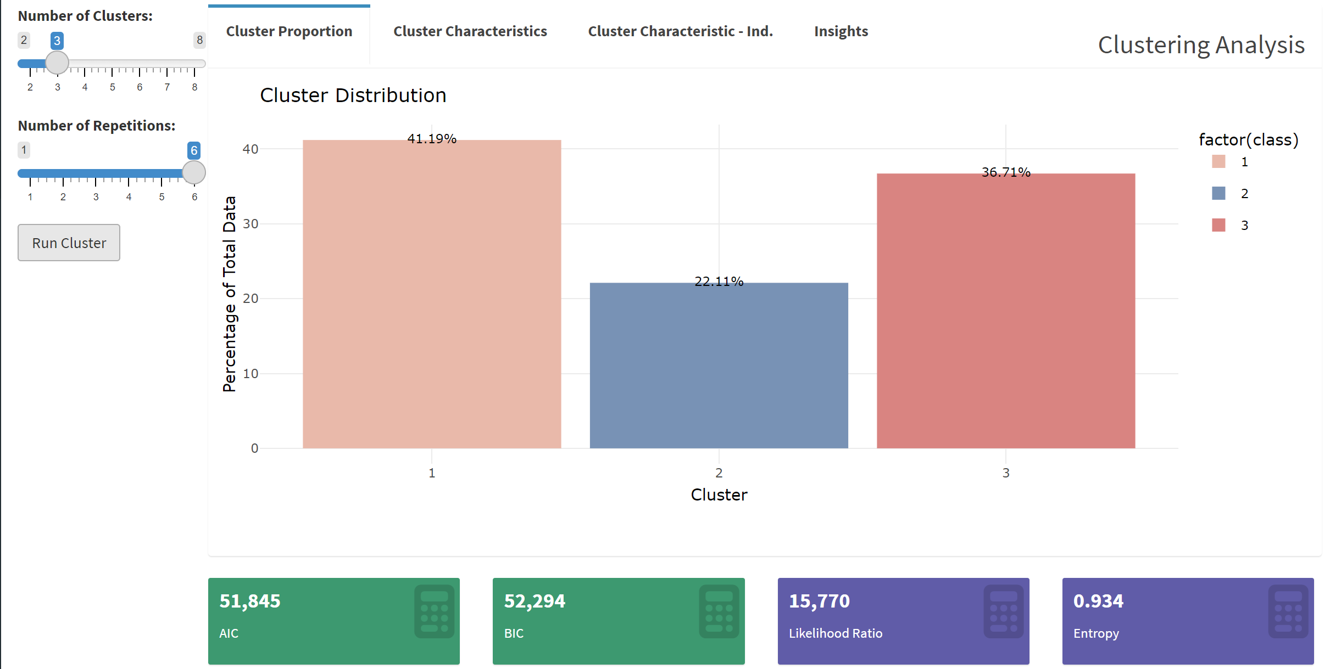
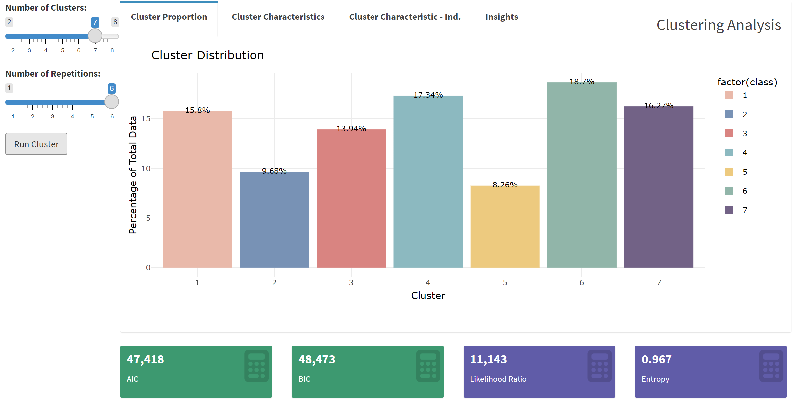
ISSS608-Visual Analytics and Applications: Singapore Housing Rental Prediction
Group 6: WAN Honglu | ZHENG Kaixin
Objective
Analysis
Prediction Models
XXX
As Singapore's population has grown, so have housing and rental prices, making it difficult for many to find suitable housing. It is difficult for tenants to obtain accurate rental information, which affects their rental decisions.
Therefore, our goal in building the visual analytic application is to democratize data and analytics to provide tenants with transparent, accurate rental information to help them make more informed rental decisions.
Through the visual analytic application, we aim to break down information barriers and improve tenants' understanding of the rental market, thereby promoting fairness and transparency in the rental market.
To achieve the project’s objective, our team has employed the following analysis models:
Exploratory Data Analysis Model
Confirmatory Data Analysis Model
Clustering Analysis Model
Prediction Models
Exploratory Data Analysis
For renters, all they need to do is enter the date they want to rent, the distance from the school, the distance from the MRT station, the size of the house they want, the type of property and the area where the house is located.
Our forecasting model estimates a forecast monthly rental price based on these inputs and provides a forecast rental range.
In correlation analysis, there is a significant positive correlation between the average floor area of a house and the monthly rent, and this relationship is also fully reflected in different planning areas.
XXX
In other words, the larger the average floor area of a house, the higher its monthly rent, and this relationship is consistent across different planning areas.
XXX
In categorical variable analysis, detached houses have the highest rental prices, exceeding $20,000.
For landlords, all they need to do is enter the project name of their house, the date they want to rent it, and the square footage of the house.
This suggests that detached houses are likely to be the high-end residential type in the area, often with larger square meters and more luxurious amenities, and therefore relatively high rental prices.
Our model will provide them with a forecast monthly rental price, while also showing the prices of other homes for rent in the same area with the same project name, giving landlords an idea of how similar homes are renting on the market.
Confirmatory Data Analysis
Data Preparation
The central region has the highest proportion, with rents ranging from the lowest $1,100 to the highest $34,000. The median rent in the central region was $4,000, compared with $3,200 in Q1 and $5,021 in Q3. We can see that rents in the central region are relatively concentrated, but there are also some high outliers.
Source of our data:
Urban Redevelopment Authority
Singapore’s national open data collection
Main data:
Lease Start Date
Project Name
Steet Name
Planning Areas
Property Type
Monthly Rent(SGD)
Average Floor Area
Number of Bedrooms
Nearest MRT Station
Distance to MRT
Latitude and Longitude
Our team collect detailed data related to past home rents, consolidate and clean up detailed and diverse data to build a comprehensive dataset that provides a solid foundation for building predictive models. This allows us to gain insight into the factors that affect rents and more accurately predict future rental prices.
Conclusion & Future Work
Our project successfully developed a visual analytics application designed to provide transparent and accurate rental information to tenants and landlords in Singapore.
By leveraging past lease data and advanced predictive modeling techniques, we have created a tool that enables users to make more informed leasing decisions.
The highest share of detached houses, with rents ranging from $9,800 in Q1 to $34,000 in Q3. The median rent for a detached house is $21,900. This indicates that detached houses have a higher level of rent and dominate the overall rent distribution.
Clustering Analysis
FUTURE WORK:
We plan to enhance the user experience and further optimize the functionality of our application. This may involve integrating more features, such as interactive to better meet users' needs.
When the number of categories is 5 or less, the number of repetitions has a small impact on the statistics, but when the number of categories is more than 5, the BIC score is significantly affected by the number of repetitions.
In addition, the score trends for AIC and Likelihood Ratio are like those for BIC, but not for Entropy, therefore, models with the lowest BIC score do not always have the best Entropy score.
In addition, we plan to expand the scope of our analysis to incorporate more data sources and variables. For example, we will explore the impact of socioeconomic factors, demographic trends or market dynamics on rental prices to gain a more comprehensive understanding of the rental market in Singapore.

