Slide 1

M-Precise
Prediction of leukemic outcomes and choice of treatment based on clinical parameters and immune cell gene expression signature
AI Against Cancer Hackathon

Slide 2
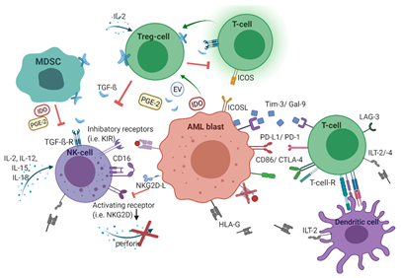
Immune cell gene expression
Gender
Age
OUTCOME
Treatment regimen
Disease-driving mutations
Our aim: to identify gene markers in immune cells (neutrophils) associated with poor/favorable prognosis in patients with diverse clinical parameters and treatment courses;
...and how can it help oncologists to predict a beneficial treatment regimen for an individual cancer patient?
Why neutrophils? - 1. they are most abundant immune cell population in humans;
2. immune cells are now being discovered as significant contributors to cancer pathogenesis, including leukemia.

Slide 3
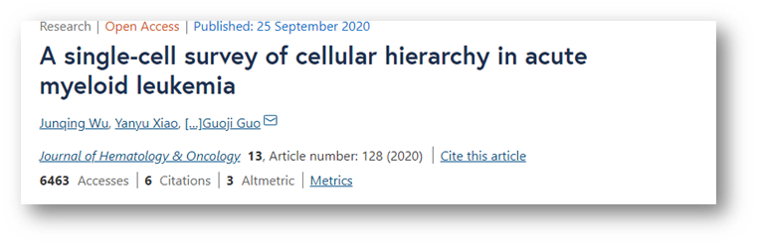
GSE130756
Dataset: single cell gene expression data on bone marrow samples of 40 patients newly diagnosed with AML
Our aim: to identify gene markers in non-mutant immune cells (neutrophils) associated with poor/favorable prognosis in patients with diverse clinical parameters and treatment courses;
...and how can it help oncologists to predict a beneficial treatment regimen for an individual patient?

Slide 4
Exploratory Data Analysis (EDA)
Data Description:
The Clinical data has 18 Features and 46 records of 40 Patients
The Neutrophils gene marker data has 5 Feature and 8330 records for 25 Patients
EDA with Clinical Data:
The Mutations WT1, IDH2, TET2, ASXL1, and TP53 are dominant among the patients.
There is an imbalance among patients by age group, i.e., young are 50% less than old patients.
Female patients are lesser than Male patients.
The FAB subtype M2 and M5 are dominant in majority of the patients
Features:
'Sample ID', 'Age', 'Age group', 'Gender', 'Date of sample collection relative to diagnosis', 'FAB subtype', 'FAB subtype (stages)', 'Mutation', 'Therapeutic regimen', 'Abbreviation', 'Classification/ category ', 'Subcategory', 'Line of therapy', 'Treatment group', 'Single- cell type', 'Cell counts', 'Post-treatment samples collection information', 'Transplantation'
Features: 'genes', 'p_val', 'avg_logFC', 'Sample ID', 'outcome',
Notes:
Here we explain two datasets based upon their features and number of records

Slide 5
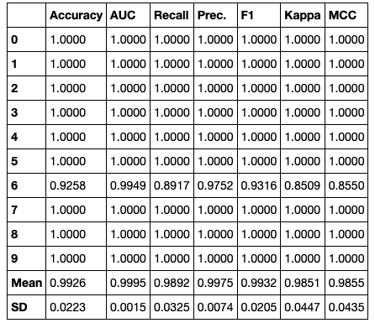
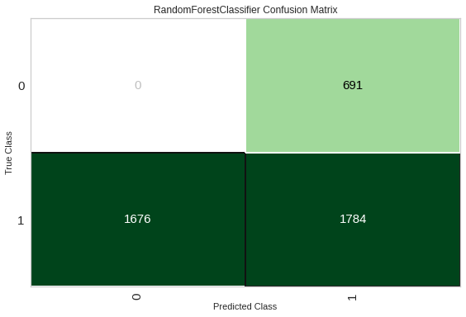
Classification Experiment No. 1
The objective of the experiment is to build a Classifier that Predicts the 'neutrophils outcomes' given patients gene expression data along with the patients' Clinical data
The Model is build using Random Forest Classifier.
Observation:
The model Overfits
The recall is very bad for relapsing class
Class 0 (relapse) and Class 1 (remission)

Slide 6
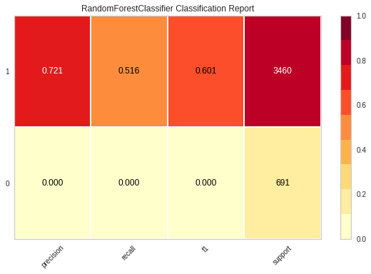
Classification Experiment No. 1
The objective of the experiment is to build a Classifier that Predicts the 'neutrophils outcomes' given patients gene expression data along with the patients' Clinical data
The Model is build using Random Forest Classifier.
Observation:
The model Overfits
The recall is very bad for relapsing class
Class 0 (relapse) and Class 1 (remission)
The model is biased towards remission class.
How to improve the result:
Balance the data.
Preprocess the data such that individual mutations are mapped to their respective Therapeutic regimen.

Slide 7
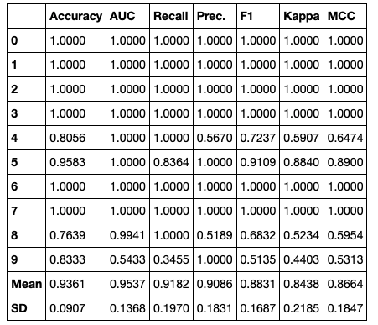
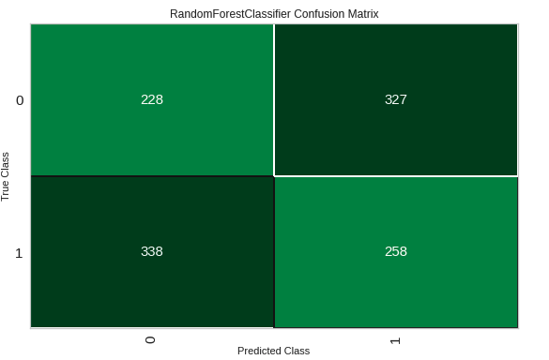
Classification Experiment No. 2
The objective of the experiment is to build a Classifier that Predicts the 'Treatment Group' given patients gene expression data along with the patients' Clinical data
The Model is build using Random Forest Classifier.
Observation:
The model Overfits
The recall is very bad for IA class
Class 0 (IA) and Class 1 (IA_DAC/DAC)
The model is biased towards remission class.
How to improve the result:
Balance the data.
Preprocess the data such that individual mutations are mapped to their respective Therapeutic regimen.

Slide 8
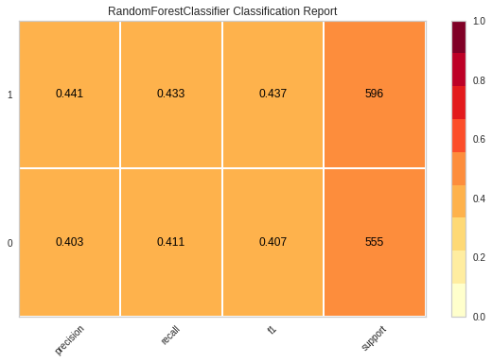
Classification Experiment No. 2
The objective of the experiment is to build a Classifier that Predicts the 'Treatment Group' given patients gene expression data along with the patients' Clinical data
The Model is build using Random Forest Classifier.
Observation:
The model Overfits
The recall is very bad for IA class
Class 0 (IA) and Class 1 (IA_DAC/DAC)
The data is complex
How to improve the result:
Revisit the Feature Engineering.
Use Deep neural network to capture the complexity of the data.

Slide 9
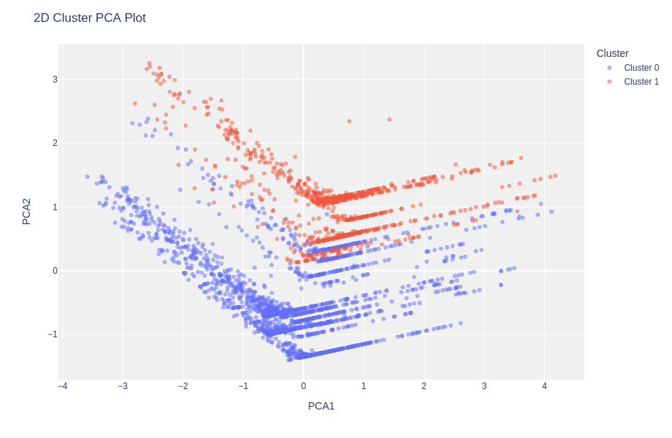
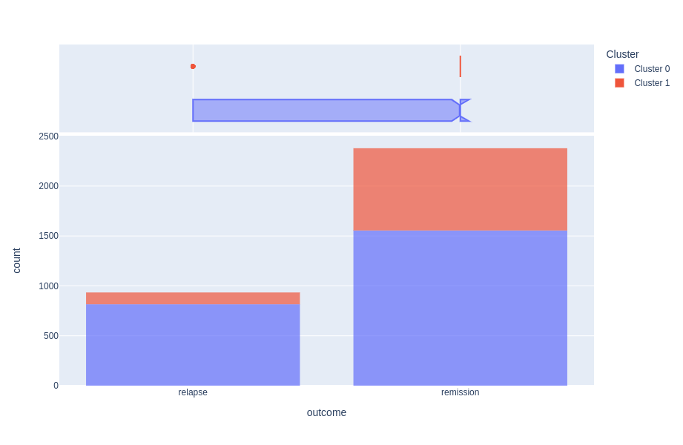
Clustering Experiment No. 3
The objective of the experiment is to perform cluster analysis and understand how many classes are present in the data to capture the Neutrophil Outcome classes I.e. relapse, or remission
Observation from Kmode Clustering:
Custer 0 (relapse) and Class 1 (remission)
A large part of relapse is labeled as remission indicating the data is complex.
This complexity is one of the causes or bad classification results

Slide 10
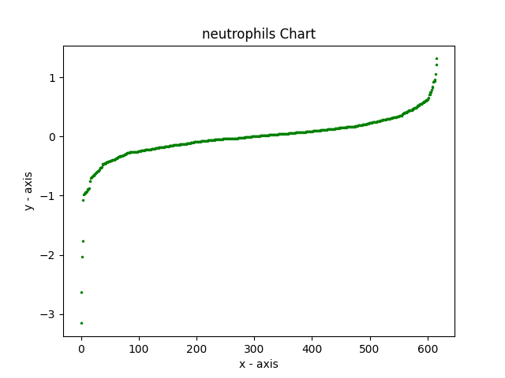
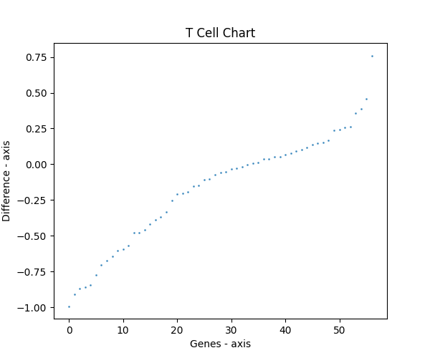
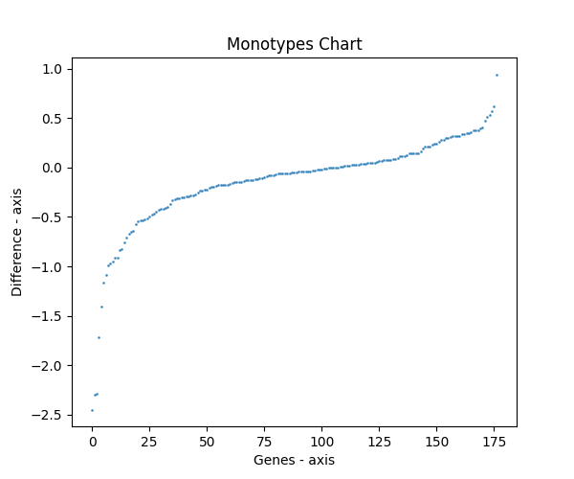
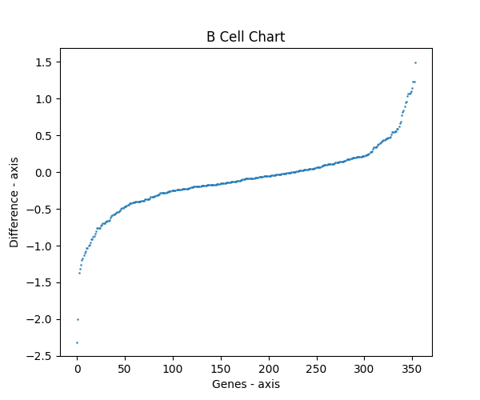
Remission and Relapse
Hidden message: The significant genes between remission patients and relapse patients

Slide 11
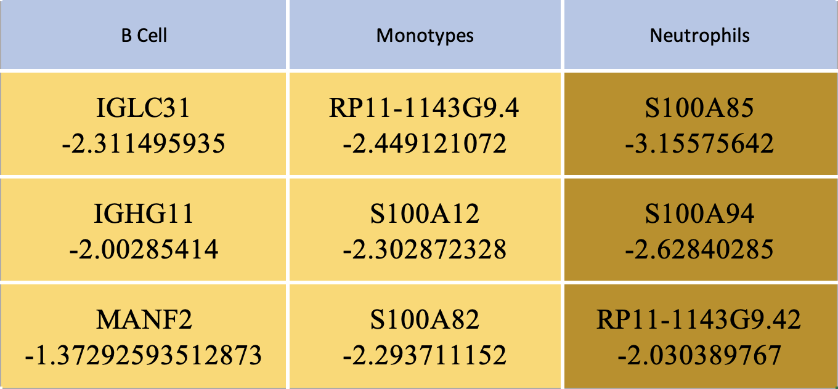
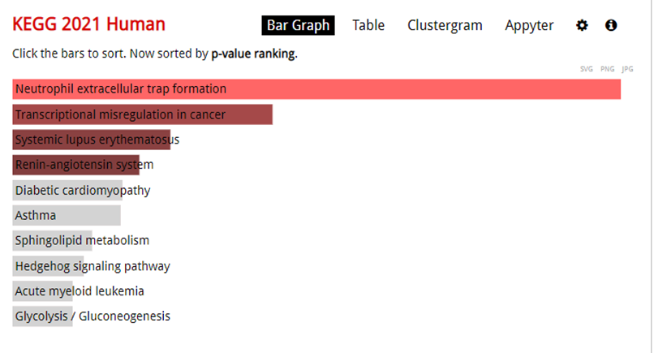
The most significant genes
S100A8/A9 is an inflammatory biomarker;
​
Focusing on inflammatory genes in neutrophils while using the classifier would help medical professionals choose a promising therapeutic regimen
https://maayanlab.cloud/Enrichr/

Slide 12
Conclusions & Next steps
We Identified a dataset to determine gene markers in immune cells.
We Build 2 classifiers:
First classifier (Exp 1) aimed to predict whether relapse or remission will occur. Results were bad but we determined a that can be solved by improving the classifier's performance.
Second classifier (Exp 2.) aimed to predict the Treatment group (i.e. IA, IA_DAC/DAC). The results not good but there is a room for improvement by performing better Feature Engineering.
Experiment 3, the clustering operations revealed the complexity of the data and indicated towards the balancing the data and using the Deep learning approach to deal with complexity of the data.

Slide 13
Thank you!
M-Precise
Libo Sun
Valeriya Kuznetsova
Rahul Sharma
Mentors:
Priyanka Gupta
Ransome Eke
AI Against Cancer Hackathon

Slide 14
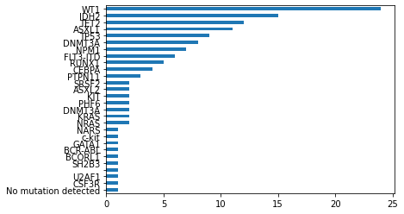
EDA of Clinical data
Plot of Count of mutations observed among the patients

Slide 15
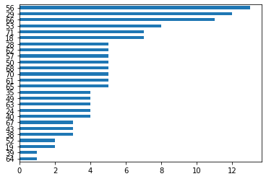
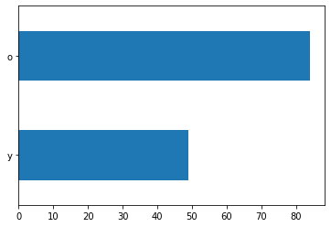
EDA of Clinical data
Plot of Count of Patients based upon their age and age group
The is an imbalance among the young (y) and old (o) patients

Slide 16
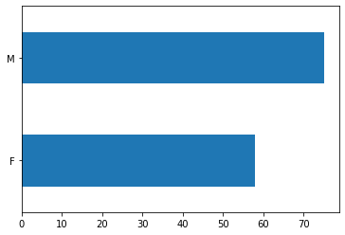
EDA of Clinical data
Plot of Count of Male vs. Female patients
There are more male patient records

Slide 17
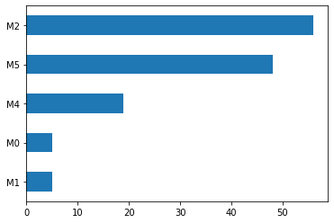
EDA of Clinical data
Plot of Count of FAB Subtype observed among the patients
The FAB subtype M2 and M5 are dominant in majority of the patients

