Slide 1
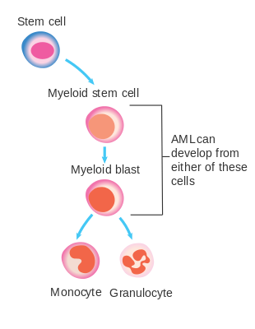
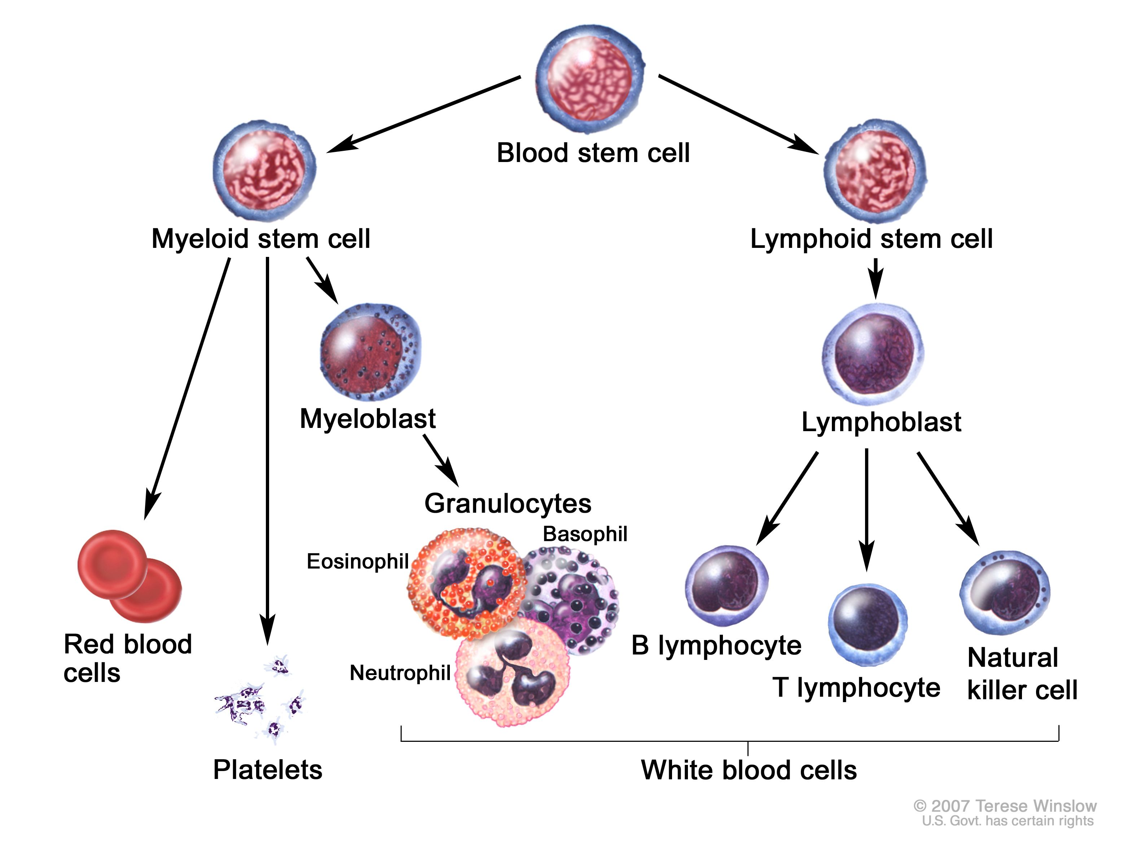
Acute myeloid leukemia is a blood cancer of immature myeloid cells (blasts)
Tet2
RUNX1
ASXL1
NPM1
FLT3
IDH
DNMT3A

Slide 2
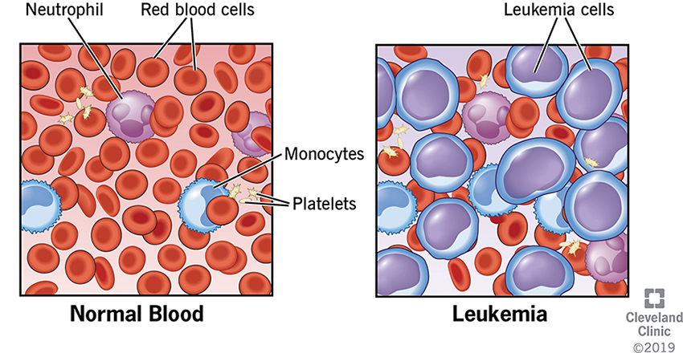
Acute myeloid leukemia starts in the bone marrow but quickly moves into the blood and other tissues. Common complications are anemia, recurring infection, and bleeding.

Slide 3
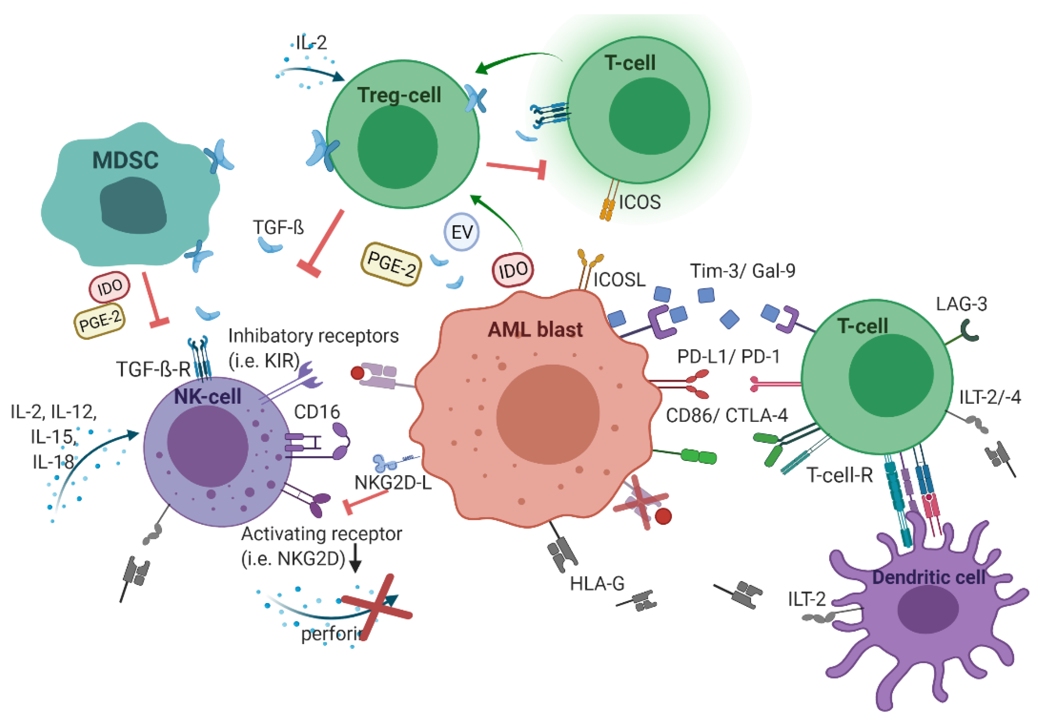
Infections occur due to the dysregulation of all types of immune cells in leukemic patients – even cells that do not carry the mutation, e.g. lymphocytes

Slide 4
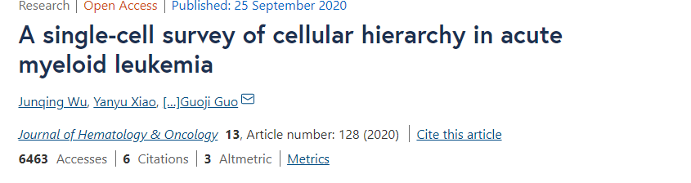
Question addressed in the paper: 1. what is the transcriptional signature of mutated AML cells (mutant cells) associated with relapse; 2. finding new therapeutic targets in mutated AML cells using transcriptomics.
Dataset: single cell gene expression (scRNA seq) data on 40 de novo AML bone marrow samples (mix of mutant and non-mutant surrounding immune cells) +
mutational profile for each patient +
clinical data
Cohort: 40 (almost all treated) AML patients, ~ half of them in CR, ~half of them relapsed/refractory (+ 3 healthy controls to build a reference transcriptome). 4 of them were followed after the treatment (1 relapsed, 3 had a remission).

Slide 5
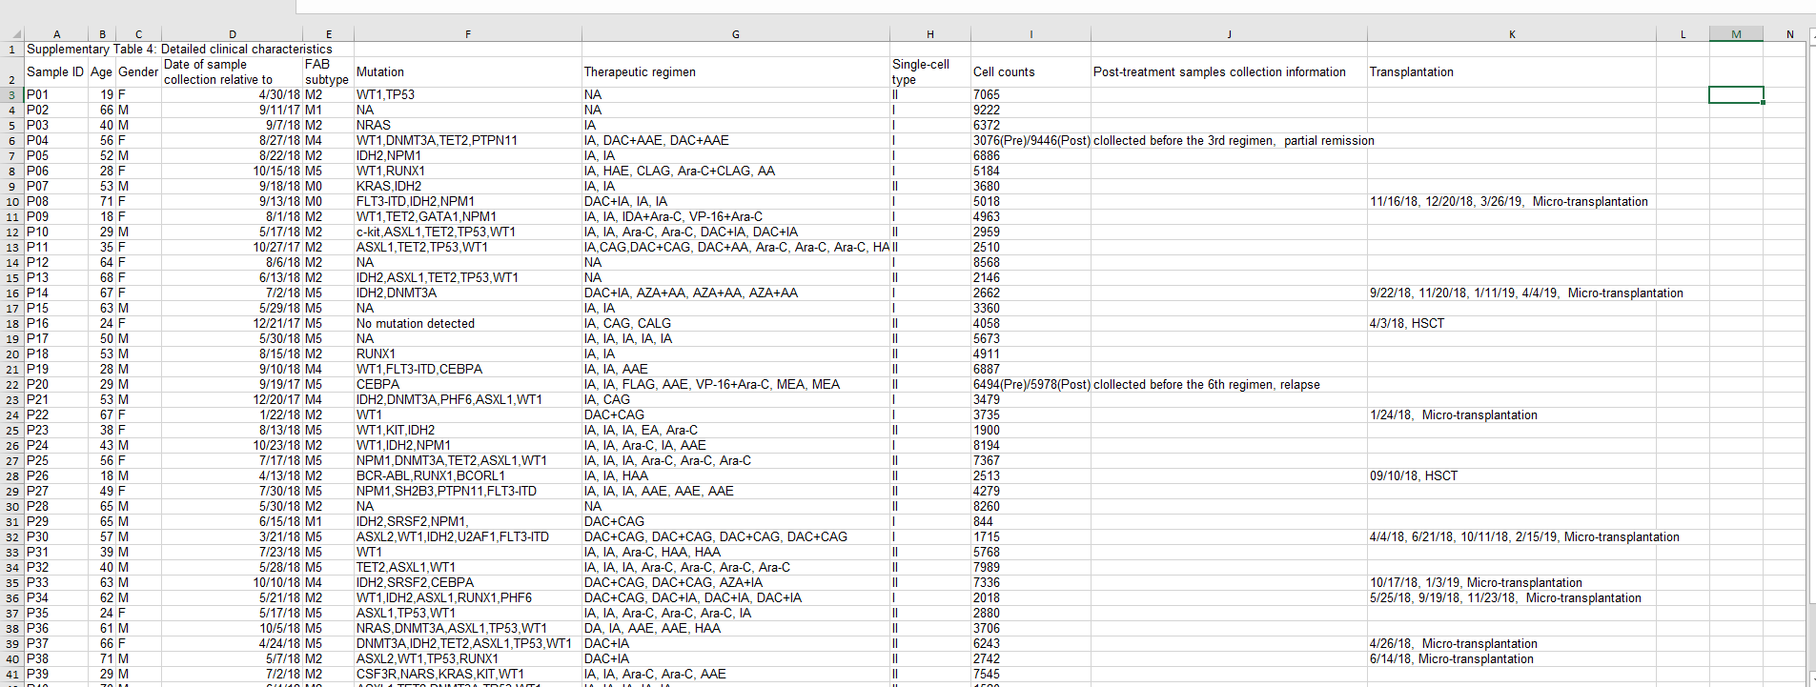
Clinical data + mutational profile
Patient ID
Patient type based on the clinical outcome (roughly: 1 – relapse; 2 – remission)
Mutational profile

Slide 6
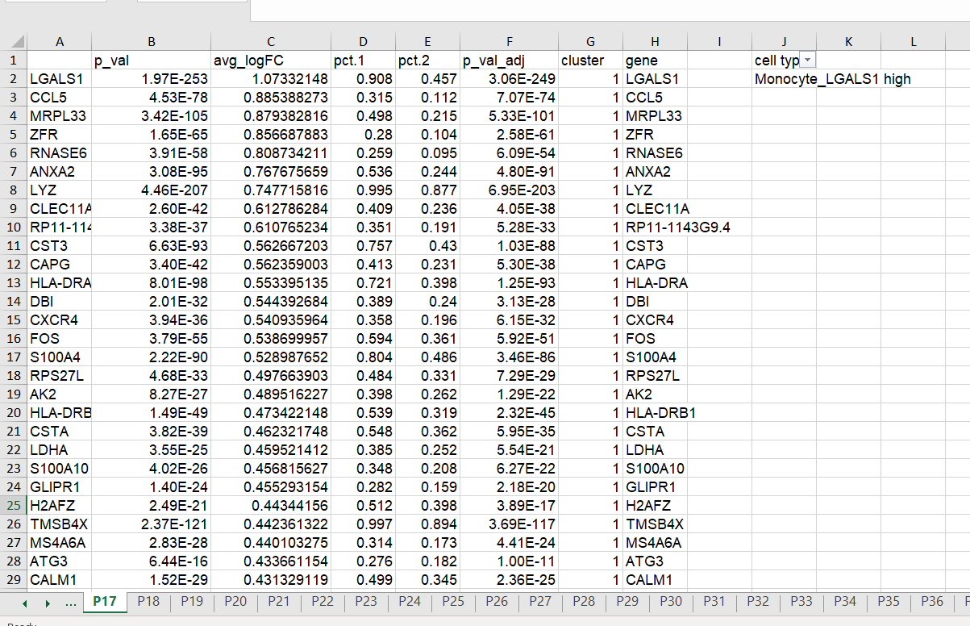
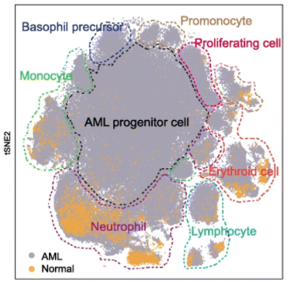
Gene expression data: DEGs for each cell type, for each sample. Data also available on GEO, GSE130756
Cell type
Patient ID

Slide 7
Dataset: single cell gene expression data on bone marrow samples (already processed, gene lists available in supplementary material)
Novel question: 1. what is the gene expression signature of non-mutant immune cells (B, T, NK cells, monocytes, neutrophils, etc) associated with poor/good prognosis ?with respect to the mutation type?
2. what are other then described in the paper pathways activated in mutant cells that could be targeted with drugs? e.g., cell adhesion molecule that could be inhibited, etc.

